Slide 1
Analytic Continuation in Exact Real Computation
Youngjo Min
SoC, KAIST

Slide 2
I. Introduction

Slide 3
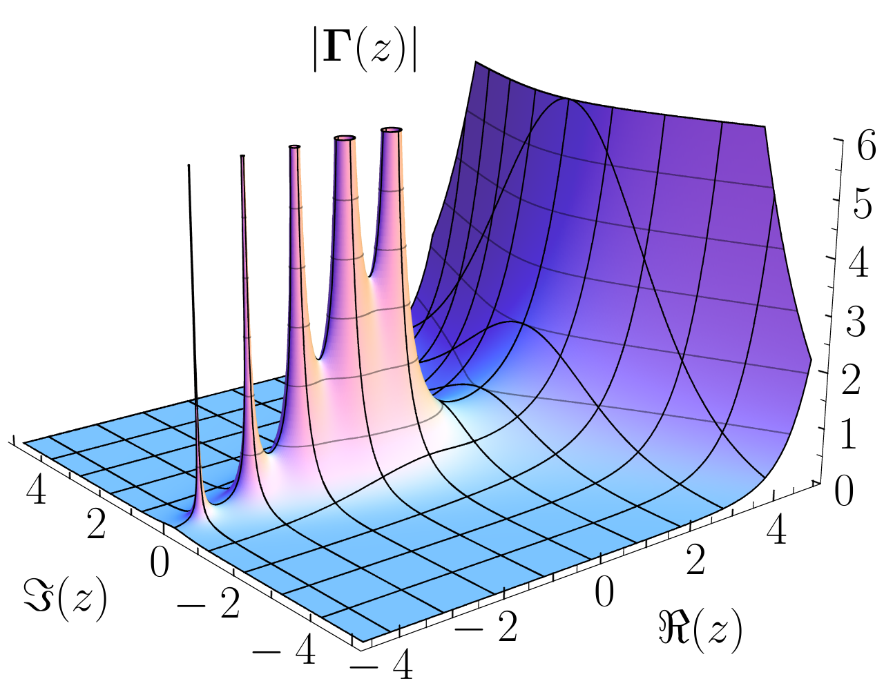
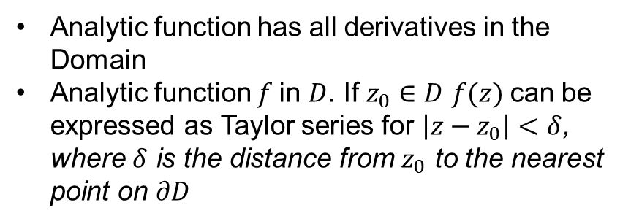
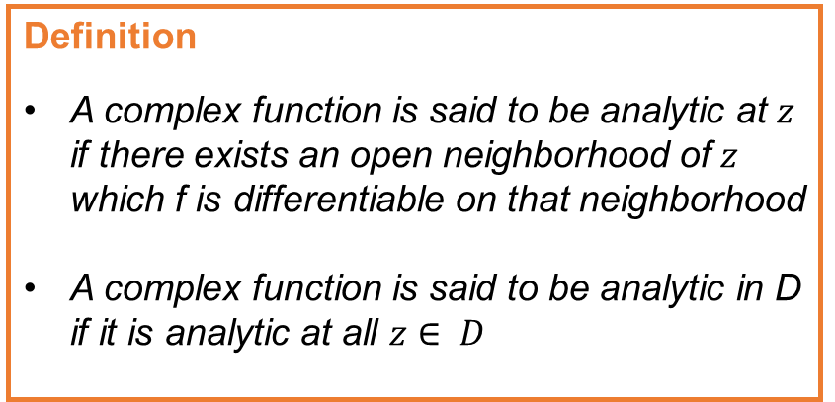
Analytic function
Definition
A complex function is said to be analytic at $z$ if there exists an open neighborhood of $z$ which f is differentiable on that neighborhood
A complex function is said to be analytic in D if it is analytic at all $z∈ D$
Analytic function has all derivatives in the Domain
Analytic function $f$in $D$. If $z_{0}∈D$ $f(z)$can be expressed as Taylor series for $\left|z−z_{0}\right|<δ$, where $δ$ is the distance from $z_{0}$ to the nearest point on $∂D$

Slide 4
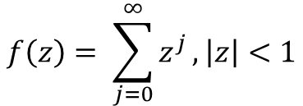
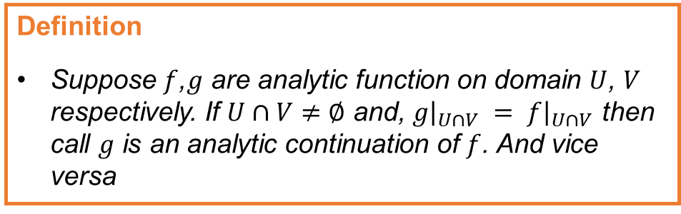
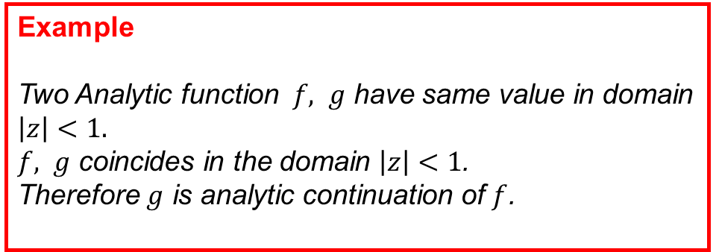

Analytic Continuation
Definition
Suppose $f$,$g$ are analytic function on domain $U$, $V$ respectively. If $U∩V≠∅$ and, $g{\left.​\right|}_{U∩V} = f{\left.​\right|}_{U∩V}$ then call $g$ is an analytic continuation of $f$. And vice versa
$$f\left(z\right)= \sum_{j=0}^{∞}{z^{j}}, \left|z\right|<1$$
$$g\left(z\right)=\frac{1}{1−z}, z≠1$$
Example
Two Analytic function $f, g$ have same value in domain $\left|z\right|<1.$
$f, g$ coincides in the domain $\left|z\right|<1$.
Therefore $g$ is analytic continuation of $f$.

Slide 5
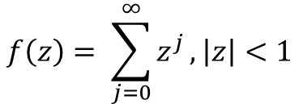
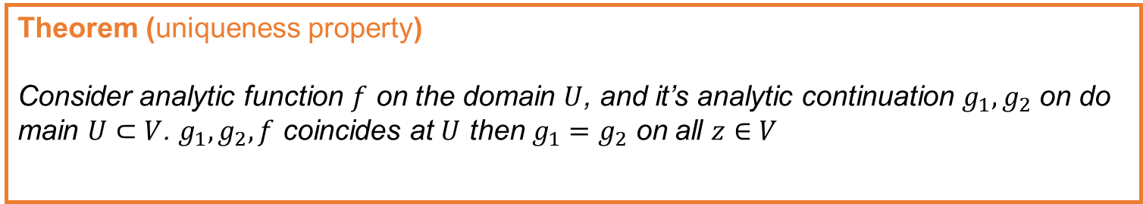

Analytic Continuation
Theorem (uniqueness property)
Consider analytic function $f$ on the domain $U$, and it’s analytic continuation $g_{1}, g_{2}$ on domain $U⊂V$. $g_{1}, g_{2}, f$ coincides at $U$ then $g_{1}=g_{2}$ on all $z∈V$
$$f\left(z\right)= \sum_{j=0}^{∞}{z^{j}}, \left|z\right|<1$$
$$g\left(z\right)=\frac{1}{1−z}, z≠1$$

Slide 6
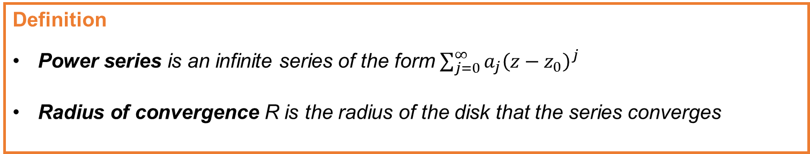
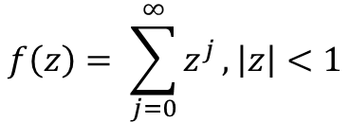
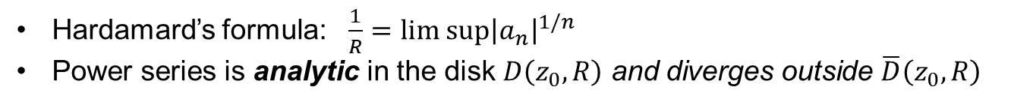
Power series
Definition
Power series is an infinite series of the form $\sum_{j=0}^{∞}{a_{j}{\left(z−z_{0}\right)}^{j}}$
Radius of convergence R is the radius of the disk that the series converges
Hardamard’s formula: $\frac{1}{R}=lim sup{{\left|a_{n}\right|}^{1/n}}$
Power series is analytic in the disk $D\left(z_{0}, R\right)$ and diverges outside $\overline{D}\left(z_{0}, R\right)$
$$f\left(z\right)= \sum_{j=0}^{∞}{z^{j}}, \left|z\right|<1$$

Slide 7
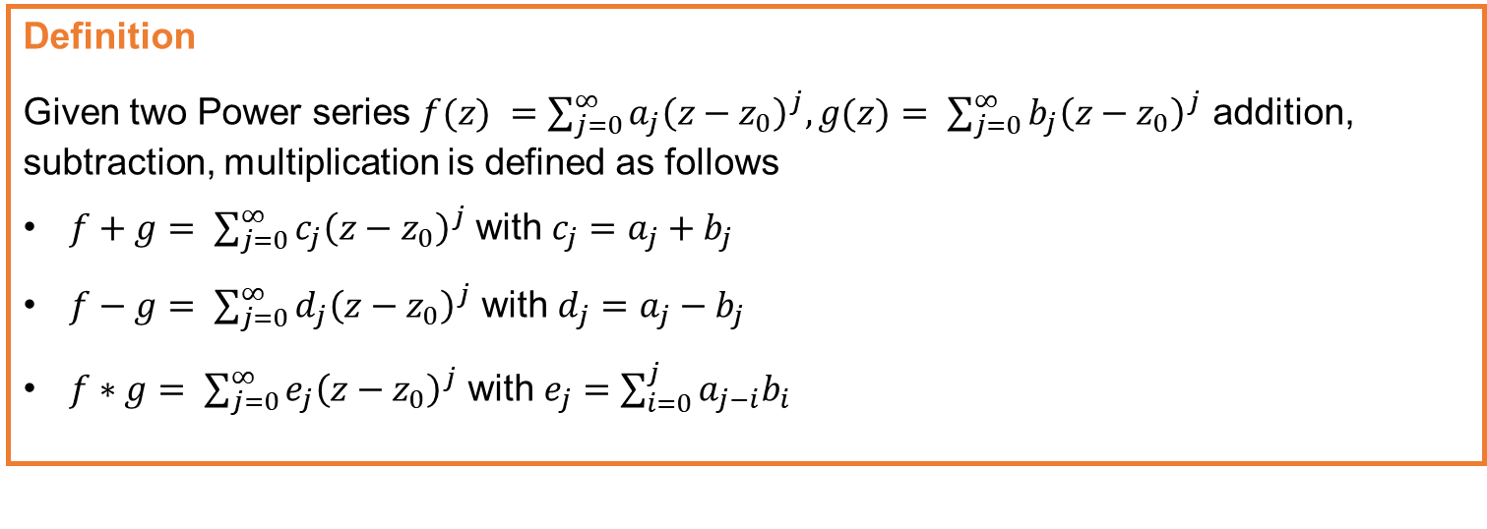
Power series arithmetic
Definition
Given two Power series $f(z) =\sum_{j=0}^{∞}{a_{j}{\left(z−z_{0}\right)}^{j},g(z)= \sum_{j=0}^{∞}{b_{j}{\left(z−z_{0}\right)}^{j}}}$ addition, subtraction, multiplication is defined as follows
$f+g= \sum_{j=0}^{∞}{c_{j}{\left(z−z_{0}\right)}^{j}}$ with $c_{j}=a_{j}+b_{j}$
$f−g= \sum_{j=0}^{∞}{d_{j}{\left(z−z_{0}\right)}^{j}}$ with $d_{j}=a_{j}−b_{j}$
$f∗g= \sum_{j=0}^{∞}{e_{j}{\left(z−z_{0}\right)}^{j}}$ with $e_{j}=\sum_{i=0}^{j}{a_{j−i}b_{i}}$

Slide 8
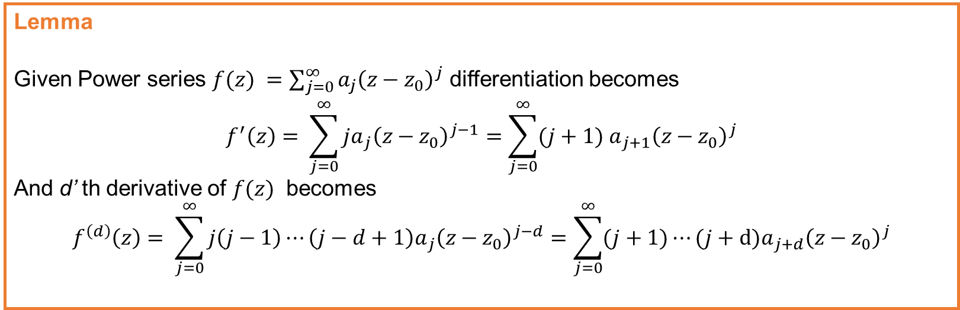
Power series differentiation
Lemma
Given Power series $f(z) =\sum_{j=0}^{∞}{a_{j}{\left(z−z_{0}\right)}^{j}}$ differentiation becomes
$$f^{′}\left(z\right)= \sum_{j=0}^{∞}{{ja}_{j}{\left(z−z_{0}\right)}^{j−1}}=\sum_{j=0}^{∞}{{(j+1) a}_{j+1}{\left(z−z_{0}\right)}^{j}}$$
And d’ th derivative of $f(z)$ becomes
$$f^{\left(d\right)}\left(z\right)= \sum_{j=0}^{∞}{{j\left(j−1\right)⋯\left(j−d+1\right)a}_{j}{\left(z−z_{0}\right)}^{j−d}}=\sum_{j=0}^{∞}{{(j+1)⋯(j+d)a}_{j+d}{\left(z−z_{0}\right)}^{j}}$$

Slide 9

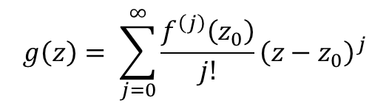
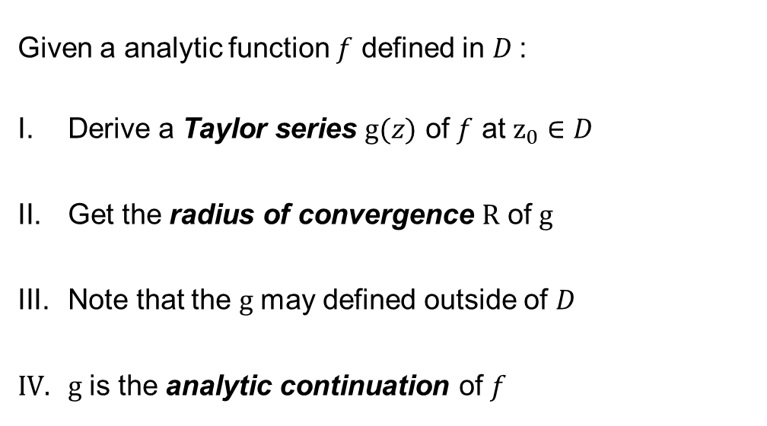
Analytic Continuation via Power Series
Given a analytic function $f$ defined in $D$:
Derive a Taylor series $g(z)$ of $f$ at $z_{0}∈D$
Get the radius of convergence $R$ of $g$
Note that the $g$ may defined outside of $D$
$g$ is the analytic continuation of $f$
$$g\left(z\right)= \sum_{j=0}^{∞}{\frac{f^{\left(j\right)}\left(z_{0}\right)}{j!}{\left(z−z_{0}\right)}^{j}}$$
$$z_{0}$$

Slide 10
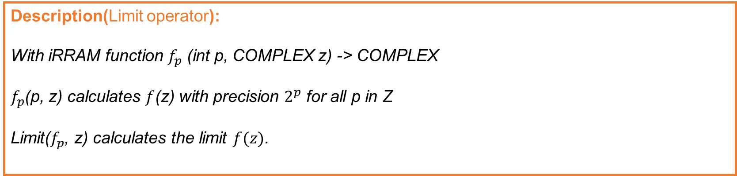
Limit operator in ERC
Description(Limit operator):
With iRRAM function $f_{p}$ (int p, COMPLEX z) -> COMPLEX
$f_{p}$(p, z) calculates $f$(z) with precision $2^{p}$ for all p in Z
Limit($f_{p}$, z) calculates the limit $f(z)$.

Slide 11
II. Implementation

Slide 12
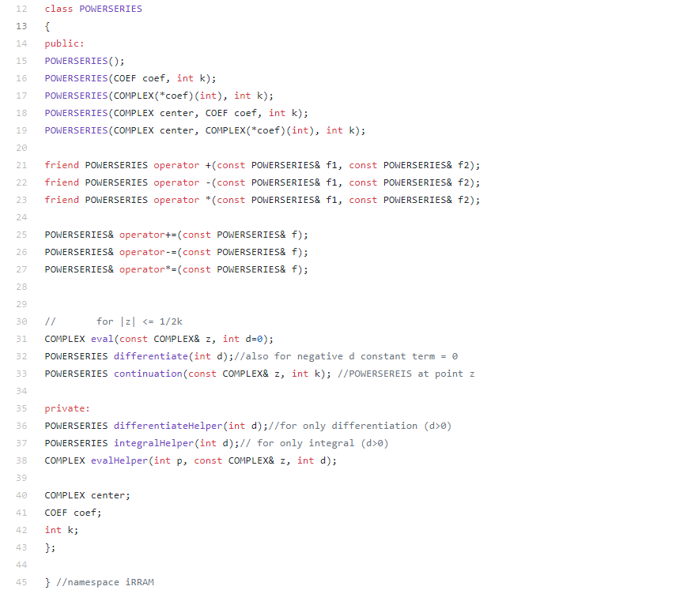
Overview
Abstract Data Type POWERSERIES in iRRAM which supports:
  Arithmetic operations (+,-,*)
  Evaluation at a point
  Differentiation
  Integration
  Analytic continuation

Slide 13
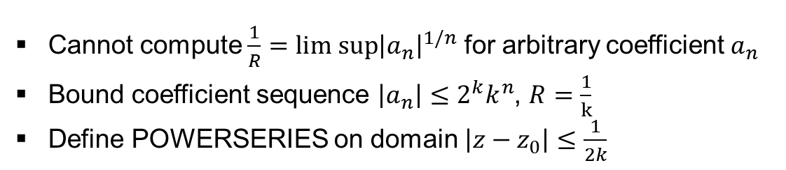
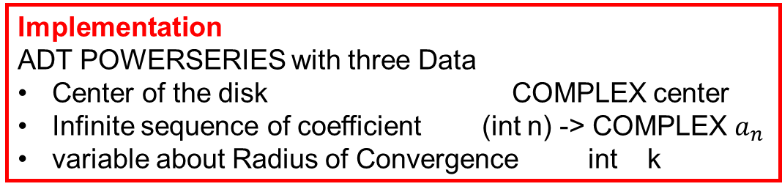
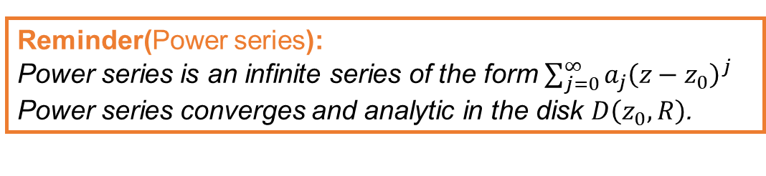
About Implementation
Reminder(Power series):
Power series is an infinite series of the form $\sum_{j=0}^{∞}{a_{j}{\left(z−z_{0}\right)}^{j}}$
Power series converges and analytic in the disk $D\left(z_{0}, R\right)$.
Implementation
ADT POWERSERIES with three Data
Center of the disk COMPLEX center
Infinite sequence of coefficient (int n) -> COMPLEX $a_{n}$
variable about Radius of Convergence int k
Cannot compute $\frac{1}{R}=lim sup{{\left|a_{n}\right|}^{1/n}}$ for arbitrary coefficient $a_{n}$
Bound coefficient sequence $\left|a_{n}\right|≤2^{k}k^{n}$, $R=\frac{1}{k}$
Define POWERSERIES on domain $\left|z−z_{0}\right|≤\frac{1}{2k}$

Slide 14

Arithmetic operations
Definition
Given two Power series $f(z) =\sum_{j=0}^{∞}{a_{j}{\left(z−z_{0}\right)}^{j},g(z)= \sum_{j=0}^{∞}{b_{j}{\left(z−z_{0}\right)}^{j}}}$ addition, subtraction, multiplication is defined as follows
$f+g= \sum_{j=0}^{∞}{c_{j}{\left(z−z_{0}\right)}^{j}}$ with $c_{j}=a_{j}+b_{j}$
$f−g= \sum_{j=0}^{∞}{d_{j}{\left(z−z_{0}\right)}^{j}}$ with $d_{j}=a_{j}−b_{j}$
$f∗g= \sum_{j=0}^{∞}{e_{j}{\left(z−z_{0}\right)}^{j}}$ with $e_{j}=\sum_{i=0}^{j}{a_{j−i}b_{i}}$

Slide 15
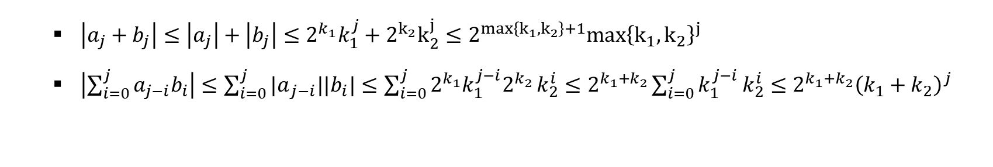
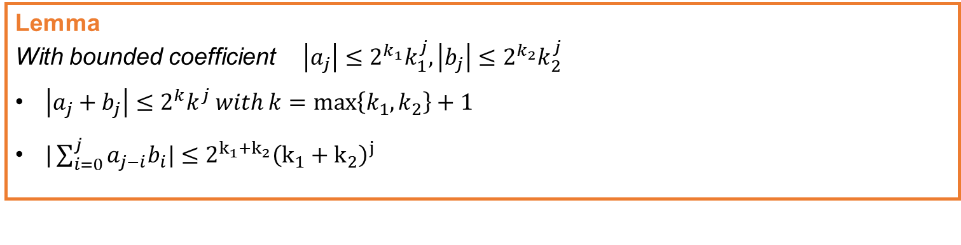
Arithmetic operations
Lemma
With bounded coefficient $\left|a_{j}\right|≤2^{k_{1}}k_{1}^{j},\left|b_{j}\right|≤2^{k_{2}}k_{2}^{j}$
$\left|a_{j}+b_{j}\right|≤2^{k}k^{j} with k=\max\left\{k_{1},k_{2}\right\}+1$
$|\sum_{i=0}^{j}{a_{j−i}b_{i}|}≤2^{k_{1}+k_{2}}{\left(k_{1}+k_{2}\right)}^{j}$
  $\left|a_{j}+b_{j}\right|≤\left|a_{j}\right|+\left|b_{j}\right|≤2^{k_{1}}k_{1}^{j}+2^{k_{2}}k_{2}^{j}≤2^{max\left\{k_{1},k_{2}\right\}+1}max{\left\{k_{1}, k_{2}\right\}}^{j}$
  $\left|\sum_{i=0}^{j}{a_{j−i}b_{i}}\right|≤\sum_{i=0}^{j}{{|a}_{j−i}||b_{i}|}≤\sum_{i=0}^{j}{2^{k_{1}}k_{1}^{j−i}2^{k_{2}}}k_{2}^{i}≤2^{k_{1}+k_{2}}\sum_{i=0}^{j}{k_{1}^{j−i }k_{2}^{i}≤2^{k_{1}+k_{2}}{\left(k_{1}+k_{2}\right)}^{j}}$

Slide 16

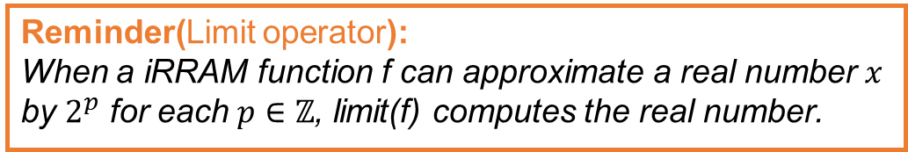
Evaluation at a point
Infinite sum can be computed using iRRAM’s limit operator:
Let $f(z)= \sum_{j=0}^{∞}{a_{j}}{\left(z−z_{0}\right)}^{j}$
Define the partial sum: $f_{t}(z)= \sum_{j=0}^{t}{a_{j}}{\left(z−z_{0}\right)}^{j}$
With condition $\left|a_{j}\right|≤2^{k}k^{j}$, $\left|z−z_{0}\right|≤\frac{1}{2k}$ implies $\left|a_{j}\right|{\left|z−z_{0}\right|}^{j}≤2^{k−j}$
Remainder is bounded by $\left|f−f_{t}\right|=\left|\sum_{j=t+1}^{∞}{a_{j}}{\left(z−z_{0}\right)}^{j}\right|≤\sum_{j=t+1}^{∞}{\left|a_{j}\right||{z−z_{0}|}^{j}≤\sum_{j=t+1}^{∞}{2^{k−j}=2^{k−t}} }$
$\left|f−f_{t}\right|≤2^{k−t}≤2^{p}$ then $k−p≤t$
Reminder(Limit operator):
When a iRRAM function f can approximate a real number $x$ by $2^{p}$ for each $p∈ℤ$, limit(f) computes the real number.

Slide 17
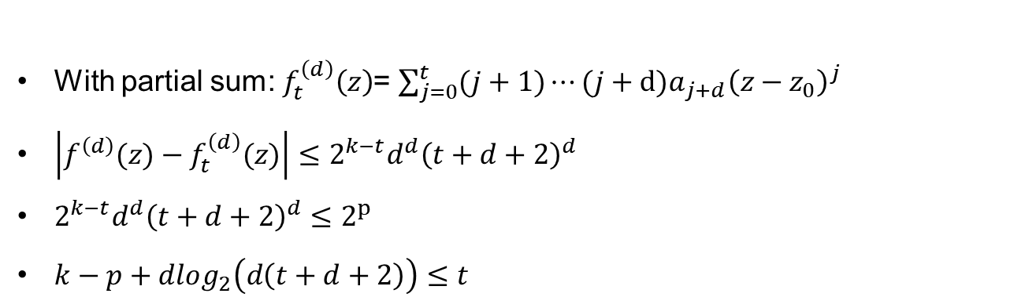
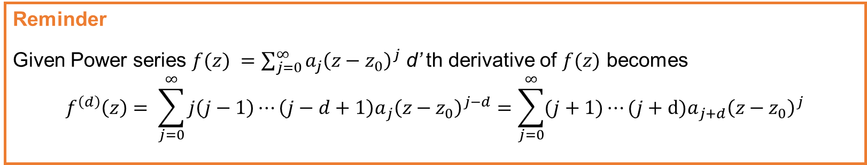
Evaluation of Derivative
Reminder
Given Power series $f(z) =\sum_{j=0}^{∞}{a_{j}{\left(z−z_{0}\right)}^{j}}$ d’ th derivative of $f(z)$ becomes
$$f^{\left(d\right)}\left(z\right)= \sum_{j=0}^{∞}{{j\left(j−1\right)⋯\left(j−d+1\right)a}_{j}{\left(z−z_{0}\right)}^{j−d}}=\sum_{j=0}^{∞}{{(j+1)⋯(j+d)a}_{j+d}{\left(z−z_{0}\right)}^{j}}$$
With partial sum: $f_{t}^{\left(d\right)}\left(z\right)$= $\sum_{j=0}^{t}{{(j+1)⋯(j+d)a}_{j+d}{\left(z−z_{0}\right)}^{j}}$
$\left|f^{\left(d\right)}(z)−f_{t}^{\left(d\right)}(z)\right|≤2^{k−t}d^{d}{\left(t+d+2\right)}^{d}$
$2^{k−t}d^{d}{\left(t+d+2\right)}^{d}≤2^{p}$
$k−p+dlog_{2}\left(d\left(t+d+2\right)\right)≤t$

Slide 18
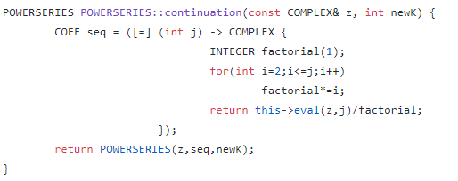
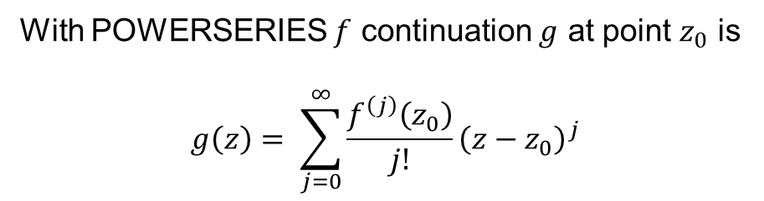
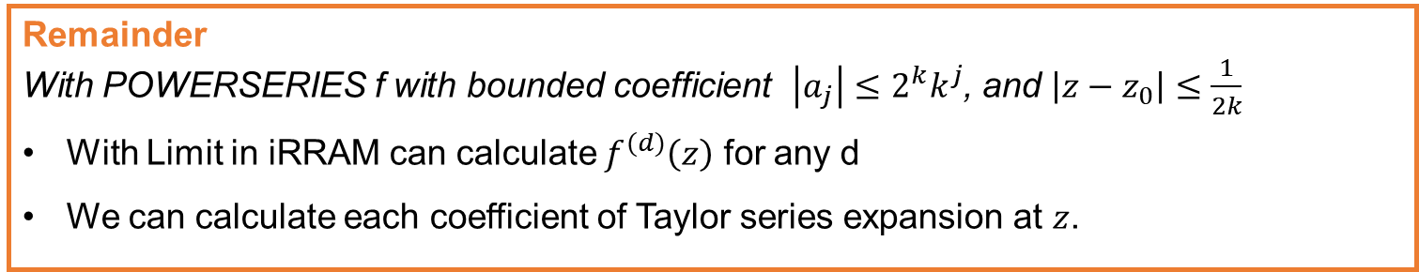
Continuation
Remainder
With POWERSERIES f with bounded coefficient $\left|a_{j}\right|≤2^{k}k^{j}$, and $\left|z−z_{0}\right|≤\frac{1}{2k}$
With Limit in iRRAM can calculate $f^{(d)}\left(z\right)$ for any d
We can calculate each coefficient of Taylor series expansion at $z$.
With POWERSERIES $f$ continuation $g$ at point $z_{0}$ is
$$g\left(z\right)= \sum_{j=0}^{∞}{\frac{f^{\left(j\right)}\left(z_{0}\right)}{j!}{\left(z−z_{0}\right)}^{j}}$$

Slide 19
III. Future Work

Slide 20
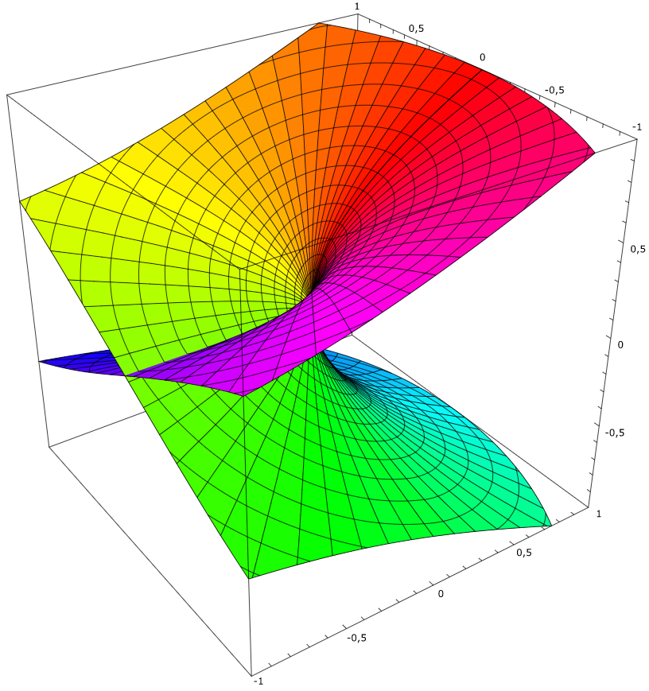

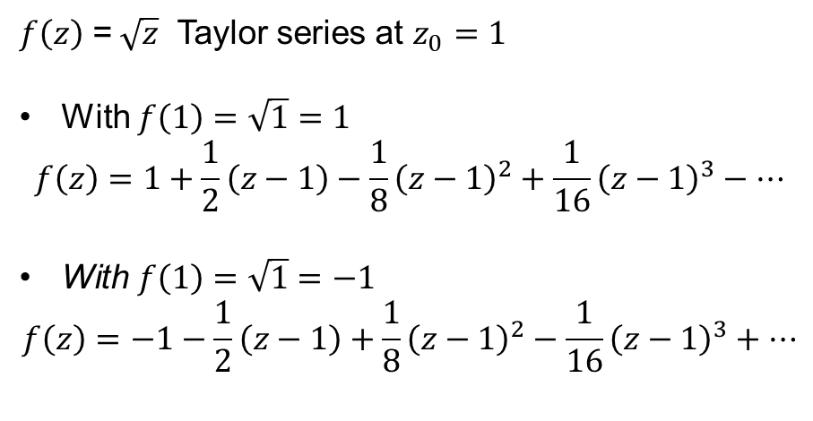
Continuation on Multivalued function
$$f\left(z\right)=Re\sqrt{z}$$
$f\left(z\right)$ =$\sqrt{z}$ Taylor series at $z_{0}=1$
With $f\left(1\right)=\sqrt{1}=1$
$$f\left(z\right)=1+\frac{1}{2}\left(z−1\right)−\frac{1}{8}{\left(z−1\right)}^{2}+\frac{1}{16}{\left(z−1\right)}^{3}−…$$
With $f\left(1\right)=$ $\sqrt{1}=−1$
$$f\left(z\right)=−1−\frac{1}{2}\left(z−1\right)+\frac{1}{8}{\left(z−1\right)}^{2}−\frac{1}{16}{\left(z−1\right)}^{3}+…$$

Slide 21
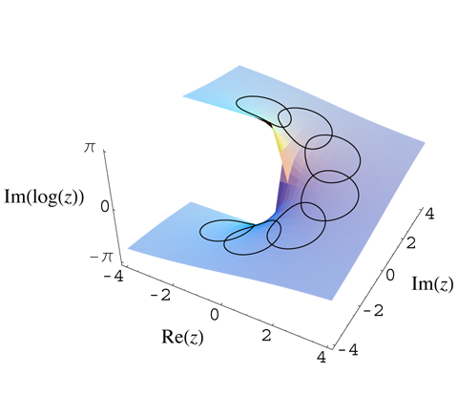
Continuation on Multivalued function

