Slide 1
Computability and Complexity of Ray Tracing
By Aknur & Halleluyah

Slide 2

HELLO!
I am Halleluyah
This is the 2nd part of the computability and complexity of ray tracing presentation.

Slide 3
Contents
Key Points Recap of Tuesday’s presentation
Three-Dimensional Rational Linear Optical Systems with Refractive Objects
Three-Dimensional Rational Linear Optical Systems with Rectangular Reflective and Refractive Objects
Three-Dimensional Linear Optical Systems with Reflective and Partially Reflective Surfaces

Slide 4
Key Points Recap
Let’s start with ….

Slide 5
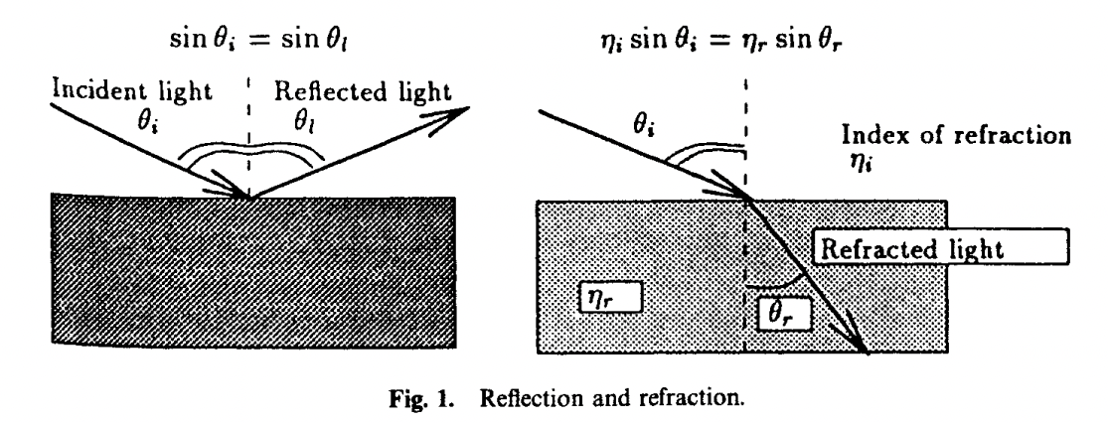
Let’s review some concepts
What are some applications of Ray Tracing?
What is ray tracing?
What are the laws of Reflection?
What is the ray tracing problem?rational vs irrational
What are the Laws of Refraction
.

Slide 6
Big concept
5.2 Ray Tracing in Three-Dimensional Rational Linear Optical Systems with Rectangular Reflective and Refractive Objects

Slide 7
5.2 Optical System:
Restriction:
Linear surfaces
Assumption:
Index of refraction
μ = 2
Why?

Slide 8
5.2 Basic Boxes:
We will be using 3 basic boxes:
-Readout box
-Multiply2 (Divide2) box
-Beam turner box

Slide 9
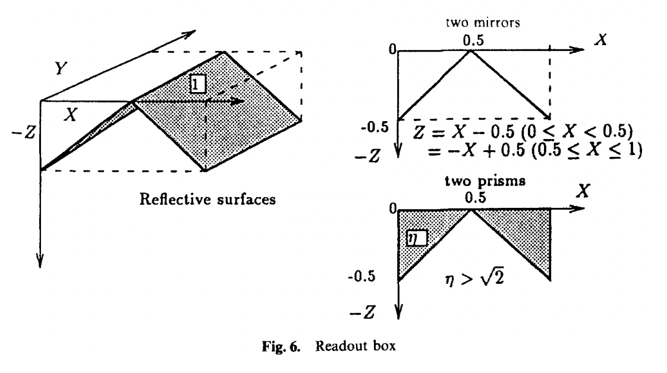
5.2 Basic Boxes: Readout box

Slide 10
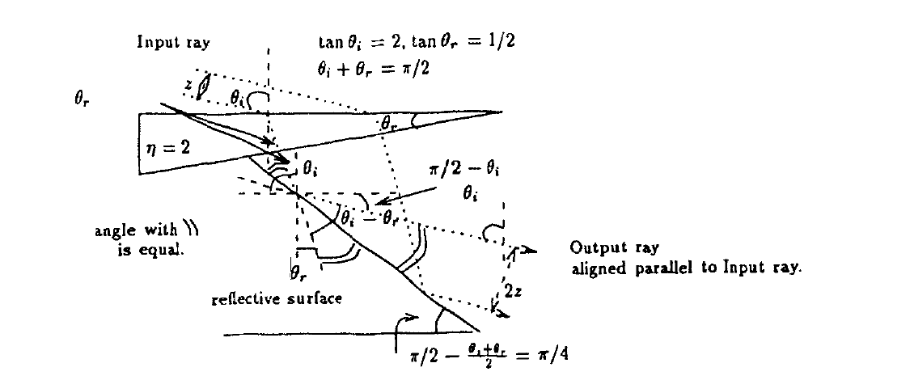

5.2 Basic Boxes: Multiply 2 (divide 2) box

Slide 11
5.2 Basic Boxes: Beam turner box
Necessity:
-to change the ray’s direction by pi/2
Assumption:
-μ >= √2
Reason:
-causing total internal reflection

Slide 12
5.2 Theorem
Theorem 5.2: The ray tracing of three-dimensional optical systems consisting of linear refractive (and reflective) objects is undecidable, even if all the objects are represented by a system of rational linear inequalities.

Slide 13
Big concept
5.3 Ray Tracing in Three-Dimensional Rational Linear Optical Systems with
Rectangular Reflective and Refractive Objects

Slide 14
5.3 Optical System:
Rectangular reflective and refractive objects
Surfaces oriented either parallel or perpendicular to one another.

Slide 15
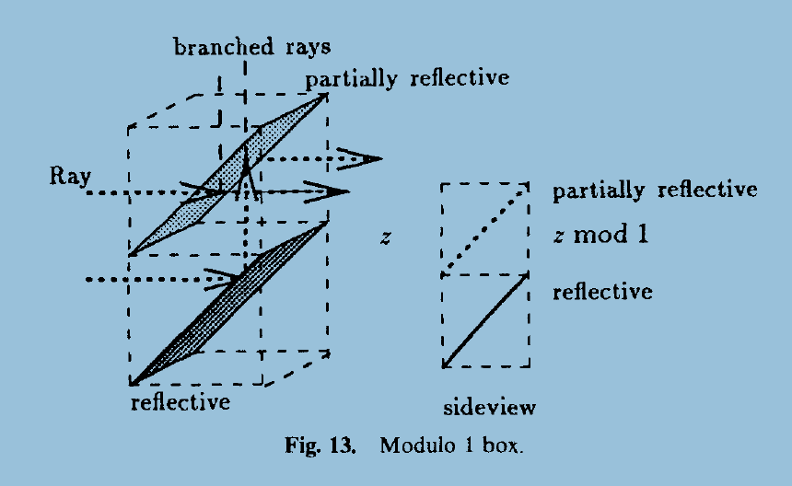
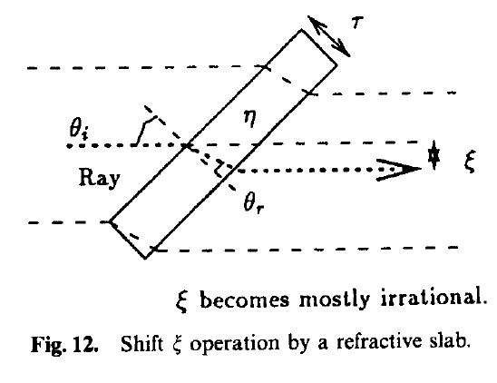
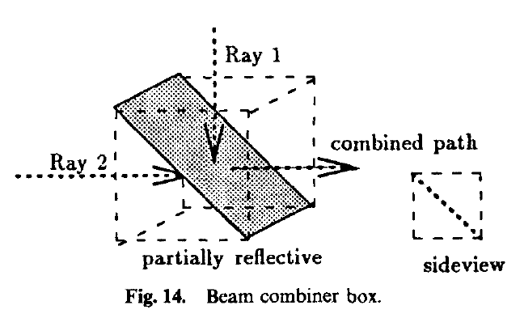
5.3 Two Counter machine
Simulation
Representation of operations

Slide 16
5.3 Basic Boxes:
We will be using 3 basic boxes:
-Shift box
-Modulo 1 box
-Beam combiner box

Slide 17
5.3 Theorem
Theorem 5.3: The ray tracing of three-dimensional optical systems consisting of linear rectangular reflective and refractive objects is undecidable, even if all the rectangular objects are represented by a system of rational linear inequalities.

Slide 18
Big concept
5.4 Ray Tracing in Three-Dimensional Linear Optical Systems with Reflective and Partially Reflective Surfaces

Slide 19
5.4 Optical System:
consist purely of reflective and partially reflective surface
irrationally represented reflective
surfaces

Slide 20
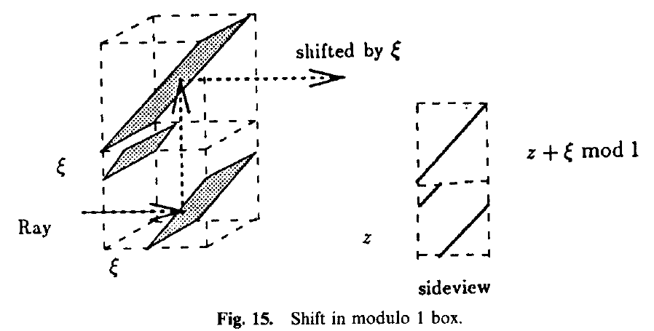
5.4 Basic Boxes:
We will be using 2 basic boxes:
-Shift in modulo 1 box
-Beam combiner box

Slide 21
5.4 Theorem
Theorem 5.4: The ray tracing of three-dimensional optical systems consisting of linear reflective and partially reflective surfaces is undecidable, if some surfaces are allowed to be represented by irrational linear inequalities.

Slide 22
Credits
Special thanks to all the people who helped:
Preparation help & support: Professor Martin Ziegler
Presentation content: http://doi.org/10.1007/BF02574009
Photographs: Unsplash
Presentation template: SlidesCarnival

Slide 23
THANKS!
Any questions?

