Slide 1
History of
Artificial Intelligence
20200535 Heejun Lee

Slide 2
Table of Content
AI in Science Fiction
First Born of AI in Academic Area
First AI Boom
AI Winter
01
02
03
04
Second AI boom
Rise of Practical ML Algorithms
Era of Deep Learning
05
06
07

Slide 3
Subsection
1. AI in Science Fictions
AI in Science Fiction
First Born of AI in Academic Area
First AI Boom
AI Winter
Second AI boom
Rise of Practical ML Algorithms
Era of Deep Learning
01
02
03
04
05
06
07

Slide 4
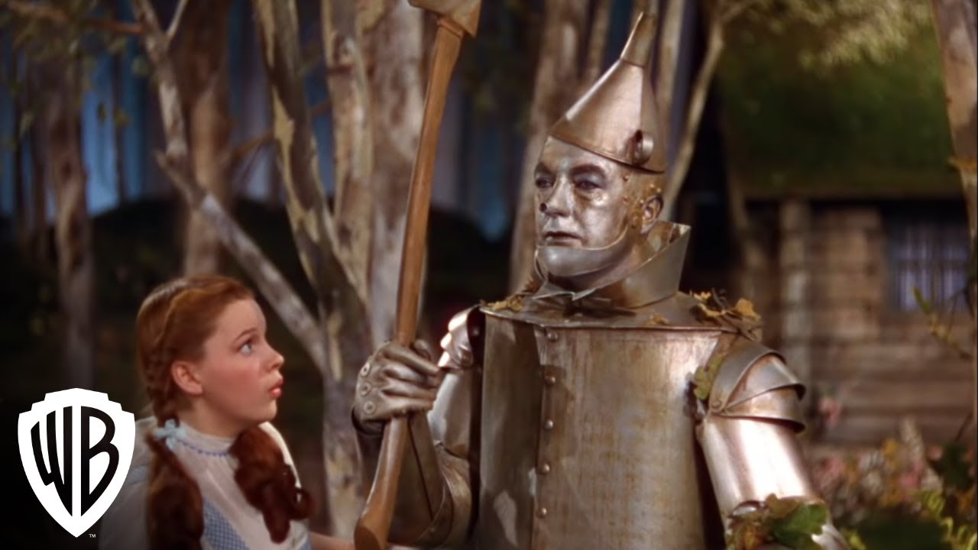
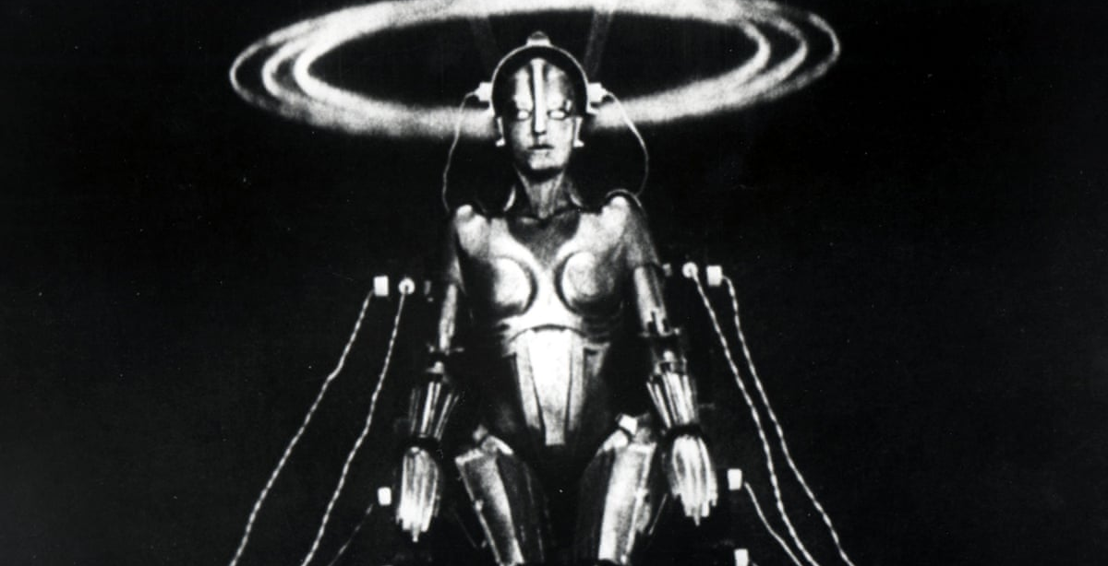
Science Fiction think about “Tin Man” (~1949)
1900~1950s, Science Fiction spread the concept of AI robots.
The concept began with the “heartless” Tin man from the Wizard of Oz
Continued with the humanoid robot that impersonated Maria in Metropolis
Notes:
In the first half of the 20th century, science fiction familiarized the world with the concept of artificially intelligent robots.
It began with the “heartless” Tin man from the Wizard of Oz and continued with the humanoid robot that impersonated Maria in Metropolis

Slide 5
Scientists think it seems good (1950)
By the 1950s, we had a generation of scientists, mathematicians, and philosophers with the concept of artificial intelligence (or AI) culturally assimilated in their minds.
Notes:
By the 1950s, we had a generation of scientists, mathematicians, and philosophers with the concept of artificial intelligence (or AI) culturally assimilated in their minds.

Slide 6
Alan Turing, Turing test: “Can Machine Think?” (1950)
Which a robot is Type A?
Text Interface
Robot X (Type A)
Robot Y (Type B)
Imitation Game (a.k.a. Turing Test)
https://www.linkedin.com/pulse/imitation-game-comprehensive-look-turing-test-eshan-mewantha-herath/
https://redirect.cs.umbc.edu/courses/471/papers/turing.pdf
Notes:
Alan Turing proposed the concept of an imitation game that identifies which opponent is A among X and Y.
X and Y try to state themself is A.
And if we change X into the machine, this becomes the Turing test.
The Turing test was designed to fool humans with machine intelligence of natural language understanding skills.

Slide 7
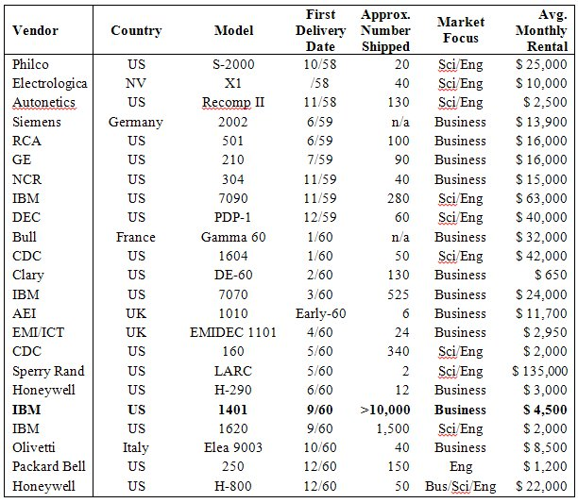
However, the computer was too expensive in the old days
The history of AI cannot be presented apart from the evolution of computers.
During the 1950s, the computer is huge and slow. Ex: IBM 1401.
People leased the computers because of cost.
However, it still costs about $1,755,000 (Inflation considered x13) per month.
But Moore’s Law led the improvement of computation speed and transistor.
https://ethw.org/Early_Popular_Computers,_1950_-_1970
Notes:
The history of AI cannot be presented apart from the evolution of computers.
During the 1950s, the computer is huge and slow.
During that time, buying computers did not make sense, so they leased the computer.
It costs about $1,755,000 (Inflation considered x13) per month.
But our Gorden Moore, who the founder of Intel improved computation speed and transistor year by year.
This is Moore’s Law.

Slide 8
Subsection
2. First Born of AI in Academic Area
First Born of AI in Academic Area
AI in Science Fiction
First AI Boom
AI Winter
Second AI boom
Rise of Practical ML Algorithms
Era of Deep Learning
02
01
03
04
05
06
07

Slide 9
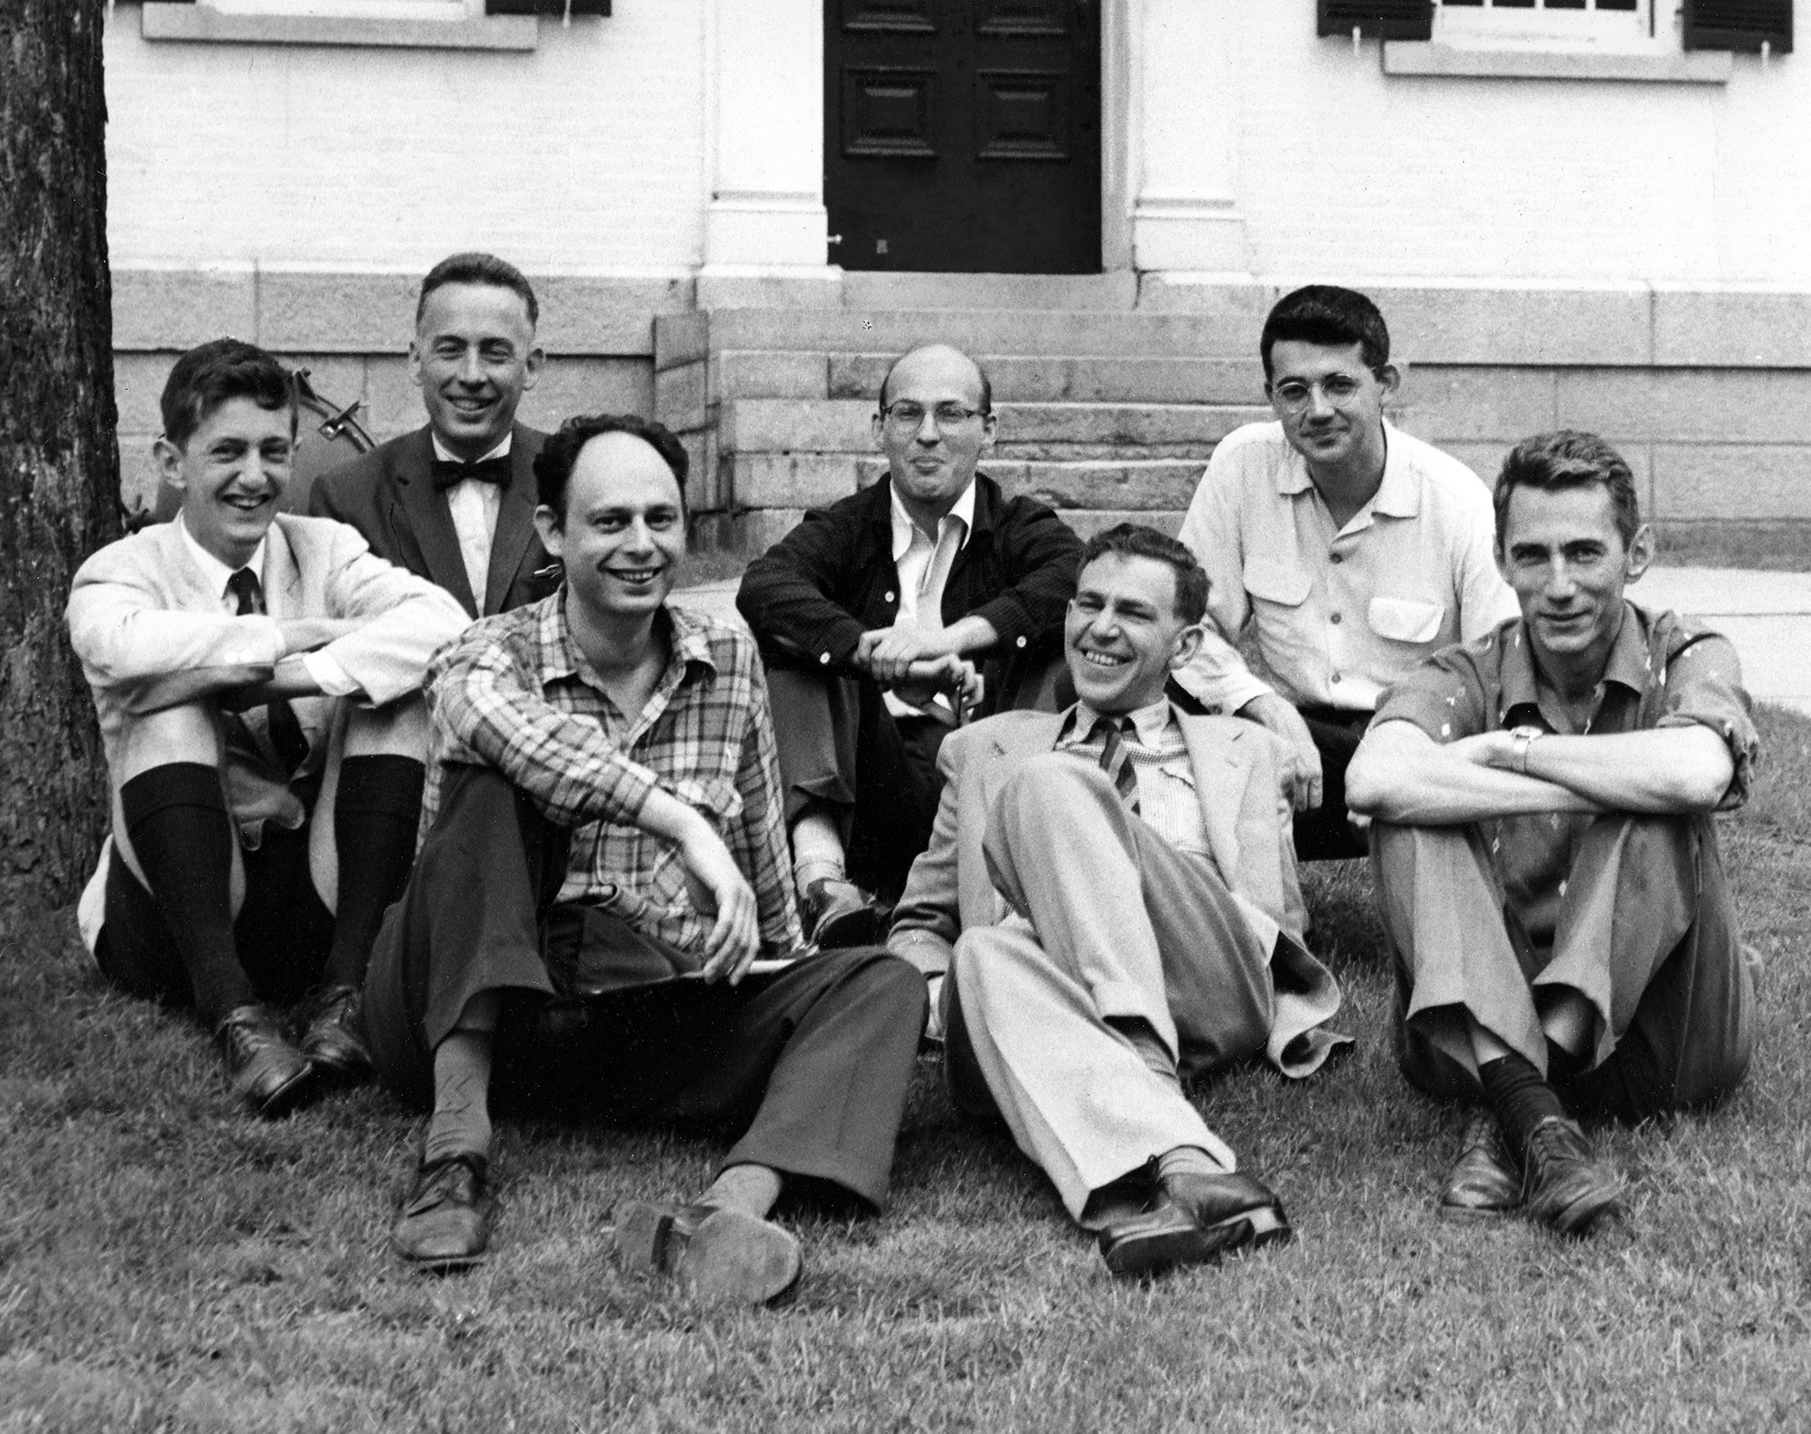
Dartmouth Summer Research Project on Artificial Intelligence (DSRPAI), 1956
https://www.cantorsparadise.com/the-birthplace-of-ai-9ab7d4e5fb00?gi=17829093c275
Notes:
The conference that started everything was held in this very early stage of AI.
It is called Dartmouth Summer Research Project on Artificial Intelligence 1956.

Slide 10
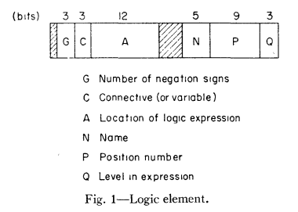
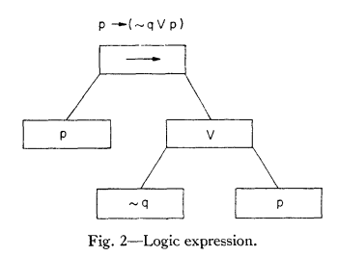
Logic theorists
“Logic theorists” was the first program to mimic human’s problem-solving skills.
And the program was presented on DSRPAI.
In addition, during the conference, many researchers introduced many interesting prototypes and visions for human-level AI.
However, they could not find good candidates for a general AI framework.
But during the conference, the researchers have a dream and motivation to research general AI.
https://en.wikipedia.org/wiki/Logic_Theorist
https://dl.acm.org/doi/10.1145/1455567.1455606
Notes:
Allen Newell, Cliff Shaw, and Herbert Simon introduced “Logic theoriests”, and it was the first program to mimic human’s problem-solving skills.
And the “Logic theorist” program was presented on DSRPAI.
In addition, during the conference, many researchers introduced many interesting prototypes and visions for human-level AI.
However, they could not find good candidates for a general AI framework.
But during the conference, the researchers have a dream and motivation to research general AI.
This motivation had kept up the AI research community for about 20 years since then.
This is why DSRPAI 1956 is considered as a remarkable starting point.

Slide 11
Subsection
3. First AI Boom
First AI Boom
AI in Science Fiction
First Born of AI in Academic Area
AI Winter
Second AI boom
Rise of Practical ML Algorithms
Era of Deep Learning
03
01
02
04
05
06
07

Slide 12
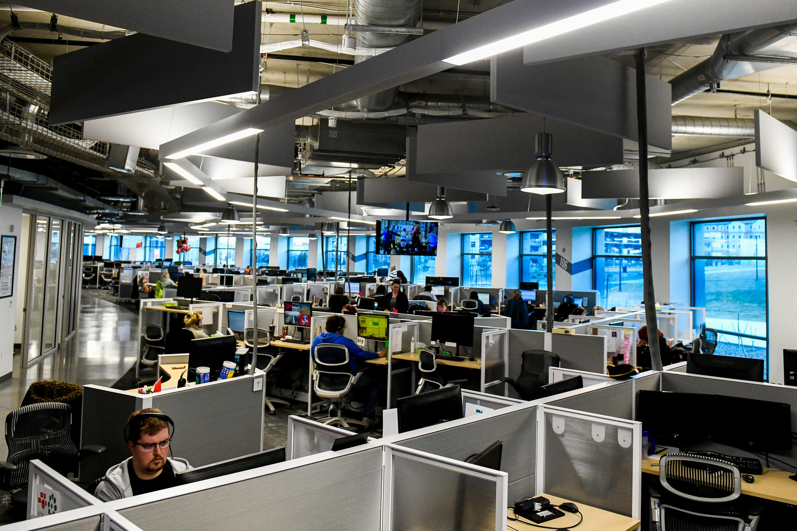

First AI boom with Funds
https://www.nytimes.com/2018/02/19/technology/ai-researchers-desks-boss.html
Notes:
After DSRPAI, AI research flourished, as well as the fund raised by DARPA and many organizations.

Slide 13
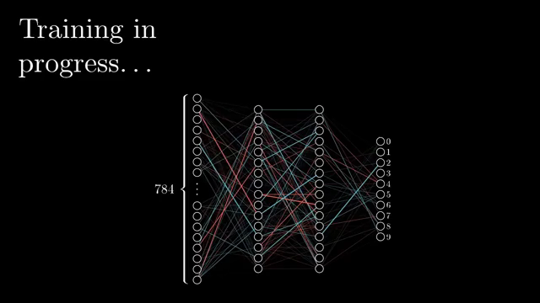
Back-propagation
The basics of continuous backpropagation were derived in the context of control theory by Henry J. Kelley in 1960, and by Arthur E. Bryson in 1961.
They used principles of dynamic programming.
In 1962, Stuart Dreyfus published a simpler derivation based only on the chain rule.
https://en.wikipedia.org/wiki/Backpropagation#History
https://www.youtube.com/watch?v=Ilg3gGewQ5U
Notes:
For one of the remarkable algorithm that developed during this period, The Back Propagation.
The basics of continuous backpropagation were derived in the context of control theory by Henry J. Kelley in 1960, and by Arthur E. Bryson in 1961.
They used principles of dynamic programming.
In 1962, Stuart Dreyfus published a simpler derivation based only on the chain rule.

Slide 14
Subsection
4. AI Winter
AI Winter
AI in Science Fiction
First Born of AI in Academic Area
First AI Boom
04
Second AI boom
Rise of Practical ML Algorithms
Era of Deep Learning
01
02
03
05
06
07

Slide 15
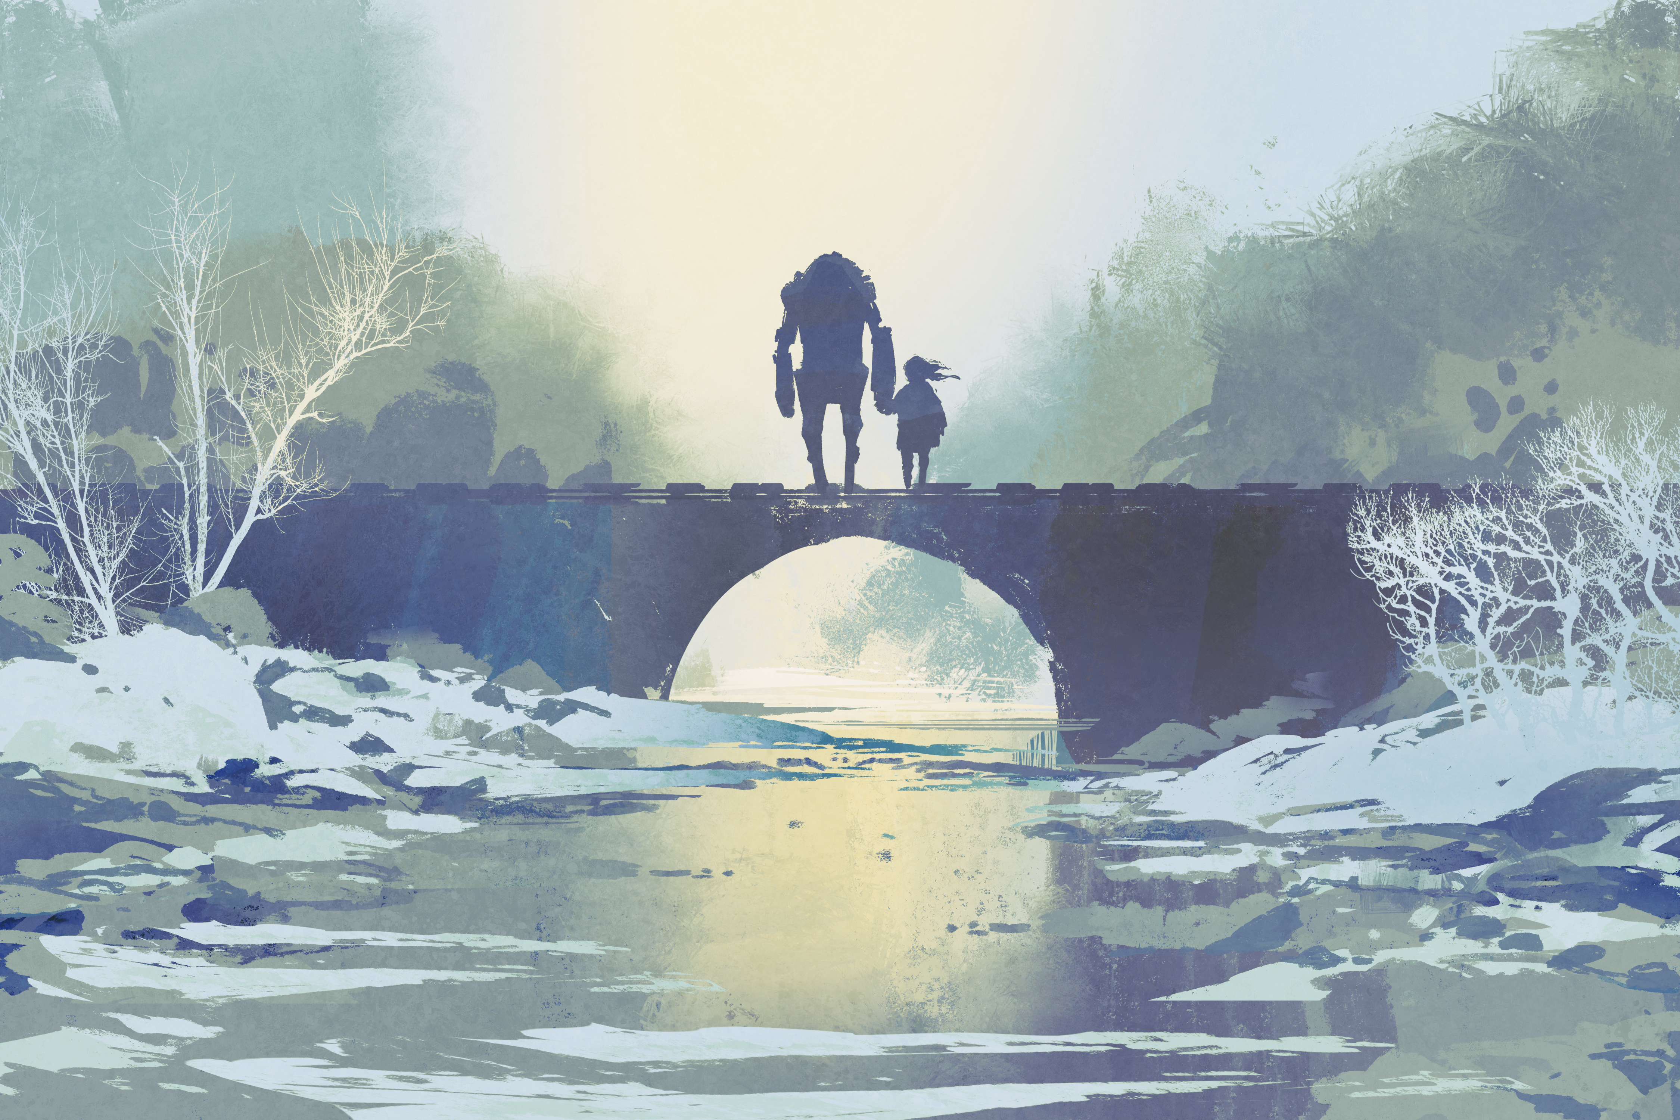
First AI winter (1970~1980)
Fund raisers cut the fund to AI researches, because of disappointing progression speed
Fortunately, some individuals carried on the research without funding.
There is many opinions about AI winter, however in this presentation 70s is considered as AI winter.
Notes:
AI and Deep learning could not keep up fund raiser’s expectations.
The impact of this lack of funding limited both DL and AI research.
Fortunately, there were individuals who carried on the research without funding.

Slide 16
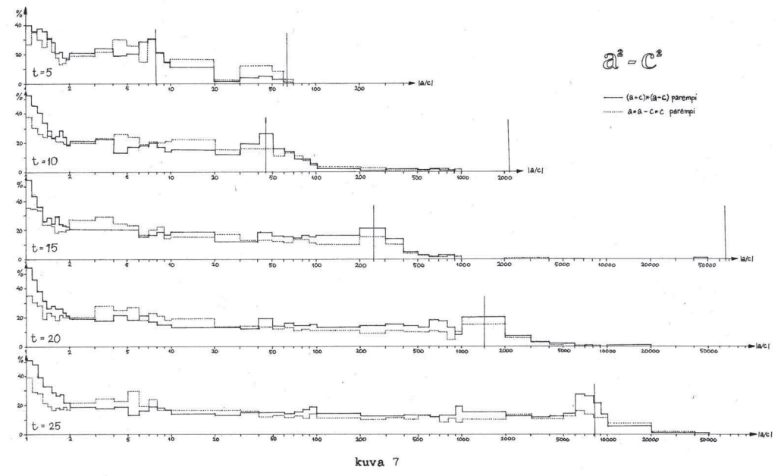
Back-propagation demonstration
Seppo Linnainmaa showed that backprop works well in DNN with his master thesis with FORTRAN.
https://en.wikipedia.org/wiki/Backpropagation#History
https://people.idsia.ch/~juergen/linnainmaa1970thesis.pdf
Notes:
Seppo Linnainmaa showed that backprop works well in DNN with his master thesis with FORTRAN.
He wrote his FORTRAN program in his 66 pages master thesis with typewriter.
I am not sure what that figure means… because the paper is wrote in Finland language

Slide 17
Subsection
5. Second AI boom
Second AI boom
AI in Science Fiction
First Born of AI in Academic Area
First AI Boom
AI Winter
Rise of Practical ML Algorithms
Era of Deep Learning
05
01
02
03
04
06
07

Slide 18
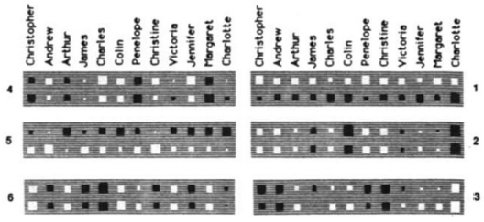
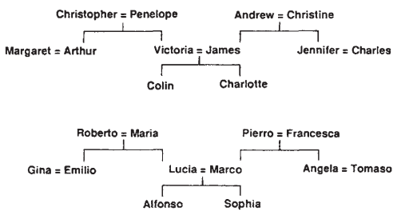
Rediscover of Back-propagation (BP or BackProp)
Hinton research team found out back-propagation on NN creates interesting connections between neurons.
They demonstrate how weights in NN are trained with BP algorithm in Nature 1986.
Trained Unit 6 indicates the person belongs in which family tree
Trained feature of on person relationship estimation
https://www.nature.com/articles/323533a0
Notes:
Hinton, find out back-propagation on NN creates interesting connections between neurons.
They demonstrate how weights in NN trained with BP algorithm in Nature 1986.

Slide 19
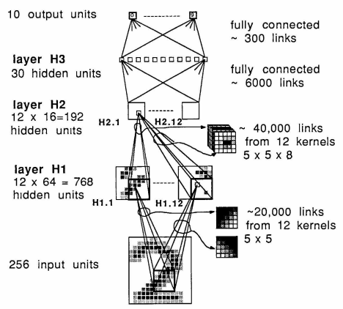
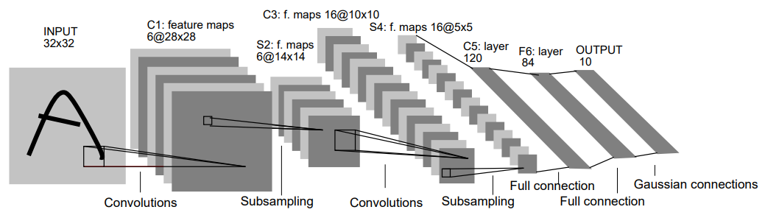
LeCunn’s Backprop Demonstration (MNIST)
LeCunn, 1989
Yann LeCunn (1989) evaluate CNN+BP on MNIST, which classifies handwritten digits with MLP and back-propagation.
Later, he introduced LeNet in 1998 with improved performance.
However, the DNN could not expend further, because of Curse of Dimensionality.
  Overfitting, Computational cost, Vanishing gradients
LeCunn, 1998
http://yann.lecun.com/exdb/publis/pdf/lecun-89e.pdf
http://yann.lecun.com/exdb/publis/pdf/lecun-01a.pdf
https://citeseerx.ist.psu.edu/viewdoc/summary?doi=10.1.1.19.8015&rank=5
https://citeseerx.ist.psu.edu/viewdoc/summary?doi=10.1.1.20.8237&rank=1
https://www.sciencedirect.com/science/article/abs/pii/S0305048301000263
Notes:
Yann LeCunn evaluate CNN+BP on MNIST, which classifies handwritten digits with MLP and back-propagation.
Later, he introduced LeNet in 1998 with improved performance.
However, the DNN could not expend further than LeNet, because of Curse of Dimensionality.
Larger DNN was hard to compute and optimize because of overfitting, computational cost, vanishing gradients, and various problem.
DNN showed usually worse optimization cost then SVM and other ML algorithms.

Slide 20
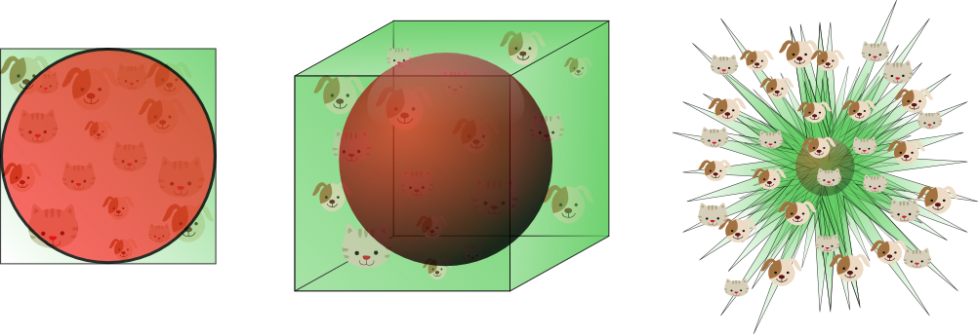
Curse of Dimensionality
“Curse of Dimensionality” means many challenges when we try to handle high-dimensional data.
Often cited when we encounter challenges and bugs during expanding dimension of the system.
Richard E. Bellman, when considering problems in dynamic programming, mentioned this quote first.
Notes:
“Curse of Dimensionality” means many challenges when we try to handle high-dimensional data.
This quote often is cited when we encounter challenges and bugs during expanding dimension of the system.
Richard E. Bellman, when considering problems in dynamic programming, mentioned this quote first.

Slide 21
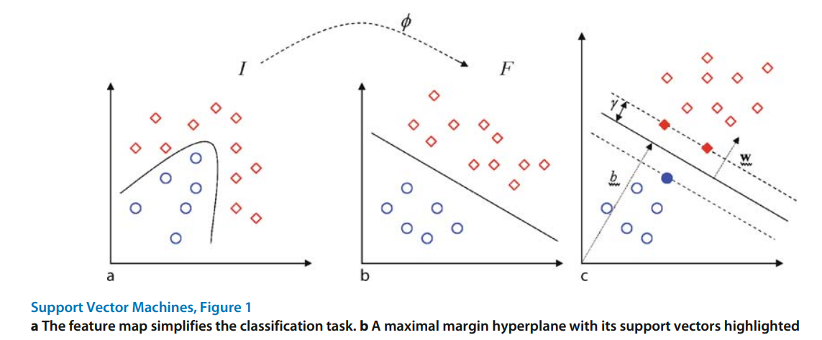
Support Vector Machine (SVM, 1992)
Developed at AT&T Bell Laboratories by Vladimir Vapnik (1992) research team
SVM is a very simple and powerful robust AI model.
During that time, training DNN properly was very difficult, so SVM was considered as strong alternative and mainstream of research trend.
https://link.springer.com/referenceworkentry/10.1007/978-0-387-30162-4_415
Notes:
Support Vector Machine is Developed at AT&T Bell Laboratories by Vladimir Vapnik research team.
SVM is a very simple and powerful robust AI model.
The model beats many baselines in terms of performance on two and one class classification tasks.
We know, DNN is better than SVM now, but during that time, training DNN properly was very difficult as following problems.
So SVM was considered as strong alternative and mainstream of research trend.

Slide 22
Subsection
6. Rise of Practical ML Algorithms
Rise of Practical ML Algorithms
AI in Science Fiction
First Born of AI in Academic Area
First AI Boom
AI Winter
Second AI boom
Era of Deep Learning
06
01
02
03
04
05
07

Slide 23
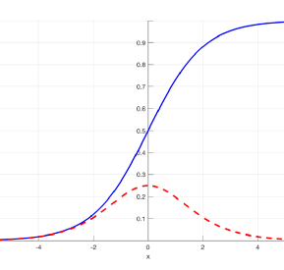
DNN goes down: The vanishing gradient
If we added more layers on DNN, we should expect higher accuracy.
But in truth, the DNN performs worse and worse while adding new layers and model structures.
The reason is that DNN training relies on backprop, and back-prop could not propagate gradient when the propagated gradient converges to zero.
Sigmoid and its gradient. The gradient converges into zero.
https://towardsdatascience.com/the-vanishing-gradient-problem-69bf08b15484
Notes:
DNN was going down during this period, because of the vanishing gradient problem.
People are struggling with training DNN, because of gradient vanishing.
If we added more layers on DNN, we should expect higher accuracy.
But in truth, the DNN performs worse and worse while adding new layers and model structures.
The reason is that DNN training relies on backprop, and back-prop could not propagate gradient when the propagated gradient converges to zero.

Slide 24
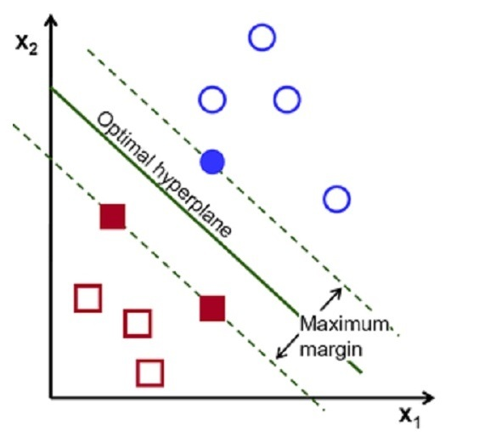
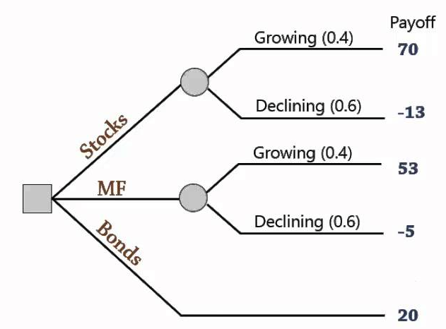
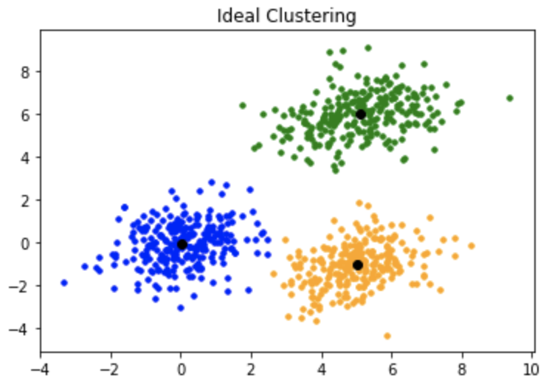
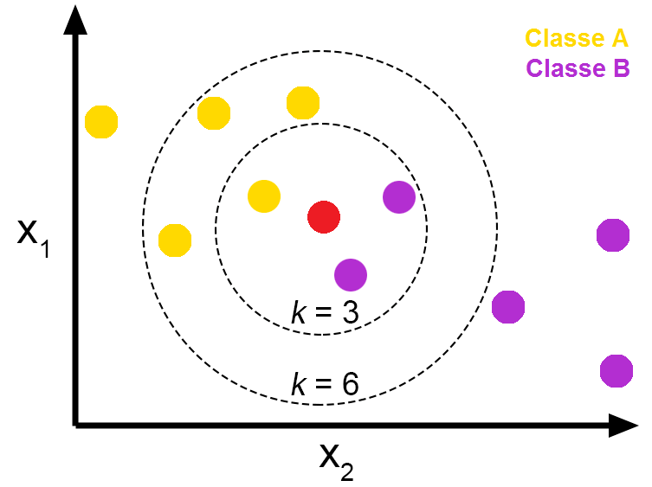
Other attractive alternatives are arising
People are trying to use simpler and more robust models than DNNs
  SVM
  Decision Tree
  k-Nearest-Neighborhood
  kMeans
Notes:
People are trying to use a simpler and more robust model than DNNs.
For example, SVM, Decision Tree, k-Nearest-Neighborhood, and kMeans.

Slide 25
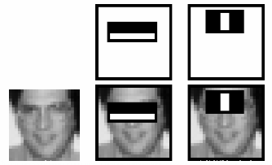
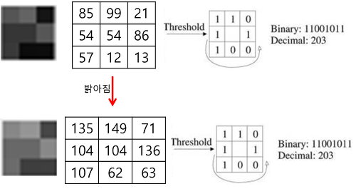
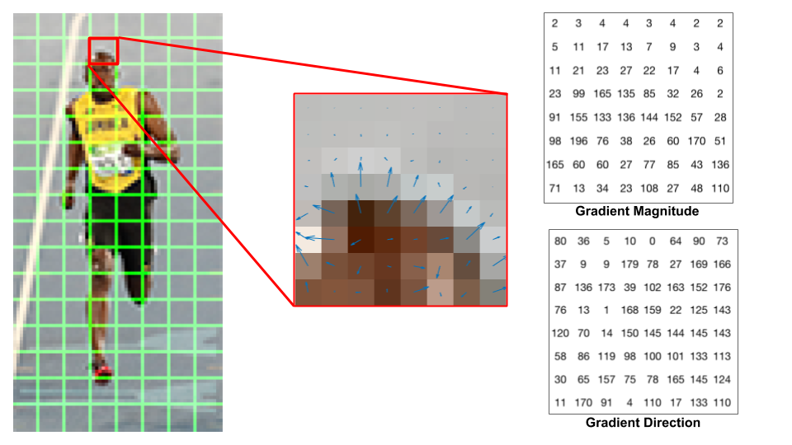
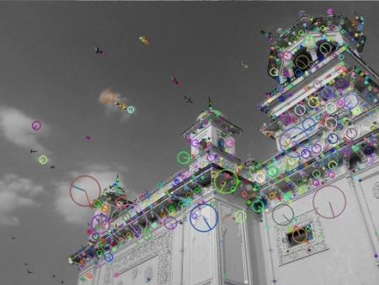
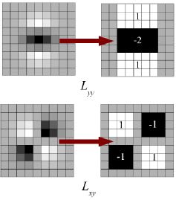
People Concentrates on Feature Engineering
Some people think the learning models are robust enough, to time to engineer features extraction.
  In CV, HAAR, LBP, HOG, SIFT, and SURF
Many of you are familiar with HAAR cascade for object detection, usually used in face recognition with OpenCV library.
Notes:
Some people think the learning models are robust enough, and it is to time to engineer features extraction.
For example, In CV field,
HAAR (1992)
LBP (1990)
Histogram of Oriented Gradients (HOG) (1986)
Scale-Invariant Feature Transform (SIFT) (1999)
Speeded Up Robust Feature (SURF) (2006)
Those feature extraction methods are working well with classifiers such as SVM.
Many of you are familiar with HAAR cascade for object detection, usually used in face recognition with OpenCV library.

Slide 26
Subsection
7. Era of Deep Learning
Subsubsection
7.1. ReLU solves vanishing gradient
Era of Deep Learning
AI in Science Fiction
First Born of AI in Academic Area
First AI Boom
AI Winter
Second AI boom
Rise of Practical ML Algorithms
07
01
02
03
04
05
06
Notes:
And yea, it is time to deep learning era.
Lets talk about ~~

Slide 27
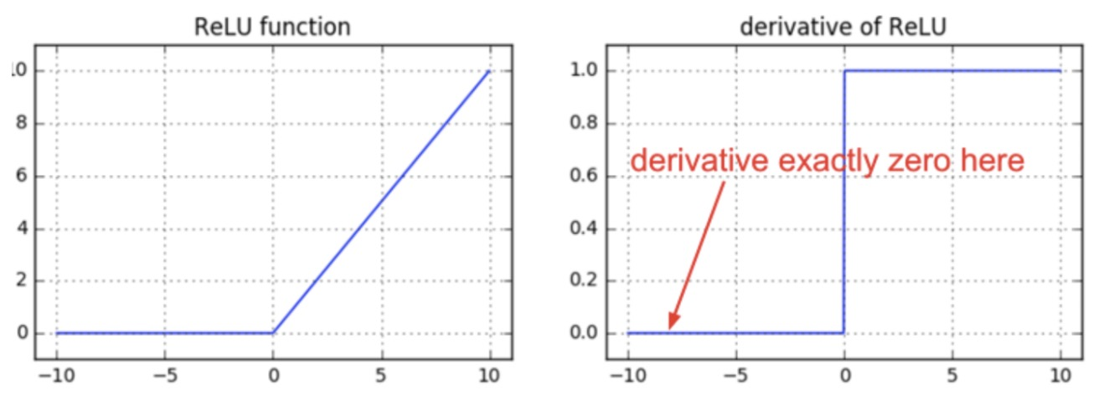

DL Training is Practical Now (2011)
People can avoid vanishing gradient problems with ReLU (introduced by Alex Krizhevsky in 2011).
GPU is insanely faster than before.
Almost unlimited cash, not like before 1970s~80s.
  Google invests in Deep Learning and AI seriously, so Google acquired DeepMind.
https://proceedings.neurips.cc/paper/2012/file/c399862d3b9d6b76c8436e924a68c45b-Paper.pdf
Notes:
People can now avoid vanishing gradient problems with ReLU.
ReLU is introduced by Alex Krizhevsky in 2011.
This research used GPU for training deep learning, and it makes training insanely faster than before.
Importantly, many research groups have almost unlimited cash (Google, Microsoft, Facebook), unlike before investment during 1970s~80s.
For example, Google invests in Deep Learning and AI seriously, so Google acquired DeepMind.
https://proceedings.neurips.cc/paper/2012/file/c399862d3b9d6b76c8436e924a68c45b-Paper.pdf

Slide 28
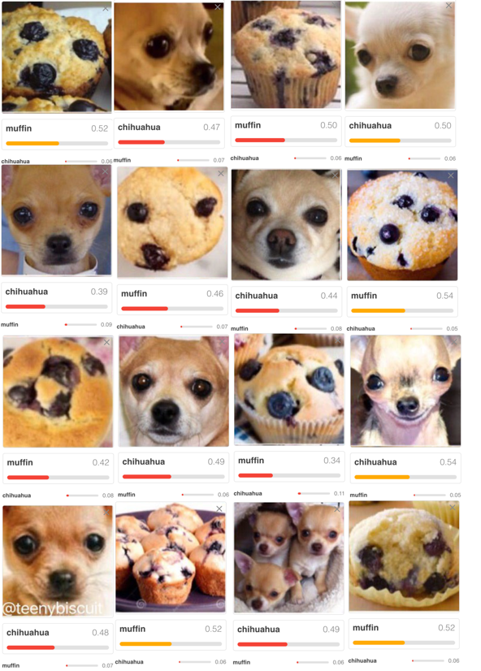
DL Training is Practical Now (2011)
However, even with powerful (at that time) GPUs and clever solutions, the human brain is quite an extremely better machine to classify Chihuahua and muffins.
Notes:
However even with powerful GPUs and clever solutions, the human brain is quite an extremely better machine to classify Chihuahua and muffins.

Slide 29
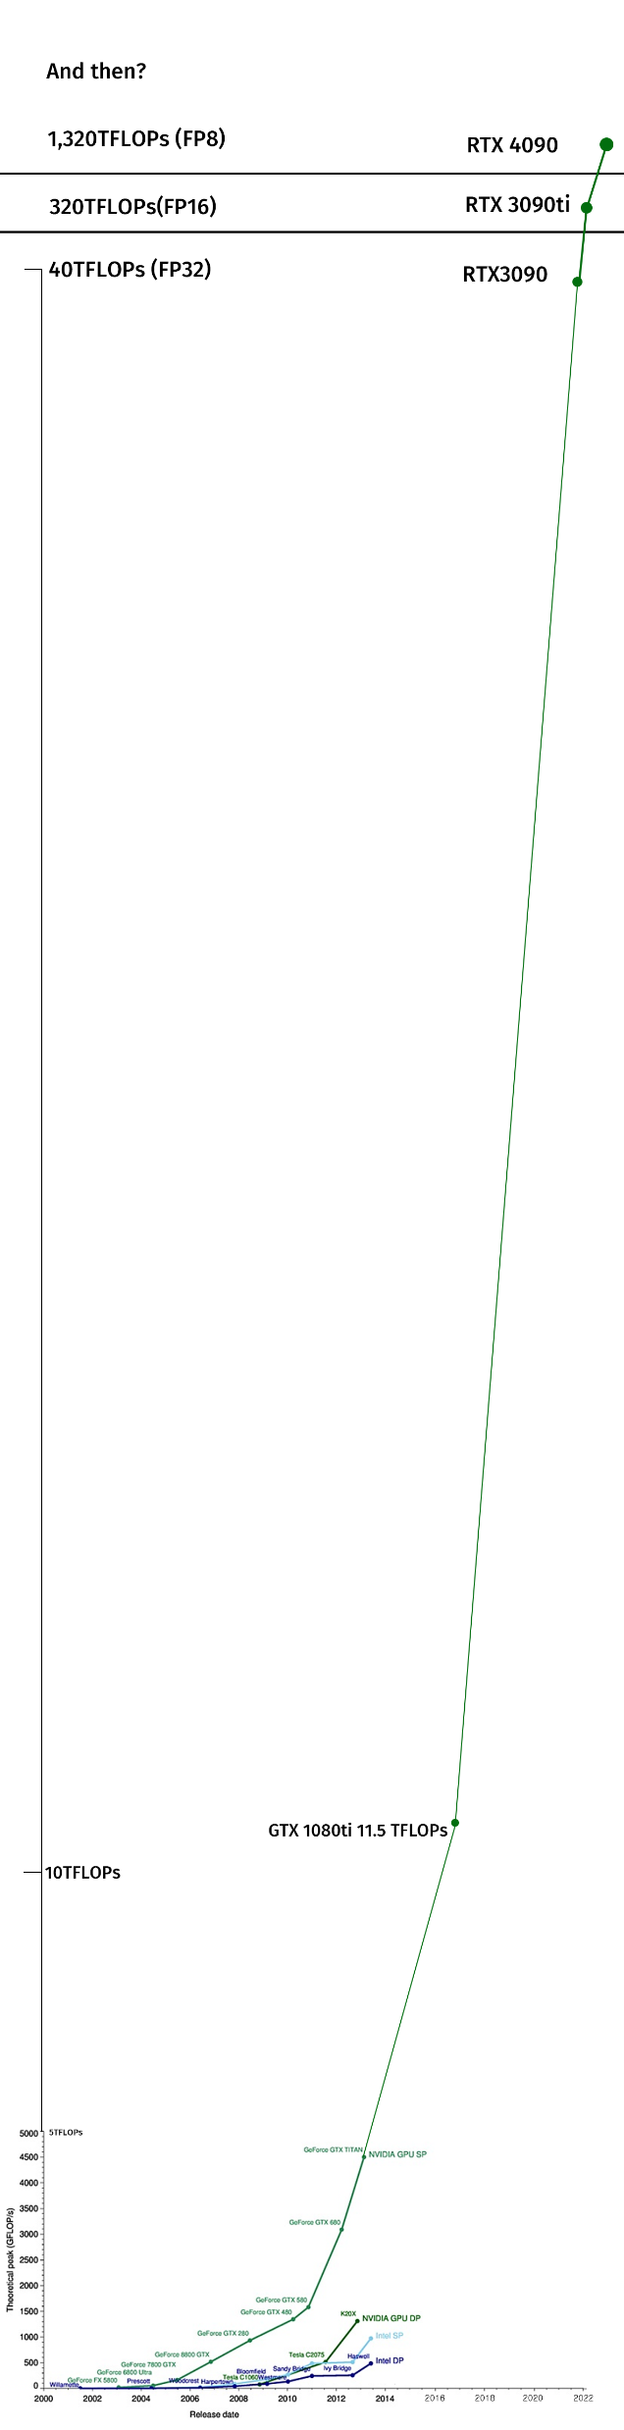
Side Story - NVidia: “operation CWAL”
GPU manufacturers are doing “operation CWAL” cheat in the real-world regarding computation power.
However, the GPU manufacturers beat Moore’s Law with parallelism.
Personally, I think the growth of GPU performance is still slower than the AI community growth speed.
Notes:
Side story is here!
Do you know the StarCraft cheat command “operation CWAL”? It means, Cannot Wait Any Longer.
IF you use this command in the game, all upgrades done instantly.
GPU manufacturers are doing “operation CWAL” cheat in the real world regarding computation power.
Moore’s Law is going to be weaker day by day, however, the GPU manufacturers beat Moore’s Law with parallelism.
They increase threads in the processor, put a bunch more transistor, increase chipset die size, and put more electricity.
Let’s see how the far GPU is growing.

Slide 30
Side Story - NVidia: “operation CWAL”
GPU manufacturers are doing “operation CWAL” cheat in the real-world regarding computation power.
However, the GPU manufacturers beat Moore’s Law with parallelism.
Personally, I think the growth of GPU performance is still slower than the AI community growth speed.
Notes:
As you can see here, GPU is significantly better than before.
However, Personally, I think the growth of GPU performance is still slower than the AI community growth speed.

Slide 31
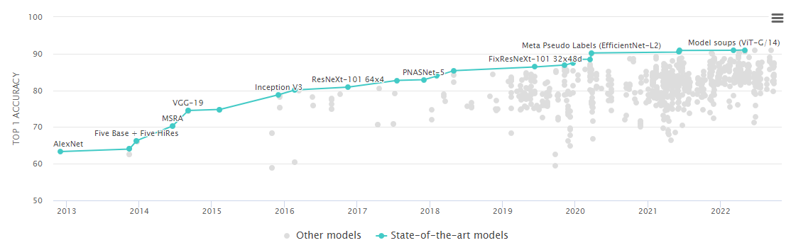
Remarkable Image Classification Models
https://arxiv.org/pdf/1409.1556.pdf
https://arxiv.org/pdf/1409.4842.pdf
https://arxiv.org/abs/1512.03385
https://arxiv.org/abs/1608.06993
https://paperswithcode.com/sota/image-classification-on-imagenet
VGG (2014)
Inception (2014)
ResNet (2015)
DenseNet (2016)
Notes:
Thanks to clever researchers and evolution on DeepLearning community including GPU and Models,
The performance of state of art model getting better and better everyday.

Slide 32
Subsection
7. Era of Deep Learning
Subsubsection
7.2. Emerge big player in DL field
Era of Deep Learning
AI in Science Fiction
First Born of AI in Academic Area
First AI Boom
AI Winter
Second AI boom
Rise of Practical ML Algorithms
07
01
02
03
04
05
06
Notes:
Now lets talk about big players in DL field.

Slide 33



Big Player in DL Field
01
02
03
DeepMind (Google)
Microsoft Research
Facebook Research
Inception v3
ResNet
PyTorch, DenseNet
Notes:
Since 2011, AlexNet announced, many things changed.
Tech giants get into the DL field, and they invest billions of money into research.
This investment accelerates DL evolution.

Slide 34




Emerging also DL frameworks
TensorFlow, Keras, Torch, Caffe, MXNet, ONNX, etc.
Also, the development environment helps the progression of DL
One of the widely used frameworks, PyTorch, is developed by Facebook Research.
Notes:
Also, the development environment helps the progression of DL.
One of the widely used frameworks, PyTorch, is developed by Facebook Research.
And others, for example, there is TensorFlow, Keras, Caffe, MXNet, ONNX, etc.

Slide 35
Subsection
7. Era of Deep Learning
Subsubsection
7.3. State-of-art
Era of Deep Learning
AI in Science Fiction
First Born of AI in Academic Area
First AI Boom
AI Winter
Second AI boom
Rise of Practical ML Algorithms
07
01
02
03
04
05
06
Notes:
Now let me show state of art result of AI researches.

Slide 36
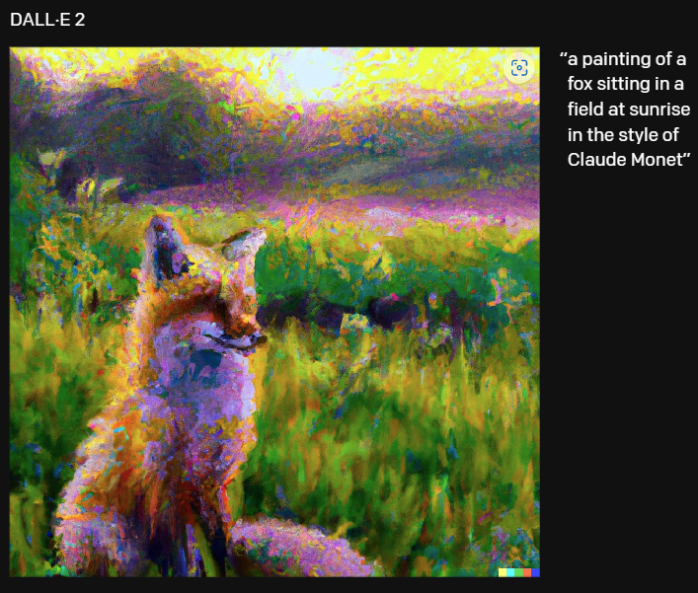
Text-to-Image: DALLE2 (2022)
DALL·E 2 Explained on Vimeo
https://cdn.openai.com/papers/dall-e-2.pdf
https://openai.com/dall-e-2/
Notes:
I am sure you have seen this model in social media or somewhere!
The model DALLE2 could generate creative images with text input. This model created with GAN and Transformers
Here is demo video.

Slide 37

Text-to-Video: CogVideo (2022)
https://github.com/THUDM/CogVideo
https://arxiv.org/abs/2205.15868
Notes:
And Next, The model CogVideo could generate video, not images like DALLE2.

Slide 38
Take Home Points & Questions
Notes:
That’s all!
Now lets talk about take home questions.

Slide 39
Summary of Today Presentation
1950~1970s
First AI Boom
1980s
Second AI Boom
2011~
State of Art
Deep Learning
Logic Theorists
Back Propagation
LeNet (CNN with Backprop)
Further researches about Back-Prop
ReLU
Deep Learning
Generative Model
Notes:
These are summary of today presentation.
~~read~~

Slide 40
Questions from Presenter
What did we learn? What do you think about AI?
Where do we go?
What can I do?
AI is cool?
AI is a scam?
General AI?
Industrial Automation?
Revenge of AI?
Contribution?
Application?
Business?
Notes:
These is questions from the presenter.
What did you learn on history of AI? Do you think AI is cool? Or not?
Then, what do you think about future of AI? Where do we go? Could we create general AI in some day? Or will we just stuck in industrial automations?
Finally, what can YOU do in AI field? What do you want to contribute? I am curious about it.

Slide 41
Thank you!
Notes:
Thank you for listening my presentation!

Slide 42
References
https://www.dataversity.net/brief-history-deep-learning/#
https://sitn.hms.harvard.edu/flash/2017/history-artificial-intelligence/
https://redirect.cs.umbc.edu/courses/471/papers/turing.pdf
https://ethw.org/Early_Popular_Computers,_1950_-_1970
https://en.wikipedia.org/wiki/Logic_Theorist
https://dl.acm.org/doi/10.1145/1455567.1455606
https://en.wikipedia.org/wiki/Backpropagation#History
https://www.youtube.com/watch?v=Ilg3gGewQ5U
https://en.wikipedia.org/wiki/Backpropagation#History
https://people.idsia.ch/~juergen/linnainmaa1970thesis.pdf
https://www.nature.com/articles/323533a0
http://yann.lecun.com/exdb/publis/pdf/lecun-89e.pdf
http://yann.lecun.com/exdb/publis/pdf/lecun-01a.pdf
https://citeseerx.ist.psu.edu/viewdoc/summary?doi=10.1.1.19.8015&rank=5
https://citeseerx.ist.psu.edu/viewdoc/summary?doi=10.1.1.20.8237&rank=1
https://www.sciencedirect.com/science/article/abs/pii/S0305048301000263
https://link.springer.com/referenceworkentry/10.1007/978-0-387-30162-4_415
https://towardsdatascience.com/the-vanishing-gradient-problem-69bf08b15484
https://proceedings.neurips.cc/paper/2012/file/c399862d3b9d6b76c8436e924a68c45b-Paper.pdf
https://arxiv.org/pdf/1409.1556.pdf
https://arxiv.org/pdf/1409.4842.pdf
https://arxiv.org/abs/1512.03385
https://arxiv.org/abs/1608.06993
https://paperswithcode.com/sota/image-classification-on-imagenet
https://cdn.openai.com/papers/dall-e-2.pdf
https://openai.com/dall-e-2/
https://github.com/THUDM/CogVideo
https://arxiv.org/abs/2205.15868

