Slide 1
History of
M/M/O/RPG
20180645 Cho Yoojin

Slide 2

Table of Contents
1
What is MMORPG?
2
History of MMORPG
Earlier Stage: PLATO & MUD
1st Generation: Ultima Online
2nd Generation: World of Warcraft
3
State of the Art
ⓒSaebyeol Yu. Saebyeol’s PowerPoint

Slide 3
1
What is MMORPG?

Slide 4
Part 1
What is MMORPG?
Massively Multiplayer Online
Role-Playing Game
“MMO + RPG”
Notes:
https://en.wikipedia.org/wiki/Massively_multiplayer_online_role-playing_game

Slide 5
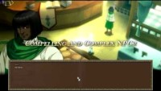
Part 1
What is MMORPG?
Notes:
https://www.youtube.com/watch?time_continue=1&v=YnL6yJL7dSo&feature=emb_logo

Slide 6
Part 1
What is MMORPG? - Roleplaying
Notes:
Image from:
Getting Started｜Game Manual | FINAL FANTASY XIV, The Lodestone

Slide 7
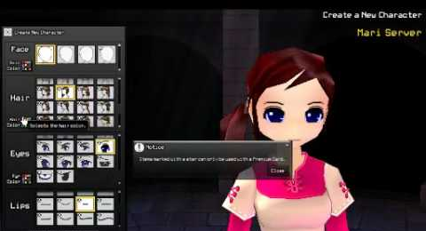
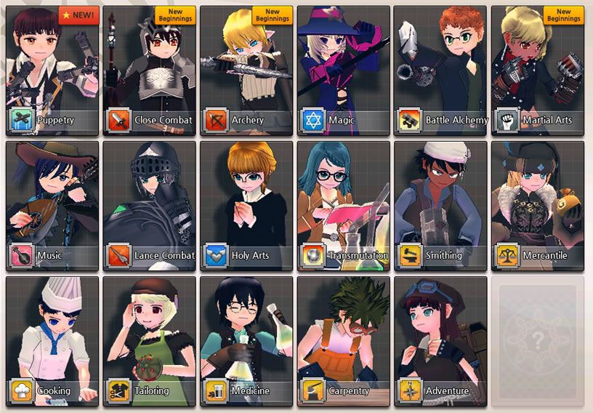
Part 1
What is MMORPG? - Roleplaying
Support customizing
Appearance
Role / Jobs
Skills
Notes:
Image from:
Mabinogi - Beginner Guide (nexon.net)

Slide 8
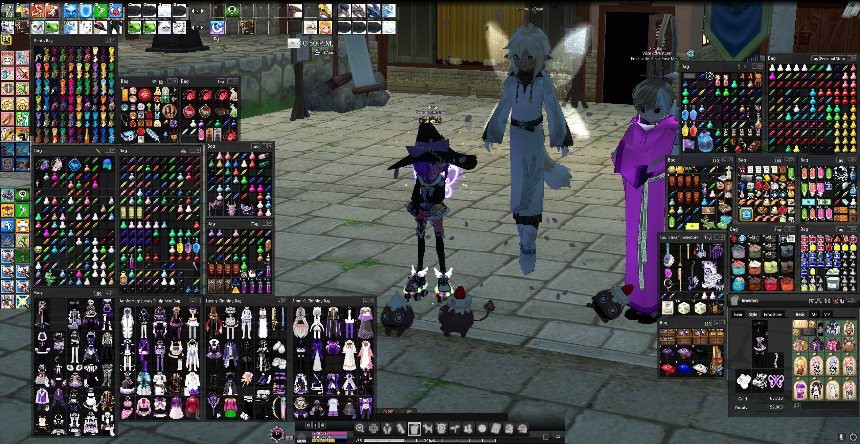
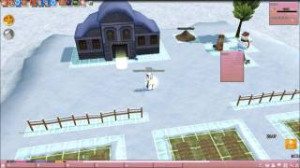
Part 1
What is MMORPG? - Roleplaying
Concept of possession
Inventory
House
Costume
Notes:
Image from:
Getting Started｜Game Manual | FINAL FANTASY XIV, The Lodestone

Slide 9
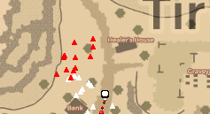

Part 1
What is MMORPG? - Roleplaying
High degree of freedom
Large map / Free moving
Free interaction with objects
Support traveling
Various activities
Notes:
Image from:
Alstroemeria Guild - Essential Mabinogi Tips & Tricks (windgazer.wixsite.com)

Slide 10
Part 1
What is MMORPG? - Multiplayer
Notes:
Image from:
Drama Mamas: How to find a World of Warcraft guild | Engadget

Slide 11
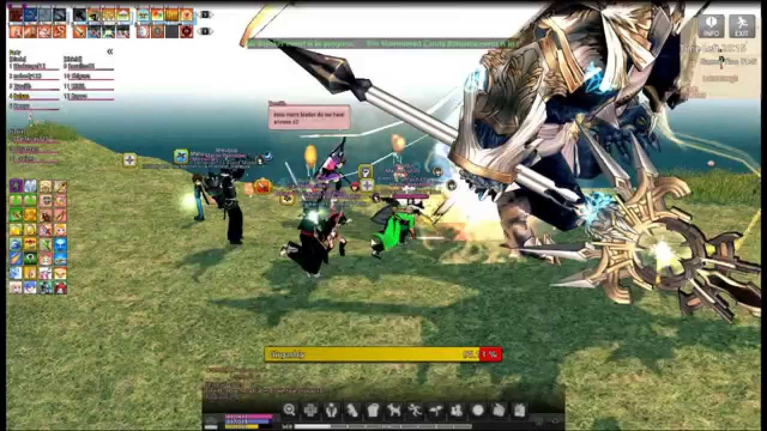
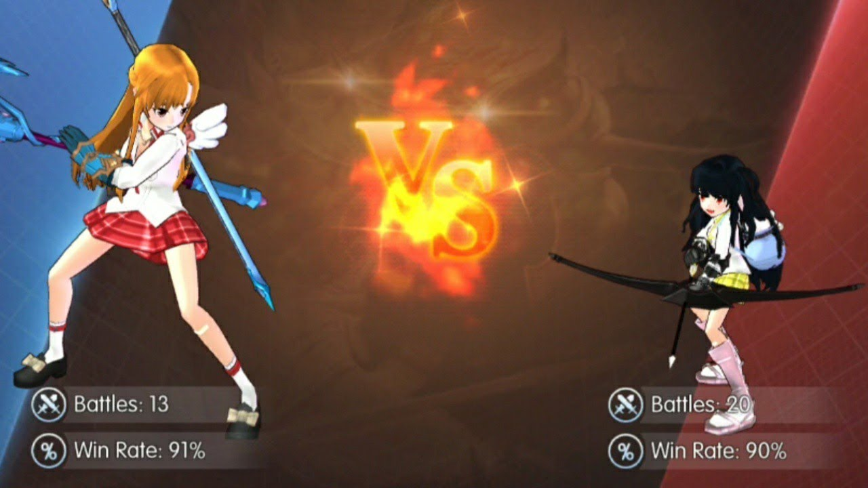
Part 1
What is MMORPG? - Multiplayer
Interact with others
Chatting
Cooperating (Raid)
Fighting (PVP)
Notes:
Image from: Doing PVP in Mabinogi: Fantasy Life - YouTube

Slide 12
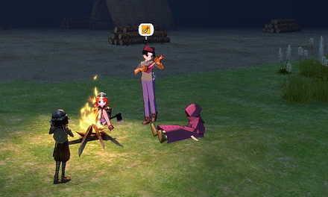
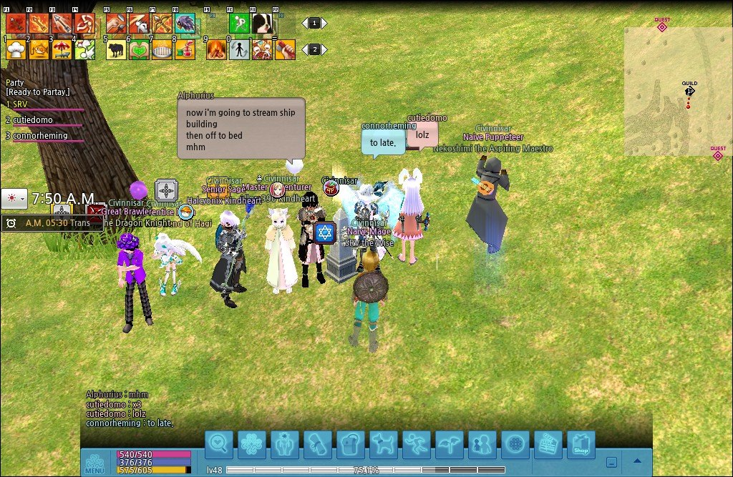
Part 1
What is MMORPG? - Multiplayer
Social relationship
Guild
Family / Marriage system
Notes:
Image from:
Drama Mamas: How to find a World of Warcraft guild | Engadget

Slide 13
2
History of MMORPG

Slide 14

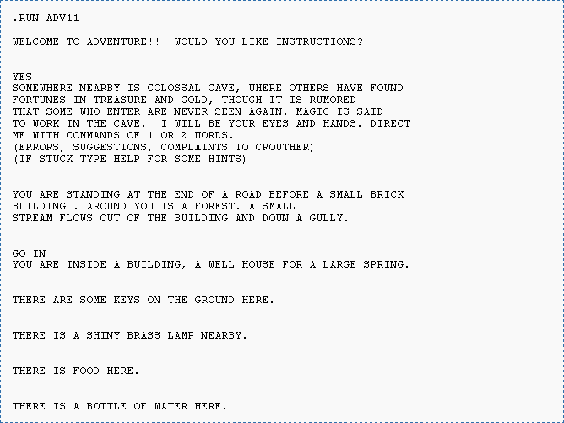
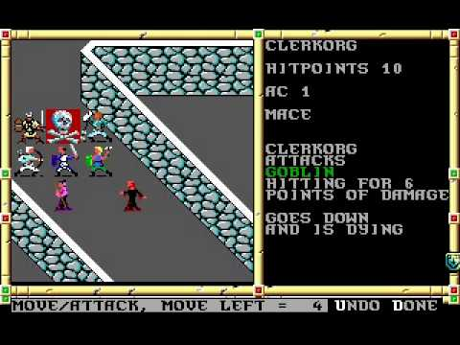
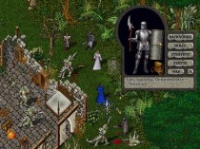
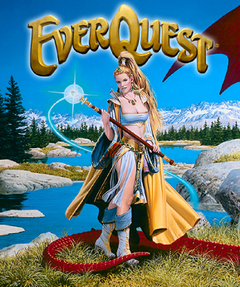
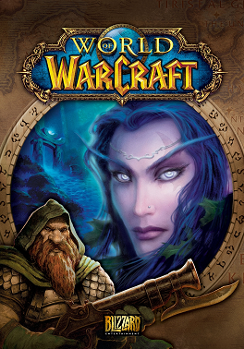
Part 2
History of MMORPG
?
1962
1975
1991
1997
1999
2004
Future
Space war
Mud Game
Neverwinter Nights
Ultima Online
Everquest
World of Warcraft
What will it be like?
The first online game
Establish basic concepts
Use graphics
Introduce PVP, Guild
Use word MMORPG
Great degree of freedom
3D Graphics
Raid & PVE
The most famous
Notes:
https://massivelyop.com/2021/08/07/the-game-archaeologist-defining-the-eras-of-mmorpg-history/

Slide 15
Part 2
History of MMORPG
이미지
이미지
이미지
>
>
Earlier Stage
1st Generation
2nd Generation
Notes:
https://en.wikipedia.org/wiki/History_of_massively_multiplayer_online_games#Current-generation_MMORPGs
https://massivelyop.com/2021/08/07/the-game-archaeologist-defining-the-eras-of-mmorpg-history/
https://www.gamereactor.eu/a-quick-history-of-the-mmorpg/

Slide 16
Part 2
History of MMORPG: Earlier Stage
Using PLATO machine
Spacewar, Moria, Avatar
The first online game
Support only two~ few players
No storylines & characters
이미지
Earlier Stage
Notes:
https://massivelyop.com/2021/08/07/the-game-archaeologist-defining-the-eras-of-mmorpg-history/

Slide 17
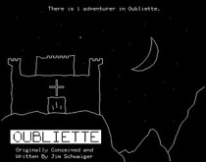
Part 2
History of MMORPG: Earlier Stage
MUD: Multi User Dungeon
Island of Kesmai, Arsdath
Text based
Have adventure with other players
Establish basic concept of MMORPG
이미지
Earlier Stage
Notes:
https://massivelyop.com/2021/08/07/the-game-archaeologist-defining-the-eras-of-mmorpg-history/

Slide 18
Part 2
History of MMORPG: 1st Generation
1st Generation -1
Neverwinter nights, Meridian 59
Provide graphics
Introduce PVP & Guild system
Notes:
https://www.youtube.com/watch?v=7Zciqdlcb0Y

Slide 19
Part 2
History of MMORPG: 1st Generation
1st Generation -2
Ultima Online, Lineage
Advanced graphics
High degree of Freedom
Popularize word MMORPG
Notes:
worldhistoryproject.org

Slide 20
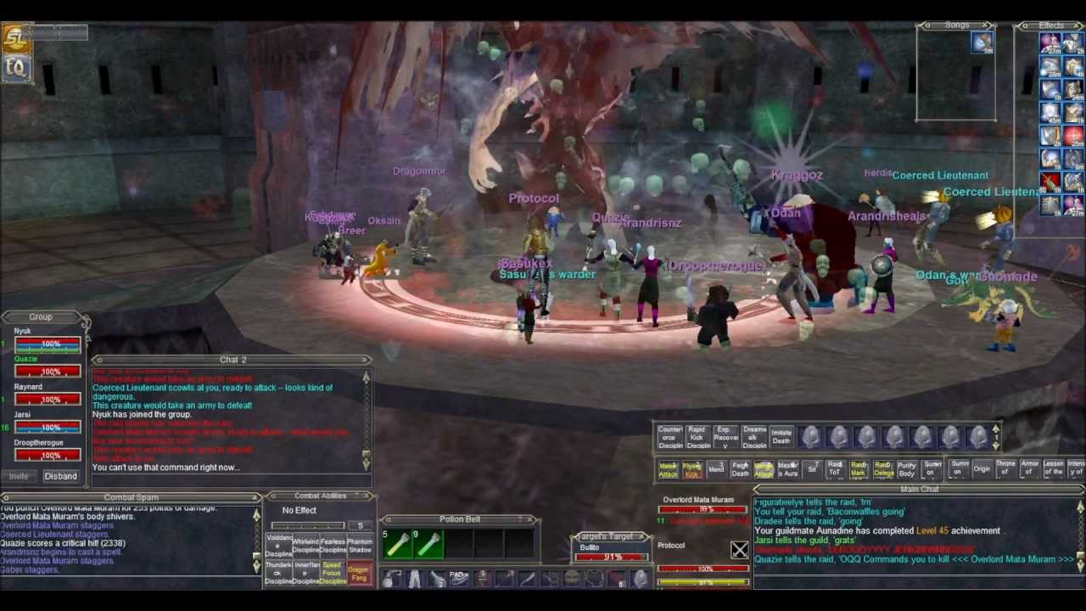
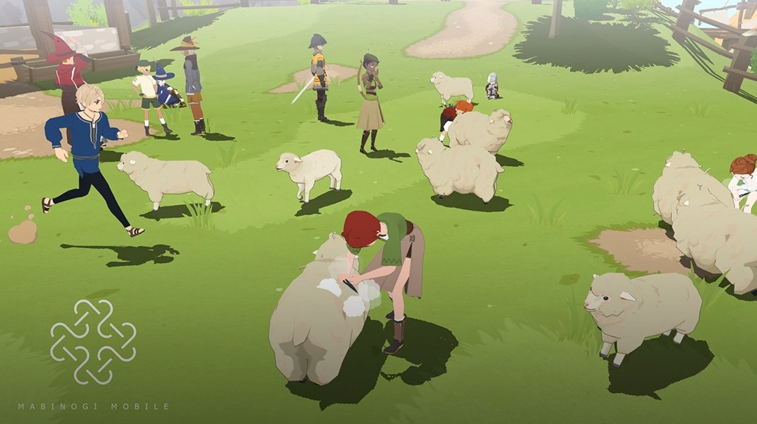
Part 2
History of MMORPG: 2nd Generation
2nd Generation -1
Everquest, Maplestory, Mabinogi
Extend contents
Introduce cooperation
PvE, Raid, PvP
Notes:
https://gurugamer.com/mobile-games/mabinogi-mobile-great-first-impression-from-the-demo-545

Slide 21

Part 2
History of MMORPG: 2nd Generation
2nd Generation -2
Word of Warcraft (WoW)
Notes:
https://www.seagm.com/world-of-warcraft-wow-us-server

Slide 22
3
State of the Art

Slide 23
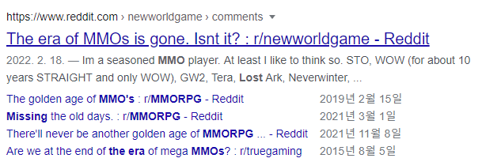
Part 3
State of the Art: Limitation
High development cost
Limited Users
Too much time required
No inovation
Notes:
https://www.reddit.com/r/newworldgame/comments/svl2aj/the_era_of_mmos_is_gone_isnt_it/

Slide 24
Part 3
State of the Art: Toward New Generation
“The Theme Park MMO Is Dead,
Enter the Sandbox”
Ryan Dancey
Notes:
https://www.escapistmagazine.com/the-theme-park-mmo-is-dead-enter-the-sandbox/

Slide 25

Part 3
State of the Art: Toward New Generation
Notes:
https://www.youtube.com/watch?v=fPqpv__NiD0&feature=emb_imp_woyt

Slide 26
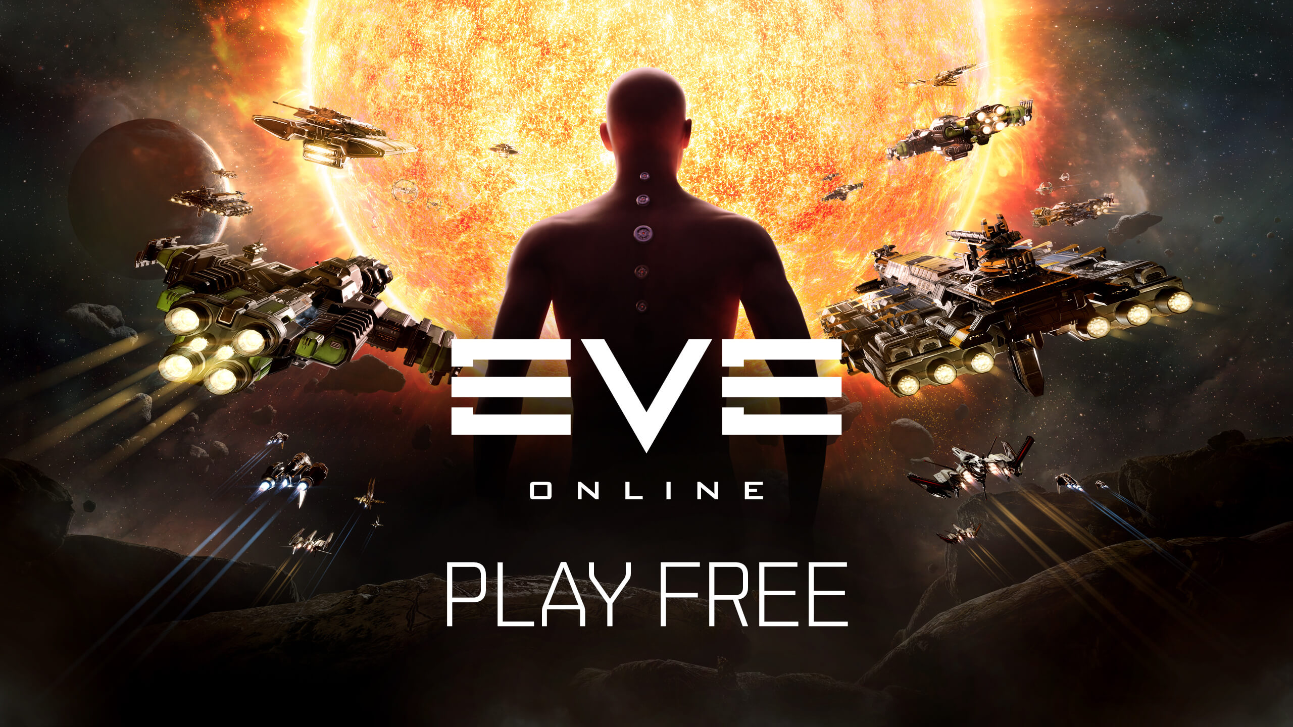
Part 3
State of the Art: Toward New Generation
Eve Online
High degree of freedom
Leave players to play as they want
Payers can influence the world
Notes:
https://en.wikipedia.org/wiki/Massively_multiplayer_online_role-playing_game

Slide 27

Part 3
State of the Art: Combined with AI / AR & VR
Combination with AR
Pokemon go
Notes:
출시 6년차 '포켓몬 고', 글로벌 누적 매출 60억달러 돌파 (g-enews.com)

Slide 28
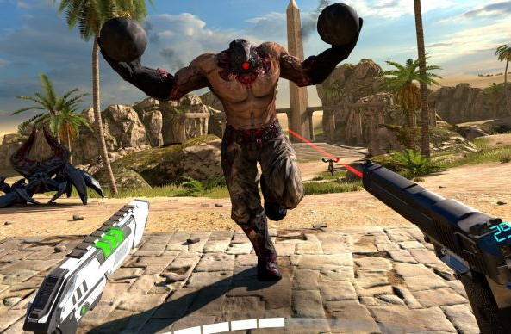
Part 3
State of the Art: Combined with AI / AR & VR
Combination with VR
The Last Hope
Notes:
The 20 best VR games for Oculus, Index and Vive | Rock Paper Shotgun

Slide 29

Part 3
State of the Art: Combined with AI / AR & VR
Combination with AI & VR
Completely new world
Notes:
https://en.wikipedia.org/wiki/Massively_multiplayer_online_role-playing_game

Slide 30
References
Template: Yu. Saebyeol
“Massively multiplayer online role-playing game”, Wikipedia, last modified Oct 26.2022, accessed Nov 14.2021, https://en.wikipedia.org/wiki/Massively_multiplayer_online_role-playing_game
“History of massively multiplayer online games”, Wikipedia, last modified Oct 26.2022 , accessed Nov 14.2021, https://en.wikipedia.org/wiki/History_of_massively_multiplayer_online_games#Current-generation_MMORPGs
“The Game Archaeologist: Defining the eras of MMORPG history”, Massively Ouerpowered, Justin Olivetti, Aug 7.2021, https://massivelyop.com/2021/08/07/the-game-archaeologist-defining-the-eras-of-mmorpg-history/
“The Theme Park MMO is dead, Enter the sandbox”, the Escapist, Greg Tito Legacy, Dec 14.2012, https://www.escapistmagazine.com/the-theme-park-mmo-is-dead-enter-the-sandbox/
“MUD ”, Wikipedia, last modified Oct 26.2022, accessed Sep 28.2021, https://en.wikipedia.org/wiki/MUD
“MMORPG”, Naver blog, last modified July 26.2022, accessed Sep 28.2021, https://m.blog.naver.com/sebangfiber/221051831062
Notes:
https://en.wikipedia.org/wiki/Massively_multiplayer_online_role-playing_game

Slide 31
Thank you

