Slide 1

Review
Complexity classes: $P, NP, PSPACE, EXP$
Example problems: 3-COLORING, EULERIAN, HAMILTONIAN, EC, VC, CLIQUE, IS, ILP
Nondeterministic WHILE+ program: "guess $x_{i}$"

Slide 2

Boolean formula – Syntax
$F$ is...
0 or 1
$x_{i}$
$¬F$
$\left(F∧F\right)$
$\left(F∨F\right)$
A formula is...
FALSE or TRUE
a variable
negation (NOT) of another formula
conjunction (AND) of two formulas
disjunction (OR) of two formulas
Length of formula: number of times to apply these

Slide 3
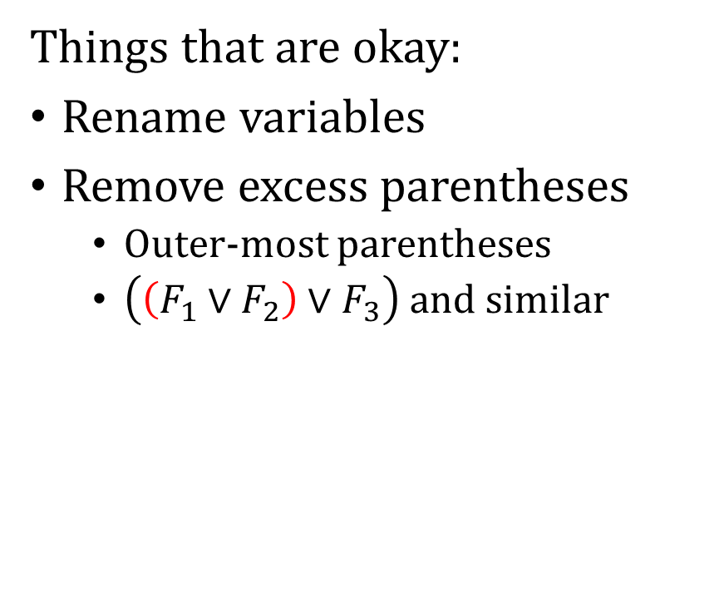

Boolean formula – Syntax
Formula or not?
10
$¬\left(x_{1}∧¬1\right)$
$\left(\left(x_{1}∨x_{2}\right)∨¬x_{1}\right)$
$a∨b∨¬a$
Things that are okay:
Rename variables
Remove excess parentheses
Outer-most parentheses
$\left(\left(F_{1}∨F_{2}\right)∨F_{3}\right)$ and similar

Slide 4
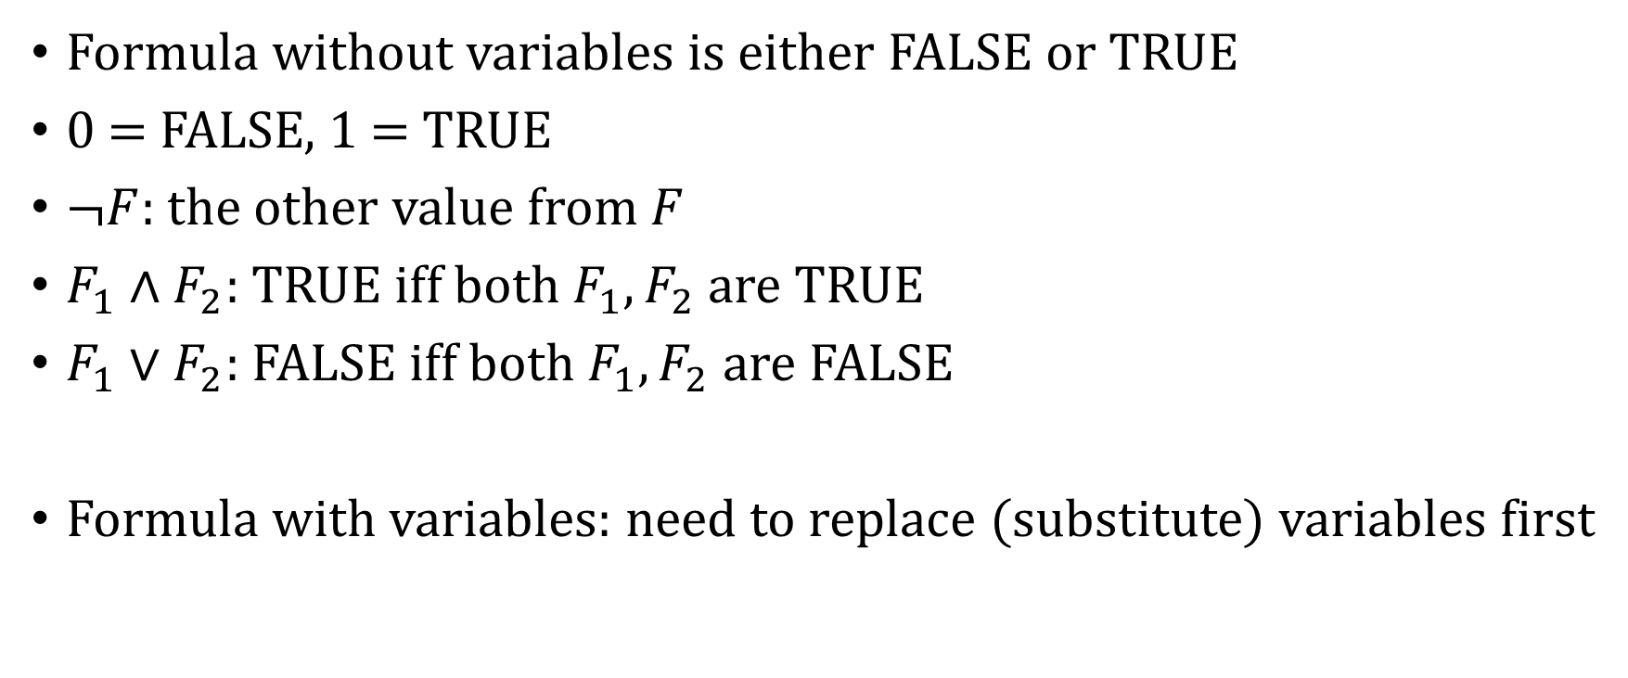
Boolean formula – Semantics
Formula without variables is either FALSE or TRUE
0 = FALSE, 1 = TRUE
$¬F$: the other value from $F$
$F_{1}∧F_{2}$: TRUE iff both $F_{1},F_{2}$ are TRUE
$F_{1}∨F_{2}$: FALSE iff both $F_{1},F_{2}$ are FALSE
Formula with variables: need to replace (substitute) variables first

Slide 5

Boolean formula – Examples
$\left(1∧¬0\right)∨\left(1∧¬1\right)$
$\left(0∧¬0\right)∨\left(1∧¬1\right)$
$\left(1∧¬0\right)∨\left(0∧¬0\right)$
$\left(a∧¬0\right)∨\left(1∧¬1\right)$
$\left(1∧¬0\right)∨\left(b∧¬b\right)$
$\left(1∨0\right)∧0$
$1∨\left(0∧0\right)$

Slide 6
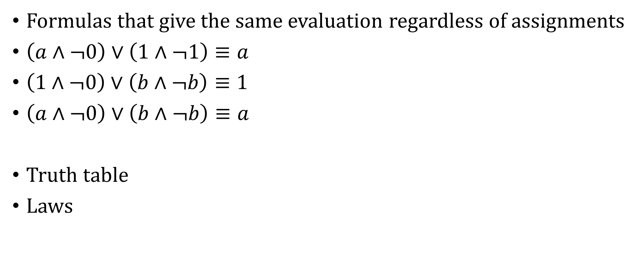
Boolean formula – Equivalent formulas
Formulas that give the same evaluation regardless of assignments
$\left(a∧¬0\right)∨\left(1∧¬1\right)≡a$
$\left(1∧¬0\right)∨\left(b∧¬b\right)≡1$
$\left(a∧¬0\right)∨\left(b∧¬b\right)≡a$
Truth table
Laws

Slide 7
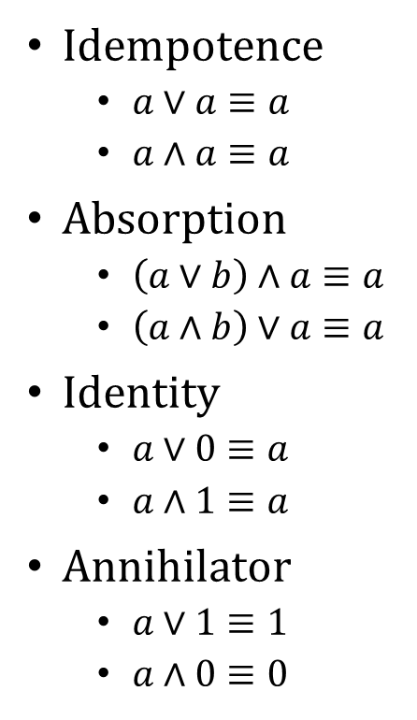
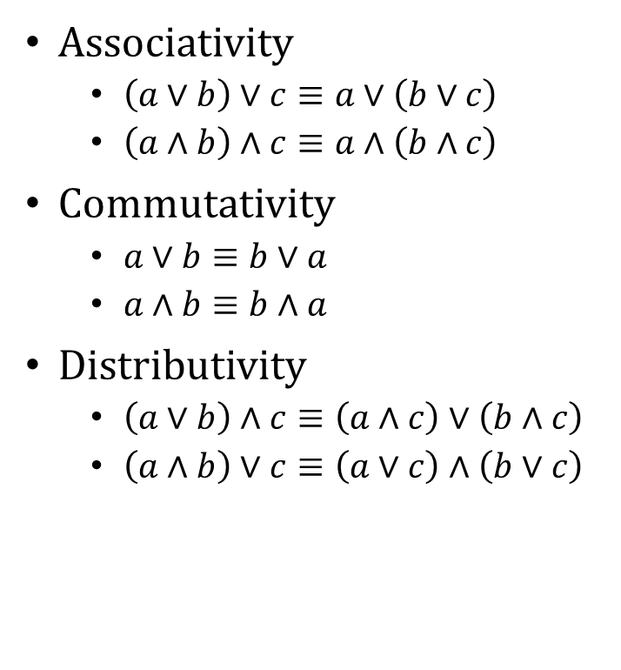
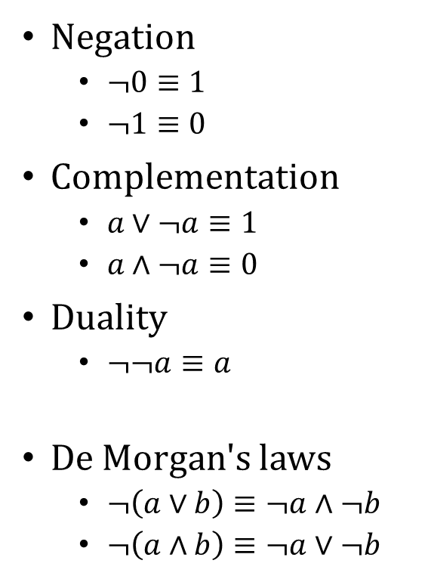
Boolean formula – Laws
Associativity
$\left(a∨b\right)∨c≡a∨\left(b∨c\right)$
$\left(a∧b\right)∧c≡a∧\left(b∧c\right)$
Commutativity
$a∨b≡b∨a$
$a∧b≡b∧a$
Distributivity
$\left(a∨b\right)∧c≡\left(a∧c\right)∨\left(b∧c\right)$
$\left(a∧b\right)∨c≡\left(a∨c\right)∧\left(b∨c\right)$
Idempotence
$a∨a≡a$
$a∧a≡a$
Absorption
$\left(a∨b\right)∧a≡a$
$\left(a∧b\right)∨a≡a$
Identity
$a∨0≡a$
$a∧1≡a$
Annihilator
$a∨1≡1$
$a∧0≡0$
Negation
$¬0≡1$
$¬1≡0$
Complementation
$a∨¬a≡1$
$a∧¬a≡0$
Duality
$¬¬a≡a$
De Morgan's laws
$¬\left(a∨b\right)≡¬a∧¬b$
$¬\left(a∧b\right)≡¬a∨¬b$

Slide 8
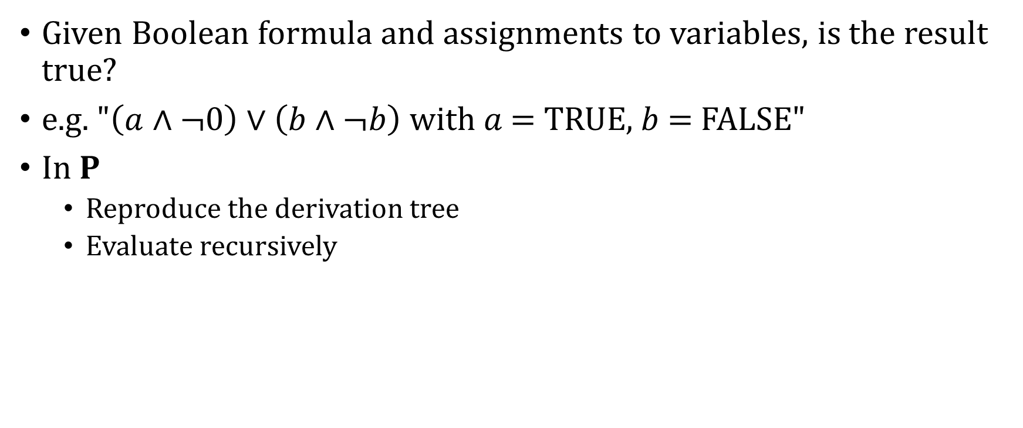
EVAL
Given Boolean formula and assignments to variables, is the result true?
e.g. "$\left(a∧¬0\right)∨\left(b∧¬b\right)$ with $a$ = TRUE, $b$ = FALSE"
In $P$
Reproduce the derivation tree
Evaluate recursively

Slide 9
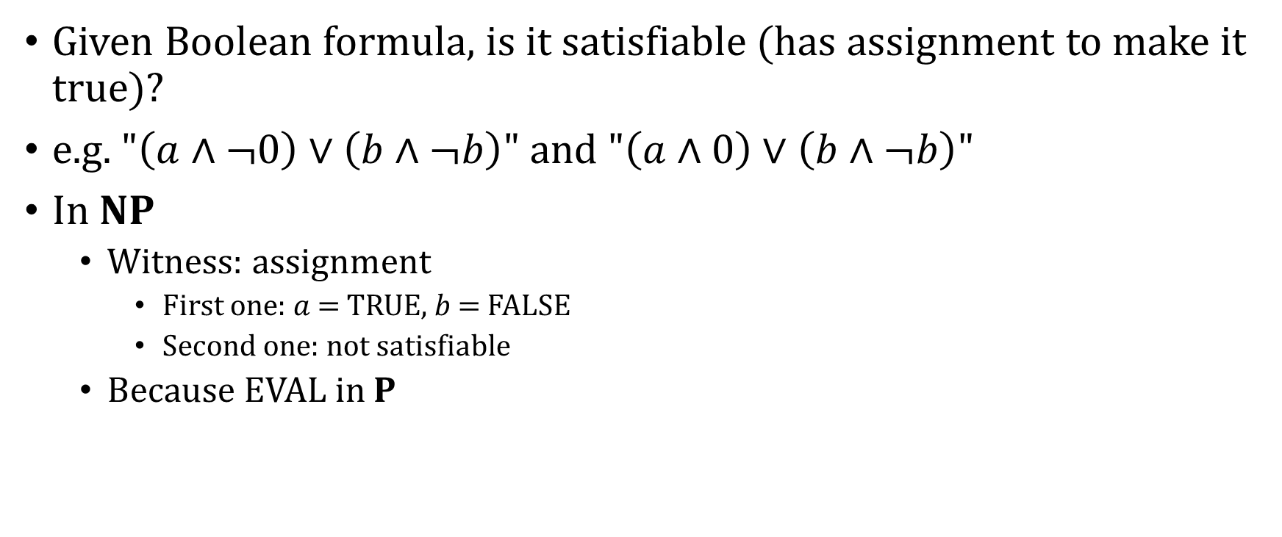
SAT
Given Boolean formula, is it satisfiable (has assignment to make it true)?
e.g. "$\left(a∧¬0\right)∨\left(b∧¬b\right)$" and "$\left(a∧0\right)∨\left(b∧¬b\right)$"
In $NP$
Witness: assignment
First one: $a$ = TRUE, $b$ = FALSE
Second one: not satisfiable
Because EVAL in $P$

Slide 10
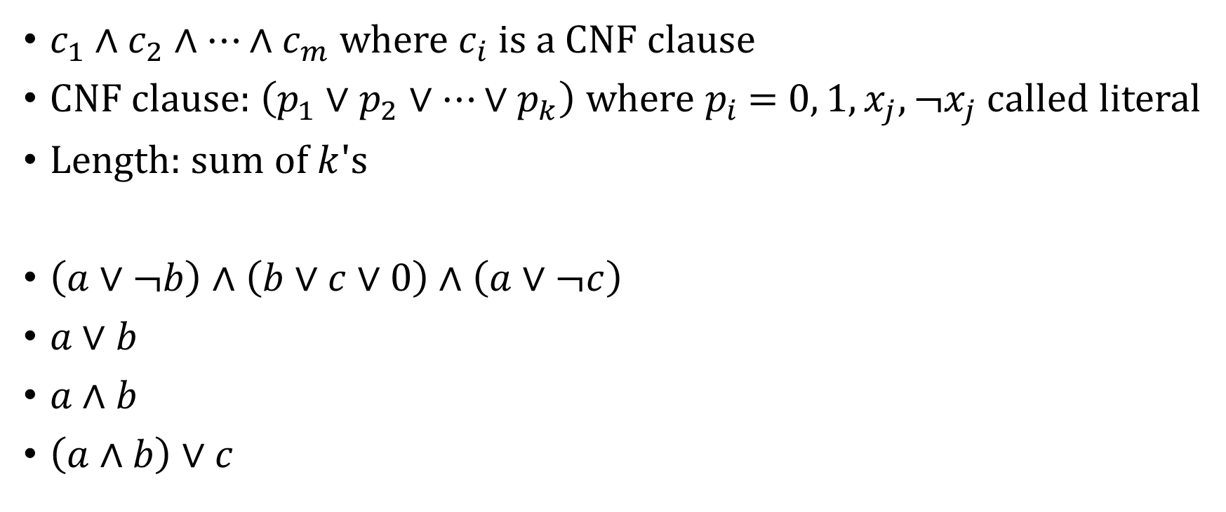
Conjunctive normal form
$c_{1}∧c_{2}∧…∧c_{m}$ where $c_{i}$ is a CNF clause
CNF clause: $\left(p_{1}∨p_{2}∨…∨p_{k}\right)$ where $p_{i}$ = $0, 1,x_{j},¬x_{j}$ called literal
Length: sum of $k$'s
$\left(a∨¬b\right)∧\left(b∨c∨0\right)∧\left(a∨¬c\right)$
$a∨b$
$a∧b$
$\left(a∧b\right)∨c$

Slide 11
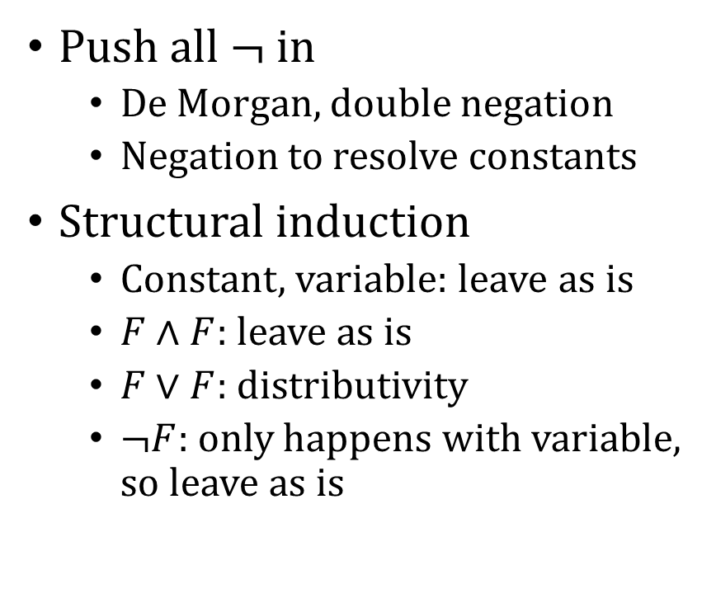
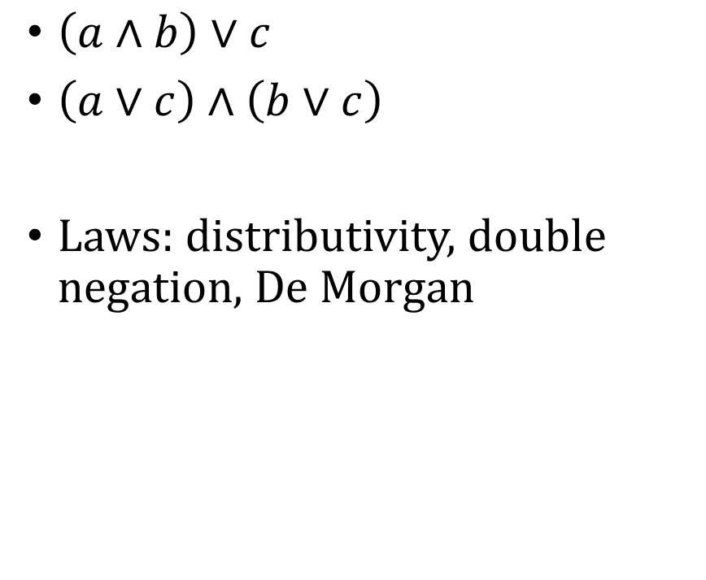
Converting to equivalent CNF
$\left(a∧b\right)∨c$
$\left(a∨c\right)∧\left(b∨c\right)$
Laws: distributivity, double negation, De Morgan
Push all $¬$ in
De Morgan, double negation
Negation to resolve constants
Structural induction
Constant, variable: leave as is
$F∧F$: leave as is
$F∨F$: distributivity
$¬F$: only happens with variable, so leave as is

Slide 12

Disjunctive normal form
$c_{1}∨c_{2}∨…∨c_{m}$ where $c_{i}$ is a DNF clause
DNF clause: $\left(p_{1}∧p_{2}∧…∧p_{k}\right)$ where $p_{i}$ = $0, 1,x_{j},¬x_{j}$
$\left(a∧¬b\right)∨\left(b∧c∧0\right)∨\left(a∧¬c\right)$

Slide 13
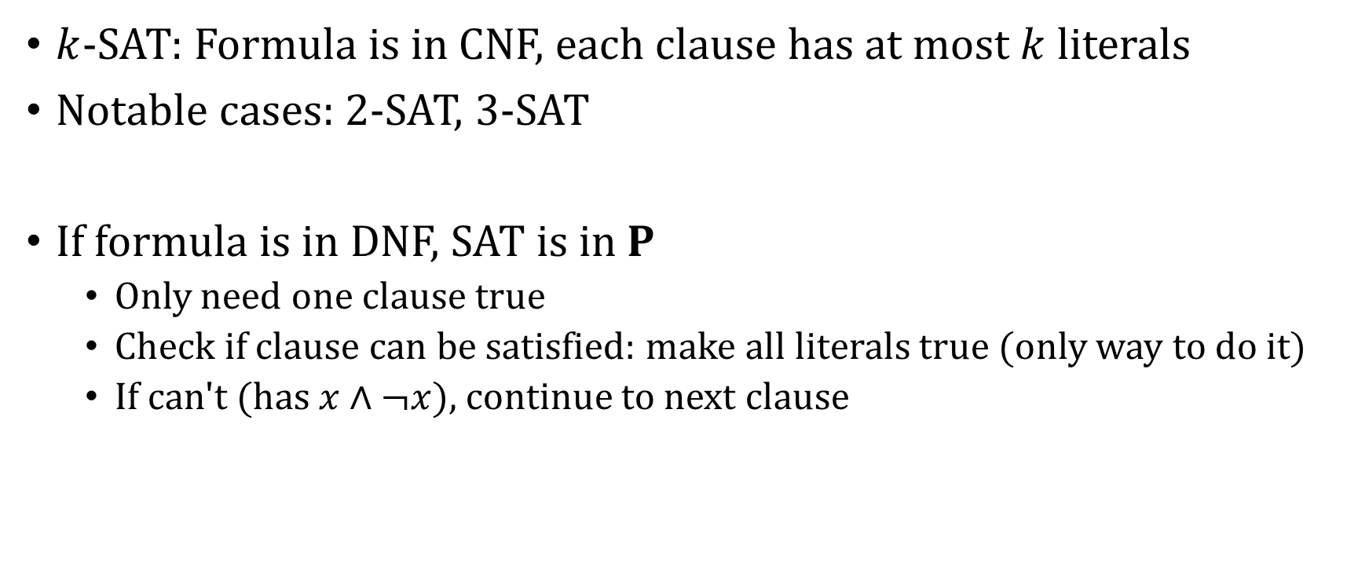
SAT, revisited
$k$-SAT: Formula is in CNF, each clause has at most $k$ literals
Notable cases: 2-SAT, 3-SAT
If formula is in DNF, SAT is in $P$
Only need one clause true
Check if clause can be satisfied: make all literals true (only way to do it)
If can't (has $x∧¬x$), continue to next clause

Slide 14
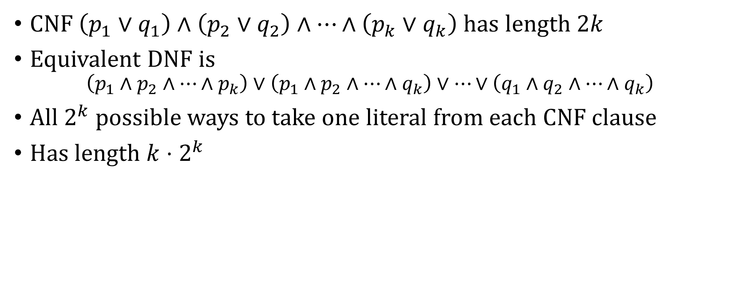
Why don't we just convert to DNF?
CNF $\left(p_{1}∨q_{1}\right)∧\left(p_{2}∨q_{2}\right)∧…∧\left(p_{k}∨q_{k}\right)$ has length $2k$
Equivalent DNF is
$$\left(p_{1}∧p_{2}∧…∧p_{k}\right)∨\left(p_{1}∧p_{2}∧…∧q_{k}\right)∨…∨\left(q_{1}∧q_{2}∧…∧q_{k}\right)$$
All $2^{k}$ possible ways to take one literal from each CNF clause
Has length $k⋅2^{k}$

Slide 15
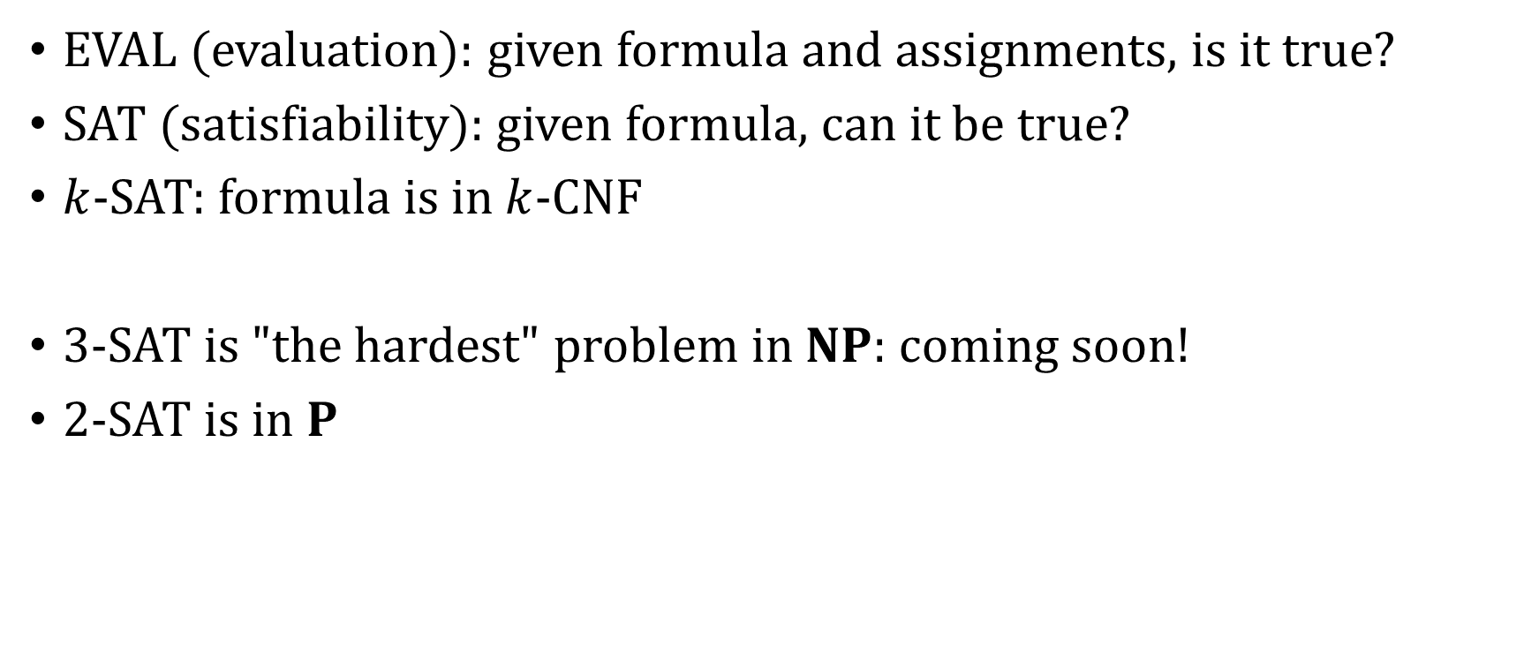
Recap
EVAL (evaluation): given formula and assignments, is it true?
SAT (satisfiability): given formula, can it be true?
$k$-SAT: formula is in $k$-CNF
3-SAT is "the hardest" problem in $NP$: coming soon!
2-SAT is in $P$

Slide 16
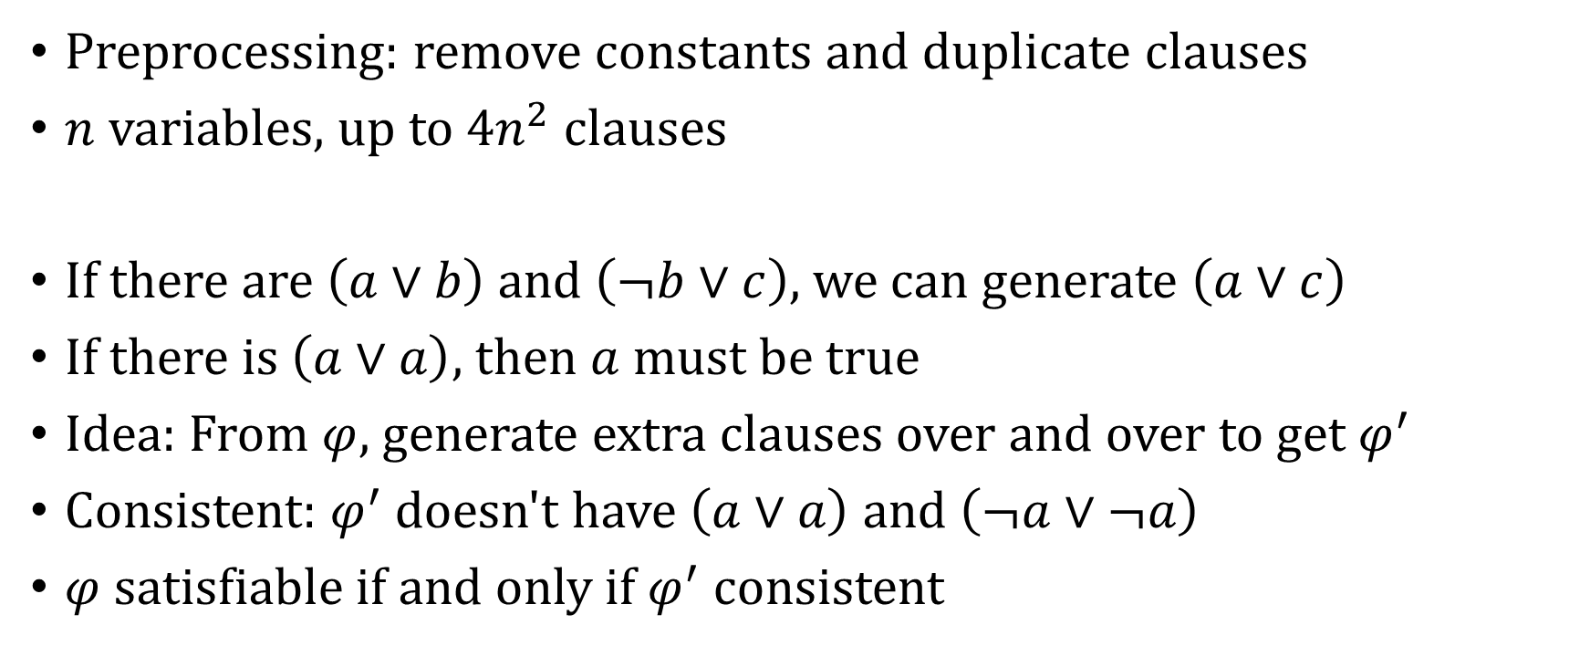
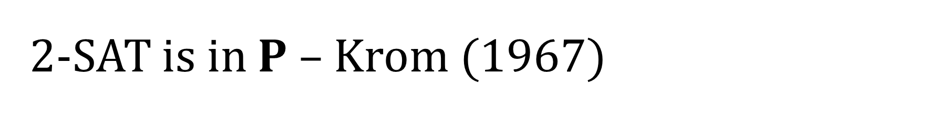
2-SAT is in $P$ – Krom (1967)
Preprocessing: remove constants and duplicate clauses
$n$ variables, up to $4n^{2}$ clauses
If there are $\left(a∨b\right)$ and $\left(¬b∨c\right)$, we can generate $\left(a∨c\right)$
If there is $\left(a∨a\right)$, then $a$ must be true
Idea: From $φ$, generate extra clauses over and over to get $φ^{′}$
Consistent: $φ^{′}$ doesn't have $\left(a∨a\right)$ and $\left(¬a∨¬a\right)$
$φ$ satisfiable if and only if $φ^{′}$ consistent

Slide 17
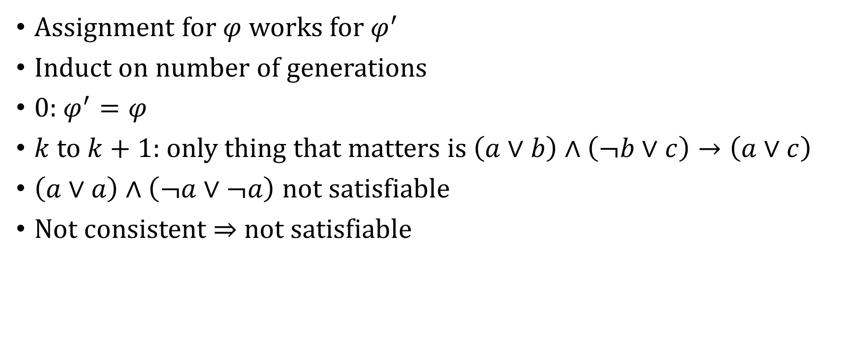
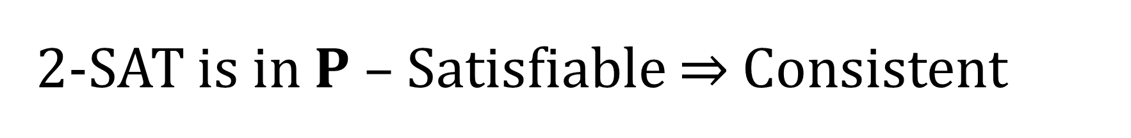
2-SAT is in $P$ – Satisfiable ⇒ Consistent
Assignment for $φ$ works for $φ^{′}$
Induct on number of generations
0: $φ^{′}=φ$
$k$ to $k+1$: only thing that matters is $\left(a∨b\right)∧\left(¬b∨c\right)→\left(a∨c\right)$
$\left(a∨a\right)∧\left(¬a∨¬a\right)$ not satisfiable
Not consistent ⇒ not satisfiable

Slide 18

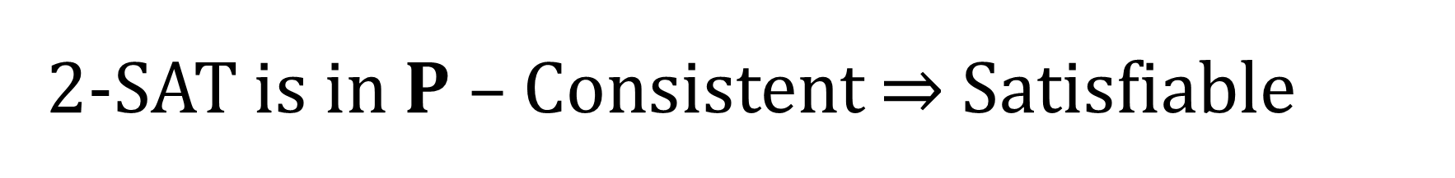
2-SAT is in $P$ – Consistent ⇒ Satisfiable
Free variable $a$: no $\left(a∨a\right)$ or $\left(¬a∨¬a\right)$ in $φ^{′}$
Induct on number of free variables
0: all variables set; $\left(a∨a\right)$ means $a$ true, $\left(¬a∨¬a\right)$ means $a$ false
$k$ to $k+1$: suppose $a$ free, we claim adding $\left(a∨a\right)$ is consistent

Slide 19
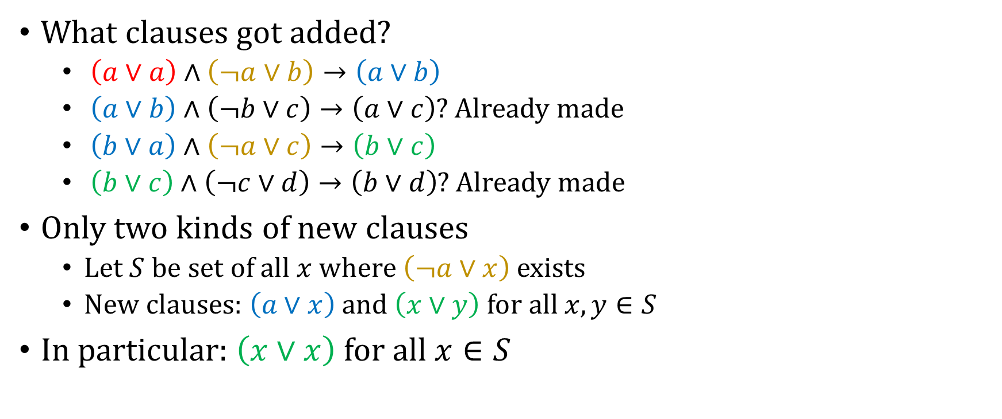
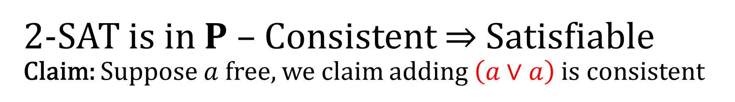
2-SAT is in $P$ – Consistent ⇒ Satisfiable Claim: Suppose $a$ free, we claim adding $\left(a∨a\right)$ is consistent
What clauses got added?
$\left(a∨a\right)∧\left(¬a∨b\right)→\left(a∨b\right)$
$\left(a∨b\right)∧\left(¬b∨c\right)→\left(a∨c\right)$? Already made
$\left(b∨a\right)∧\left(¬a∨c\right)→\left(b∨c\right)$
$\left(b∨c\right)∧\left(¬c∨d\right)→\left(b∨d\right)$? Already made
Only two kinds of new clauses
Let $S$ be set of all $x$ where $\left(¬a∨x\right)$ exists
New clauses: $\left(a∨x\right)$ and $\left(x∨y\right)$ for all $x,y∈S$
In particular: $\left(x∨x\right)$ for all $x∈S$

Slide 20
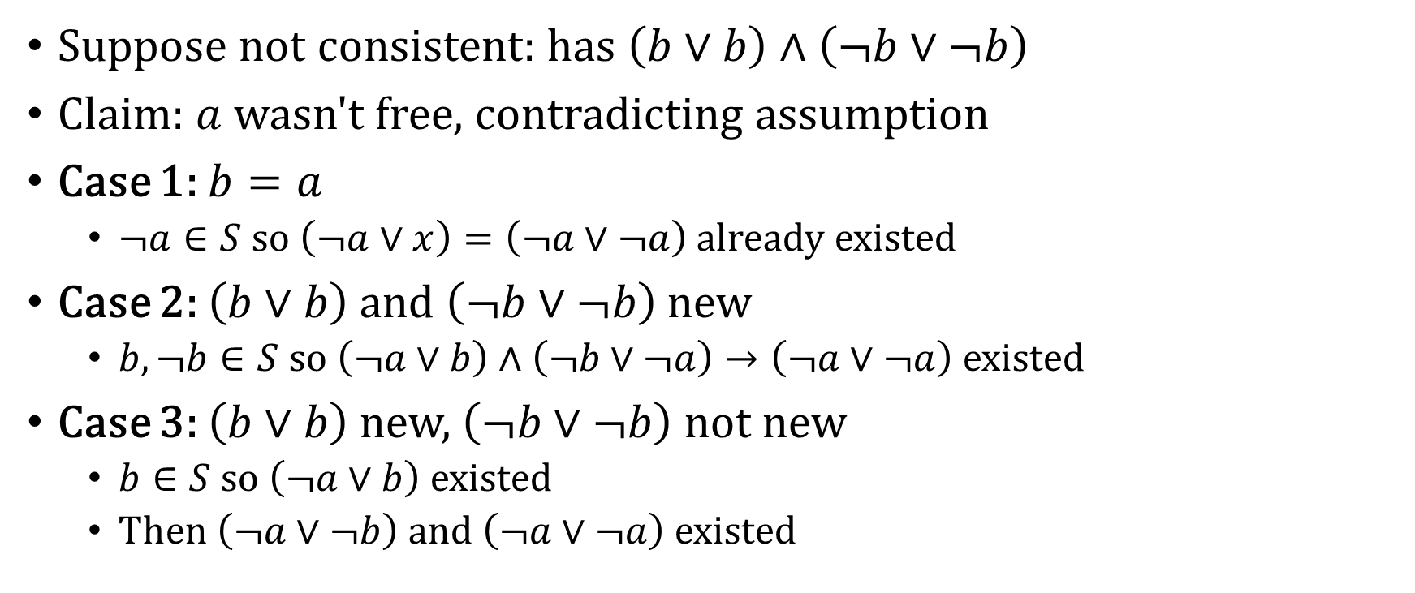
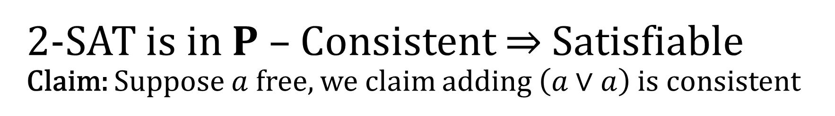
2-SAT is in $P$ – Consistent ⇒ Satisfiable Claim: Suppose $a$ free, we claim adding $\left(a∨a\right)$ is consistent
Suppose not consistent: has $\left(b∨b\right)∧\left(¬b∨¬b\right)$
Claim: $a$ wasn't free, contradicting assumption
Case 1: $b=a$
$¬a∈S$ so $\left(¬a∨x\right)=\left(¬a∨¬a\right)$ already existed
Case 2: $\left(b∨b\right)$ and $\left(¬b∨¬b\right)$ new
$b,¬b∈S$ so $\left(¬a∨b\right)∧\left(¬b∨¬a\right)→\left(¬a∨¬a\right)$ existed
Case 3: $\left(b∨b\right)$ new, $\left(¬b∨¬b\right)$ not new
$b∈S$ so $\left(¬a∨b\right)$ existed
Then $\left(¬a∨¬b\right)$ and $\left(¬a∨¬a\right)$ existed

Slide 21
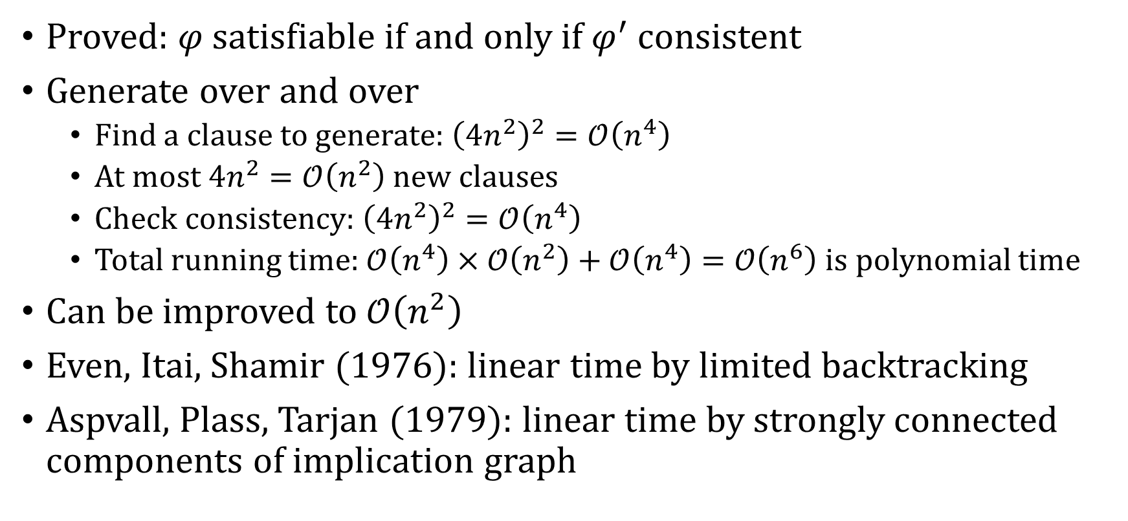
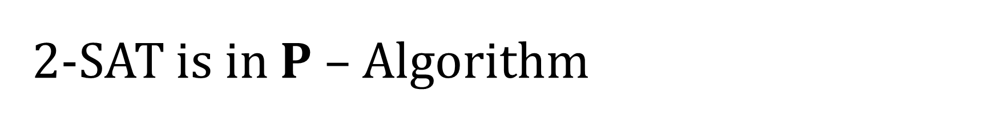
2-SAT is in $P$ – Algorithm
Proved: $φ$ satisfiable if and only if $φ^{′}$ consistent
Generate over and over
Find a clause to generate: ${\left(4n^{2}\right)}^{2}=𝒪\left(n^{4}\right)$
At most $4n^{2}=𝒪\left(n^{2}\right)$ new clauses
Check consistency: ${\left(4n^{2}\right)}^{2}=𝒪\left(n^{4}\right)$
Total running time: $𝒪\left(n^{4}\right)×𝒪\left(n^{2}\right)+𝒪\left(n^{4}\right)=𝒪\left(n^{6}\right)$ is polynomial time
Can be improved to $𝒪\left(n^{2}\right)$
Even, Itai, Shamir (1976): linear time by limited backtracking
Aspvall, Plass, Tarjan (1979): linear time by strongly connected components of implication graph

Slide 22
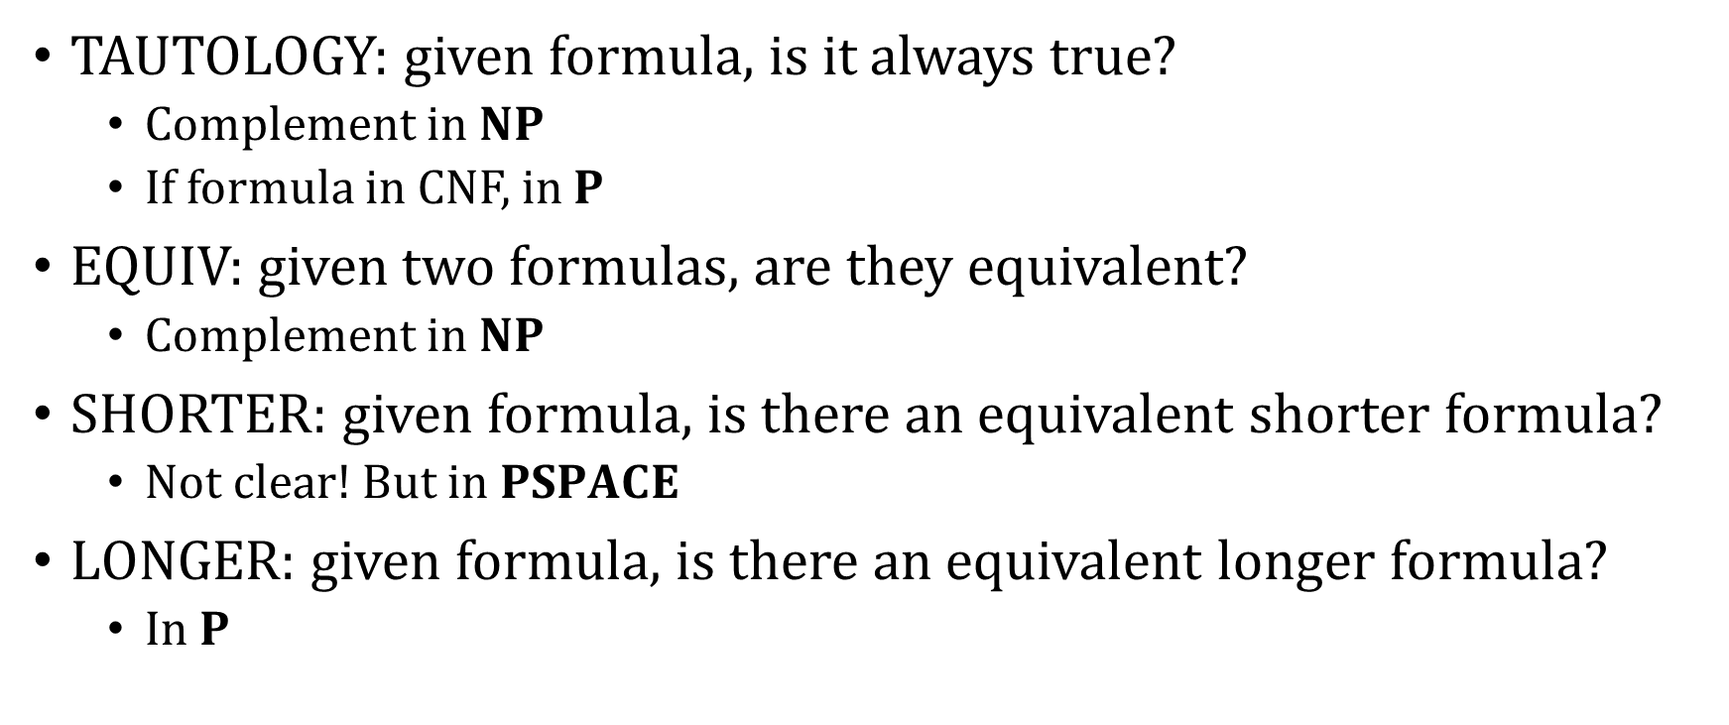
More decision problems
TAUTOLOGY: given formula, is it always true?
Complement in $NP$
If formula in CNF, in $P$
EQUIV: given two formulas, are they equivalent?
Complement in $NP$
SHORTER: given formula, is there an equivalent shorter formula?
Not clear! But in $PSPACE$
LONGER: given formula, is there an equivalent longer formula?
In $P$

Slide 23
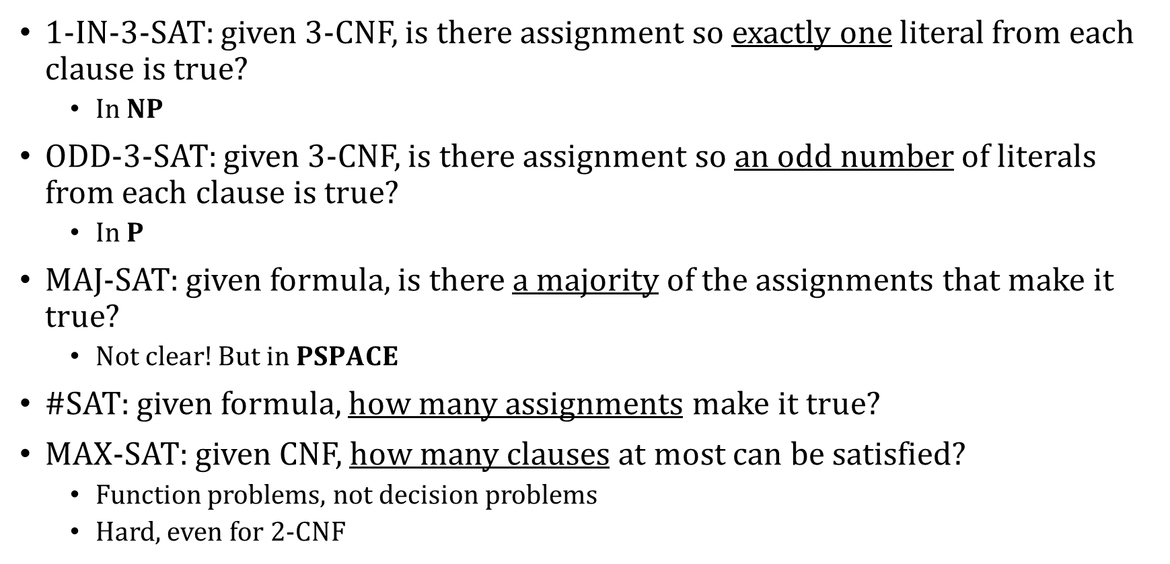
More satisfiability problems
1-IN-3-SAT: given 3-CNF, is there assignment so exactly one literal from each clause is true?
In $NP$
ODD-3-SAT: given 3-CNF, is there assignment so an odd number of literals from each clause is true?
In $P$
MAJ-SAT: given formula, is there a majority of the assignments that make it true?
Not clear! But in $PSPACE$
#SAT: given formula, how many assignments make it true?
MAX-SAT: given CNF, how many clauses at most can be satisfied?
Function problems, not decision problems
Hard, even for 2-CNF

Slide 24
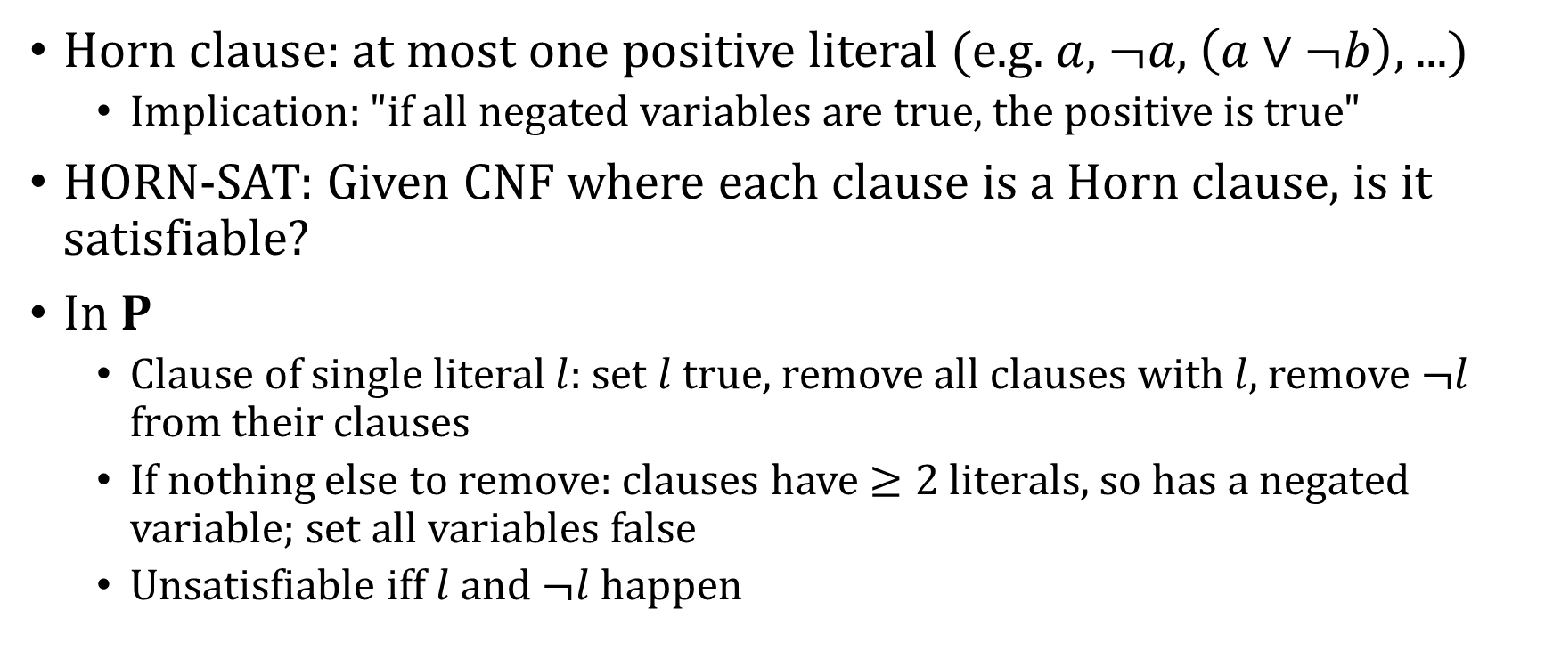
HORN-SAT
Horn clause: at most one positive literal (e.g. $a$, $¬a$, $\left(a∨¬b\right)$, ...)
Implication: "if all negated variables are true, the positive is true"
HORN-SAT: Given CNF where each clause is a Horn clause, is it satisfiable?
In $P$
Clause of single literal $l$: set $l$ true, remove all clauses with $l$, remove $¬l$ from their clauses
If nothing else to remove: clauses have $≥2$ literals, so has a negated variable; set all variables false
Unsatisfiable iff $l$ and $¬l$ happen

