Slide 1
PEDAGOGY OF INTELLIGENCE
#20210300 Jihoon Seo

Slide 2
CONTENTS
01.
02.
Measuring Intelligence
Target of Pedagogy
03.
04.
Teaching vs Training
Ethics of Intelligence
How can we quantify intelligence?
Level of intelligence to be taught
Compare teaching and training
What Makes Ethics?

Slide 3
01.
Measuring Intelligence

Slide 4
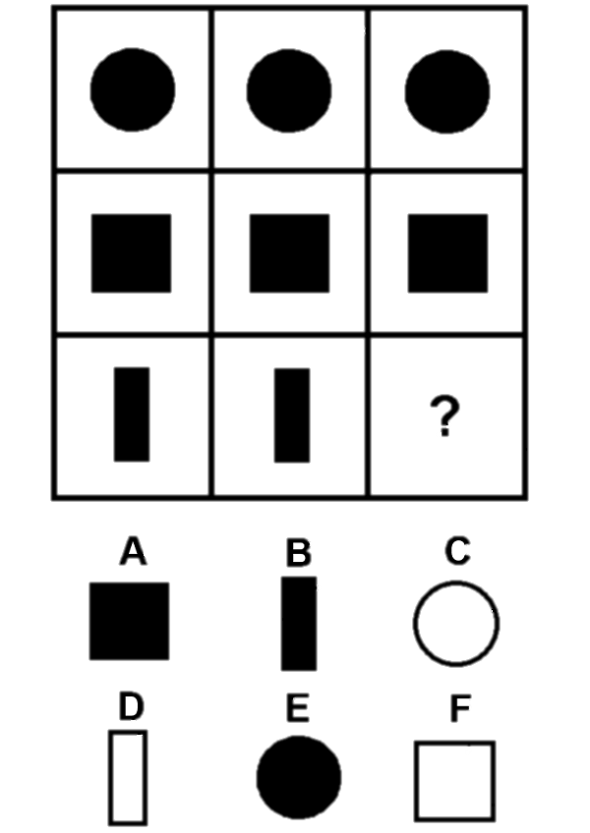
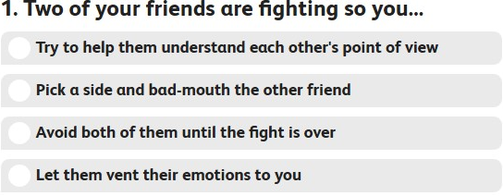
Quantify Test
IQ
(intelligence quotient)
EQ(emotional intelligence quotient)
Notes:
There’s lots of quantify test for intelligence such as IQ or EQ. The most famous test is IQ test. The aim of the test is to quantify a ‘portion’ of intelligence with a standard score. Many people think that the iq test is absolute, but it tests only a fraction of our intelligence. Many people think absolutely of the iq test, but it tests only a fraction of our intelligence.
One of the things designed to cover these iq tests is the eq test. The eq test verifies emotional identification and control, motivation, and interpersonal skills.

Slide 5
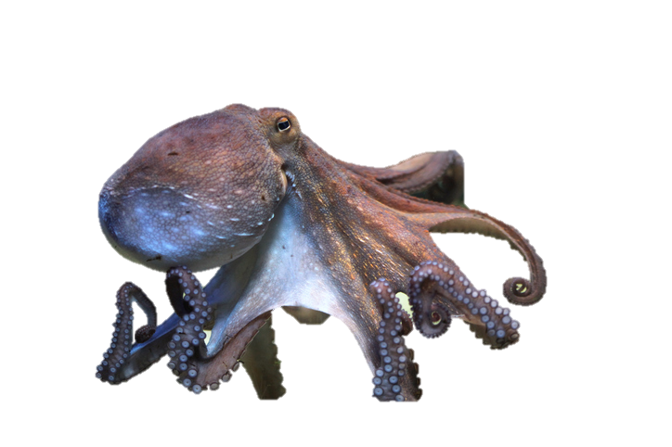

Quantify Test
IQ
(intelligence qutient)
Notes:
Animals are often compared to these standards, too. For example, octopuses and killer whales are tested to have iqs comparable to humans. The score was about 80. Well, That doesn't mean they can communicate with us. High Test score does not mean they have intact intelligence. This problem will be addressed in Chapter 2.

Slide 6
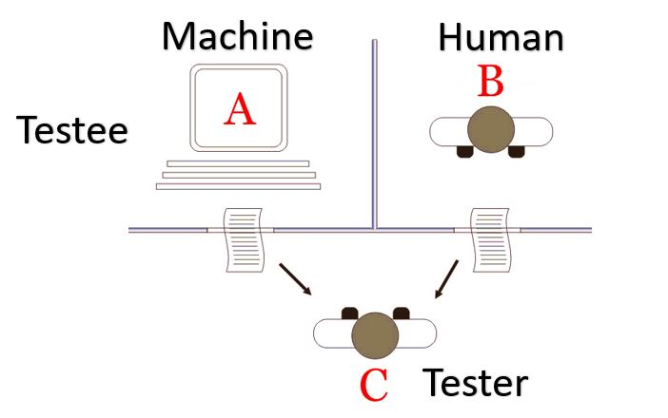
Test for AI
- Turing Test
Notes:
Turing Test is test to distinguish between humans and AI. AI can be evaluated depending on how much turing test has passed. Prepare one questioner and two respondents, one of whom is a computer and the other is a human. The questioner doesn't know which is the computer. If the response is only on the keyboard and the questioner cannot determine which is the computer in this test, the computer passes the test. In other words, if a computer can communicate like a human being, we can think it like a human being. This is the most basic Turing test. there was an artificial intelligence that caught two to three out of ten people, but was only few artificial intelligence like yujin from England has passed it so far.

Slide 7
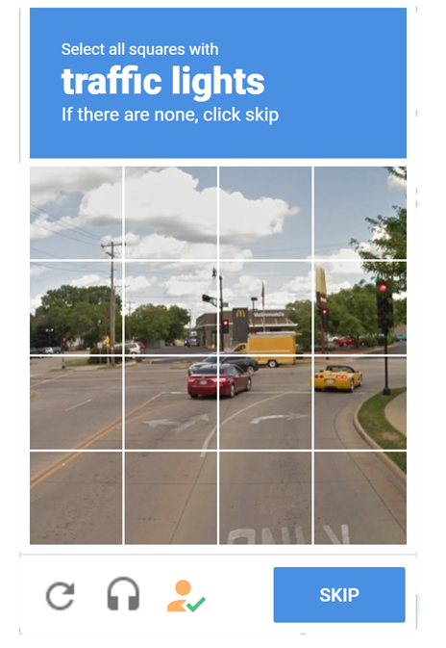
Test for AI
-CAPTCHA
Notes:
It is the captcha that you may experience it before. This type of simple Turing test has already been too old that is almost passed by research by companies such as Google, but this is an example of Turing test.

Slide 8
CONTENTS
01.
02.
Measuring Intelligence
Target of Pedagogy
03.
04.
Teaching vs Training
Ethics of Intelligence
How can we quantify intelligence?
Level of intelligence to be taught
Compare teaching and training
What Makes Ethics?

Slide 9
02.
Target of Pedagogy

Slide 10
Animals can get high intelligence score…
But can they teach each other?
Notes:
Then, do these standards apply to animals? The iq of octopuses and killer whales is about 90, just below the human average of 100. About 35% of people have an iq lower than 90, so the figure is definitely high.

Slide 11
Cognitive System
Understand Teacher’s Communicative intent
Understand their referential signals
Understand information content
communal living
Pointing
Eyegazing
…
Specific media
such as language
Notes:
Sort of cognitive system requires at least three thing. First learner must understand the teacher’s communicative intent. Second, the teacher and learner must be able to understand their referential signals, such as pointing and eyegaze. Third, the learner must be able to understand the information content of the pedagogical interaction.
Human’s social communication was explicity selected for in evolution, which means pedagogy can be applied to human.

Slide 12
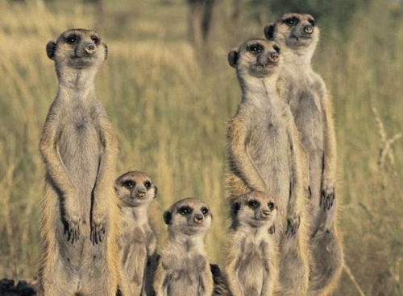
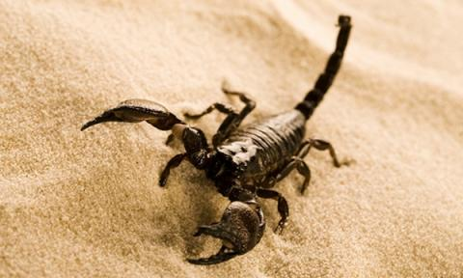
Meerkat!
Understand Teacher’s Communicative intent - O
Understand their
referential signals - O
Understand
information content - X
Notes:
Let's see does it applies to animals, too.
Meerkat is a good example. Meerkats who live in the desert feed on scorpions. But their venom is so dangerous that Meerkats can't eat it easily. The parents Meerket teaches their young how to eat scorpions by giving them a dead scorpion, a non-poison scorpion, and a fully alive scorpion at the end. However, communication in this learning process only used the first and second step in the cognitive system, and no clear meaning transmission was made in their teaching, which is third cognitive system. However, meaning transmission is very common in us humans. This is differences between humans and the most of animals.

Slide 13
AI Test on Cognitive system..?
Notes:
The cognitive system is a good measure of the learning potential of the object. Then, wouldn't it be possible to evaluate AI's intelligence by examining how well it is performing this system?
This is purely my idea. I think if this method is well designed, it seems that it can be a crieria for evaluating training methods.

Slide 14
CONTENTS
01.
02.
Measuring Intelligence
Target of Pedagogy
03.
04.
Teaching vs Training
Ethics of Intelligence
How can we quantify intelligence?
Level of intelligence to be taught
Compare teaching and training
What Makes Ethics?

Slide 15
03.
Teaching vs
Training

Slide 16
Training
Classification
Supervised
Learning
Machine Learning
Regression
Unsupervised Learning
Clustering
Notes:
Machine learning is largely divided into 'supervised learning' and 'unsupervised learning’.
As you can see in figure, Famous methods classifications and regression are all in category of supervised learning.

Slide 17
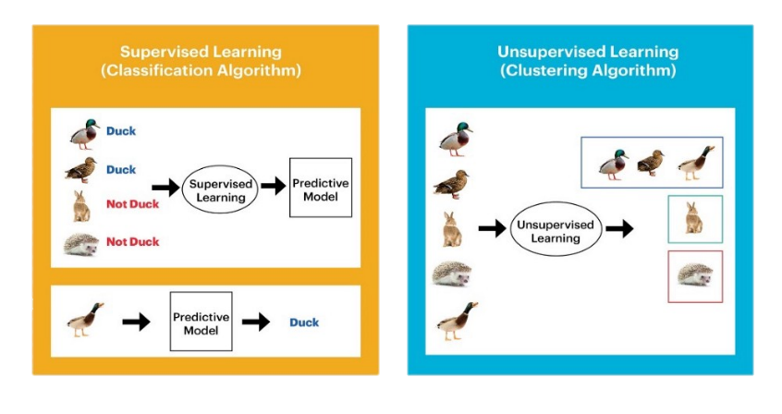
Training
Notes:
Supervised Learning receives input from Input Data and the label that corresponds to the correct answer to Input Data, as it says 'supervised learning'. It learns the model from the given data and the label and predicts the label when new data is received as input.
Unsupervised learning is based on the input data to find clusters.
For example, In supervised learning, we tried to train the model to recongize duck. But in Unsupervised learning, it can group the ducks together through the patterns of ducks, or might be bird’s one.

Slide 18


Teaching
Academic learning
- Lots of questions and answers
Learning from Social life
- Have no correct answer
Notes:
It’s similar as human’s learning process such as academic learning and social learning. Academic learning is what you learn in school. You learn with the text book which is already set. And solve the test through the application of that knowledge. It shows a very similar form to supervised learning. It will be difficult to feel the difference when comparing people with well-learned supervised learning functions in a multiple-choice test. But when you learn to work in society, you can't see a clear answer. Many behaviors such as communication and exercise are similar with unsupervised learning.

Slide 19
Teaching vs Training
Supervised
Learning
Academic learning
Unsupervised Learning
Learning from Social life
Notes:
Be more specific I think supervised learning and academic learning are very similar. Like quantifying the similarity between what I solved and the given answer (loss function) and giving a direction of development. But learning in social life and unsupervised learning seem to have some similarities and differences. So how do you think about this? Please feel free to speak.

Slide 20
CONTENTS
01.
02.
Measuring Intelligence
Target of Pedagogy
03.
04.
Teaching vs Training
Ethics of Intelligence
How can we quantify intelligence?
Level of intelligence to be taught
Compare teaching and training
What Makes Ethics?

Slide 21
04.
Ethics of Intelligence

Slide 22
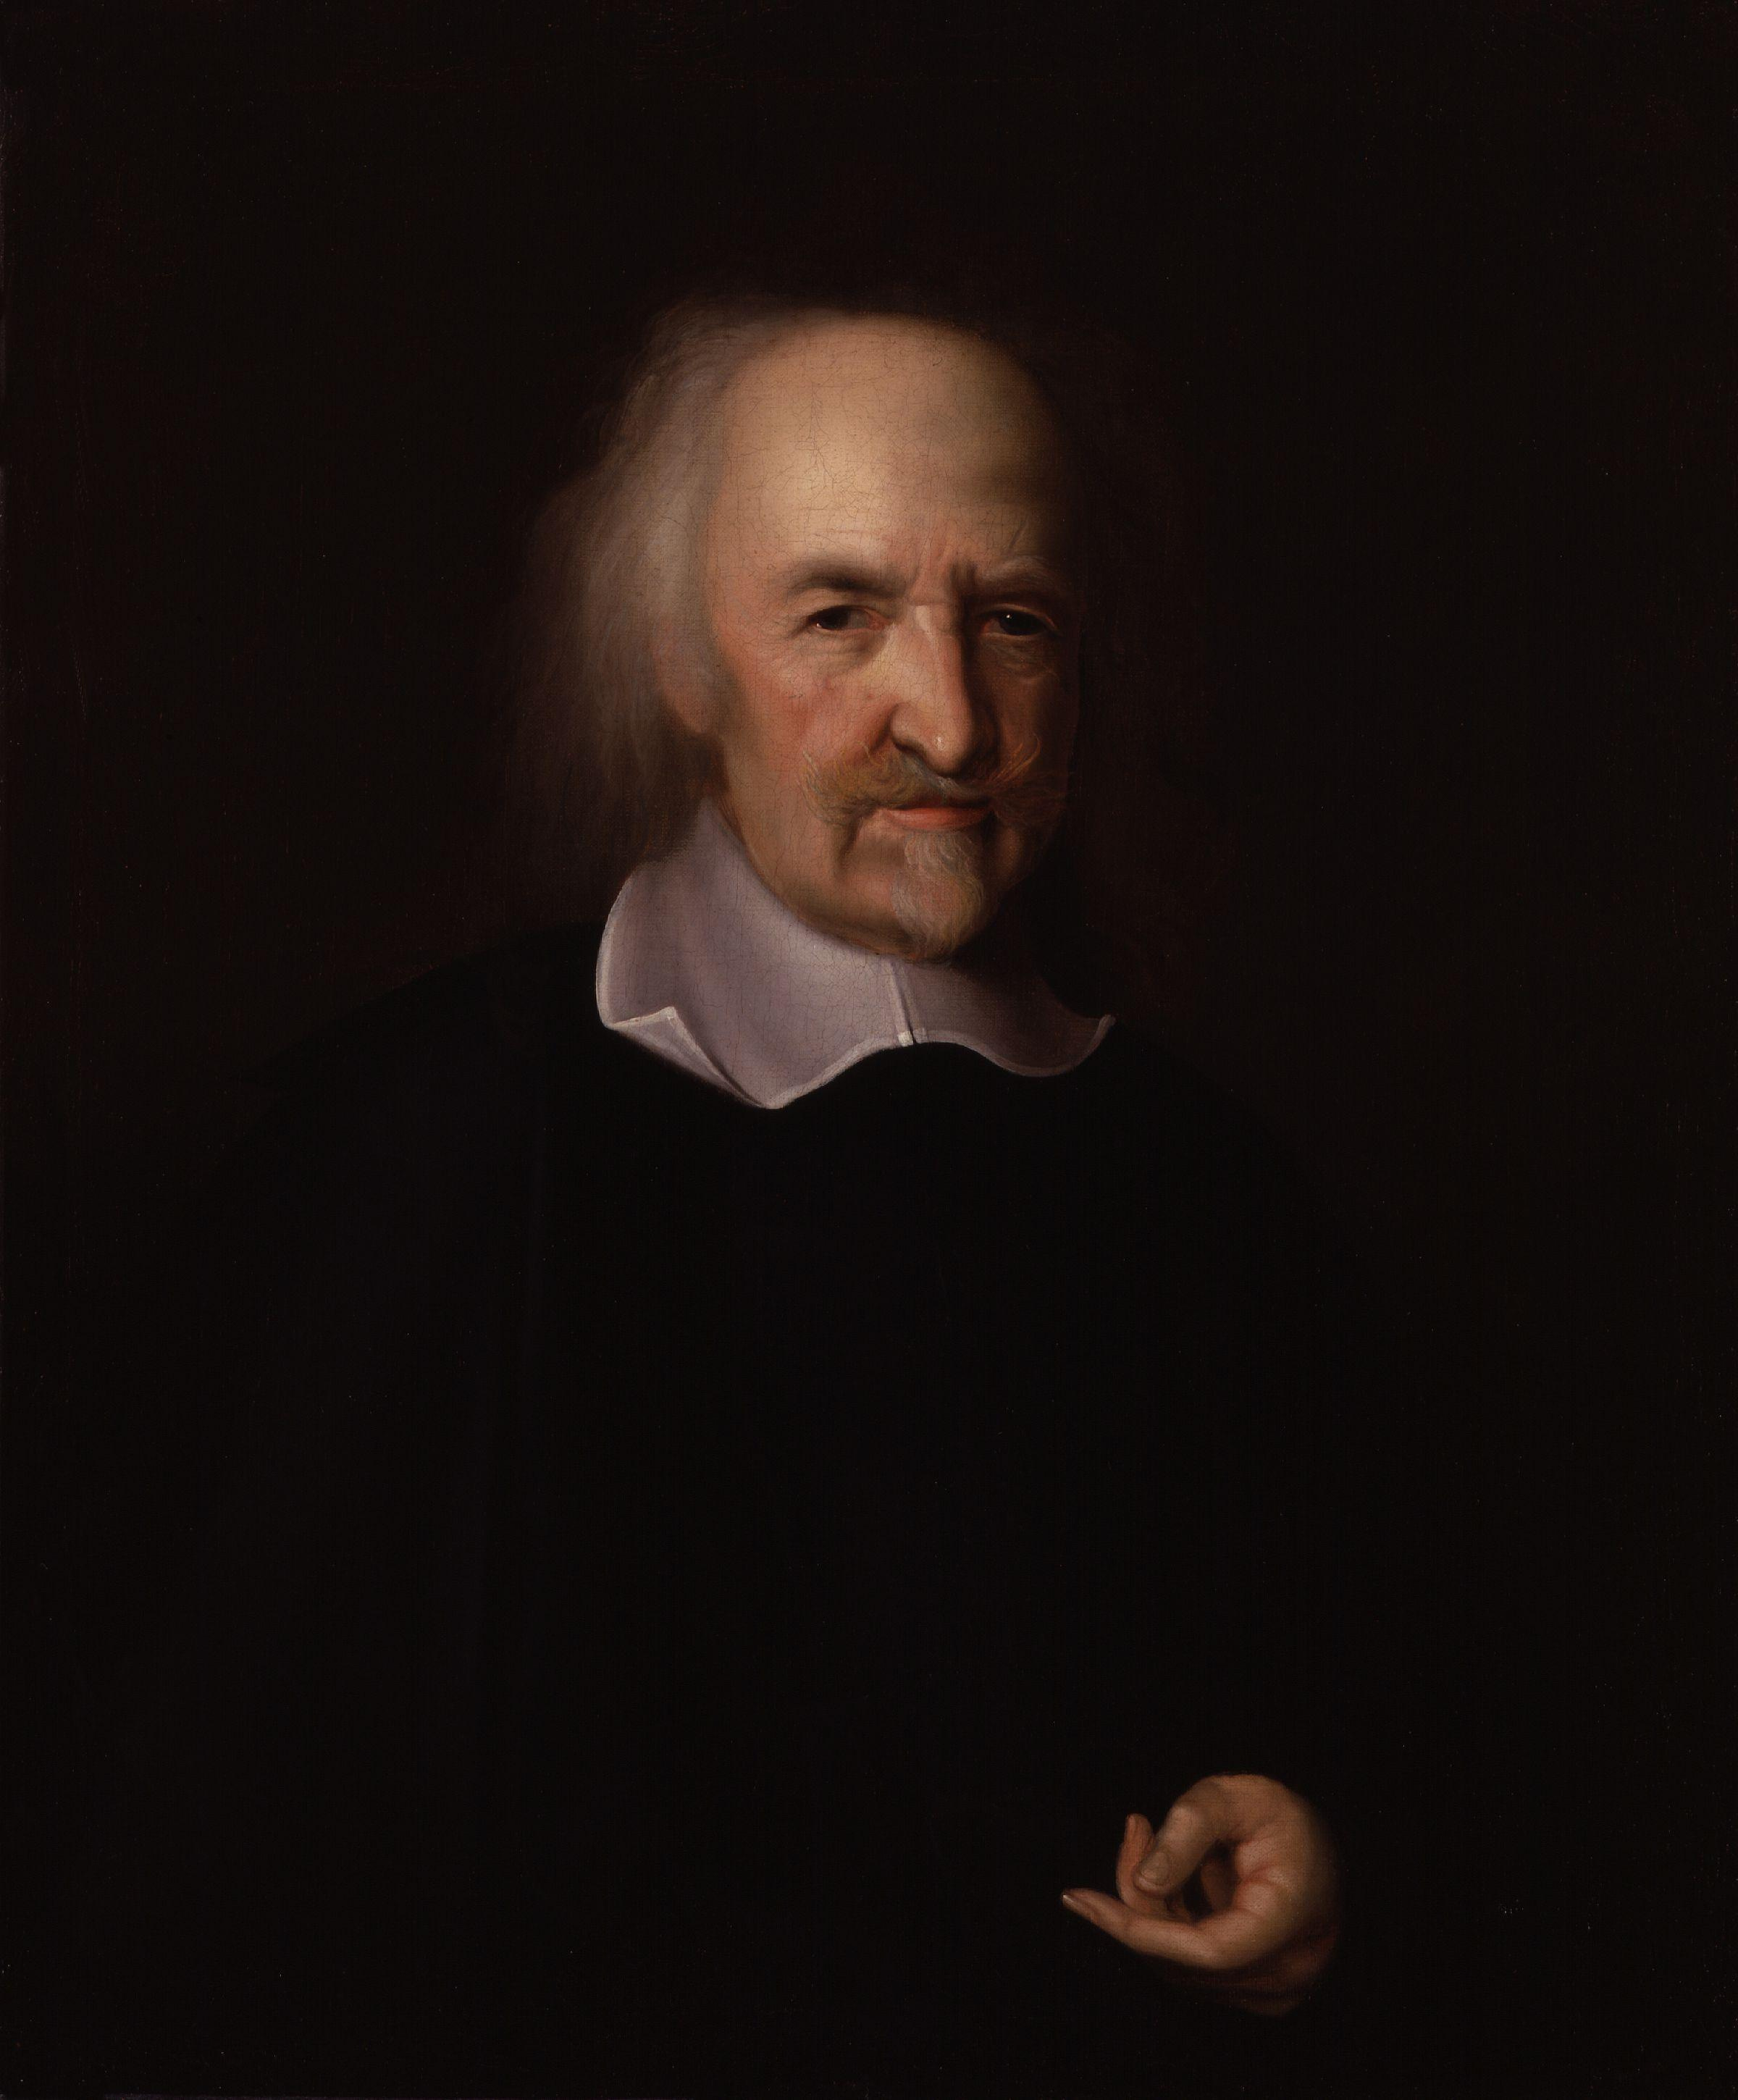
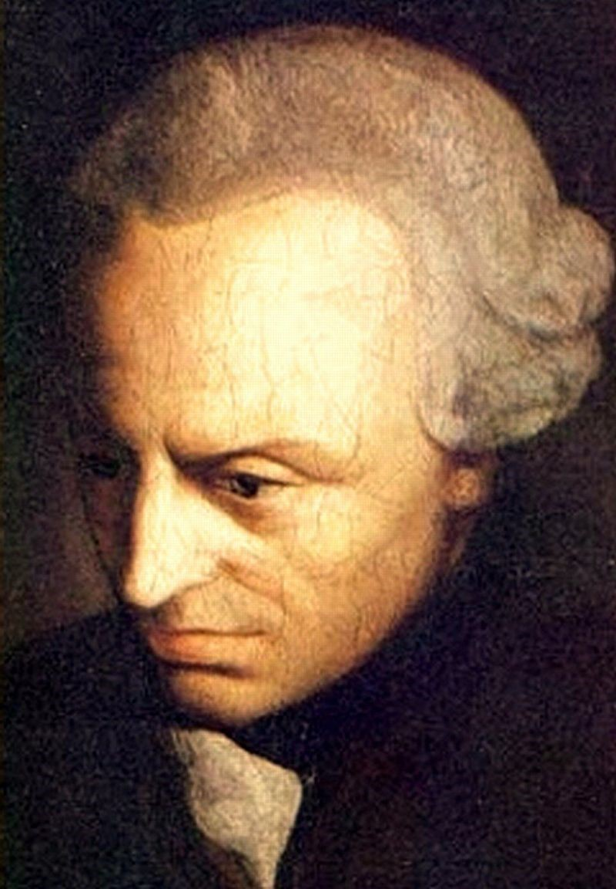
Where does morality come from?
Thomas Hobbes
Immanuel Kant
If you behave immorally, others will hurt you
Ethics comes from
free will
Notes:
Many philosophers have answered the question of where morality comes from. Hobbs explained morality through the sentence 'The war of all again all' that when someone becomes immoral, he’s immoral will get back to him. Kant said that free will makes morality. So is AI moral? Or before that, can AI be moral?

Slide 23
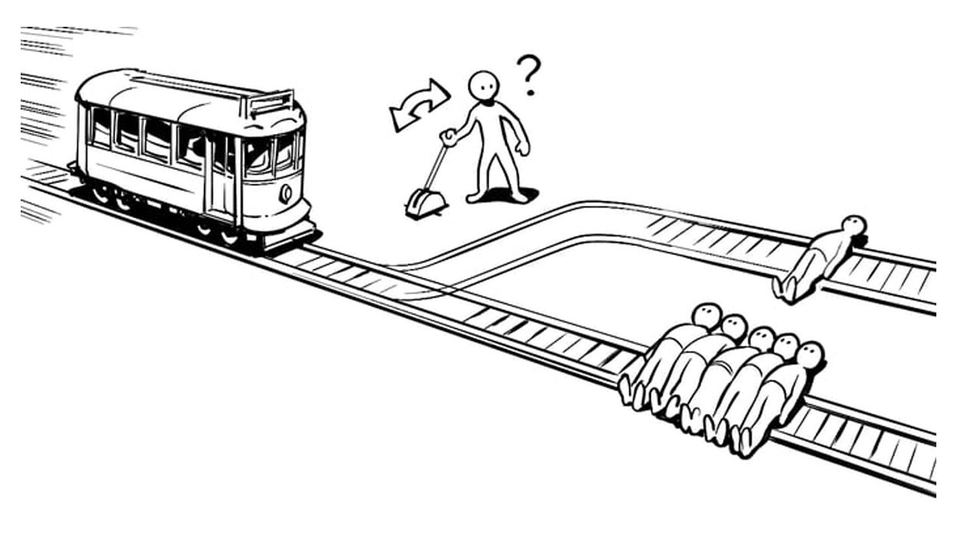
Trolley dilemma for AI
Notes:
Let's bring up the trolley dilemma to talk about it. When you learn philosophy, you learn about utilitarianism with this problem.
The basic form of the problem is, when you have five people on one side and one person on one side on two tracks, and you have to decide which way to send the train. When you don't hold yourself legally responsible, you're going to start calculating the ethics or the value of people.
A more intuitive problem is when you have a child on one side and a parent on the other, and from an ethical point of view, it may be right to save a child, but utilitarianly, it is right to save a parent. Whatever choice you make, that worry and the resulting of your choice tells you that you are moral. But AI can't do that.

Slide 24
Trolley dilemma for AI
There exists a unique ‘right’ action among two choices.
All information is disclosed.
All actions occur fully deterministically.
But still is it fundamentally impossible for a computer to even recognize the right choice.
Notes:
Professor Ziegler's thesis informs the following facts.
Even if there exists a unique ‘right’ solution of this problem and the problem has no logical problem by first to third statement, AI can’t make a answer. Even it can’t recognize the right choice.

Slide 25
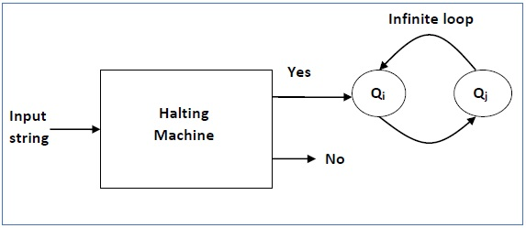
Can AI Be Ethical?
Does AI is ethical
= Does AI can get a answer of trolly dilemma
= Halting Problem
= Undecidable
Notes:
Be specific at this is as follows.
The question ‘Does AI is ethical’ is mean ‘Does AI Does AI can get a answer of trolly dilemma’
It’s kind of halting problem, which is undecidable.
This means that we do not know not only AI is moral or immoral, but also the possibilities of morality.
Looking at this, I think AI may need regulation. What do you think?

Slide 26
Need a Regulation for AI Behavior
(Violence, weapons...)
Notes:
Looking at this, I think AI may need regulation. What do you think?

Slide 27
References https://en.wikipedia.org/wiki/Intelligence_quotient https://en.wikipedia.org/wiki/Emotional_intelligence https://en.wikipedia.org/wiki/Supervised_learning https://en.wikipedia.org/wiki/Unsupervised_learning https://ko.wikipedia.org/wiki/%ED%8A%9C%EB%A7%81_%ED%85%8C%EC%8A%A4%ED%8A%B8 https://blogs.scientificamerican.com/thoughtful-animal/is-pedagogy-specific-to-humans-teaching-in-the-animal-world/ https://deepinsight.tistory.com/m/135 https://blog.naver.com/PostView.nhn?isHttpsRedirect=true&blogId=shyrgh&logNo=100113689610 https://m.blog.naver.com/PostView.naver?isHttpsRedirect=true&blogId=enter2727&logNo=100019585116
Matthias Englert, Sandra Siebert, Martin Ziegler, Logical Limitations to Machine Ethics with Consequences to Lethal Autonomous Weapons ,11 Nov 2014

