Slide 1
Philosophy of reality
20210003 강덕현

Slide 2
Philosophy?
Learning of previous thoughts made upon the world
Qualification of ‘previous thoughts’: Systematic & sound structure
Beginning of structure: ‘Question’
There is no ‘Divine Answer’
What should be a question, after all?

Slide 3
Reality?
Questions for examining ‘reality’:
The structure of ‘truth’
Validity of reality relies upon the notion of true and false.
Ex) Is this world/perception/sensation/reality/etc. not a ‘deception’?
2. The structure of ‘existence’
To be ‘real’ is assigned to subjects that ‘exist’; the notion of being is fundamental to it.
Ex) ‘Is’ that apple actually red? ‘Am’ I dreaming, or dreaming of dreaming?

Slide 4
The problem of precedence
Each word already represents a philosophical position.
‘Structure of truth’ := logic is a system preceding &/ independent of perception, mind, consciousness
‘Structure of existence’ := being is an ‘entity’(or something conjoined to it) preceding &/ independent of perception, mind, consciousness

Slide 5
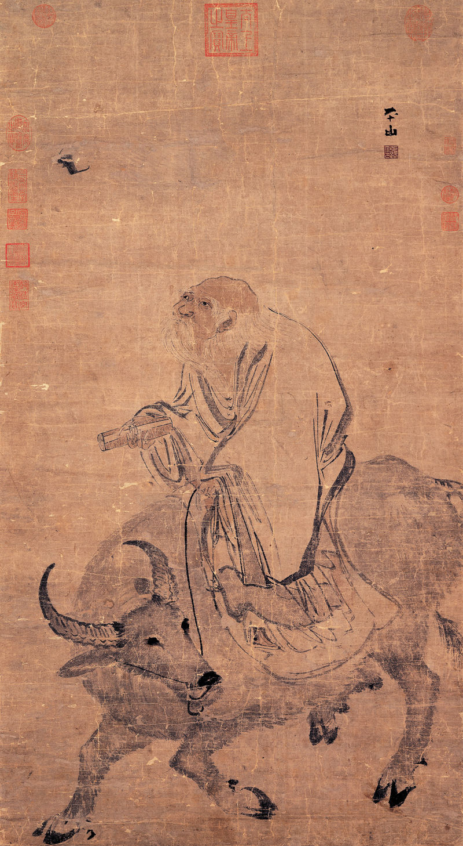
Taoism
Lao-zi(老子; old man): universal Tao(道; the road) and De(德)
Against Confucianism, which focused on ethical codes and values
絕學無憂。 Cut loose from knowledge and your worries will be naught. 唯之與阿，相去幾何？
What difference is between
polite and rude? 善之與惡，相去何若？
What difference is between good and evil?
- Tao Te Chiang, Ch. 20
道生之，德畜之，
Tao give birth to all, De nuture all, 物形之，勢成之。
So everything is shaped,
and flow of force is made.
- Tao Te Chiang,
Ch. 51

Slide 6
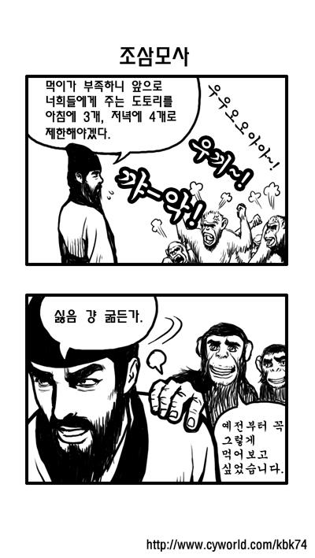
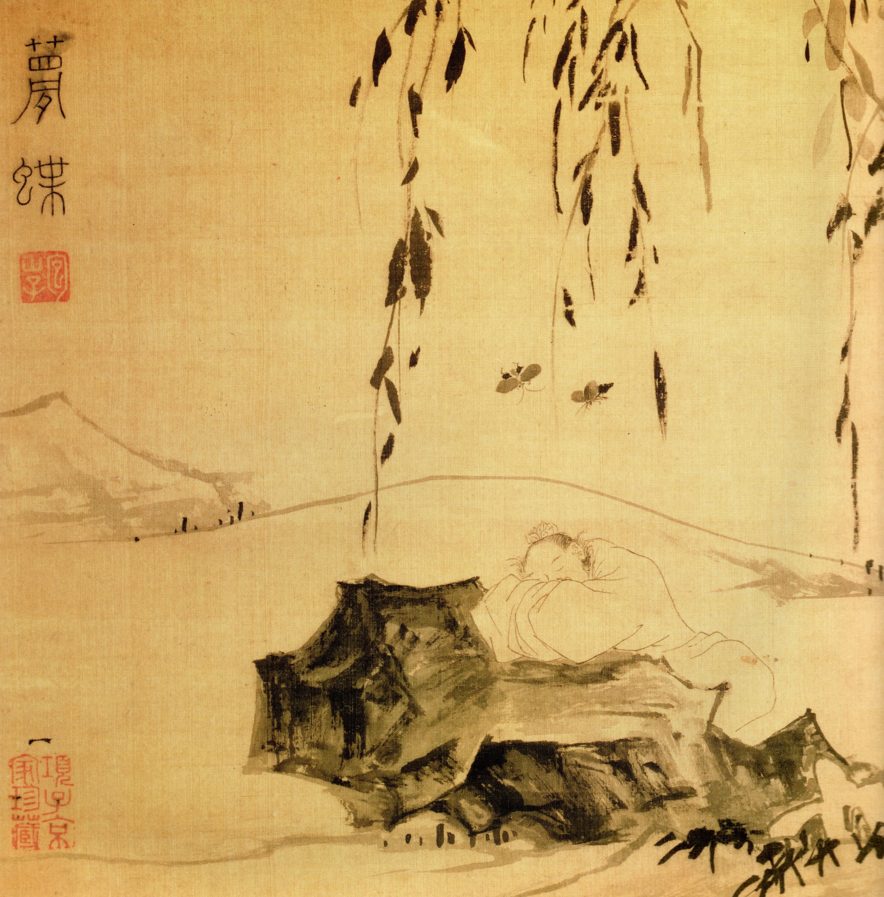

Zhuang-zi
Zhuang-zi(莊子): universal ki(氣; energy)
The story of monkeys
The story of wife’s funeral and dish-drum
The story of butterfly

Slide 7
The butterfly
有無之果孰有孰無也
I yet not know if ‘exist’ or ‘naught’ exists or not,
…
吾所謂之其果有謂乎, 其果無謂乎
I not know whether what I spoke is actually exists spoken, or this spoken is naught.
- Zhuang Zhou Vol. 2 Ch. 1
夫道未始有封, 言未始有常,
Tao had no distinction, and words had no fixed meanings,
爲是而有畛也, 請言其畛
And thus(by giving meaning to words) distinctions were made, which I will now talk about.
- Zhuang Zhou Vol. 2 Ch. 2

Slide 8
The butterfly
惡識所以然
How may I know why such things happen?
惡識所以不然
How may I know why such things not happen?
- shadow to penumbra, Zhuang Zhou Vol. 2 Ch. 5
不知, 周之夢爲胡蝶與, 胡蝶之夢爲周與
Cannot know, whether Zhou(Zhuang zi) was dreaming as butterfly, or butterfly dreaming as zhou.
周與胡蝶, 則必有分矣, 此之謂物化
Between Zhou and butterfly, there must exist a difference, and such shall be the change and becoming of things.
- Zhuang Zhou Vol. 2 Ch. 6

Slide 9
The butterfly
Does questioning truth; existence; reality really matter?

Slide 10
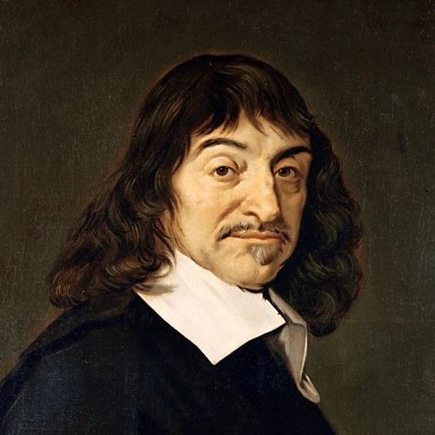
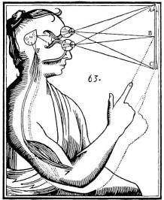
Descartes
Cogito Ergo Sum
Heavily religious
Logic applied to ‘soul’ and ‘body’ is different

Slide 11
Descartes
Structure of meditations:
Skepticism of prior perceptions
But they are mad, and I should not be any the less insane were I to follow examples so extravagant. – 1st
At the same time I must remember that I am a man, and that
consequently I am in the habit of sleeping, and in my dreams
representing to myself the same things or sometimes even less probable things, than do those who are insane in their waking moments. – 2nd
but some evil genius not less powerful than deceitful,
has employed his whole energies in deceiving me; I shall consider that the heavens, the earth, colours, figures, sound, and all other external things are nought but the illusions and dreams of which this genius has availed himself in order to lay traps for my credulity; - 3rd

Slide 12
Descartes
Structure of meditations:
Expungement of deceivable ideas; Cogito remaining;
I pause to consider, I revolve all these things in my mind, and I find none of which I can say that it pertains to me.
What of thinking? I find here that thought is an attribute that belongs to me; it alone cannot be separated from me.
I am, I exist, that is certain.
… but by the understanding only, and since they are not known from the fact that they are seen or touched(the ideas from sensations ex. the wax), but only because they are understood, I see clearly that there is nothing which is easier for me to know than my mind.

Slide 13
Descartes
Structure of meditations:
Undeniable existence of God, derived from pure reasoning
But among these ideas, some appear to me to be innate, some
adventitious, and others to be formed [or invented] by myself;
But further, the idea of heat, or of a stone, cannot exist in
me unless it has been placed within me by some cause which possesses within it at least as much reality as that which I conceive to exist in the heat or the stone.

Slide 14
Descartes
Structure of meditations:
Undeniable existence of God, derived from pure reasoning
Hence there remains only the idea of God, concerning which we
must consider whether it is something which cannot have proceeded from me myself.
For although the idea of substance is within me owing to the fact that I am substance, nevertheless I should not have the idea of an infinite substance—since I am finite—if it had not proceeded from some substance which was veritably infinite.
Nor should I imagine that I do not perceive the infinite by a true
idea, but only by the negation of the finite,

Slide 15
Descartes
Structure of meditations:
Undeniable existence of God, derived from pure reasoning
God, I say, whose idea is in me, i.e. who possesses all those
supreme perfections of which our mind may indeed have some idea but without understanding them all, who is liable to no errors or defect [and who has none of all those marks which denote imperfection]. From this it is manifest that He cannot be a deceiver, since the light of nature teaches us that fraud and deception necessarily proceed from some defect.

Slide 16
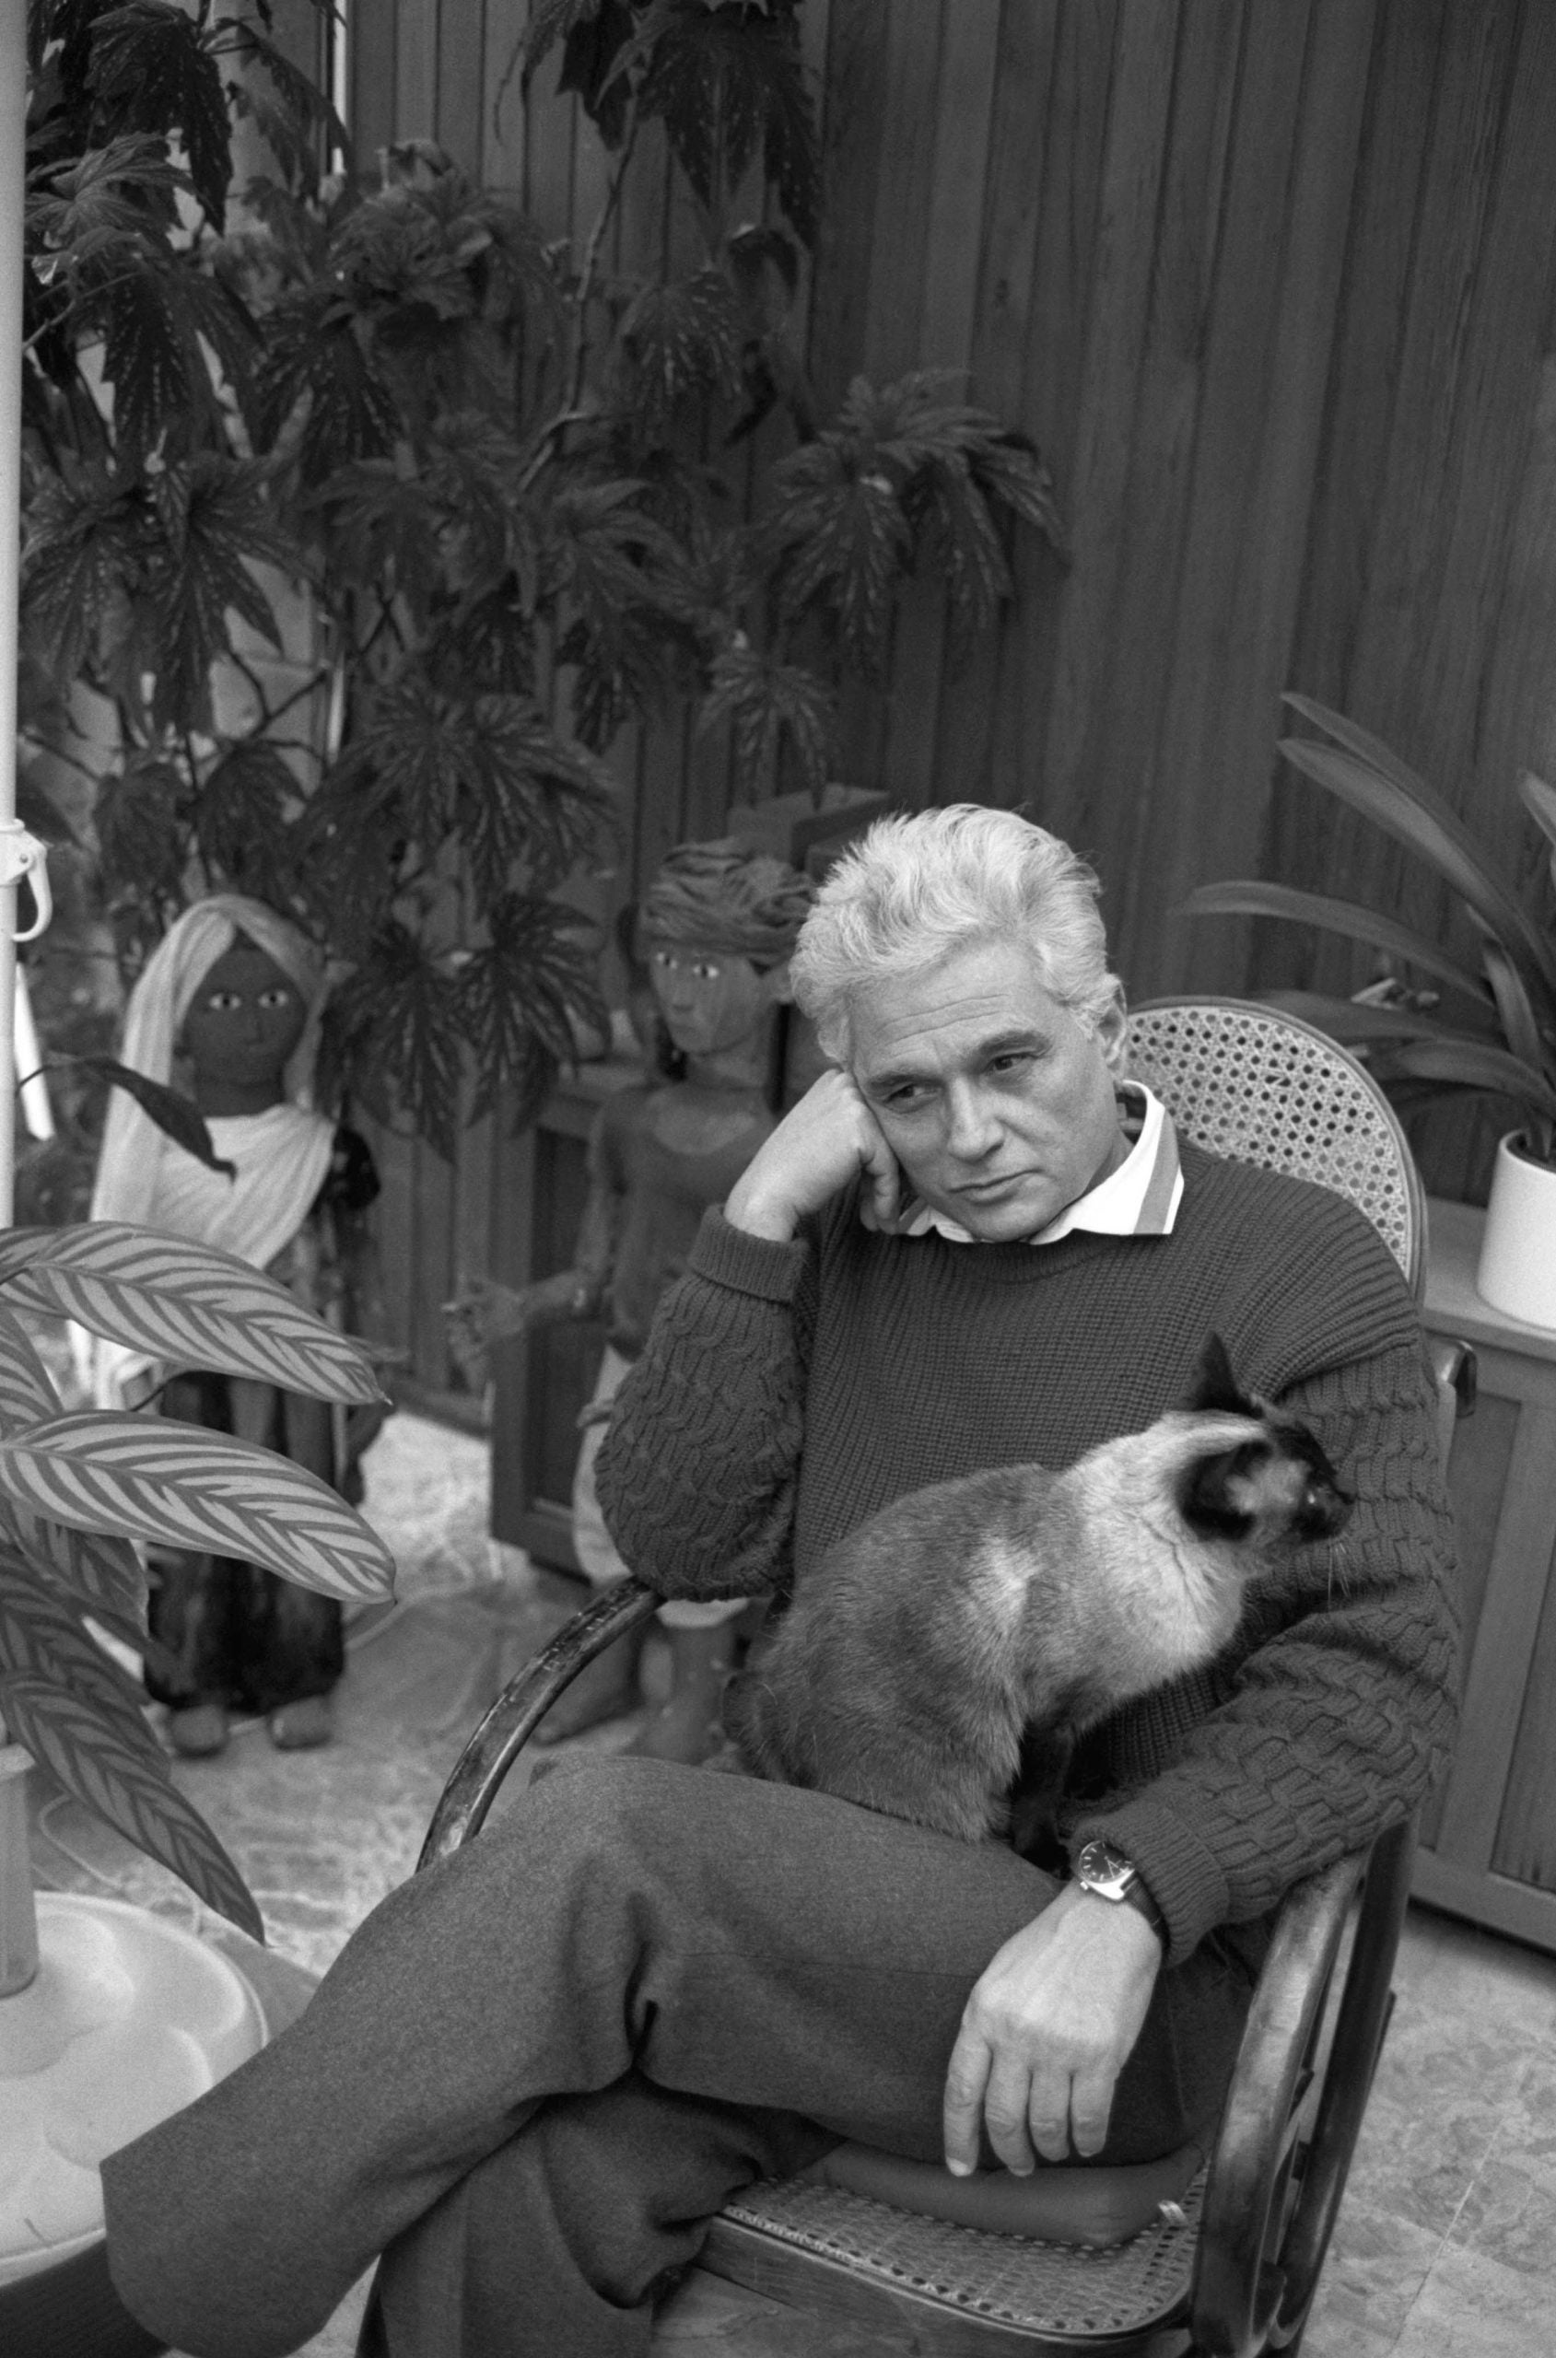
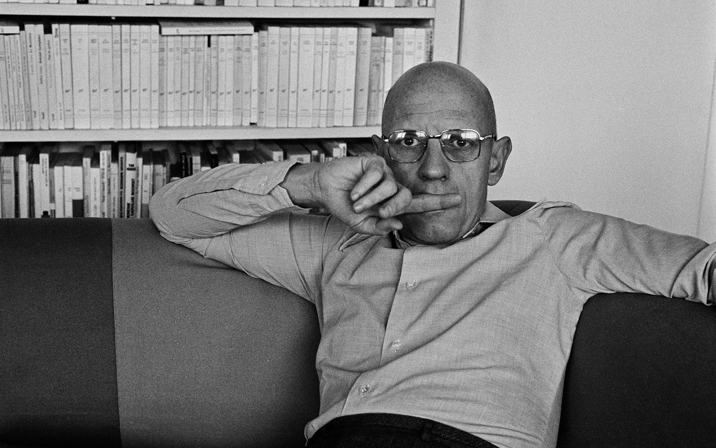
Foucault versus Derrida
Does Descartes include or expunge in his development of meditations the ‘madness’? – regarding the ‘first meditation’

Slide 17
Foucault versus Derrida
Michael Foucault(1961, Folie et Déraison: Histoire de la folie à l'âge classique):
We can assume that we are dreaming and identify with the subject dreaming to find "some reason to doubt": the truth
still appears, as a condition of the possibility of the dream.
We cannot, on the other hand, suppose, even by thought, that one is mad, because madness is precisely the condition of the impossibility of the thought:
But they are mad, and I should not be any the less insane were I to follow examples so extravagant. – 1st

Slide 18
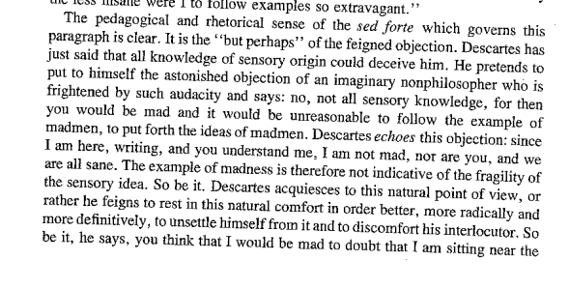
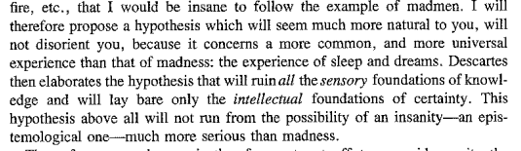
Foucault versus Derrida
Jacques Derrida(Cogito and history of madness, 1963):

Slide 19
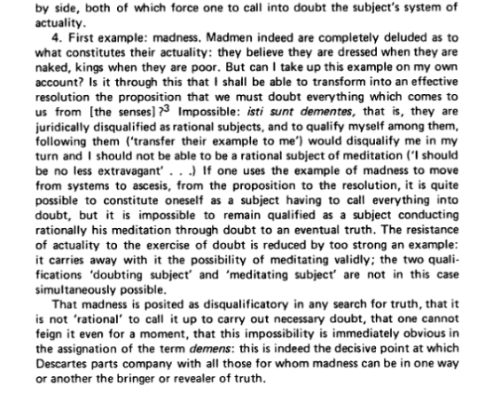
Foucault versus Derrida
Foucault’s rebuttal(1972 appendix to Histoire de la folie):

Slide 20
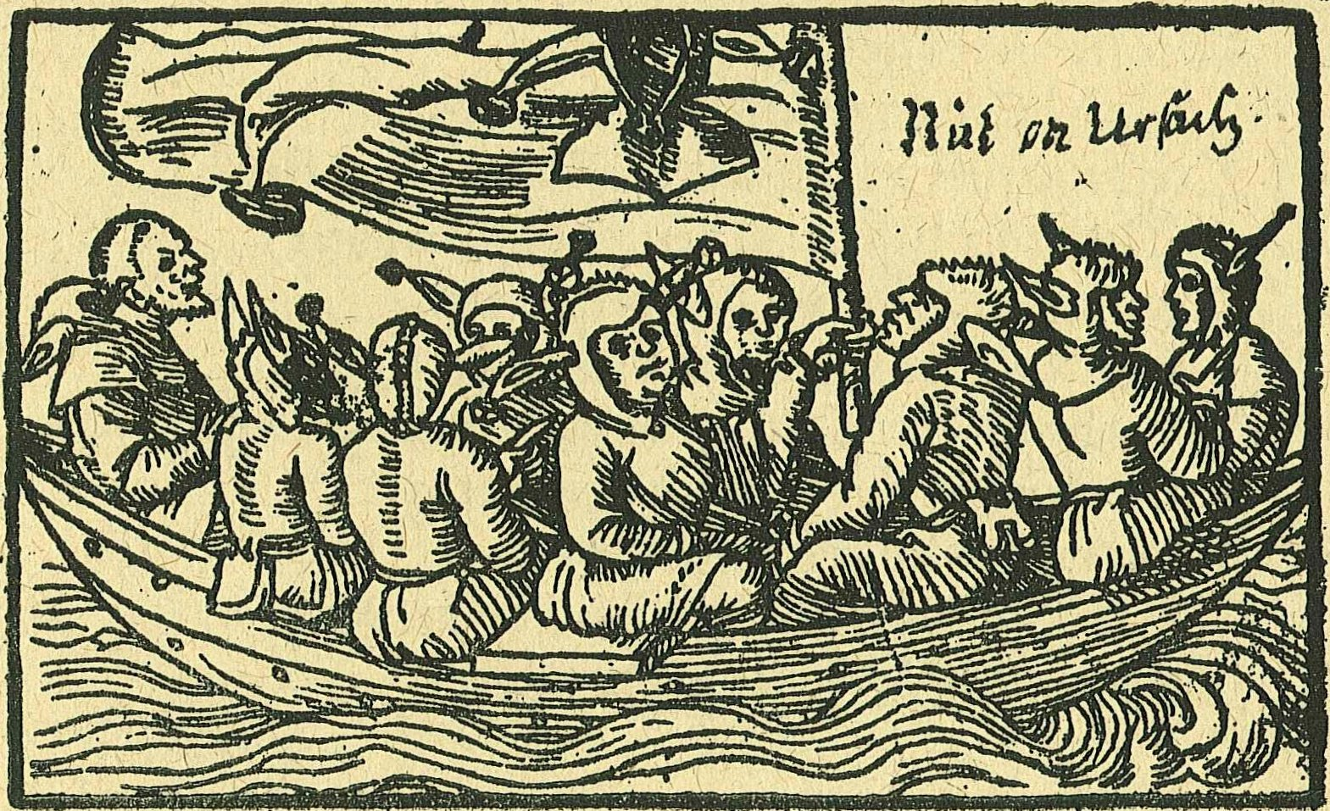
Cogito, Meditation, Madness
Does questioning truth; existence; reality ‘valid’ if we are to actually doubt everything?

