Slide 1
The Simulation Hypothesis
Siripon Sutthiwanna (Ted)
siripon_s@kaist.ac.kr

Slide 2
Table of Content
Introduction
Motivation
What is (and is not) simulation hypothesis?
Bostrom’s argument on the probability of simulated reality
Computability counterargument
The Search for Evidence
Inside this simulation, who are we?
Conclusion

Slide 3
Why discuss simulation hypothesis?
Hypothesizing the origin of reality based on what our ability to create a (virtual) one.

Slide 4
Table of Content
Introduction
Motivation
What is (and is not) simulation hypothesis?
Bostrom’s argument on the probability of simulated reality
Computability counterargument
The Search for Evidence
Inside this simulation, who are we?
Conclusion

Slide 5
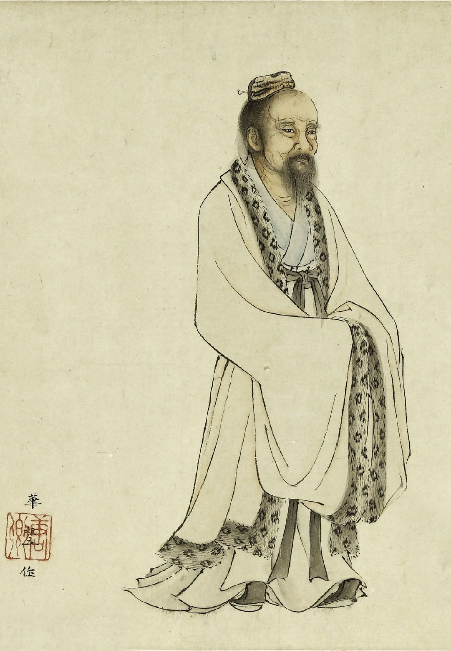
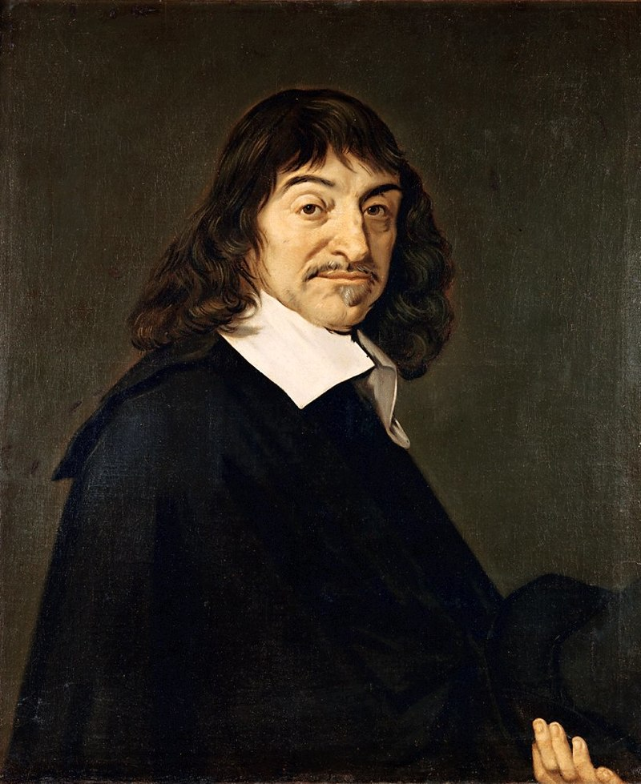
1. Illusion of Reality
Chuang Tzu’s
Dream of Butterfly
Descartes’ Demon

Slide 6
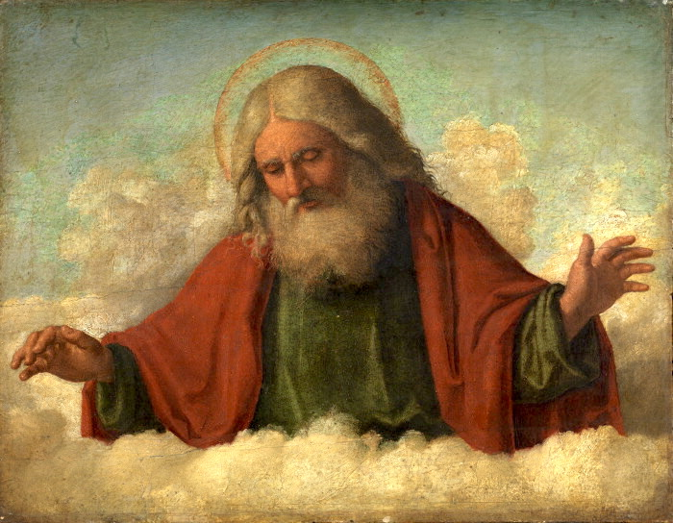
2. The Belief in Creator of Reality

Slide 7
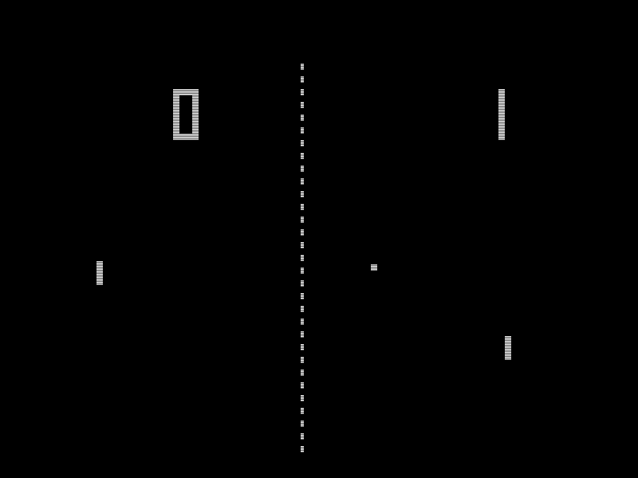
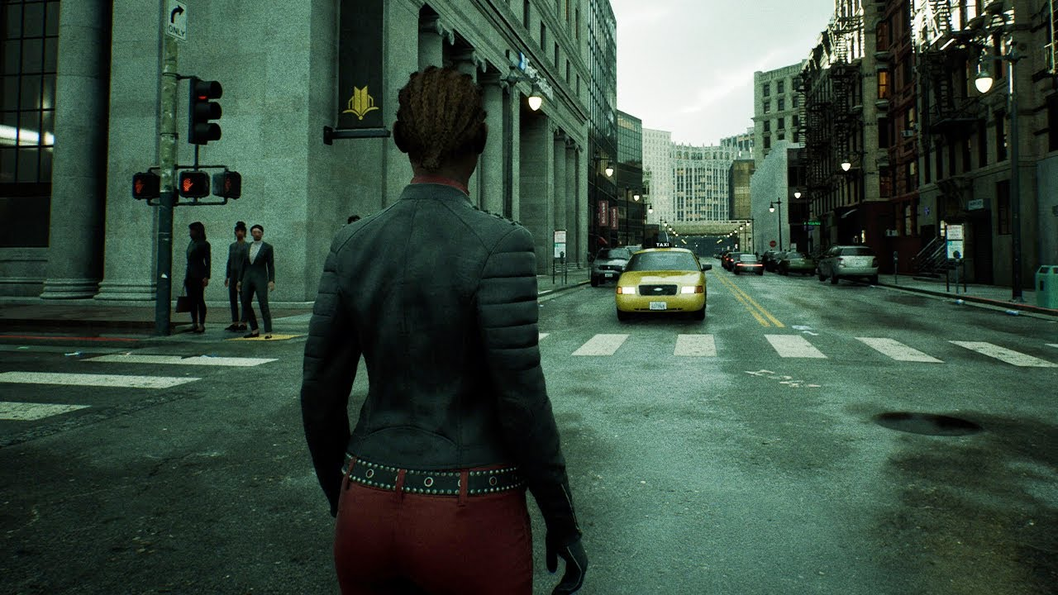
3. The Advancement of Simulation Tech.
Pong (1972)
The Matrix Reborn (2021)

Slide 8
Table of Content
Introduction
Motivation
What is (and is not) simulation hypothesis?
Bostrom’s argument on the probability of simulated reality
Computability counterargument
The Search for Evidence
Inside this simulation, who are we?
Conclusion

Slide 9

1. There is reality outside the simulation
If the creator of reality live on Mount Olympus on the same Earth as that is not [SIM].

Slide 10
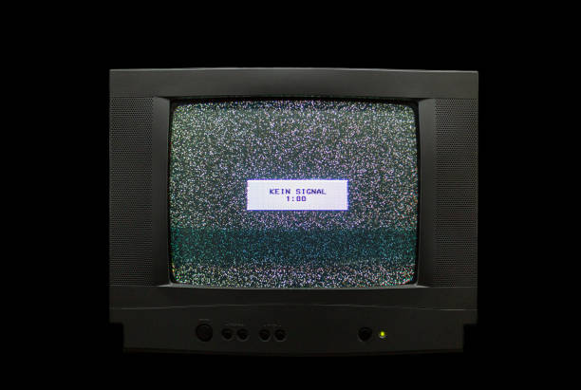
2. There is someone who simulates us
If we are inside a computer that just happens to exist - with no one that built it, just pops into existence from nothingness - then it is not [SIM].

Slide 11
Table of Content
Introduction
Motivation
What is (and is not) simulation hypothesis?
Nick Bostrom’s argument on the probability of simulated reality
Computability counterargument
The Search for Evidence
Inside this simulation, who are we?
Conclusion

Slide 12
Nick Bostrom, 2003 – Are You Living In A Computer Simulation?
Human will run a simulation of the entire history of humanity to learn about their ancestors – call this Ancestor simulation.

Slide 13
Assumption: Substrate Independence
Consciousness is not tied to physical body.
(Maybe the people in AI chapter of this course will discuss this.)

Slide 14







The Simulation Structure
Human will run simulation of human.
Top-level reality human runs simulations of humans.
The simulated human runs simulation of humans inside the simulation.
So on…
Simulates human
Simulates human
Simulates human

Slide 15
Bostrom’s conclusion
At least 1 of the following is true.
Human likely goes extinct before the simulation can be invented.
Future human has low interest in running the simulation.
We are almost certainly simulated.

Slide 16


















Why are we likely to be simulated?
It is unlikely that we exists on the top-level reality (if it even exists).

Slide 17
Bostrom’s conclusion
If we can construct a simulation of us, then we are almost certainly to be in a simulation.
Note that it is not “We are almost certainly in a simulation.” (We must be able to construct a simulation first to arrive at that statement.)

Slide 18
Table of Content
Introduction
Motivation
What is (and is not) simulation hypothesis?
Nick Bostrom’s argument on the probability of simulated reality
Computability counterargument
The Search for Evidence
Inside this simulation, who are we?
Conclusion

Slide 19
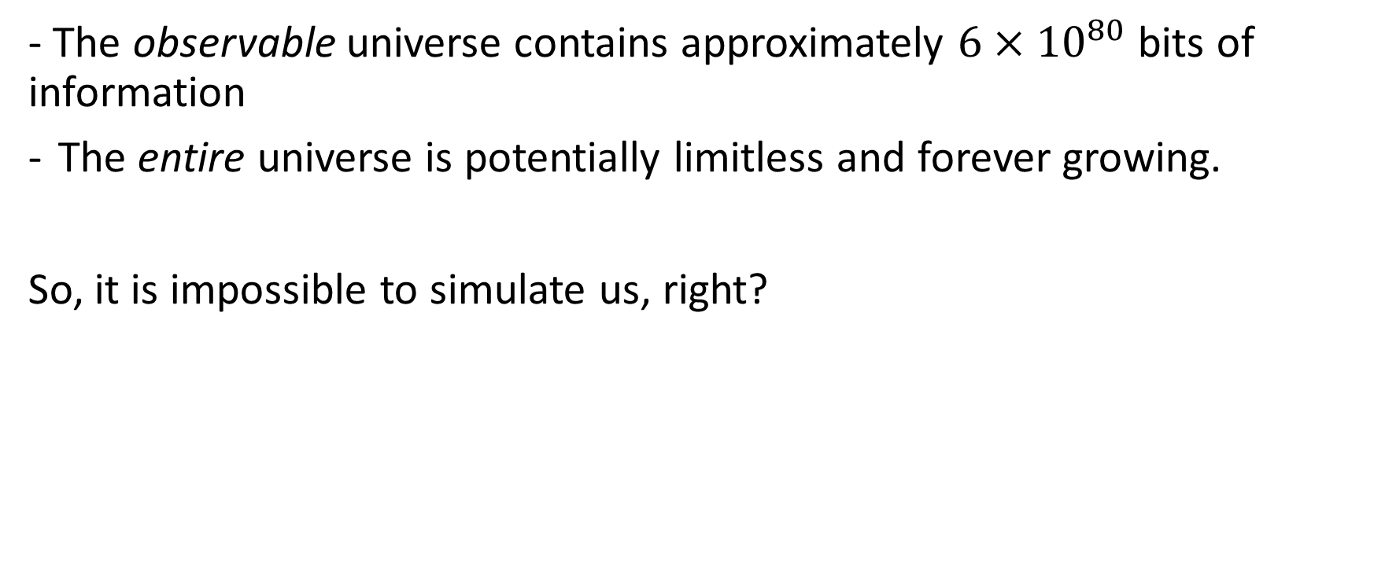
Computability of the Universe
- The observable universe contains approximately $6×{10}^{80}$ bits of information
The entire universe is potentially limitless and forever growing.
So, it is impossible to simulate us, right?

Slide 20
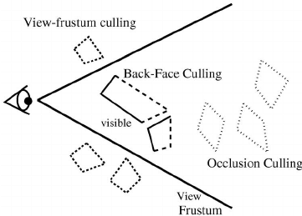
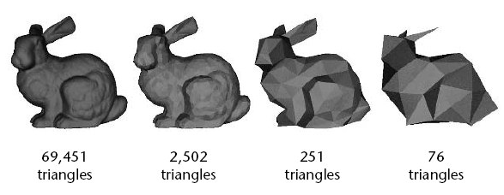

Optimizing the simulation
What if the simulation only needs to simulate only what “brains” can feel?
The maximum bandwidth of human sensory is $100$ Mbps.
4K 60FPS video bitrate is $85$ Mbps.

Slide 21
- Maybe it’s not a digital computer that runs the simulation. - Maybe our physics is not the same as theirs.

Slide 22
Table of Content
Introduction
Motivation
What is (and is not) simulation hypothesis?
Nick Bostrom’s argument on the probability of simulated reality
Computability counterargument
The Search for Evidence
Inside this simulation, who are we?
Conclusion

Slide 23
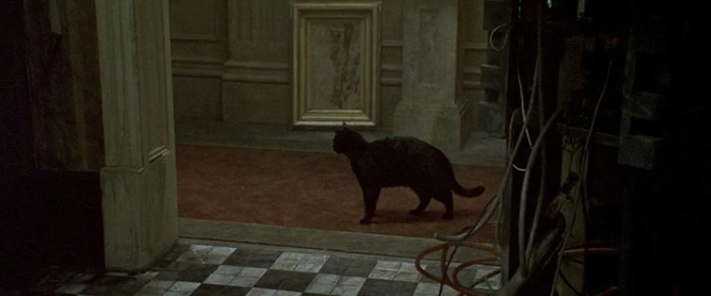
Glitch in the Matrix
If human-like intelligence simulates us – maybe, they may not understand every rules of nature and make imperfect simulation.
(and because they are human-like, they probably also are bad programmers.)

Slide 24
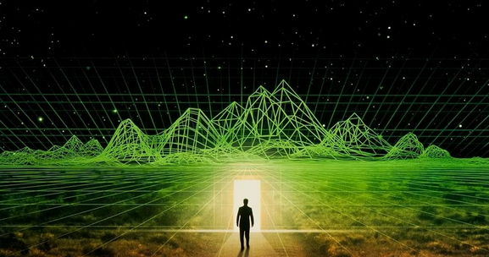
Does gaining insight from creating simulations help us prove the hypothesis?
If we know our simulation has a border, can we drive a car to find the border in our reality?

Slide 25
Discrete Space-Time (1)
It is possible according to Physics and Math.
Not yet proven/disproven by experiment
class Position {
float x;
float y;
float z;
}
// ...
while (isSimRunning) {
simulation.update();
}

Slide 26
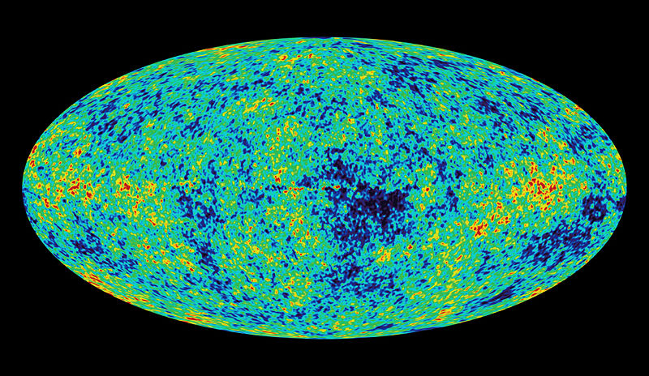
Discrete Space-Time (2)
Proposed experiment to prove discrete space-time is to search for anisotropy in cosmic rays hitting the Earth.

Slide 27



Is simulation hypothesis testable? (1)
[██████████] 100%
Reality Test finishes
Result: Positive
We are inside a simulation.

Slide 28
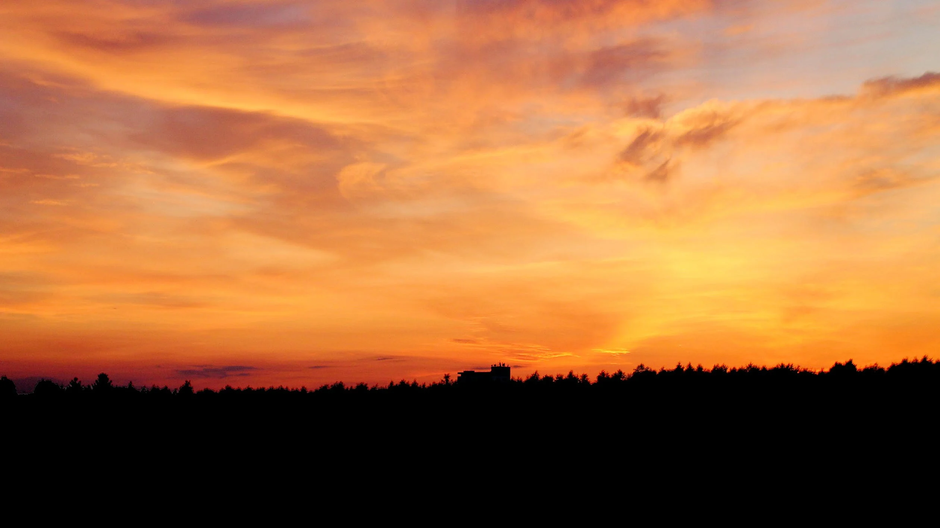
Is simulation hypothesis testable? (2)
Hi. [x]
You are in a simulation.
[Click here] for more info.

Slide 29
Table of Content
Introduction
Motivation
What is (and is not) simulation hypothesis?
Nick Bostrom’s argument on the probability of simulated reality
Computability counterargument
The Search for Evidence
Inside this simulation, who are we?
Conclusion

Slide 30

We are simulated – We are AI/NPC.

Slide 31
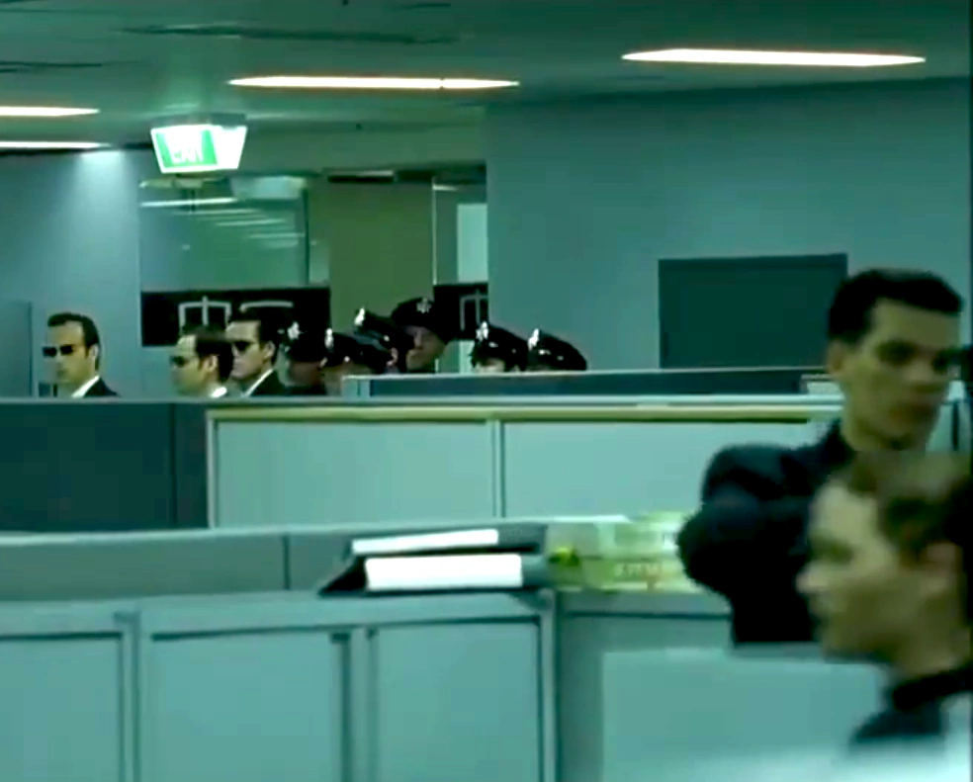
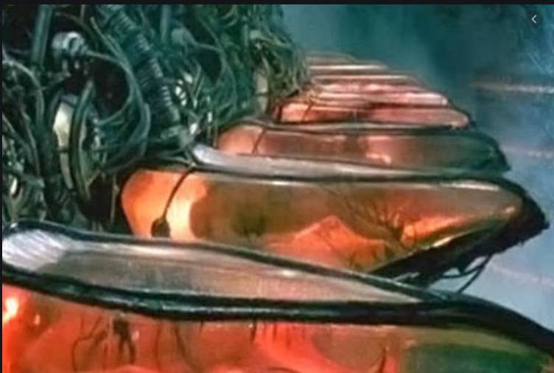





We are “players” (1)
Maybe our real body exists outside the Matrix, being used as human battery.

Slide 32
We are “players” (2)
Since no one here knows that they are players and has memory of the outside (I assume), …
We have never seen outside
Fake memory has been planted (permanently, temporally)

Slide 33
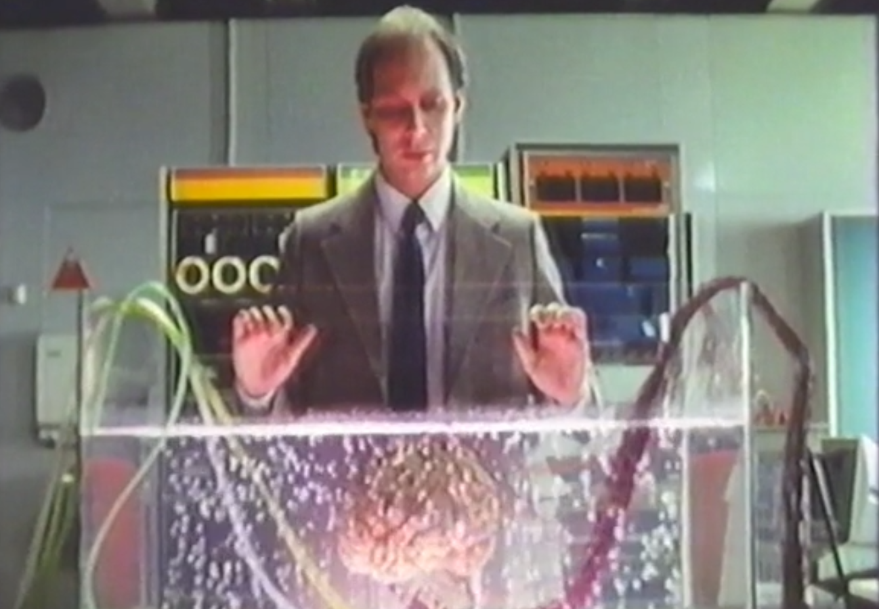
We are “players” (3) – Where are we?
Are we inside the simulation?
Or outside sleeping in a pod?
Are ‘the thought inside the simulation’ we and ‘the body outside the simulation’ we the same person?

Slide 34
Table of Content
Introduction
Motivation
What is (and is not) simulation hypothesis?
Nick Bostrom’s argument on the probability of simulated reality
Computability counterargument
The Search for Evidence
Inside this simulation, who are we?
Conclusion

Slide 35
Let’s assume we are simulated, are we real?
↓
Let’s assume our reality is still real even if we are simulated,
Then, can “virtual” reality we simulate be real?

Slide 36
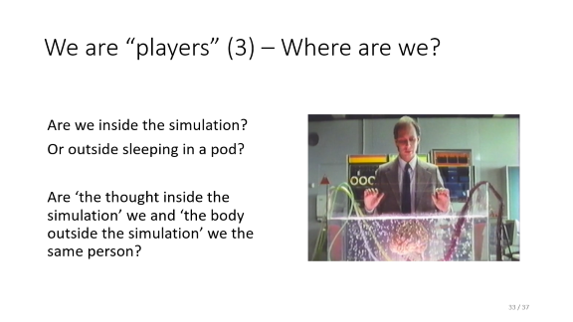
In VR, Where are we?
Are we inside the VR game?
Or outside sitting on a gaming chair?
Are we the character we are playing?
Or the person that is wearing a headset?

Slide 37


