Slide 1
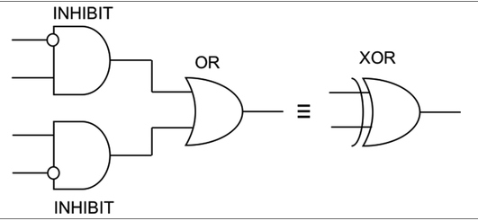
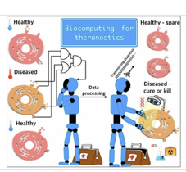
A guest lecture:
Molecular computation for Martin Ziegler’s class
“Unconventional Computing” …
(Updated version from 2024 Fall)
Notes:
Need two classes …
Unconventional computing…

Slide 2
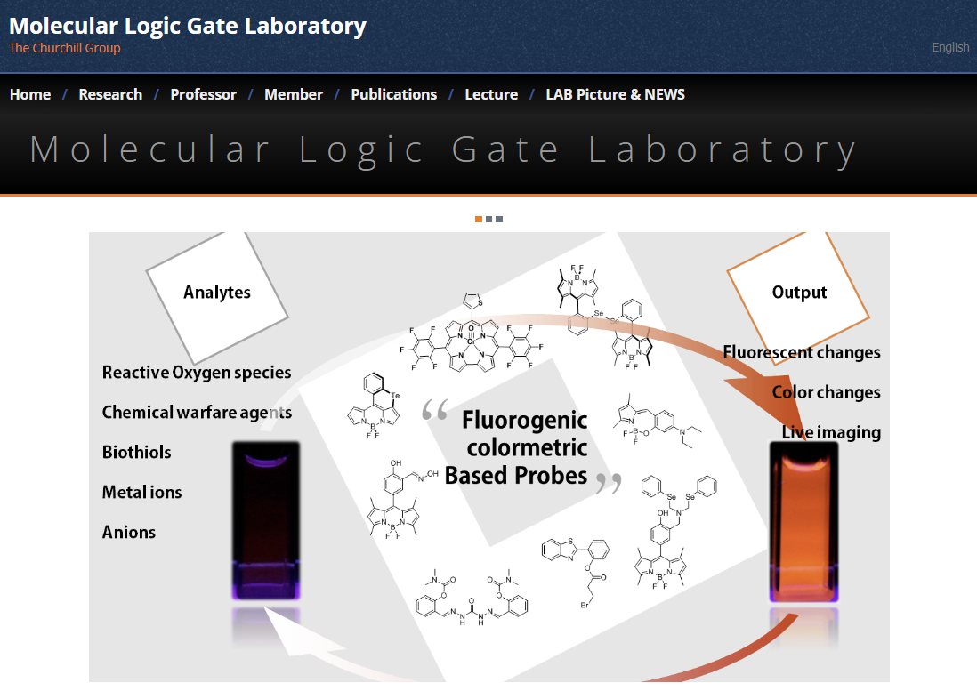
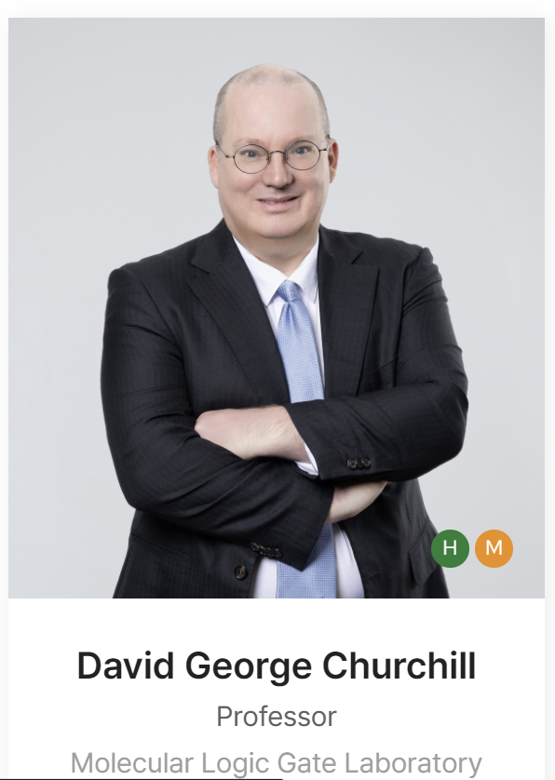

Slide 3
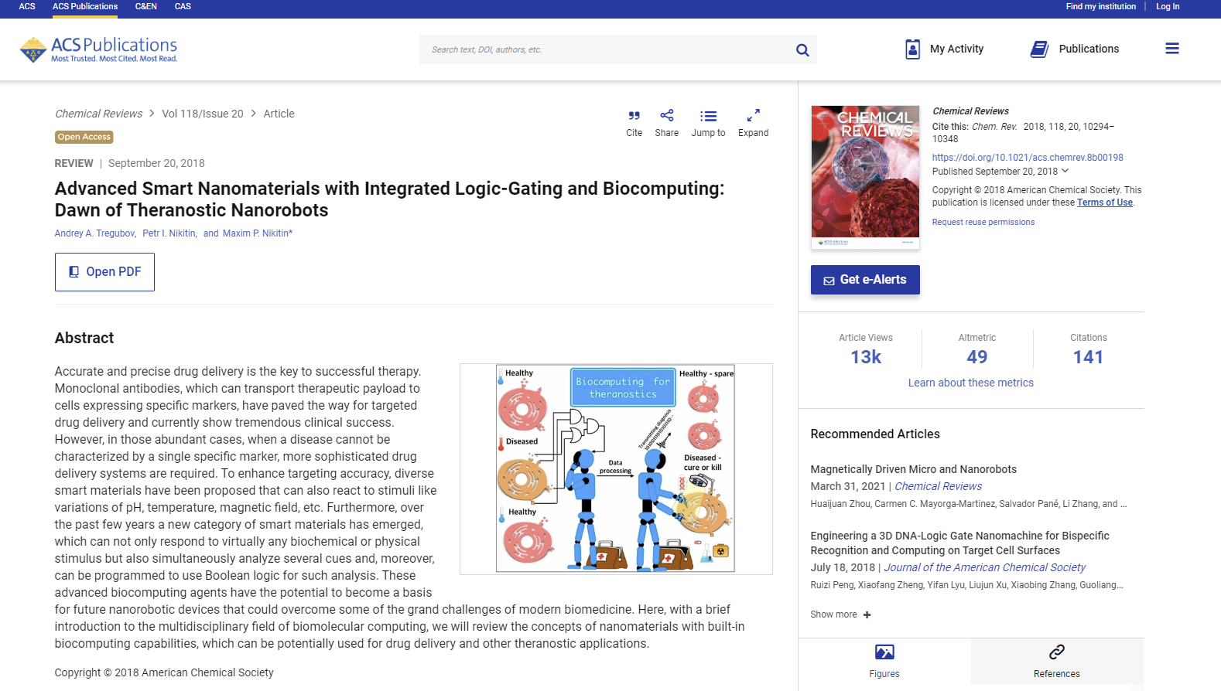
Objectives for Today
Introduce an aspirational area of the physical sciences.
  Topic is related area to your course “Theory of Computation”.
Show examples of Molecular Logic (Truth tables).
  Patterns are same as normal logic.
Show that it is an active research topic.
  This research has serious challenges (e.g., integration).
Describe the inputs (external stimuli) and outputs (reactions, photophysical changes).
Profile some personalities, researchers, events, concepts…
Recommend you think about future aims from your point of view.
Omit ”quantum computing.”
Note: Many graphics and items of artwork in this presentation are selected from the Internet; for educational purposes; used without permission

Slide 4
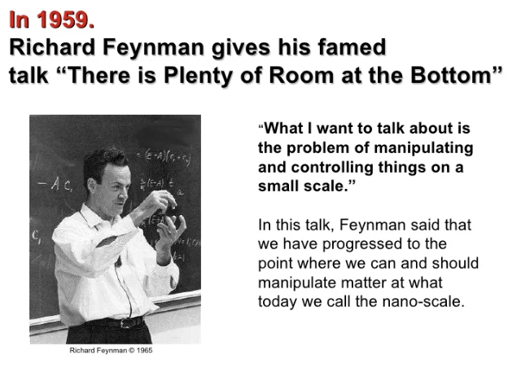
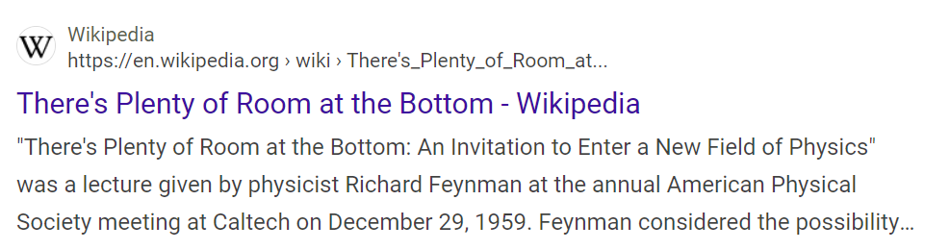

Slide 5
“Molecules respond to changes in their environment.
The presence of various ions, neutral species, pH, temperature, and viscosity, among many others, result in colour or emission changes as a result of the complex interplay of many excited state processes and environmental parameters.”
Chem. Soc. Rev. (2018) 47 (7): 2228–2248

Slide 6
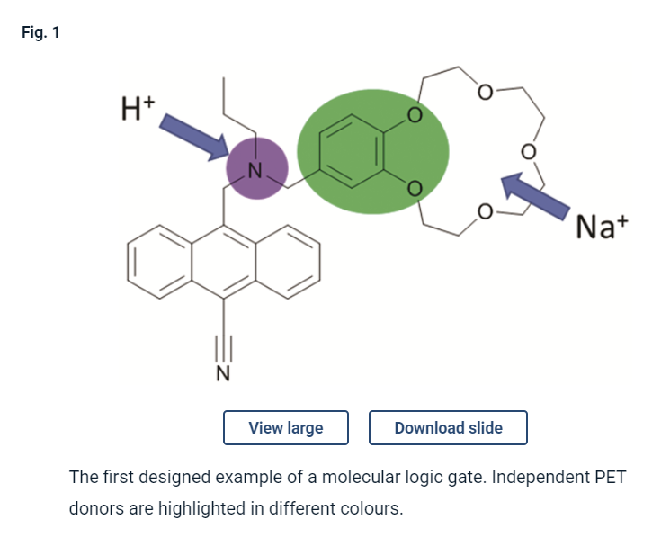
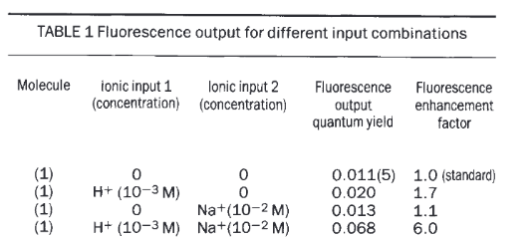
P. de Silva, H. Q. N. Gunaratne and C. P. McCoy, Nature, 1993, 364, 42–44.
PET = Photoinduced Electron Transfer

Slide 7
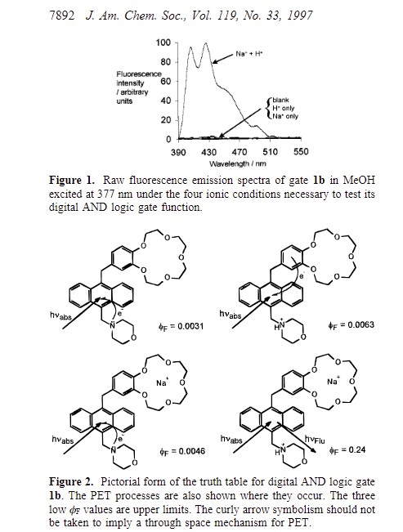
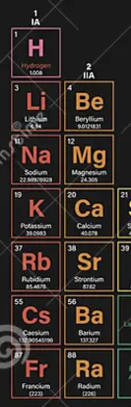
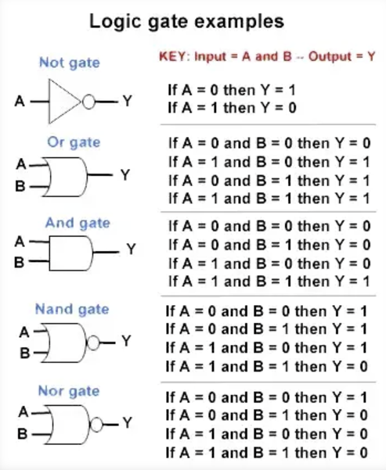
Case studies: simple ones compounded ones.

Slide 8
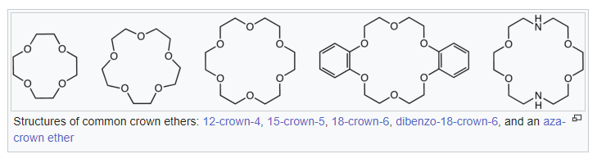
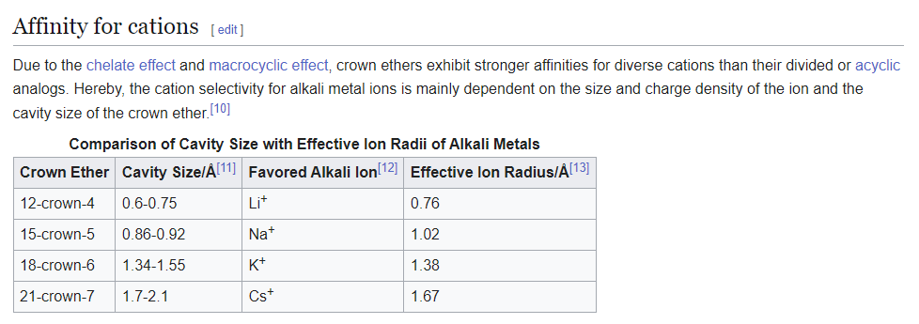
One way of tuning “selectivity”
A look at the fit using alkali metals into crown ether
metal ion is one of many types of “external stimuli.”

Slide 9
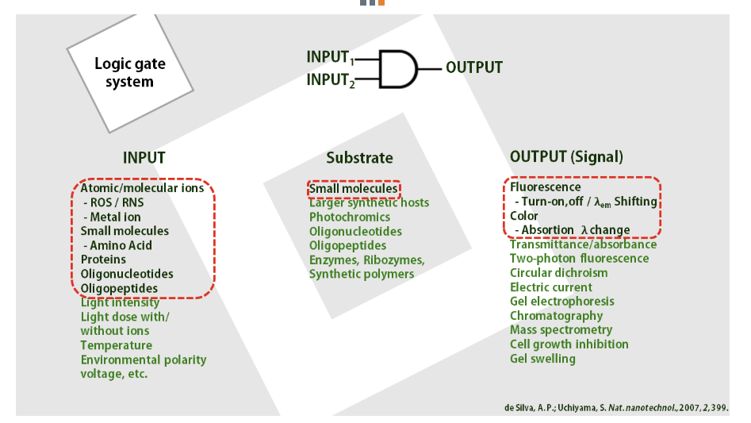

Slide 10
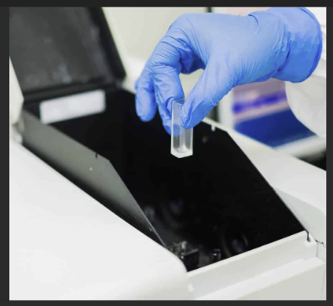
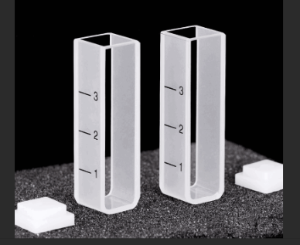
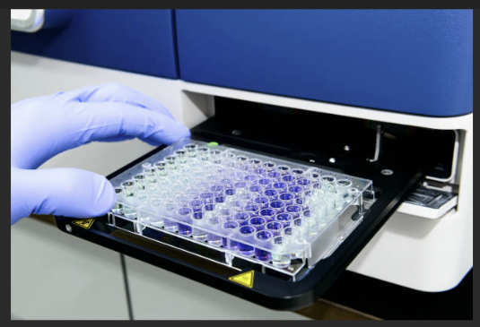
Often we look at absorption and emission spectra

Slide 11
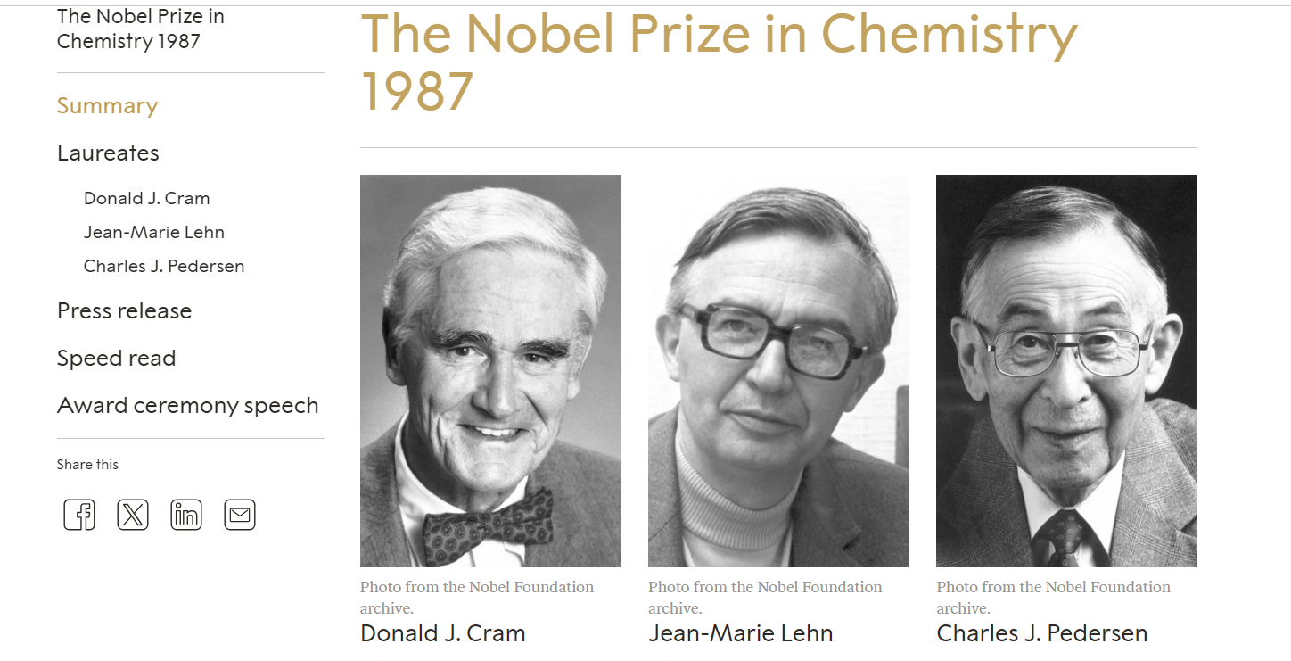
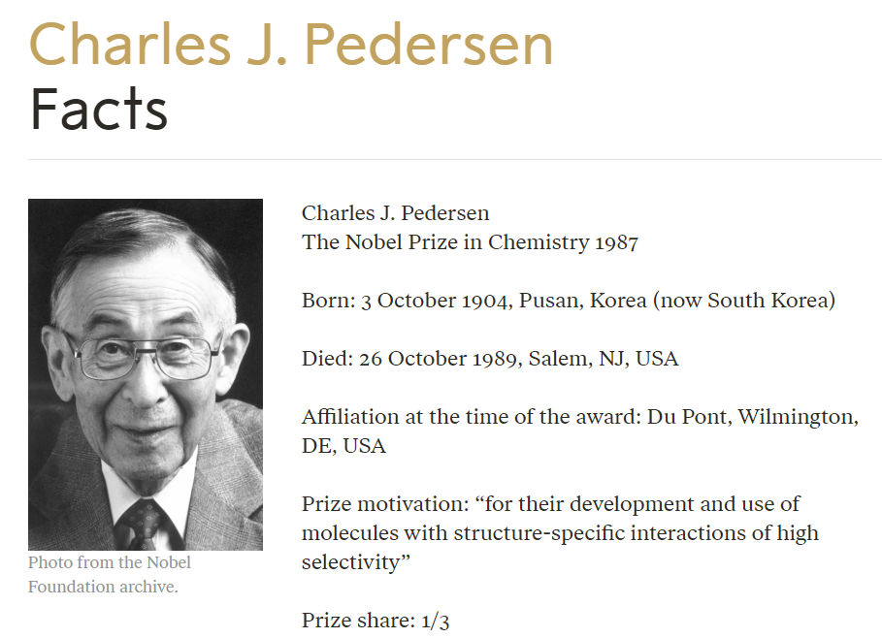
1987 Nobel prize in Chemistry for such host guest complexation. A look at the fit using alkali metals…

Slide 12
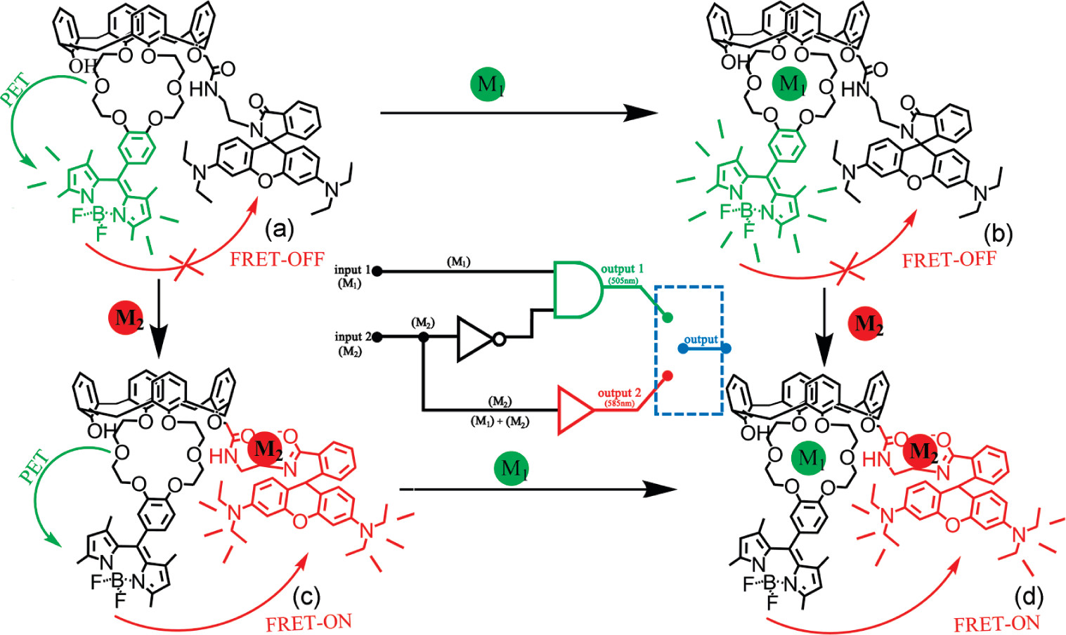
Proposed different complexation situation of compound 1 with different ions.
A Multianalyte Chemosensor on a Single Molecule: Promising Structure for an Integrated Logic Gate Mingjian Yuan, Weidong Zhou, Xiaofeng Liu, Mei Zhu, Junbo Li, Xiaodong Yin, Haiyan Zheng, Zicheng Zuo, Canbin Ouyang, Huibiao Liu, Yuliang Li, and Daoben Zhu The Journal of Organic Chemistry 2008 73 (13), 5008-5014.

Slide 13
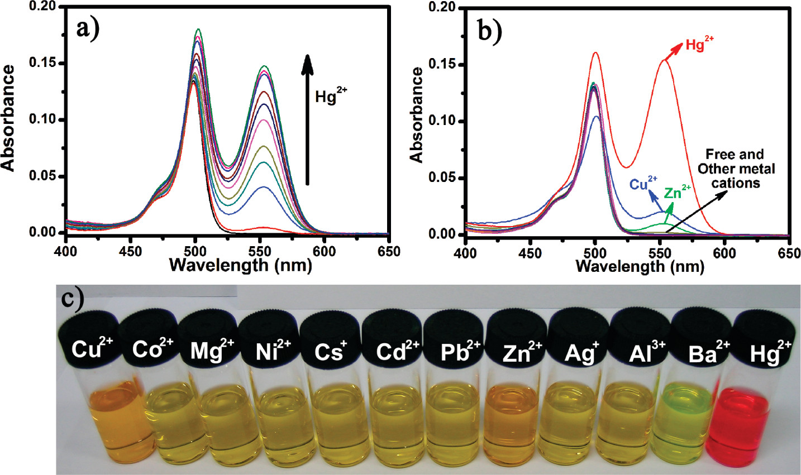
Absorbance spectra of compound 1 in the presence of increasing Hg2+ concentrations (0, 2, 3, 3.5, 4, 5, 10, 15, 20, 30, 40 μM) in acetonitrile solution. The concentration of compound 1 was 2 μM. (b) Absorbance spectra change of compound 1 (2 μM) upon addition of different metal cations (20 equiv) in acetontrile solution. (c) Photograph of compound 1 with different metal ions.

Slide 14
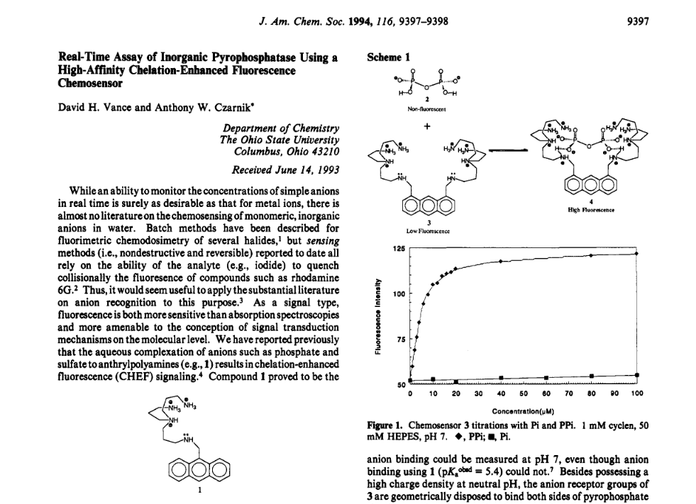
Notes:
Biological connection …

Slide 15
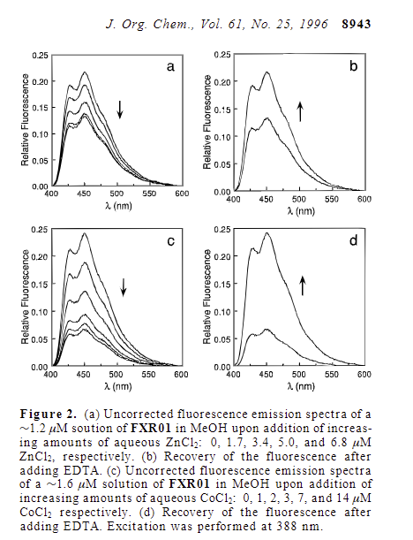
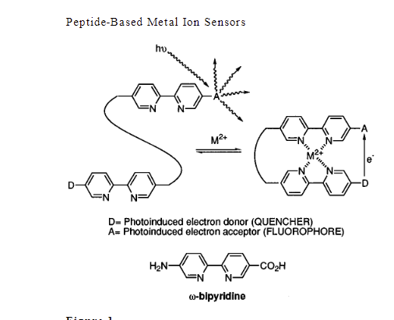

Slide 16
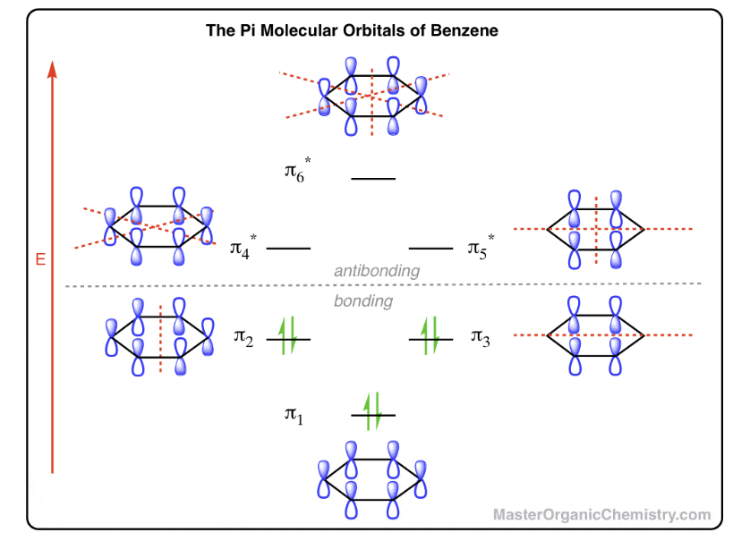
Benzene: molecular orbitals (frontier orbitals)
Contrasts with hexane (C₆H₁₂).
Contrasts with the switches in solid state … (ic notes)
Notes:
https://www.physicsforums.com/threads/measuring-the-built-in-potential-of-a-pn-junction.1015545/

Slide 17

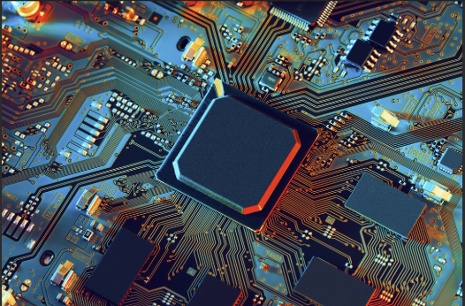
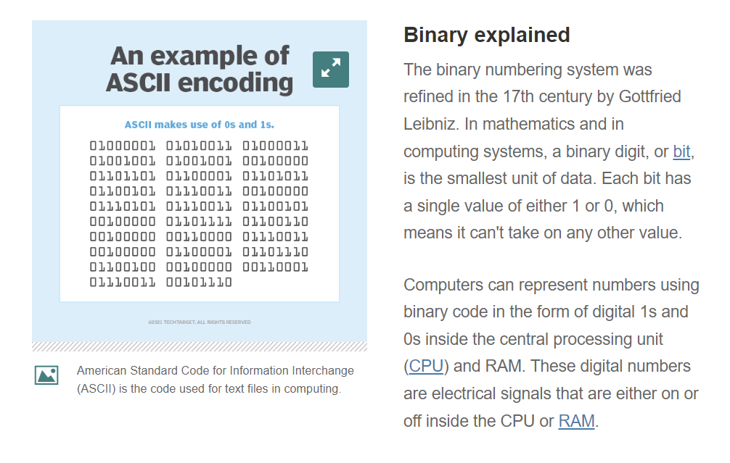
The integrated circuit & the revolution with silicon
(solid state)
Revolution with Silicon → “Silicon Valley.”
If you read the book “Chip wars”, it will explain much about the history of the integrated circuit etc.
The Americans…
Got it started and the interest in producing (high quality) chips continues to this day.
Wiki “An integrated circuit is defined as:[1] A circuit in which all or some of the circuit elements are inseparably associated and electrically interconnected so that it is considered to be indivisible for the purposes of construction and commerce.”
Challenge: Can we achieve something like this in solution?
The first slides addressed this research direction.

Slide 18
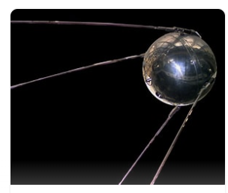

Slide 19
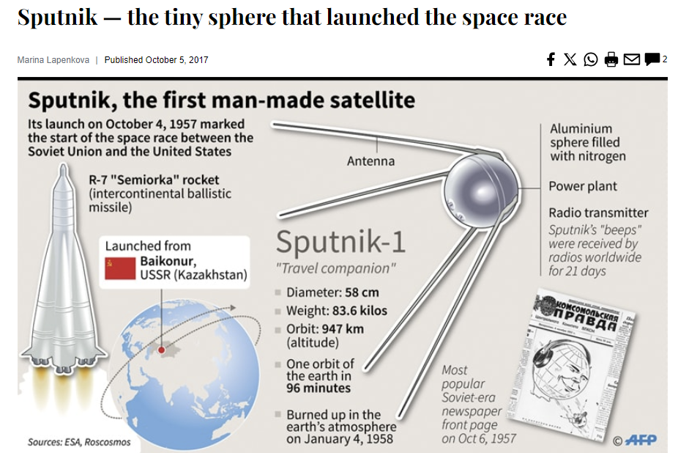

Slide 20
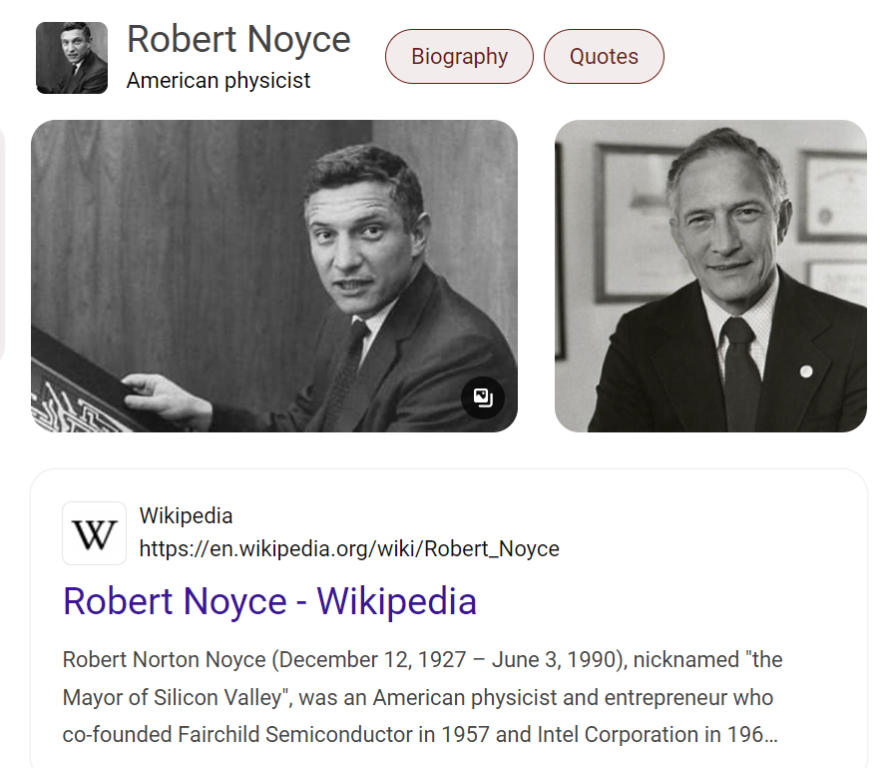

Slide 21
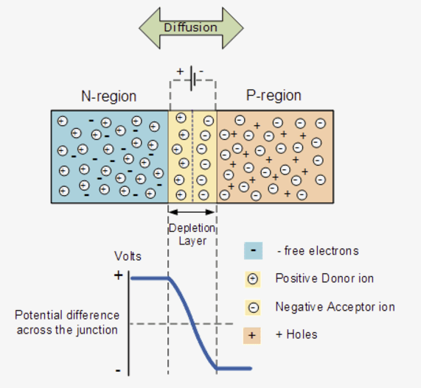
Solid State: A pn junction
Solution state, versus the extremely widespread conventional solid state methods…..
Below is part of what we would teach undergraduates about electronics in our Inorg. Chem. Class…
“Why is it important to measure the built-in potential of a pn junction?”
“The built-in potential of a pn junction is a key parameter that affects the behavior and performance of electronic devices such as diodes, transistors, and solar cells. By accurately measuring the built-in potential, engineers and scientists can better understand and optimize the functionality and efficiency of these devices.
Reference: https://www.physicsforums.com/threads/measuring-the-built-in-potential-of-a-pn-junction.1015545/”

Slide 22
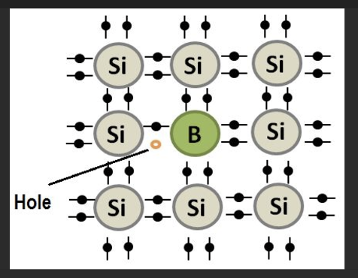
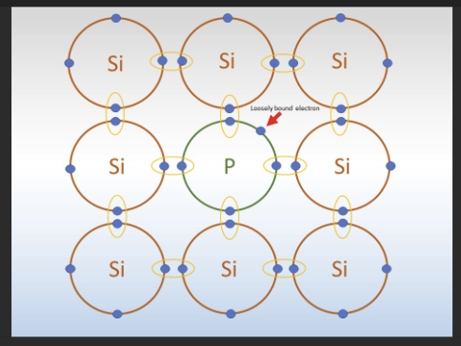
“P-type: Doped with trivalent impurities (e.g., aluminum), leading to a deficit of electrons.”
“N-type: Doped with pentavalent impurities (e.g., phosphorus), creating an excess of electrons.”

Slide 23
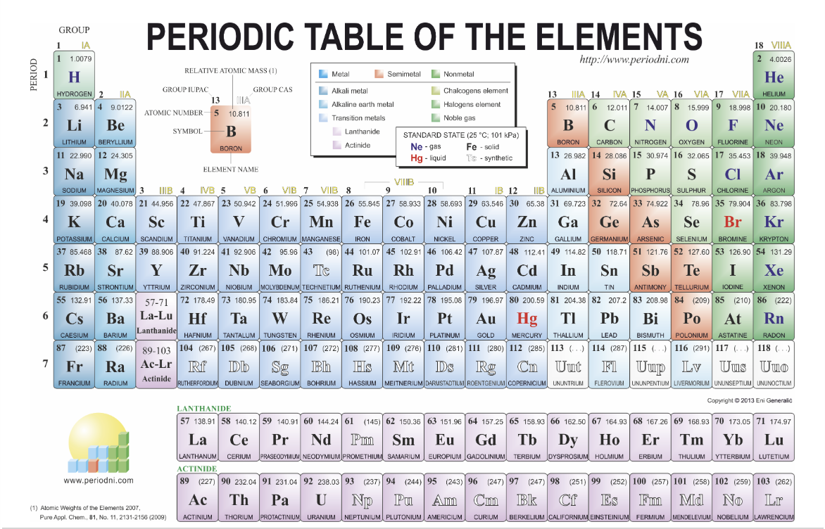

Slide 24
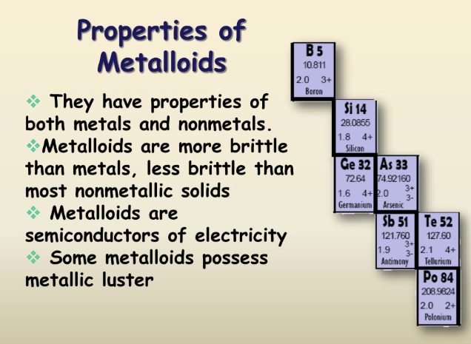

Slide 25
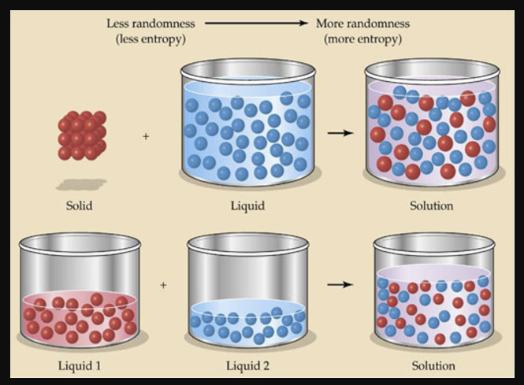
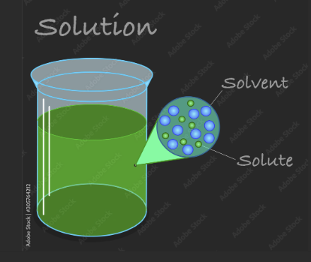
With solution computers, we are much more at the mercy of more chemical principles:
mass action, dilution, physical properties of solvent and solute etc. But there is more to gain: our brain is not made of silicon; we can interface with e.g. biology in an extremely natural way.

Slide 26
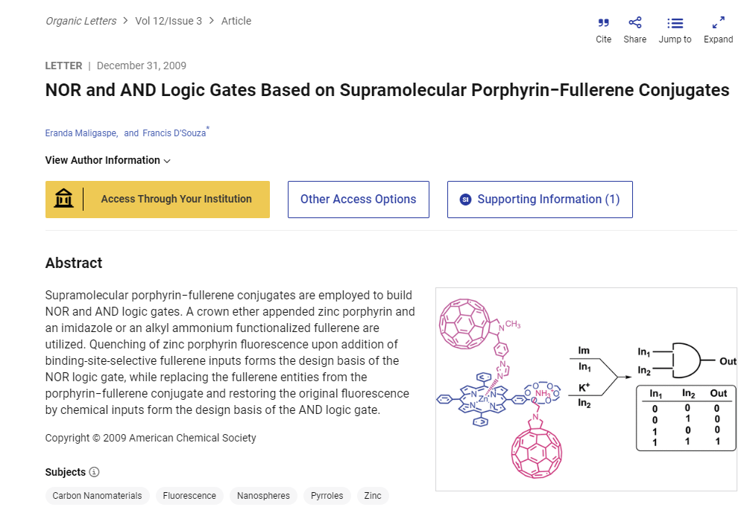

Slide 27
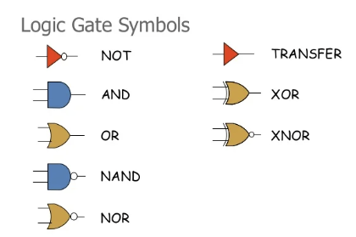
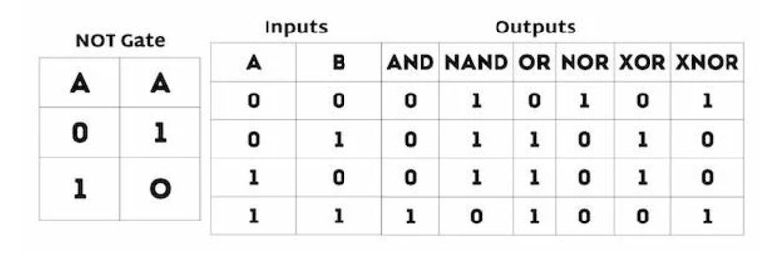
Basic Boolean Logic Gates:
Single and Two Inputs
“BASIC LOGIC GATES REPRESENTED USING THE TRUTH TABLE”

Slide 28
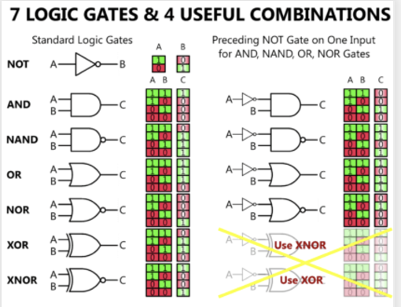
EARLIER EXAMPLE BY YUAN ET AL.

Slide 29
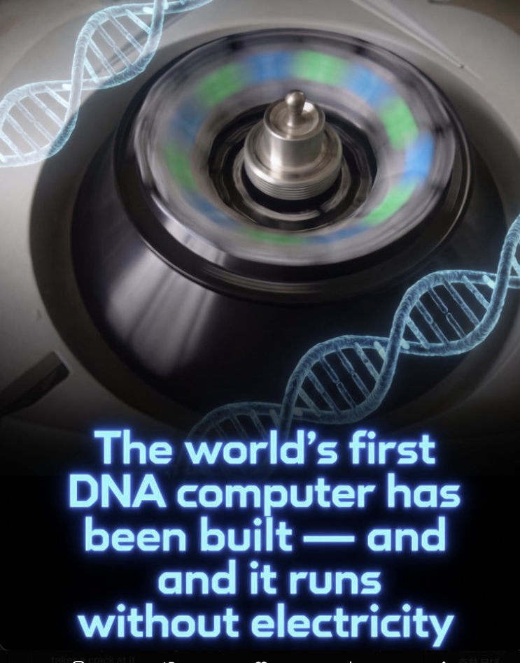
[Stérin, T., Eshra, A., Evans, C. G., Adio, J., & Woods, D. (2026). A thermodynamically favoured molecular computer. Nature, 657, 646–652. DOI: 10.1038/s41586-026-10996-5]

Slide 30
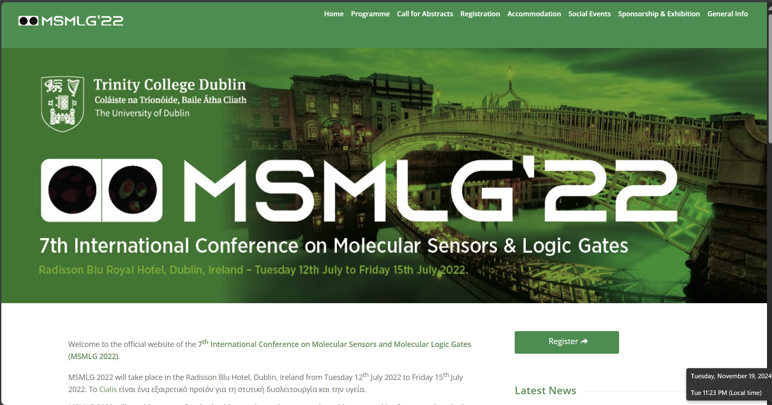
Major International Conferences – had one in Korea Univ. in 2012…

Slide 31
More and more major literature reviews/perspectives are appearing in our field … central to chemistry or interdisciplinary …
Accessed Nov. 2024

Slide 32
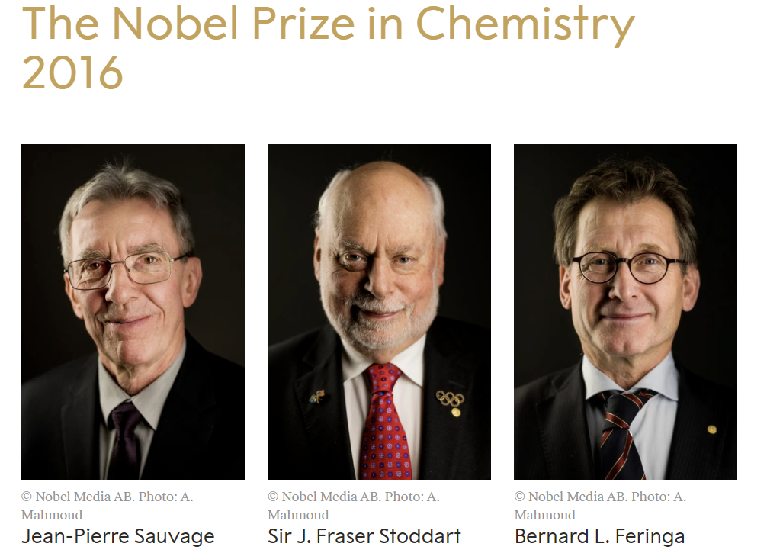
A related topic: molecular machines…
This topic is along the lines of what we can do with computation; these researches have also thought about molecular computation to a good degree.

Slide 33
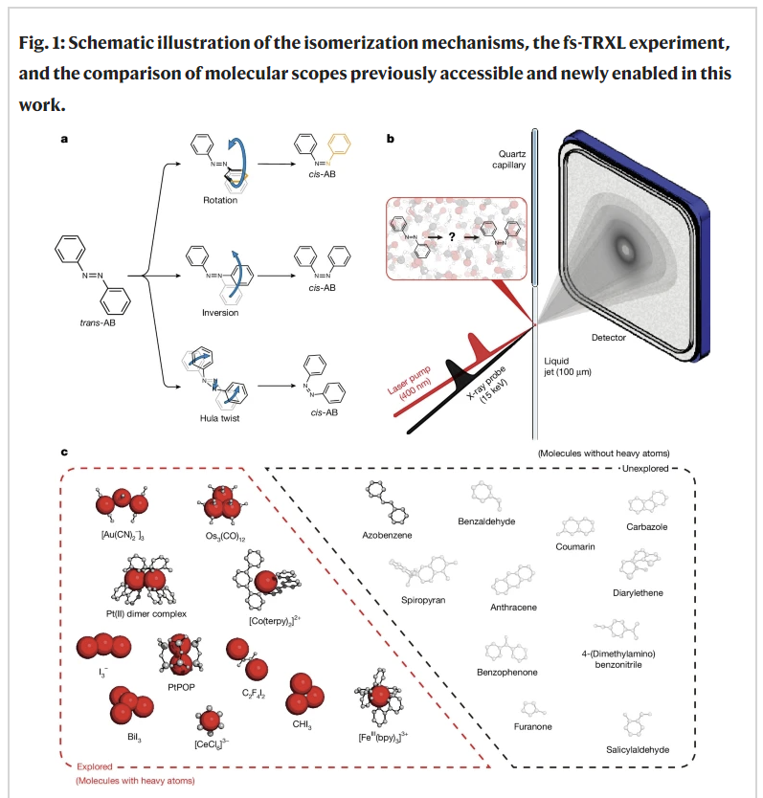
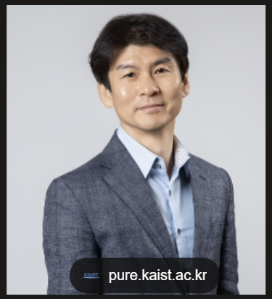
Fundamental understanding of molecular motions

Slide 34
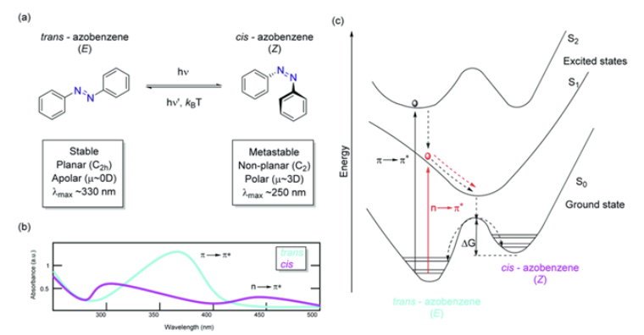
https://ch-fanyi.com

Slide 35
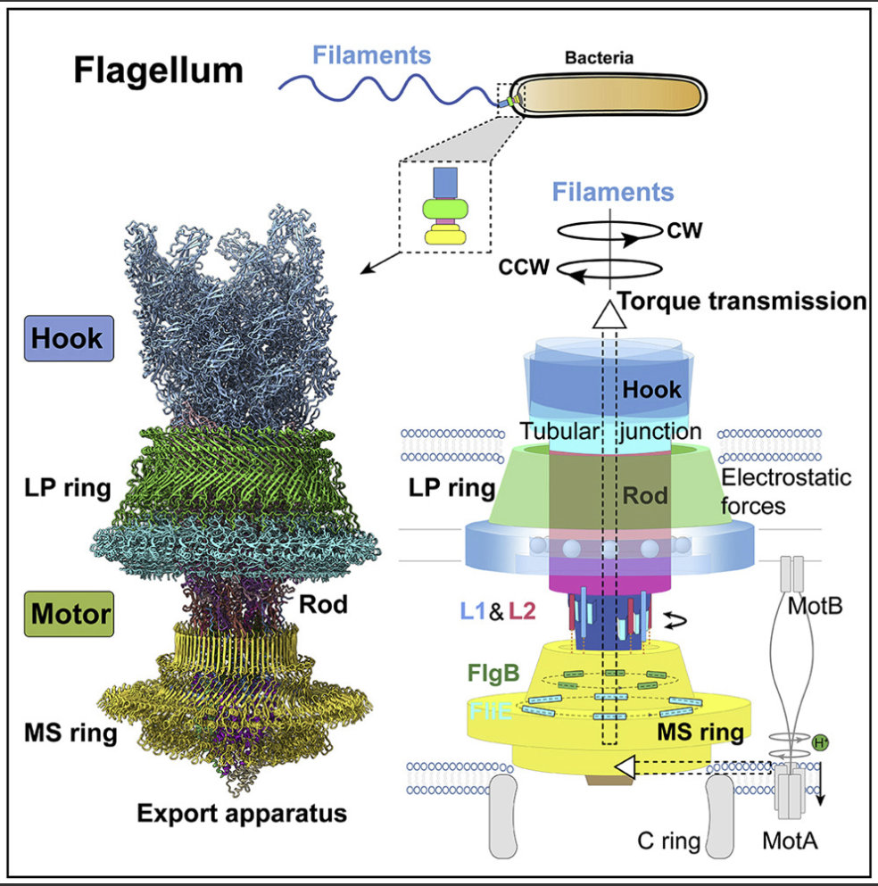

Slide 36
Scientists built the world's first DNA computer, executing mathematical calculations using self-assembling genetic molecules rather than electricity. Researchers at Maynooth University in Ireland have unveiled a breakthrough in molecular biocomputing: the world's first Scaffolded DNA Computer.
Detailed in a study published in Nature, the system operates without electronic components or silicon chips. Instead, it processes data when short DNA strands, a longer structural DNA scaffold, water, and salt are combined in a test tube.
After brief heating and cooling, trillions of floating DNA strands compete, bind, and detach along the scaffold, relying on thermodynamic stability to find the correct computational answers.
During testing, the bio-computer executed 10 distinct programs, including addition, division by two, multiplication by three, and parity detection, reusing some programs for up to 25 consecutive calculations. While simple problems like 10 plus 3 were solved in just 30 seconds, more complex computations involving millions of numbers required up to 14 hours.
Because incorrect molecular pairings are energetically unfavorable, the strands naturally replace each other until reaching a stable state that encodes the final result. This milestone opens possibilities for zero-electricity computing, long-term biological data storage, and cellular disease detection.

Slide 37
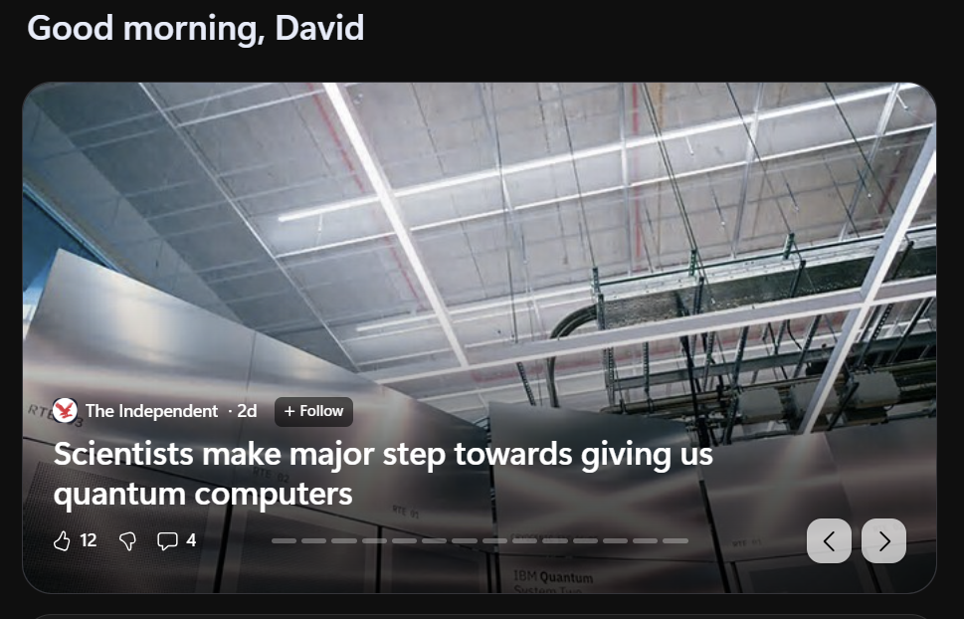

Slide 38

“Quantum mechanics, the study of physics at small scales, reveals surprising fundamental natural principles. Quantum computers specifically harness these phenomena to access mathematical methods of solving problems not available with classical computing alone.”
https://www.ibm.com/think/topics/quantum-computing

Slide 39


Slide 40

the chemistry or molecules of quantum hardware (?)

Slide 41
Continued and future challenges
Current challenge: Integration
Cycling: We need 10¹¹ cycles for considering commercial applications with molecular switches.
Let’s admire the size of these molecules ….
“Plenty of room at the bottom”
feynman
And the quest continues …
The way chemists think.
We have to make the compound reproducibly ….
Demanding purity from reactions (might have a lot of side reactions).
Chemical or photolytic decomposition?
Reversible, versus irreversible.

Slide 42
Summary: Today, you have seen…
An active area of research (conferences and possible prizes)
How commercial applications might abound.
Connections of chemistry to different areas. examples from the original primary literature.
Recent and related achievements and a bit of history, perspectives, .
The different ways chemists/scientists are approaching computation in new ways.
How information is stored and possibly processed in solution.

Slide 43

Thank you very much for your kind attention!!

