Slide 1
APPROXIMATION CAPABILITIES OF NEURAL NETWORKS

Slide 2
APPROXIMATION… WHAT?
What are neural network systems actually capable of?
We can “approximate” that with the Universal Approximation Theorem
(Spoilers: They can do pretty much everything… kind of…)

Slide 3
Artificial Neural Network
Mathematical Recap

Slide 4
ARTIFICIAL NEURAL NETWORK RECAP
Connections/Synapses
Nodes/Neurons
Input
Output
width
Input layer
Output layer
Hidden layers
depth

Slide 5


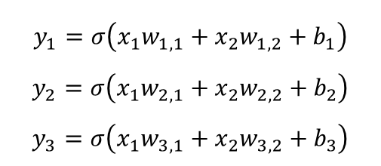

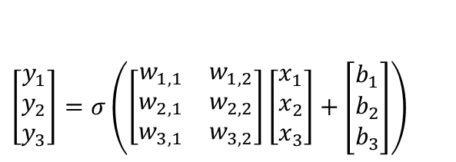


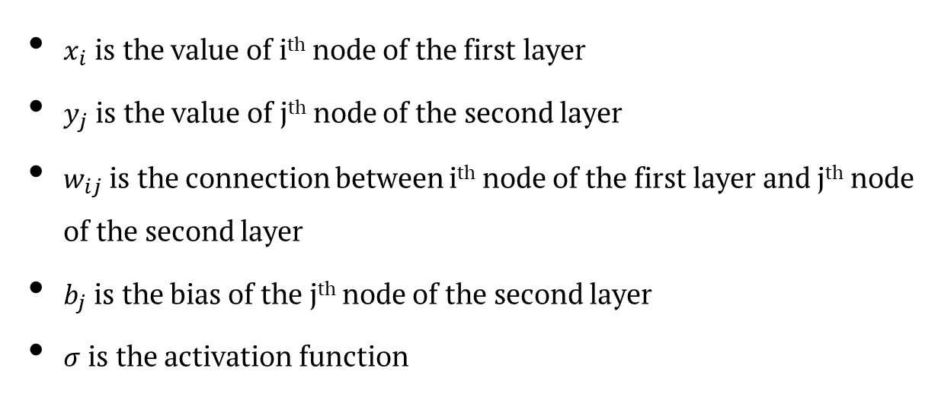







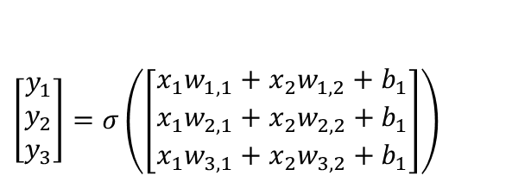




ARTIFICIAL NEURAL NETWORK RECAP
$$σ$$
$x_{i}$ is the value of i^{th} node of the first layer
$y_{j}$ is the value of j^{th} node of the second layer
$w_{ij}$ is the connection between i^{th} node of the first layer and j^{th} node of the second layer
$b_{j}$ is the bias of the j^{th} node of the second layer
$σ$ is the activation function
$$y_{1}$$
$$b_{1}$$
$$w_{1,1}$$
$$x_{1}$$
$$w_{1,2}$$
$$w_{2,1}$$
$$w_{2,2}$$
$$y_{2}$$
$$b_{2}$$
$$x_{2}$$
$$w_{3,2}$$
$$w_{3,1}$$
$$y_{3}$$
$$b_{3}$$
$$y_{1}=σ\left(x_{1}w_{1,1}+x_{2}w_{1,2}+b_{1}\right)$$
$$y_{2}=σ\left(x_{1}w_{2,1}+x_{2}w_{2,2}+b_{2}\right)$$
$$y_{3}=σ\left(x_{1}w_{3,1}+x_{2}w_{3,2}+b_{3}\right)$$
$\left[\begin{matrix}y_{1} \\ y_{2} \\ y_{3}\end{matrix}\right]=$ $σ\left(\left[\begin{matrix}x_{1}w_{1,1}+x_{2}w_{1,2}+b_{1} \\ x_{1}w_{2,1}+x_{2}w_{2,2}+b_{1} \\ x_{1}w_{3,1}+x_{2}w_{3,2}+b_{1}\end{matrix}\right]\right)$
$\left[\begin{matrix}y_{1} \\ y_{2} \\ y_{3}\end{matrix}\right]=$ $σ\left(\left[\begin{matrix}w_{1,1} & w_{1,2} \\ w_{2,1} & w_{2,2} \\ w_{3,1} & w_{3,2}\end{matrix}\right]\left[\begin{aligned}x_{1} \\ x_{2} \\ x_{3}\end{aligned}\right]+\left[\begin{aligned}b_{1} \\ b_{2} \\ b_{3}\end{aligned}\right]\right)$
$$Y=σ\left(WX+B\right)$$

Slide 6





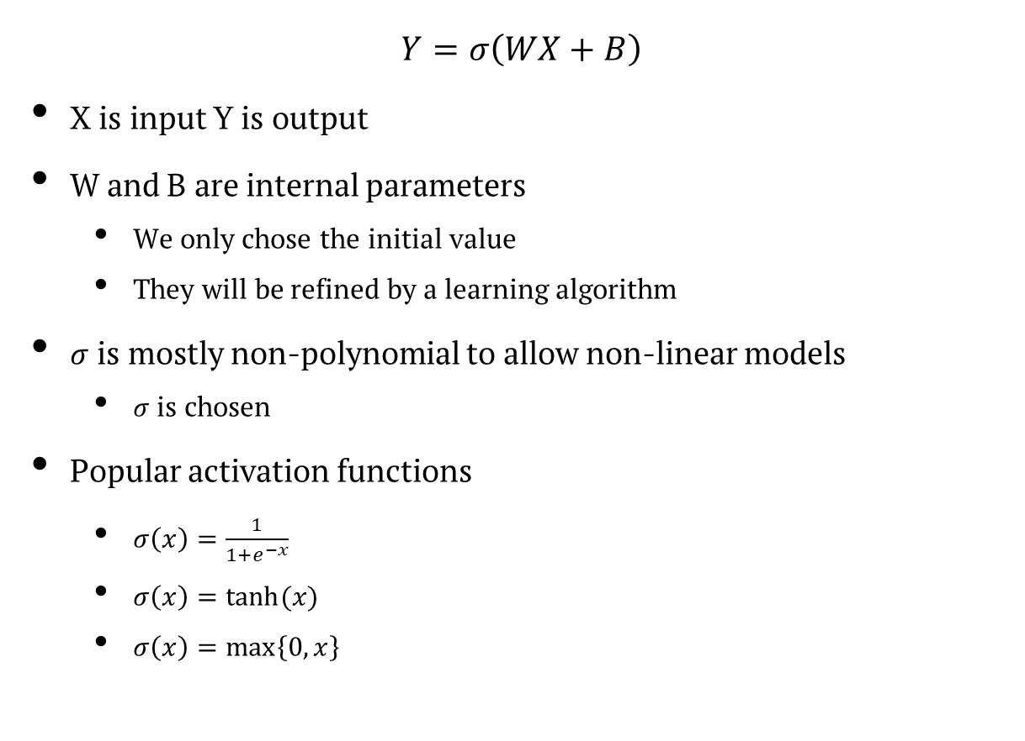
ARTIFICIAL NEURAL NETWORK RECAP
$$σ$$
$$Y=σ\left(WX+B\right)$$
X is input Y is output
W and B are internal parameters
We only chose the initial value
They will be refined by a learning algorithm
$σ$ is mostly non-polynomial to allow non-linear models
$σ$ is chosen
Popular activation functions
$σ\left(x\right)=\frac{1}{1+e^{−x}}$
$σ\left(x\right)=tanh⁡(x)$
$σ\left(x\right)=\max\left\{0,x\right\}$
$$X$$
$$W$$
$$Y$$
$$B$$

Slide 7
Universal Approximation Theorem
Overview

Slide 8
UNIVERSAL APPROXIMATION THEOREM
Overview:
Any continuous function can be “Approximated” with an ANN.
or
An ANN with the right size and parameters can “Approximate” any continuous function.

Slide 9
Approximation
Mathematical Definition

Slide 10
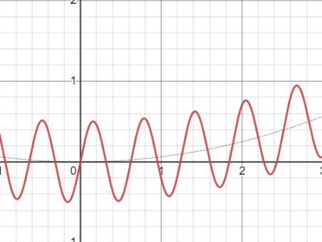
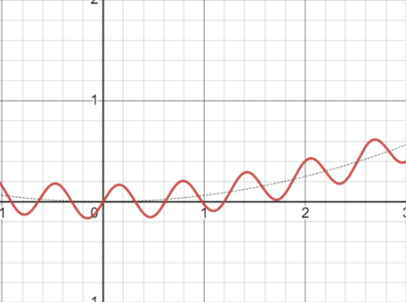
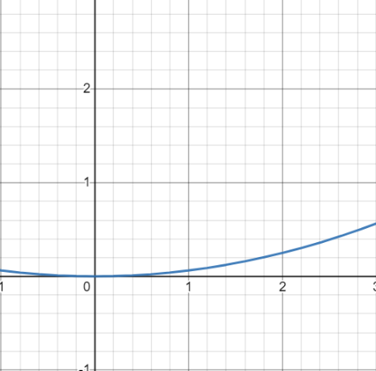
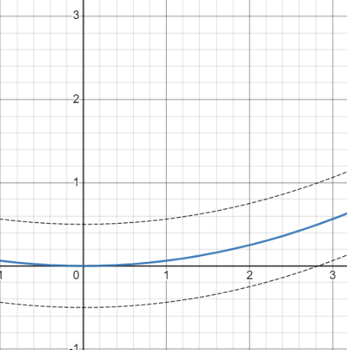
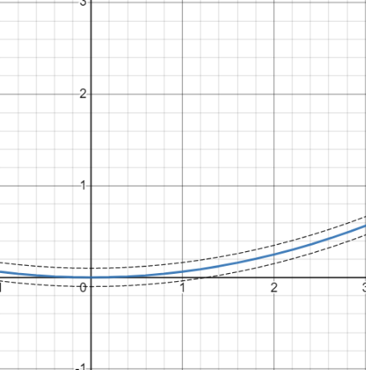
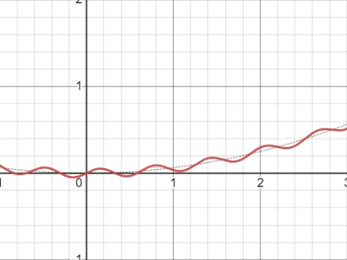
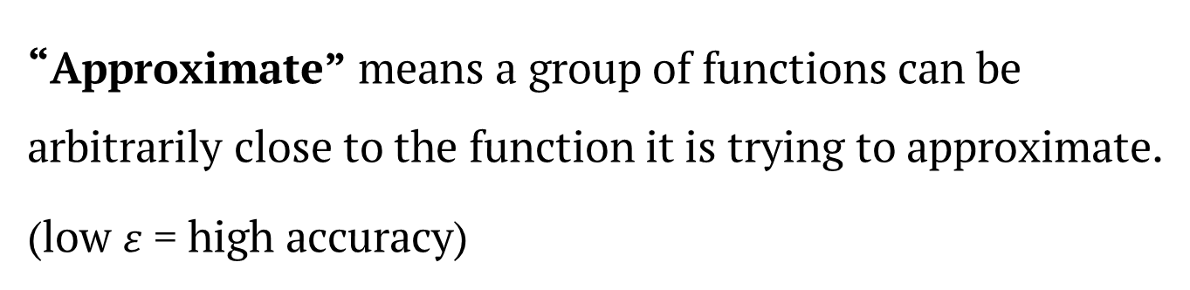



APPROXIMATION
“Approximate” means a group of functions can be arbitrarily close to the function it is trying to approximate.
(low $ε$ = high accuracy)
$$∙∙∙$$
Function to approximate
$$ε=0.5$$
$$ε=0.1$$
Group of Functions

Slide 11
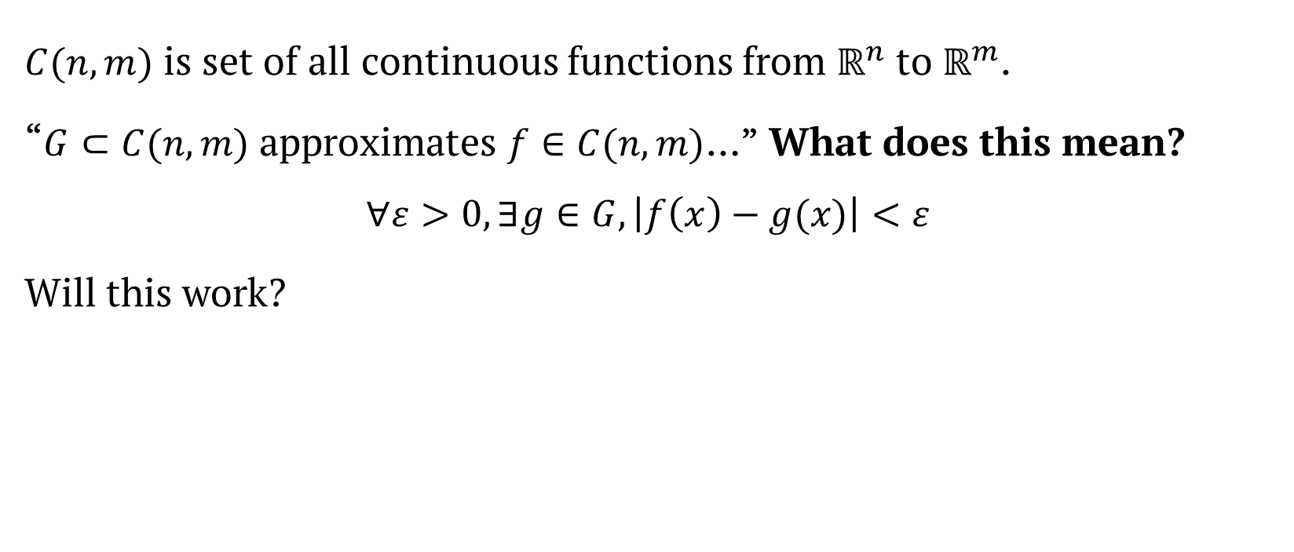
APPROXIMATION
$C(n,m)$ is set of all continuous functions from $ℝ^{n}$ to $ℝ^{m}$.
“$G⊂C(n,m)$ approximates $f∈C(n, m)$…” What does this mean?
$$∀ε>0,∃g∈G,\left|f\left(x\right)−g(x)\right|<ε$$
Will this work?

Slide 12
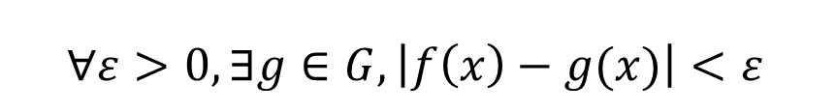
APPROXIMATION
$$∀ε>0,∃g∈G,\left|f\left(x\right)−g(x)\right|<ε$$

Slide 13
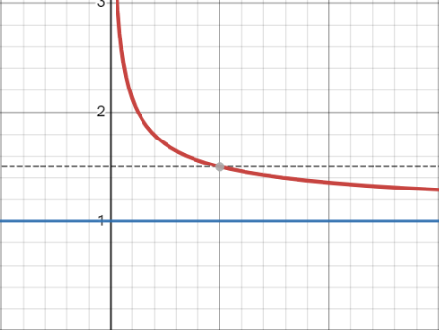
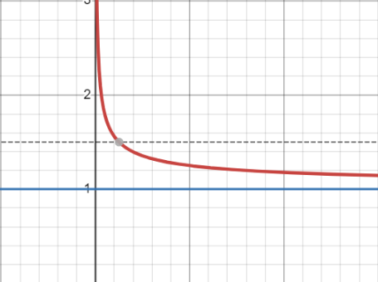
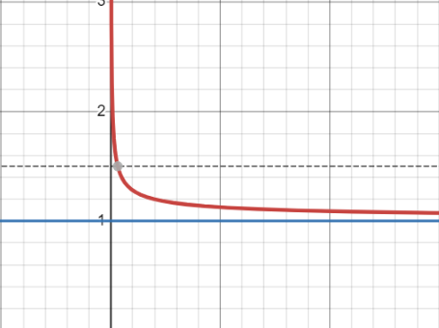
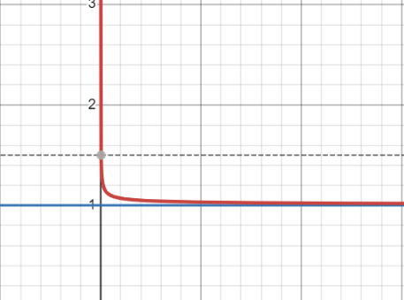
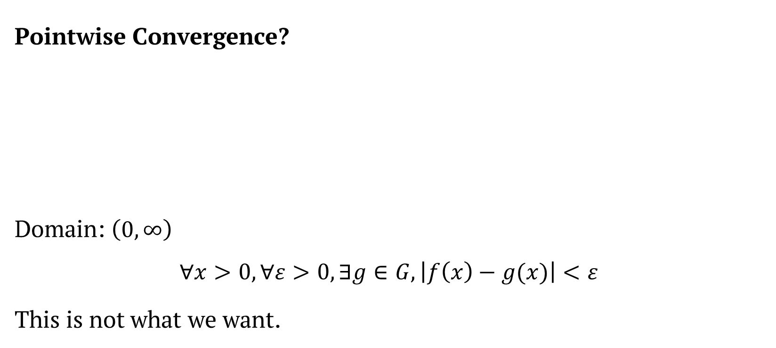
APPROXIMATION
Pointwise Convergence?
Domain: $\left(0, ∞\right)$
$$∀x>0,∀ε>0,∃g∈G,\left|f\left(x\right)−g(x)\right|<ε$$
This is not what we want.

Slide 14


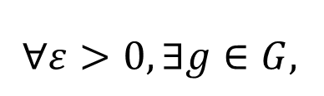
APPROXIMATION
$$∀x>0,$$
$$\left|f\left(x\right)−g(x)\right|<ε$$
$$∀ε>0,∃g∈G,$$

Slide 15
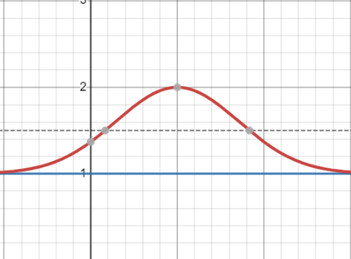
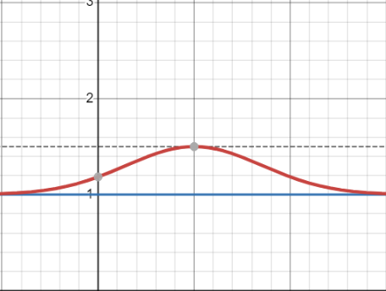
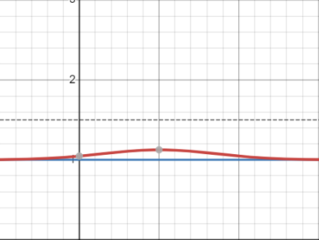
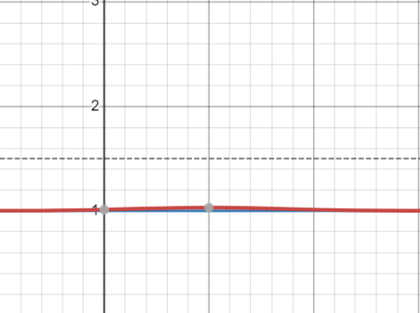

APPROXIMATION
Uniform Approximation?
Domain: $\left(0, ∞\right)$
$$∀ε>0,∃g∈G,∀x>0,\left|f\left(x\right)−g(x)\right|<ε$$
Functions have desired accuracy for every possible input.

Slide 16
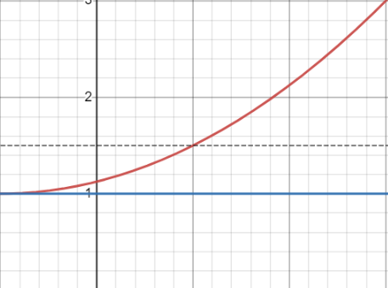
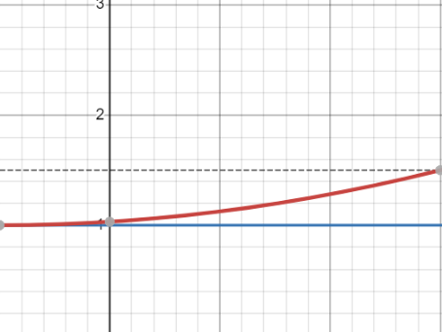
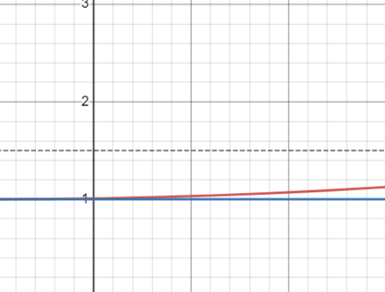

APPROXIMATION
Uniform Approximation?
Domain: $\left(0, ∞\right)$
$$∀ε>0,∃g∈G,∀x>0,\left|f\left(x\right)−g(x)\right|<ε$$

Slide 17


APPROXIMATION
Uniform Approximation in a compact set
Domain: $\left(0, ∞\right)→\left[0, 3\right]$
$$∀ε>0,∃g∈G,∀x∈\left[0, 3\right],\left|f\left(x\right)−g(x)\right|<ε$$
Note: Set A is compact $↔$ Set A is both bounded and closed

Slide 18
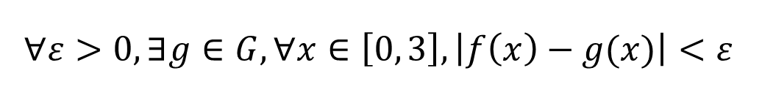
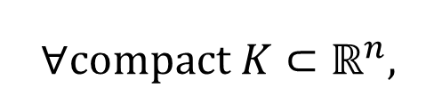
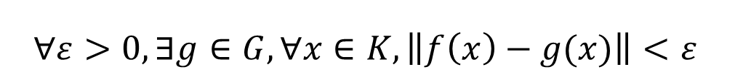
APPROXIMATION
$$∀compact K⊂ℝ^{n},$$
$$∀ε>0,∃g∈G,∀x∈K,\left\|f\left(x\right)−g(x)\right\|<ε$$
$$∀ε>0,∃g∈G,∀x∈\left[0, 3\right],\left|f\left(x\right)−g(x)\right|<ε$$

Slide 19

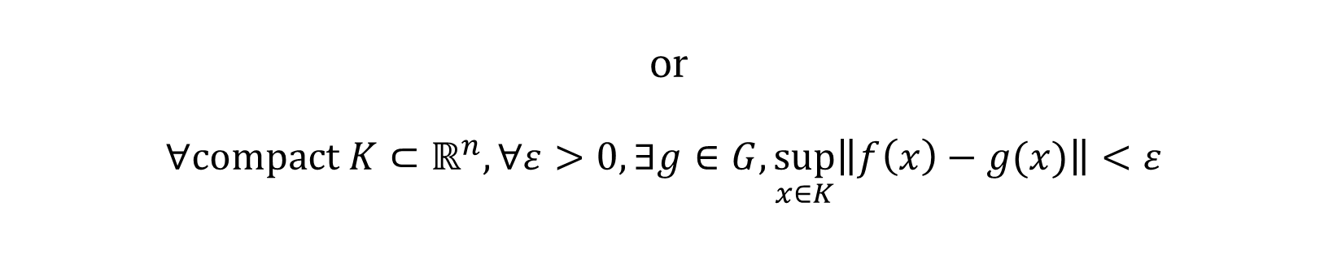
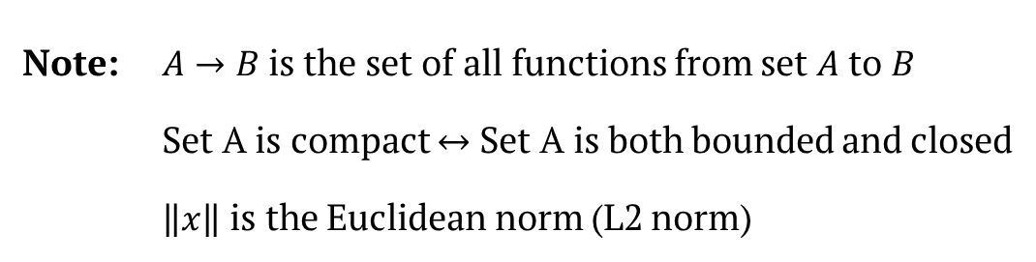
APPROXIMATION
$G⊂ℝ^{n}→ℝ^{m}$ approximates $f:ℝ^{n}→ℝ^{m}$
$$↕$$
$$∀compact K⊂ℝ^{n},∀ε>0,∃g∈G,∀x∈K,\left\|f\left(x\right)−g(x)\right\|<ε$$
or
$$∀compact K⊂ℝ^{n},∀ε>0,∃g∈G,\sup_{x∈K}\left\|f\left(x\right)−g(x)\right\|<ε$$
Note: $A→B$is the set of all functions from set $A$ to $B$
Set A is compact $↔$ Set A is both bounded and closed
$\left\|x\right\|$ is the Euclidean norm (L2 norm)

Slide 20
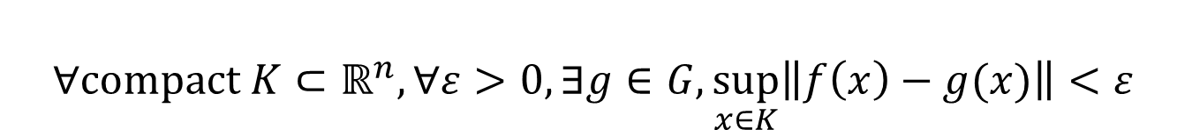
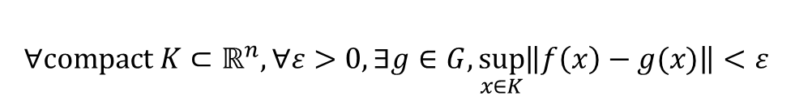
APPROXIMATION
$$∀compact K⊂ℝ^{n},∀ε>0,∃g∈G,\sup_{x∈K}\left\|f\left(x\right)−g(x)\right\|<ε$$
$$∀compact K⊂ℝ^{n},∀ε>0,∃g∈G,\sup_{x∈K}\left\|f\left(x\right)−g(x)\right\|<ε$$

Slide 21


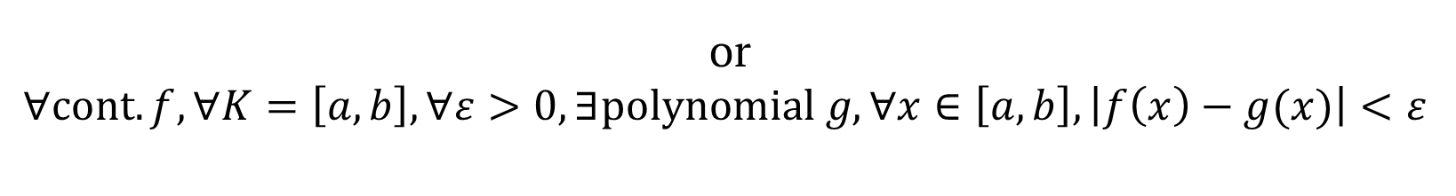
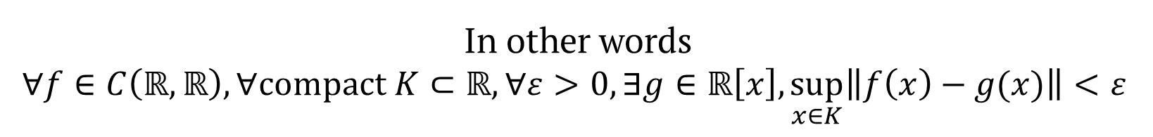
APPROXIMATION
Weierstrass Approximation Theorem
Denote $ℝ\left[x\right]$as set of all polynomials in $ℝ$
Denote $C(A,B)$ as set of all continuous functions from $A$ to $B$
Then,
$ℝ\left[x\right]$ approximates all $f∈C\left(ℝ,ℝ\right).$
In other words
$$∀f∈C\left(ℝ,ℝ\right),∀compact K⊂ℝ,∀ε>0,∃g∈ℝ\left[x\right],\sup_{x∈K}\left\|f\left(x\right)−g(x)\right\|<ε$$
or
$$∀cont.f,∀K=\left[a, b\right],∀ε>0,∃polynomial g,∀x∈\left[a,b\right], \left|f\left(x\right)−g(x)\right|<ε$$
$$∀compact K⊂ℝ^{n},∀ε>0,∃g∈G,\sup_{x∈K}\left\|f\left(x\right)−g(x)\right\|<ε$$

Slide 22
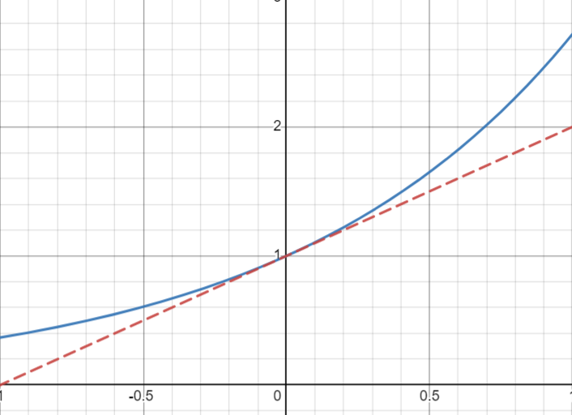
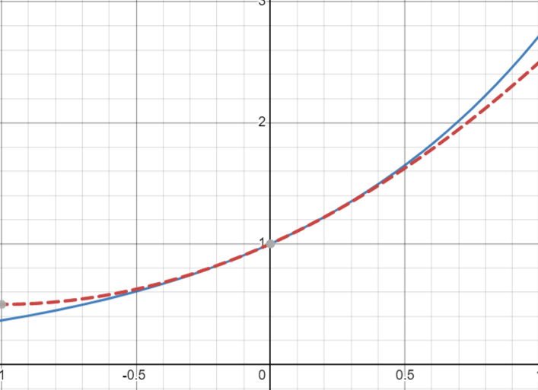
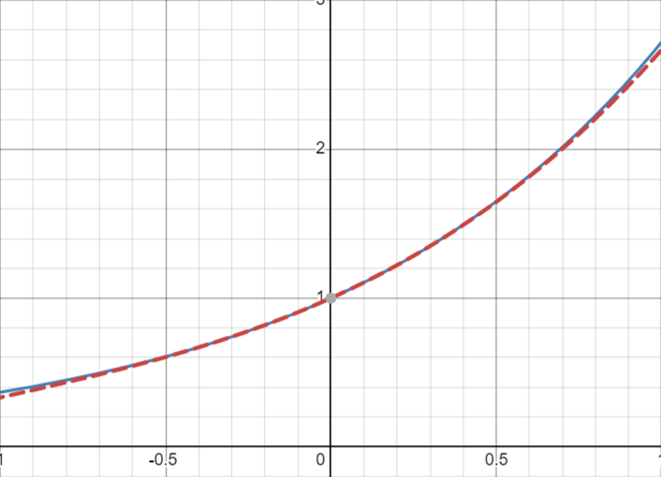
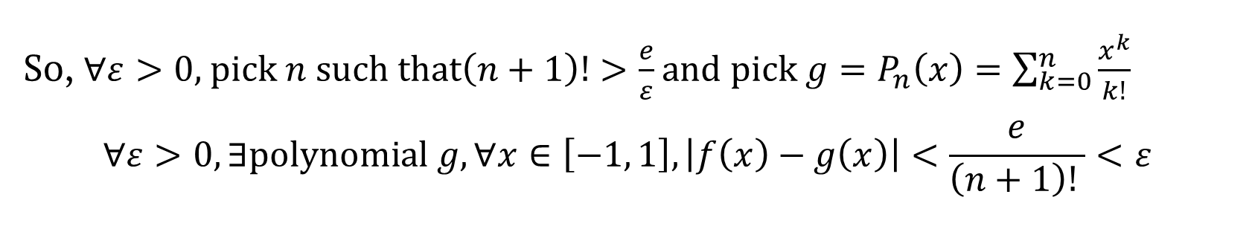
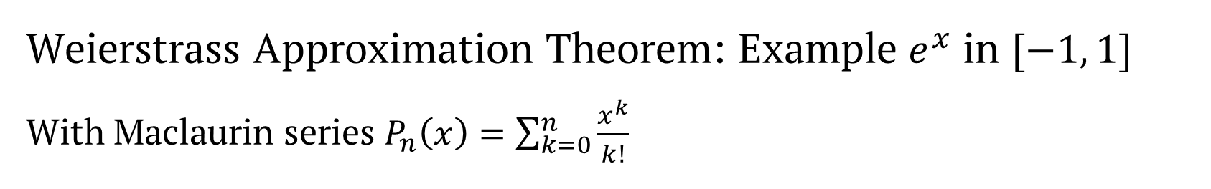
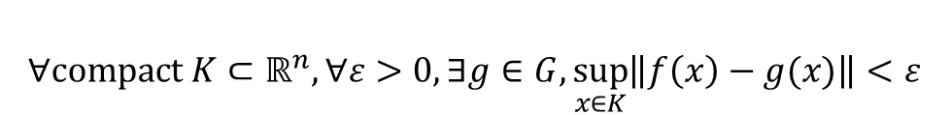
APPROXIMATION
Weierstrass Approximation Theorem: Example $e^{x}$ in $[−1, 1]$
With Maclaurin series $P_{n}\left(x\right)=\sum_{k=0}^{n}{\frac{x^{k}}{k!}}$
By Taylor’s theorem, we can deduce $∀x∈\left[−1, 1\right], \left|e^{x}−P_{n}\left(x\right)\right|≤\frac{e}{\left(n+1\right)! }$
So, $∀ε>0,$ pick $n$ such that$\left(n+1\right)!>\frac{e}{ε}$ and pick $g=P_{n}\left(x\right)=\sum_{k=0}^{n}{\frac{x^{k}}{k!}}$
$$∀ε>0,∃polynomial g,∀x∈\left[−1, 1\right], \left|f\left(x\right)−g\left(x\right)\right|<\frac{e}{\left(n+1\right)! }<ε$$
$$∀compact K⊂ℝ^{n},∀ε>0,∃g∈G,\sup_{x∈K}\left\|f\left(x\right)−g(x)\right\|<ε$$

Slide 23
Arbitrary Width Case
Statements

Slide 24
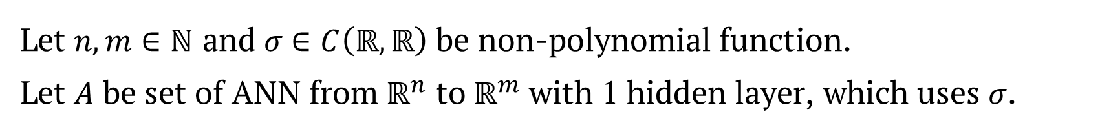

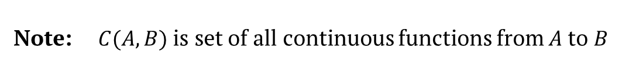


ARBITRARY WIDTH CASE
Let $n,m∈ℕ$ and $σ$ $∈C\left(ℝ,ℝ\right)$ be non-polynomial function.
Let $A$ be set of ANN from $ℝ^{n}$ to $ℝ^{m}$ with 1 hidden layer, which uses $σ$.
Input
$n$ nodes
Output
$m$ nodes
Hidden
Any number of nodes
Then,
$$∀f∈C\left(ℝ^{n}\text{,}ℝ^{m}\right),A approximatesf$$
Note: $C(A,B)$ is set of all continuous functions from $A$ to $B$

Slide 25










ARBITRARY WIDTH CASE
Let $n,m∈ℕ$ and $σ$ $∈C\left(ℝ,ℝ\right)$ be non-polynomial function.
Then,
$$∀f∈C\left(ℝ^{n}\text{,}ℝ^{m}\right),∀compact K⊂ℝ,∀ε>0,$$
$$∃k∈ℕ, A∈ℝ^{k×n},b∈ℝ^{k},C∈ℝ^{m×k},$$
Bias b
Weight $A$
Weight $C$
such that
$$g\left(x\right)=C∙σ(Ax+b)$$
then
$$\sup_{x∈K}\left\|f\left(x\right)−g(x)\right\|<ε$$
$n$ nodes
$k$nodes
$m$ nodes
Note: $σ\left(\left[\begin{matrix}x_{1} \\ ⋮ \\ x_{n}\end{matrix}\right]\right)=\left[\begin{matrix}σ\left(x_{1}\right) \\ ⋮ \\ σ\left(x_{n}\right)\end{matrix}\right]$
$$∀compact K⊂ℝ^{n},∀ε>0,∃g∈G,\sup_{x∈K}\left\|f\left(x\right)−g(x)\right\|<ε$$

Slide 26
Arbitrary Width Case
Visual Proof

Slide 27
Arbitrary Depth Case
Statements

Slide 28




ARBITRARY DEPTH CASE
Let $n,m∈ℕ$
Let $σ$ $∈C\left(ℝ,ℝ\right)$ be non-polynomial function such that $∃x∈σ,σ′\left(x\right)>0$.
Let $A$ be set of ANN from $ℝ^{n}$ to $ℝ^{m}$ with any numbers of hidden layers.
Hidden layers has $n+m+2$ nodes and uses $σ$ as activation function.
Input
$n$ nodes
Output
$m$ nodes
Any number of Hidden Layers
$n+m+2$ of nodes each
Then,
$$∀f∈C\left(ℝ^{n}\text{,}ℝ^{m}\right),A approximatesf$$

Slide 29
Approximation Theorem in Lp Space

Slide 30

ARBITRARY DEPTH CASE WITH Lp
$${\left\|\left[\begin{matrix}x_{1} \\ ⋮ \\ x_{n}\end{matrix}\right]\right\|}_{p}={\left({\left|x_{1}\right|}^{p}+…+{\left|x_{n}\right|}^{p}\right)}^{\frac{1}{p}}$$
$L^{p}\left(A\text{,} B\right)$ is the set of Bochner–Lebesgue p-integrable functions from A to B

Slide 31





ARBITRARY DEPTH CASE WITH Lp
Let $n,m∈ℕ$ and $σ\left(x\right)=ReLU\left(x\right)=max⁡\{0, x\}$.
Let $A$ be set of ANN from $ℝ^{n}$ to $ℝ^{m}$ of width $d=max⁡\{n+1, m\}$ that uses $σ$.
Input
$n$ nodes
Output
$m$ nodes
Any number of Hidden Layers
Then,
$$∀f∈L^{p}\left(ℝ^{n}\text{,}ℝ^{m}\right),∀ε>0,∃g∈G,\int_{ℝ^{n}}{{\left\|f\left(x\right)−g\left(x\right)\right\|}_{p}dx}<ε$$
Note: ${\left\|\left[\begin{matrix}x_{1} \\ ⋮ \\ x_{n}\end{matrix}\right]\right\|}_{p}={\left({\left|x_{1}\right|}^{p}+…+{\left|x_{n}\right|}^{p}\right)}^{\frac{1}{p}}$
$L^{p}\left(A\text{,} B\right)$ is the set of Bochner–Lebesgue p-integrable functions from A to b
$$∀compact K⊂ℝ^{n},∀ε>0,∃g∈G,\sup_{x∈K}\left\|f\left(x\right)−g(x)\right\|<ε$$

Slide 32

ARBITRARY DEPTH CASE WITH Lp
$$∀f∈L^{p}\left(ℝ^{n}\text{,}ℝ^{m}\right),∀ε>0,∃g∈G,\int_{ℝ^{n}}{{\left\|f\left(x\right)−g\left(x\right)\right\|}_{p}dx}<ε$$
$$∀compact K⊂ℝ^{n},∀ε>0,∃g∈G,\sup_{x∈K}\left\|f\left(x\right)−g(x)\right\|<ε$$

Slide 33


ARBITRARY DEPTH CASE WITH Lp
$$∀f∈L^{p}\left(ℝ^{n}\text{,}ℝ^{m}\right),∀ε>0,∃g∈G,\int_{ℝ^{n}}{{\left\|f\left(x\right)−g\left(x\right)\right\|}_{p}dx}<ε$$
$$∀compact K⊂ℝ^{n},∀ε>0,∃g∈G,\sup_{x∈K}\left\|f\left(x\right)−g(x)\right\|<ε$$

Slide 34







UNIVERSAL APPROXIMATION THEOREM
Pointwise Approximation
Domain: $\left(0, 4\right)$
$$y=1+\frac{1}{\sqrt{x}}$$
$$y=1+\frac{1}{2\sqrt{x}}$$
$$y=1+\frac{1}{4\sqrt{x}}$$
$$y=1+\frac{1}{8\sqrt{x}}$$
$$\int_{0}^{4}{{\left\|f\left(x\right)−g\left(x\right)\right\|}_{p}dx}=\int_{0}^{4}{\frac{1}{k\sqrt{x}}dx}=\frac{4}{k}$$
$$∀ε>0,∃g=1+\frac{1}{k\sqrt{x}},\int_{D}{{\left\|f\left(x\right)−g\left(x\right)\right\|}_{p}dx}<ε$$
$$∀compact K⊂ℝ^{n},∀ε>0,∃g∈G,\sup_{x∈K}\left\|f\left(x\right)−g(x)\right\|<ε$$

Slide 35
Conclusion

Slide 36

UNIVERSAL APPROXIMATION THEOREM
Universal Approximation Theorem
ANN Approximates any continuous function
$∀compact K⊂ℝ^{n},∀ε>0,∃g∈G,\sup_{x∈K}\left\|f\left(x\right)−g(x)\right\|<ε$
You can constrain either width or depth
Can also approximate functions in $L^{p}$ space

Slide 37

UNIVERSAL APPROXIMATION THEOREM
Limitation
Does not provide the weights and biases of ANN
Does not say which $σ$ is good
You can constrain either width or depth
The function has to be continuous

Slide 38



UNIVERSAL APPROXIMATION THEOREM
Function has to be continuous
Number recognition
Continuous
Cryptographic Hash functions
Not Continuous at all

Slide 39
The End
You may wake up now

