Slide 1
VC Dimension
Brought to you by:
Abbas Mammadov

Slide 2
Table of Content
Introduction & Preliminaries
VC dimension
01
03
Shattering
04
Applications & Beyond
02

Slide 3

Executive Summary
Learning Machine & other Preliminaries
Definition of Shattering
Examples of Shattering
Defining VC dimension
Examples of VC dimension
Why VC dimension is considered to be useful
Applications in Machine Learning & Neural Networks
Other measurement tools

Slide 4
Table of Content
01
Introduction & Preliminaries
VC dimension
03
Shattering
04
Applications & Beyond
02

Slide 5

Introduction & Preliminaries

Slide 6
A learning machine
W (tensor with adjustable parameters)
x
y
A learning machine f takes an input x and transforms it, somehow using weights W, into a predicted output y = +/- 1.
f

Slide 7
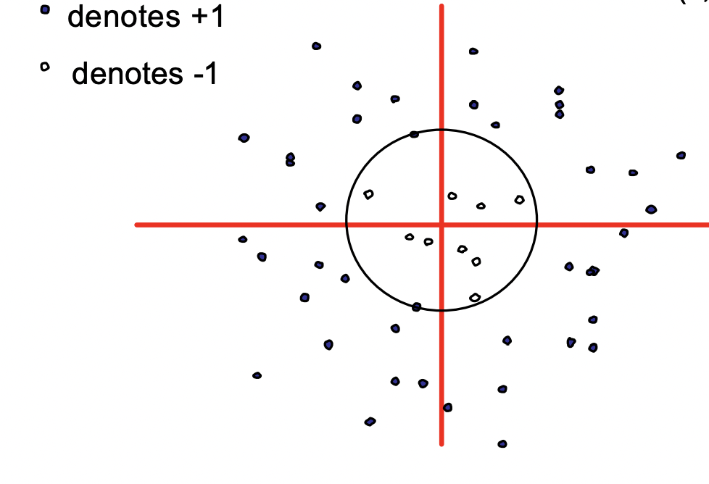
Example 1 (learning machine)
W
x
y
f(x, b) = sign(x*x - b)
f
Slide credits to Andrew W. Moore, VC-dimension lecture slides

Slide 8
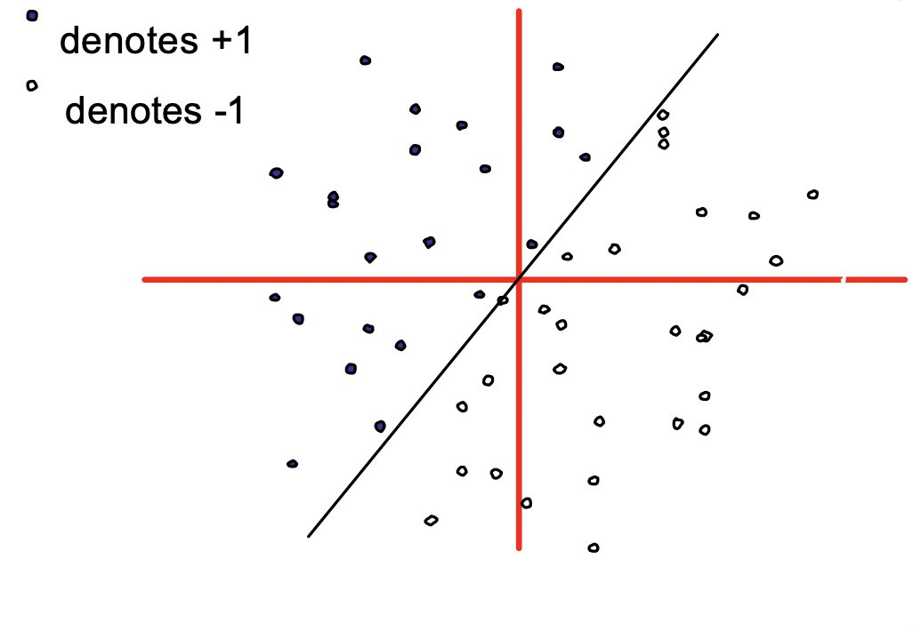
Example 2 (learning machine)
W
x
y
f(x, W) = sign(x*W)
f
Slide credits to Andrew W. Moore, VC-dimension lecture slides

Slide 9
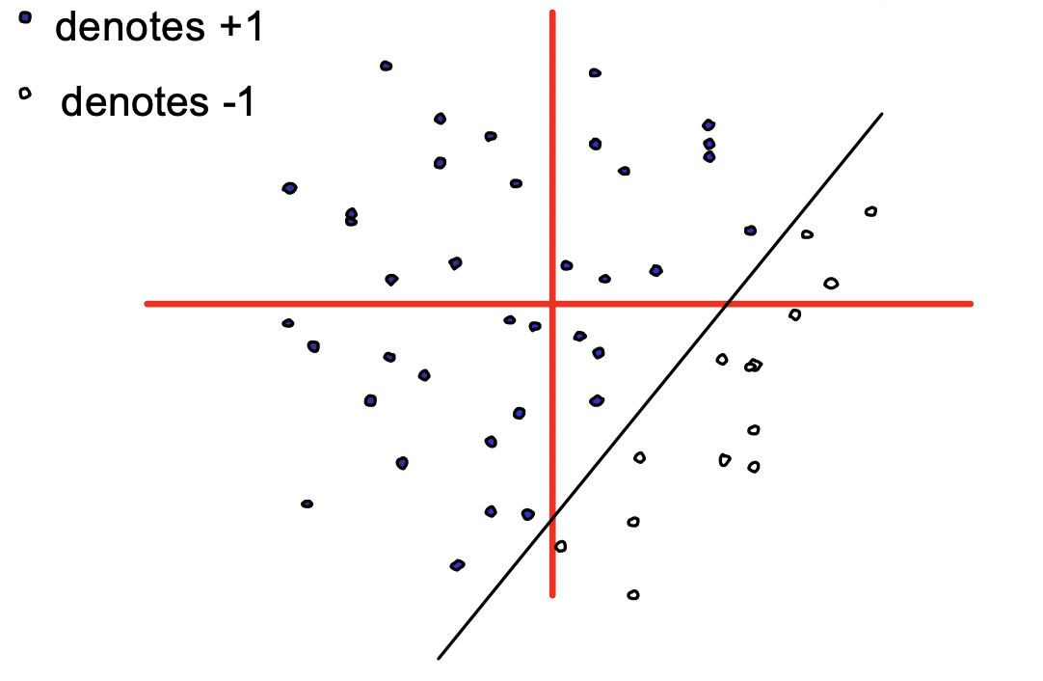
Example 3 (learning machine)
W
x
y
f(x, W, b) = sign(x*W + b)
f
Slide credits to Andrew W. Moore, VC-dimension lecture slides

Slide 10
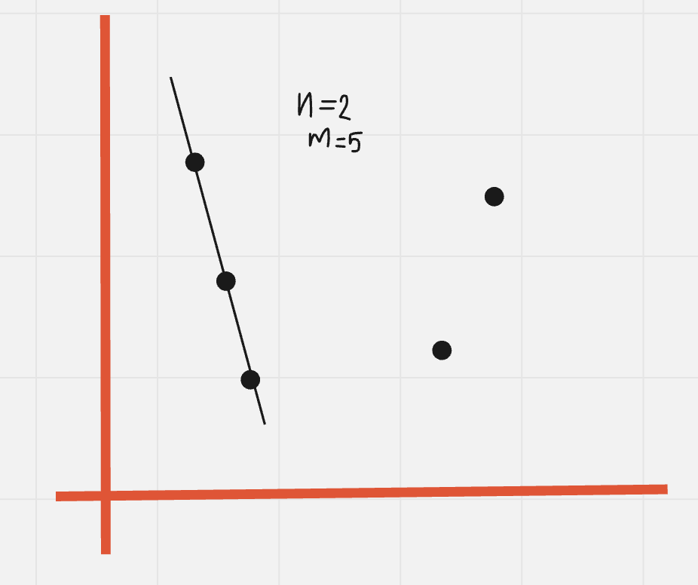
General position
Example
In a n-dimensional feature space a set of m points (m>n) is in general position if and only if no subset of (n+1) points lie on (n-1) dimensional hyperplane.
Below is a counterexample for the case of n=2 and m=5.

Slide 11
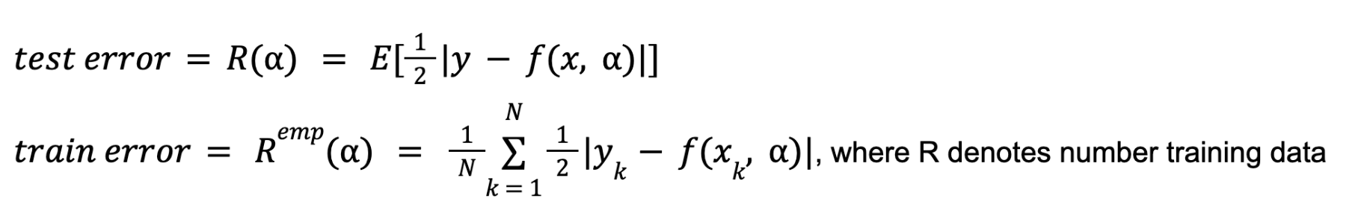
Definitions
Given some learning machine f. (recall filled circles denote +1, and empty ones -1)
Assumption that training data were drawn i.i.d.
Assumption that test (unseen) data is coming and will come from the same distribution.
All points are in general position.
Then let’s define below quantities

Slide 12
Definitions
Now denote the VC dimension of above learning machine f as D, which is measure for power of f.
It was proven that
With the assumption that D<<R, since otherwise it may result in obvious overfitting.
This gives us a way to estimate the error on future data based only on the training error and the VC-dimension of f.

Slide 13
Definitions
Now denote the VC dimension of above learning machine f as D, which is measure for power of f.
It was proven that
With the assumption that D<<R, since otherwise it may result in obvious overfitting.
But how can we measure VC dimension?
This gives us a way to estimate the error on future data based only on the training error and the VC-dimension of f.

Slide 14
Table of Content
Introduction & Preliminaries
VC dimension
01
03
02
Applications & Beyond
Shattering
04

Slide 15

Shattering

Slide 16
Definition
Example (r = 3)
Machine f can shatter a set of points x1, x2, ..., xr if and only if for every possible training set of the form (x1, y1), (x2, y2), …(xr, yr) there exists some value of weights W that gets zero training error.
Basic counting implies that there are 2^r such training sets to consider, each with a different combination of +1’s and –1’s for the y’s.
 | y-values (all 8 possibilities - sample space)
x1 | +1 | +1 | +1 | -1 | +1 | -1 | -1 | -1
x2 | +1 | +1 | -1 | +1 | -1 | +1 | -1 | -1
x3 | +1 | -1 | +1 | +1 | -1 | -1 | +1 | -1

Slide 17
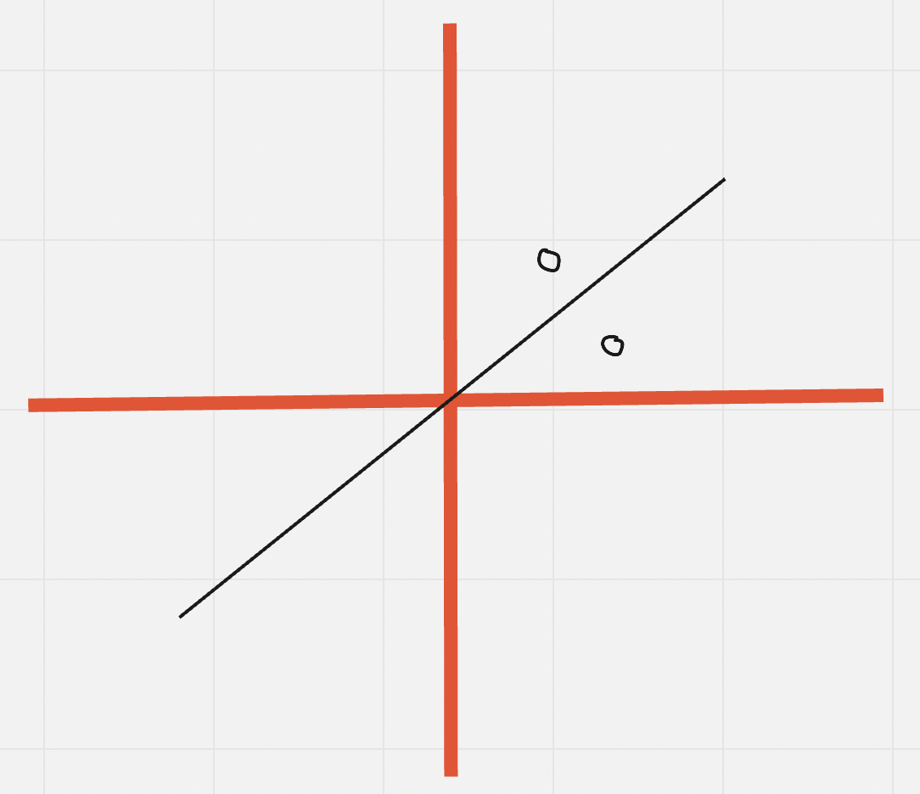
Example problem 1
Can f(x, W) = sign(x*W) shatter below two points which are in general position in 2D (plane)?

Slide 18
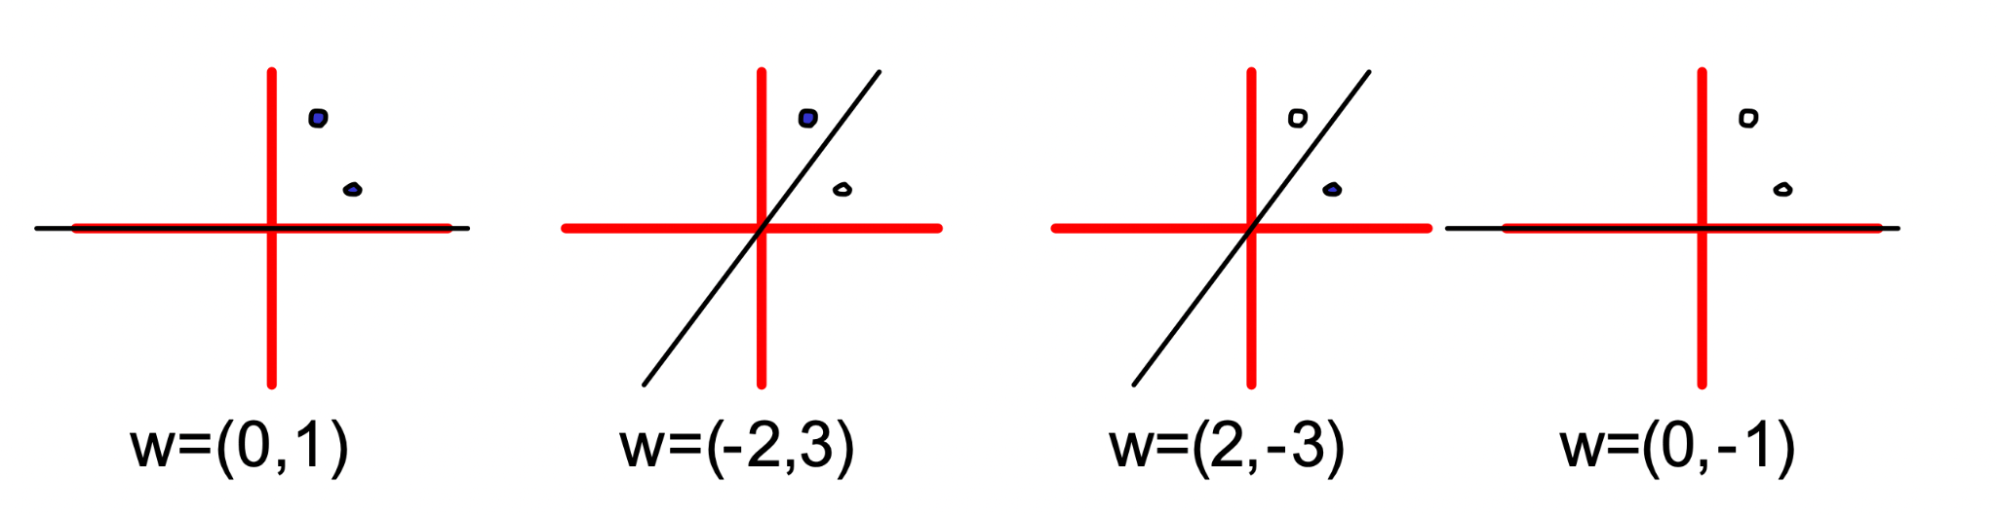
Solution to problem 1
Can f(x, W) = sign(x*W) shatter arbitrary two points which are in general position in 2D (plane)?
– Yes, indeed, we can!

Slide 19
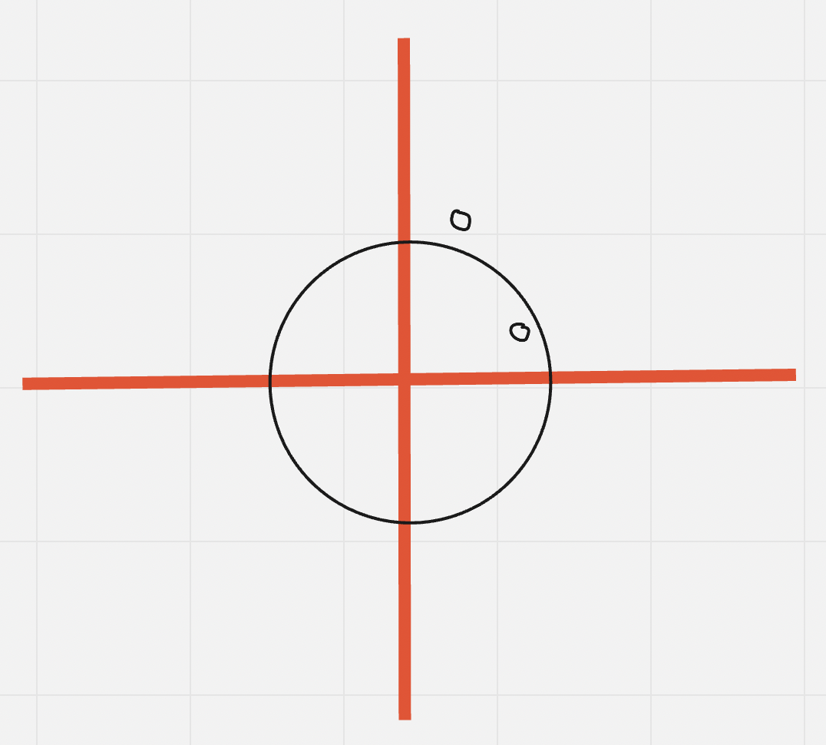
Example problem 2
Can f(x, b) = sign(x*x - b) shatter below two points which are in general position in 2D (plane)?

Slide 20
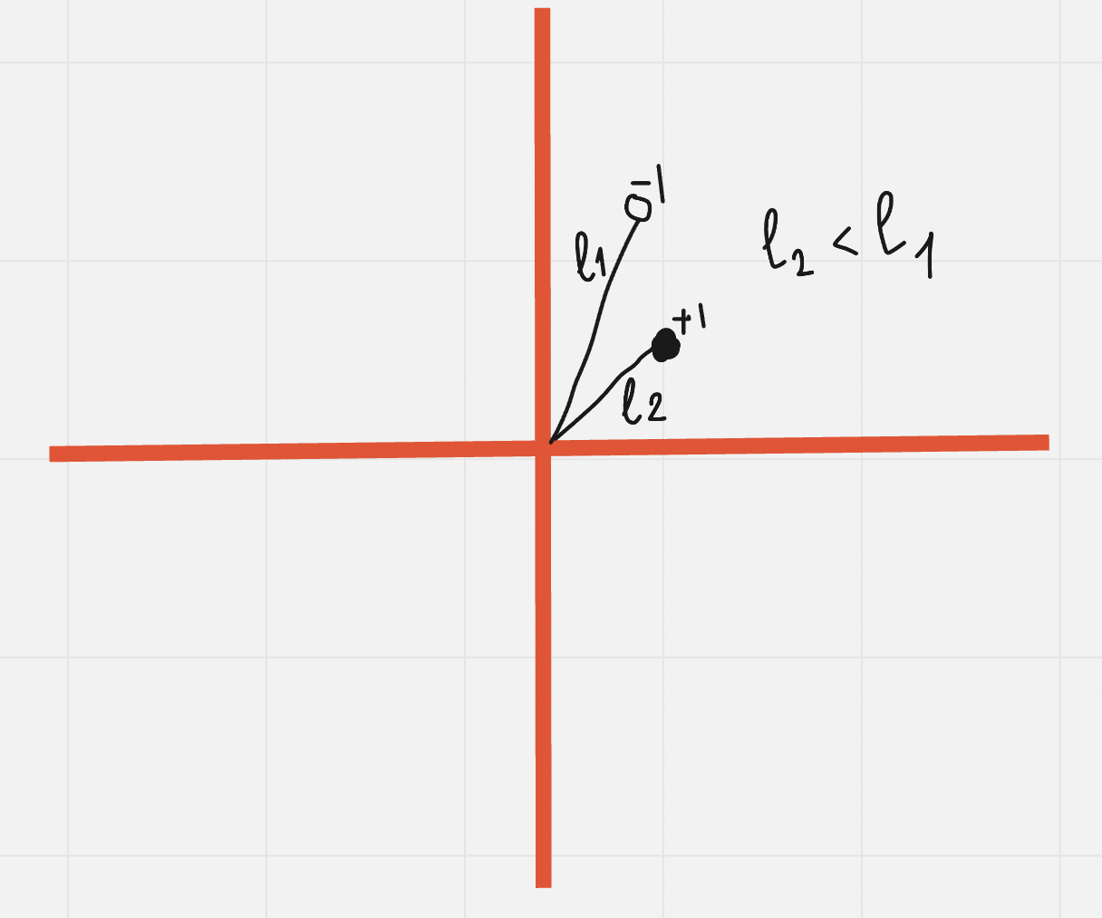
Example problem 2
Can f(x, b) = sign(x*x - b) shatter below two points which are in general position in 2D (plane)?
– No, we cannot! :( Because, distance from center to positive point can be less than one with negative.

Slide 21
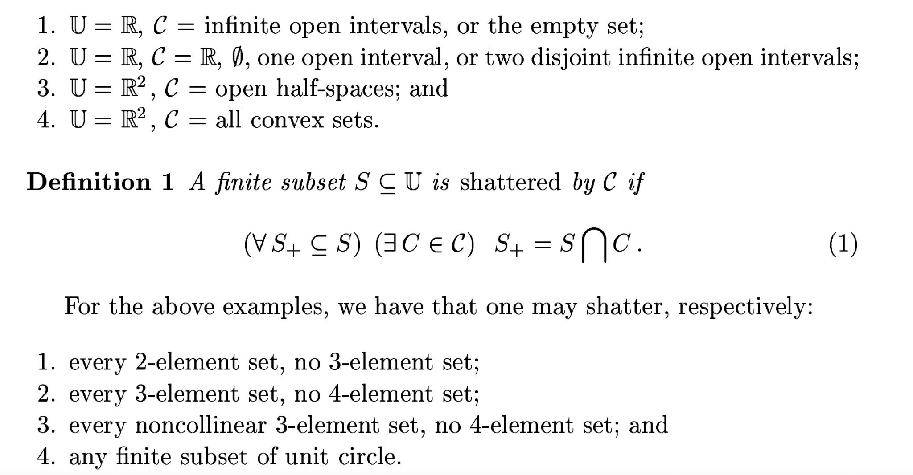
Some more examples on shattering
VC dimension of Neural networks, Eduardo D. Sontag

Slide 22
Table of Content
03
01
Introduction & Preliminaries
VC dimension
Shattering
04
Applications & Beyond
02

Slide 23

VC dimension

Slide 24
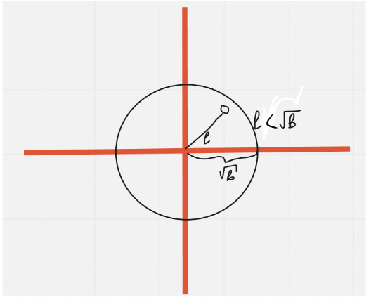
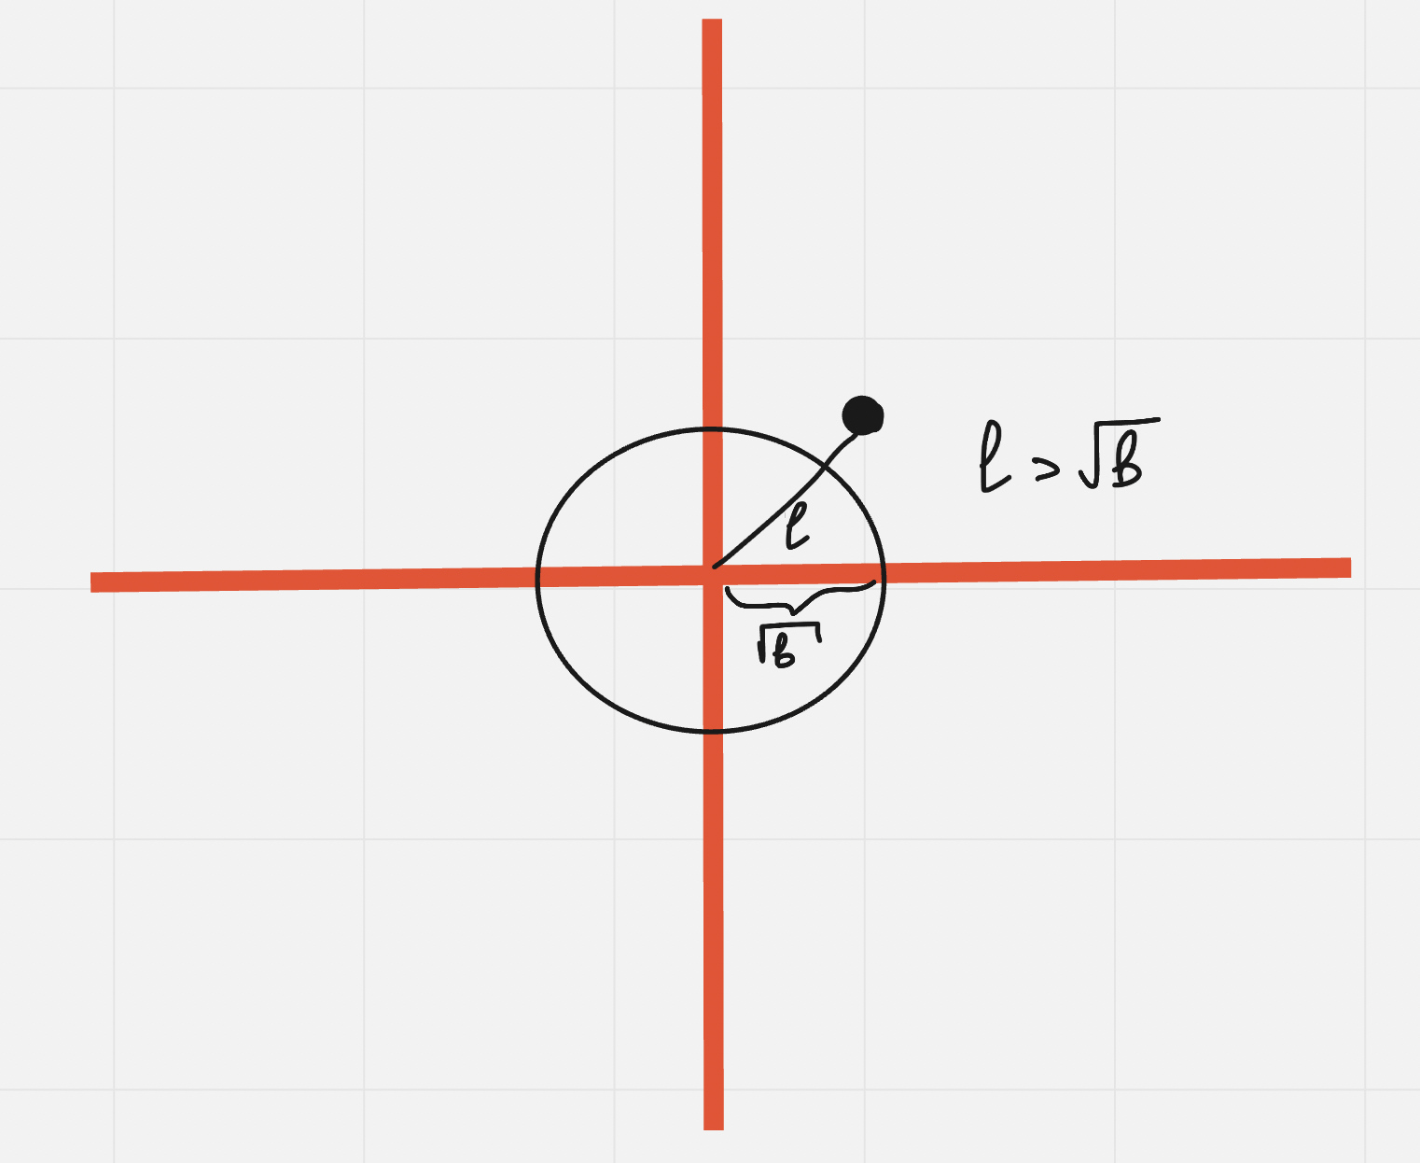
Definition of VC dimension
Example
Given machine f, the VC dimension D is the maximum number of points that can be arranged so that f shatter them.
The VC dimension of f(x, b) = sign(x*x - b) is D=1, since it can not shatter two points as discussed and can shatter one point obviously.

Slide 25
Example of VC dimension
What is the VC dimension (D) for given learning machine of f(x, a, b) = sign(a*x*x - b)?
What is the difference between previous example without the addition of learnable parameter a?

Slide 26
Example of VC dimension
What is the VC dimension (D) for given learning machine of f(x, a, b) = sign(a*x*x - b)?
What is the difference between previous example without the addition of learnable parameter a?
– Actually, two points are possible in this case, considering the flexibility of changing sign which alters the inside of circle to positive and outside to negative.
How about three points? Because above finding just implies that D is greater than or equal to 2.

Slide 27
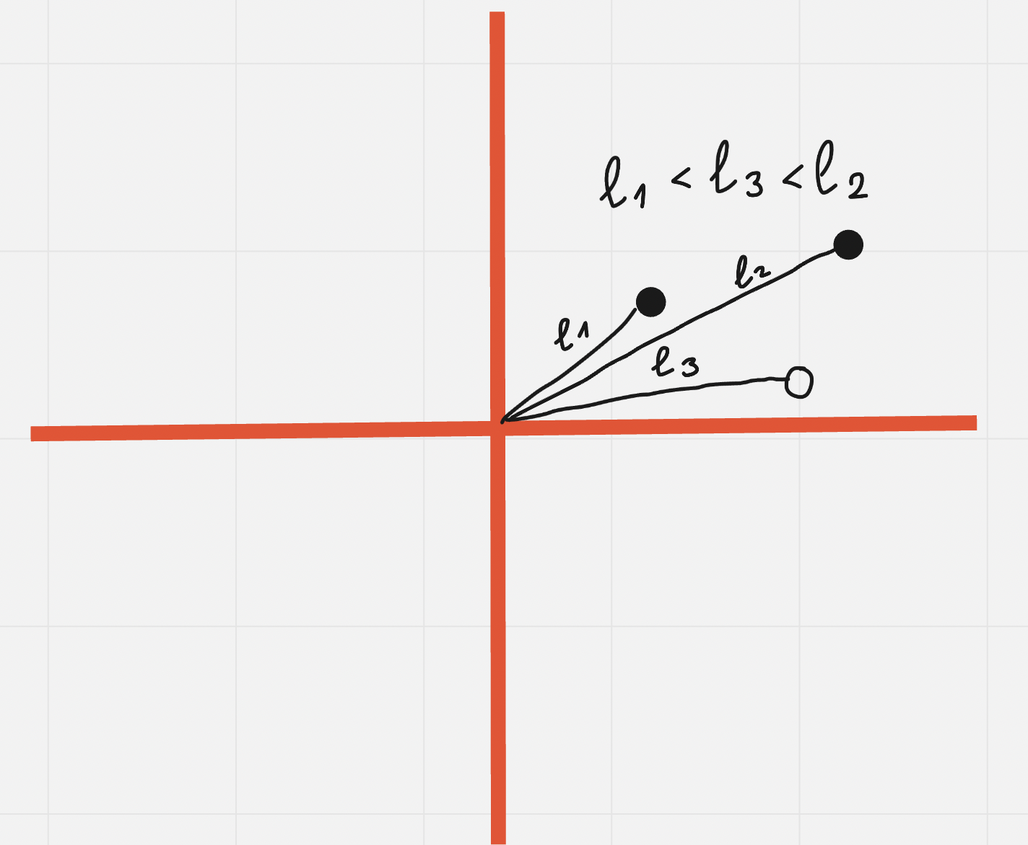
Example of VC dimension
What is the VC dimension (D) for given learning machine of f(x, a, b) = sign(a*x*x - b)?
What is the difference between previous example without the addition of learnable parameter a?
– Actually, two points are possible in this case, considering the flexibility of changing sign which alters the inside of circle to positive and outside to negative.
How about three points? Because above finding just implies that D is greater than or equal to 2.
– Unfortunately, three points are impossible! We will have alternating points of +1/-1/+1 in terms of distance from the center.
Answer: D=2.

Slide 28
Example of VC dimension for separating line
What is the VC dimension (D) for given learning machine of f(x, W, b) = sign(W*x + b)?
one? - 1 point is obvious
two? - 2 points were handled by even the case when b = 0 before
What about three points?

Slide 29
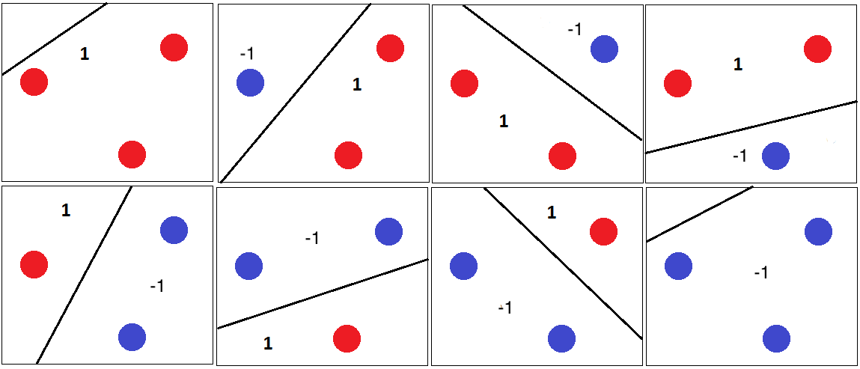
Example of VC dimension for separating line
What is the VC dimension (D) for given learning machine of f(x, W, b) = sign(W*x + b)?
one? - 1 point is obvious
two? - 2 points were handled by even the case when b = 0 before
What about three points?
– Of course, we can. Because they are in general position, i.e. no 3 of them are coinciding or collinear, so any single of them can be separated from rest of the two with desired sign along with the case three points are kept in the same side of line with desired sign.
What about four points?

Slide 30
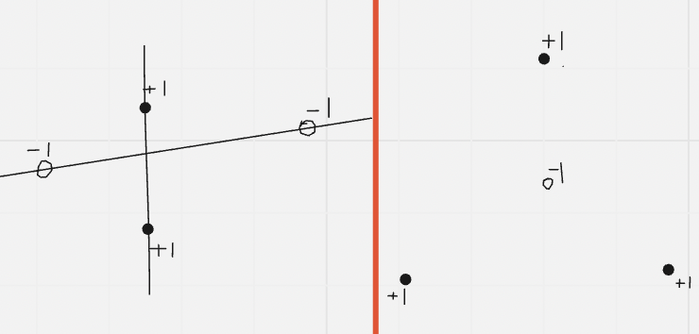
Example of VC dimension for separating line
What is the VC dimension (D) for given learning machine of f(x, W, b) = sign(W*x + b)?
one? - 1 point is obvious
two? - 2 points were handled by even the case when b = 0 before
What about three points?
– Of course, we can. Because they are in general position, i.e. no 3 of them are coinciding or collinear, so any single of them can be separated from rest of the two with desired sign along with the case three points are kept in the same side of line with desired sign.
What about four points?
– Unfortunately, all examples given in the right implies that there is no line which can separate +1 and -1’s.
Answer: D=3.

Slide 31
VC dimension of linear classifiers in m-dimensions
What is the VC dimension (D) of f(x, W, b) = sign(W*x + b), where the input is m-dimensional?
one?, two?, something related to m?

Slide 32
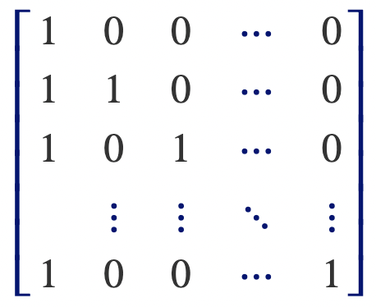
VC dimension of linear classifiers in m-dimensions
What is the VC dimension (D) of f(x, W, b) = sign(W*x + b), where the input is m-dimensional?
one?, two?, something related to m?
Let’s sketch the proof that D is at least m+1. Let’s also add b into the W-weights matrix as a new term, and add 1 to the each of m+1 inputs x, which we considered as a standard vectors. Then obvious observation yields that concatenation of x input vectors is square matrix which is invertible, so for any input we can find a solution for the weights (W) and bias (b).
X =
[W, b] = inv(X)*y
https://home.work.caltech.edu/slides/slides07.pdf

Slide 33
VC dimension of linear classifiers in m-dimensions
What is the VC dimension (D) of f(x, W, b) = sign(W*x + b), where the input is m-dimensional?
one?, two?, something related to m?
Let’s sketch the proof that D is at least m+1. Let’s also add b into the W-weights matrix as a new term, and add 1 to the each of m+1 inputs x, which we considered as a standard vectors. Then obvious observation yields that concatenation of x input vectors is square matrix which is invertible, so for any input we can find a solution for the weights (W) and bias (b).
X =
[W, b] = inv(X)*y
One can prove m+2 points is not possible as well. ( → D<m+2)
Answer: D=m+1.
https://home.work.caltech.edu/slides/slides07.pdf

Slide 34
Table of Content
Introduction & Preliminaries
VC dimension
01
03
04
Shattering
Applications & Beyond
02

Slide 35


Applications & Beyond

Slide 36
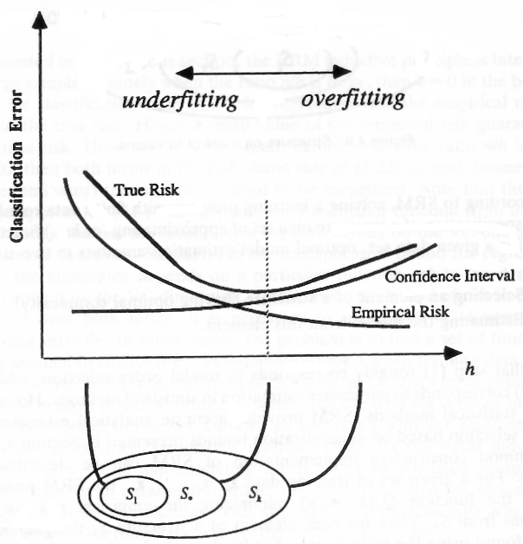
Determining the balance
Dotted vertical line - ideal balance between bias and variance, at which you are neither underfitting nor overfitting to your data.
Goal should be to choose a model with a complexity that is just enough for the classification task - any less would lead to underfitting, and any more would lead to overfitting.

Slide 37
Using VC dimensionality
• Decision Trees
• Perceptrons
• Neural Nets
• Decision Lists
• Support Vector Machines
• And many many more
The main goals in this aspect are
1. Understanding which learning machines are more or less powerful under which circumstances
2. Using Structural Risk Minimization for to choose the best learning machine

Slide 38
Which model selection method is best do you think now?
1. (CV) Cross-validation
2. AIC (Akaike Information Criterion)
3. BIC (Bayesian Information Criterion)
4. (SRMVC) Structural Risk Minimize with VCdimension
• AIC, BIC and SRMVC have the advantage that you only need the training error.
• CV error might have more variance
• SRMVC is wildly conservative
• Asymptotically AIC and Leave-one-out CV should be the same
• Asymptotically BIC and a carefully chosen k-fold should be the same
• BIC is what you want if you want the best structure instead of the best predictor (e.g. for clustering or Bayes Net structure finding)
• Many alternatives to the above including proper Bayesian approaches.
• It’s an emotional issue.
Slide credits to Andrew W. Moore, VC-dimension lecture slides

Slide 39
Takeaways
Learning Machine
Shattering
VC dimension
Applications of VC dimension
Various methods to measure power of a model

Slide 40



