Slide 1
VR
Technologies
History, Survey and
Classification
Farhadiba Mohammed
20226471
Notes:
namen hinzufügen - gruppennummer

Slide 2
Contents (Today)
01.
02.
03.
04.
What is VR?
VR Keywords to remember
History of VR
(since 1956)
Classification
1.1 The Perfect VR
1.2 Definitions
2.1 The 3 I’s of VR
3.1 Classification
3.2 The Reality-Virtuality Continuum

Slide 3
Contents (Thursday)
05.
06.
07.
08.
VR Methods
VR Applications
Locomotion Techniques in VR
VR Challenges
Notes:
2.1 Entertainment: Tiltbrush

Slide 4
What is VR?

Slide 5


Sword Art Online
(2012, Aincrad- und Fairy-Dance-Arc, 25 Episodes)
Notes:
VRMMORPG -> NerveGear -> Complete immersion -> Game Goal -> login but no logout -> must beat all floors -> in death = death -> Why this example?
STory:
Example of a” perfect” VR environment
VRMMORPG called Sword Art Online is released
Access through NerveGear Helmet that stimulates users five senses via their brain
So the environment really feels like you would actually live in it, as it addresses all your senses. So you completely immerse in it and forget about your real body outside the world
Game: Take role of an avatar. Setting is Aincrad a steel castle that consists of 100 floors.
Each floor has monsters which need to be conquered to gain experience points and level up
On release date: 10000 players log into SAO’S mainframe cyberspace for the first time
But twists in the stoory is that they found themselevs unable to log out
The Game developer appears inside the game telling them they have to beat all 100 floors in order to leave this game.
But those who suffer in-game deaths or forcibly remove the helmet out-game will suffer real-life deaths
Protagonist: AMong them one player who is one of the 1000 testers of the previously enclosed beta versioon of the game advantage of experience in the previous vr
Why am I telling you about this? Famoous quoote about the Ultimatr display/ VR

Slide 6


The perfect VR
The ultimate display would, of course,be a room with in which the computer can control the existence of matter. A chair displayed in such a room would be good enough to sit in. Handcuffs displayed in such a room would be confining, and a bullet displayed in such a room would be fatal. With appropriate programming, such a display could literally be the Wonderland into which Alice walked.
- Ivan Sutherland
Notes:
Vision: The perfect Virtual Reality is a perfect illusion: The user can no longer distinguish the virtual world from the real, physical world.
But currently we are (maybe gladly) still limited in technologies to realise a world like this.
So what is VR in fact?

Slide 7
Etymology
Virtual
Reality
"To have the effect of being such without actually being such"
"The property of being real "
Real -> "To have concrete existence"
Virtual Reality
"To have the effect of concrete existence without actually having concrete existence"
Notes:
Lets first have a look at the etymology of the word virtual reality.
which is exactly the effect achieved in a good virtual reality system. There is no requirement that the virtual environment match the real world.

Slide 8
Virtual reality is a simulated 3D environment that enables users to explore and interact with a virtual surrounding in a way that approximates reality, as it is perceived through the users' senses.
Virtual reality is the use of computer technology to create the effect of an interactive three-dimensional world in which the objects have a sense of spatial presence.
Notes:
Here are some other definitions of virtual Reality.
So the key aspects are:
three dimensionality
interaction
stimulating user senses
computer technology and computing power in that sense
and presence

Slide 9


Contents (Today)
01.
02.
03.
04.
What is VR?
VR Keywords to remember
History of VR
(since 1956)
Classification
1.1 The Perfect VR
1.2 Definitions
2.1 The 3 I’s of VR
3.1 Classification
3.2 The Reality-Virtuality Continuum

Slide 10
Immersion
3 I’s
Interaction
Imagination
Notes:
Framework of 3 I’s of VR Design. Will talk about each a little more in detail

Slide 11
Immersion
Describes the technical multimodal abilities for the VR system tricking the user that he/she feels being somewhere else
Presence: Describes to which extent the user of a VR system develops a sense of being in the virtual environment. Subjective Perception of being physically present in a non-physical world.
Orientation: Describes a person’s awareness of time, place and person

Slide 12


Interaction
Interaction refers to the user’s degree of manoeuvrability of objects in the simulated environment and the natural degree of feedback from the real environment.
Notes:
Interaction refers to the user’s degree of manoeuvrability of objects in the simulated environment and the natural degree of feedback from the real environment. There are two types of interactions which are the three-degree-freedom (3DoF) interaction and the six-degree-freedom (6DoF) interaction.
3doF:
Normally, 3DoF is where a viewer can view a 360° image or video using a VR headset and move their head side to side to explore around;
Ultimately, 3DoF is better suited for static environments where only choice selection is needed, not physical interactions.
3DoF is an effective option for organizations looking to give learners an all-encompassing view of a real-world environment with authentic human interactions. For example, observational soft skills training (e.g. coaching and feedback) is more effective with 3DoF because learners can focus on the experience as a spectator, observe the situation from different perspectives, or experience the situation first-hand in their own role.
6dof: more interaction possibilities -> manipulation through natural skills -> powerful computer to proocess infromation and interact with additional hardware -> ideal for technical training
Viewer can view 360° and move around and interact
Viewers can inspect or manipulate objects in the virtual environment through natural skills such as their own language, body movements or actions.
whilst the 6DoF requires a powerful gaming laptop or computer to process information to play and interact with using extra accessories such as sensors, data gloves and other sensing devices. The device adjusts the image and audio presented by the system according to the movement of the viewer’s head, hands, eyes, language and body.
6DoF is ideal for experiences where the learner is physically moving through the virtual space and directly interacting with the environment. For example, technical skills training (e.g. pallet stacking) may be more effective in 6DoF because learners will feel like they’re in their actual work environment interacting with real-life objects and performing complex tasks.

Slide 13



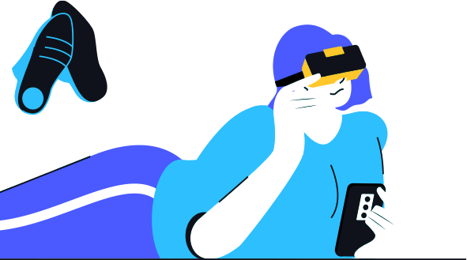
Imagination
Refers to human imagination that allows the transfer from capabilities into the virtual world
Place Illusion
Plausability Illusion
Embodiment Illusion
Notes:
There are different types of illusions that produce different effects, hence changing the way VR’s illusion affects us.
Place illusion works on producing an effect or a feeling that the person has actually been transported somewhere else. This is achieved by taking various factors into consideration such as:
The Quality of the display: The quality of the display plays an important role in making the illusion seem realistic. This is because in case we have a lower quality display, the illusion looks less real due to possibly a more pixelated look, which isn’t desirable.
Position and rotation tracking (6 degrees of freedom for maximum immersion): More degrees of freedom, the better. It makes the user feel like they are in the virtual world as it tracks the head movement in real-time. If it isn’t supported by a good tracking mechanism, it will constantly remind the user that what they are viewing isn’t really as it doesn’t move along with you.
Use of external hardware to stimulate other senses such as sound and touch: By including hardware that includes our various senses, the immersion, and authenticity of the illusion feel far more real compared to those that cater to less number of senses.
Plausibility Illusion
Plausibility illusion works on the principle of creating a plausible environment that we can believe to be real. The above factors can be taken into consideration for plausibility illusion as well. However, the illusion can easily be broken if:
The environment doesn’t respond in a realistic way: If you end up running into another person, and they pass through you or don’t react, you will immediately realize that it is an illusion, hence breaking the effect.
Objects go through repetitive motions to a point that it becomes very noticeable: If you see the same bird hopping around a puddle and flying away and returning for a few minutes, it will look unrealistic because not every bird will do the hop in the same manner.
Embodiment Illusion
Focus on body than environment -> tracking important
Embodiment illusion works on making the user believe that the body they have in the virtual world belongs to them, unlike the other two illusions where they focus more on making the environment more realistic. Position and rotation tracking is extremely important for this type of illusion because the body in the virtual world needs to be able to imitate your movements in the real world to make it seem realistic in the virtual one.

Slide 14
Contents (Today)
01.
02.
03.
04.
What is VR?
VR Keywords to remember
History of VR
(since 1956)
Classification
1.1 The Perfect VR
1.2 Definitions
2.1 The 3 I’s of VR
3.1 Classification
3.2 The Reality-Virtuality Continuum

Slide 15
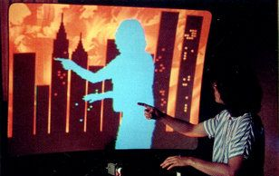
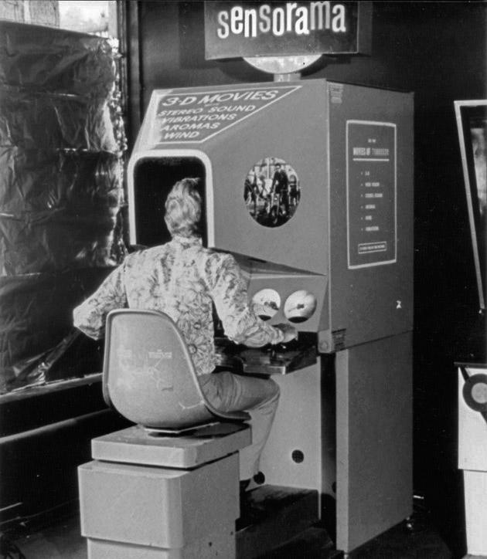
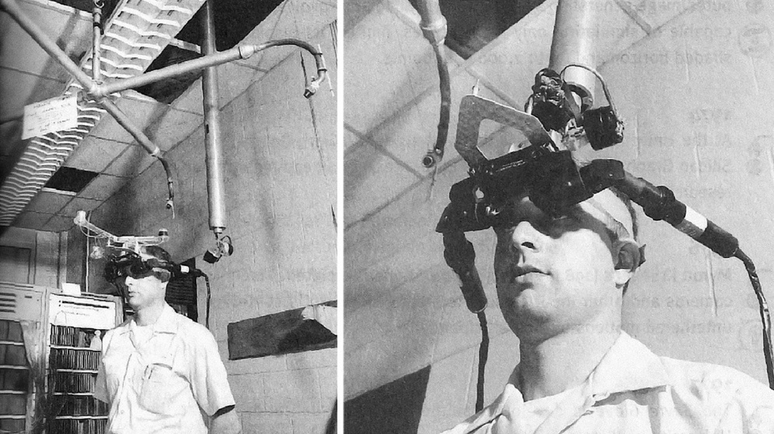
VR in Military
Telesphere Mask
Videoplace
Head tracker in HMD followed pilot's eye movements to match computer-generated images.
First HMD by Morton Heilig, but without motion–tracking
By Myron Krueger. Interaction through user silhouettes
1960
1975
1979
1956
1968
1978
Sensorama
Sword of Damocles
Aspen Movie Map
First VR machine created by Morton Heilig
First VR HMD by Ivan Sutherland
Users can take a virtual tour through the streets of Aspen
Notes:
1956: Cinematographer Morton Heilig created Sensorama, the first VR machine (patented in 1962). It was a large booth that could fit up to four people at a time. It combined multiple technologies to stimulate all of the senses: there was a combined full colour 3D video, audio, vibrations, smell and atmospheric effects, such as wind.
This was done using scent producers, a vibrating chair, stereo speakers and a stereoscopic 3D screen. Heilig thought that the Sensorama was the "cinema of the future" and he wanted to fully immerse people in their films. Six short films were developed for it.
1960: Heilig also patented the Telesphere Mask which was the first head-mounted display (HMD). This provided stereoscopic 3D images with wide vision and stereo sound. There was no motion tracking in the headset at this point.
1968: Sutherland, with his student Bob Sproull, created the first virtual reality HMD, named The Sword of Damocles. This head-mount connected to a computer rather than a camera and was quite primitive as it could only show simple virtual wire-frame shapes.
These 3D models changed perspective when the user moved their head due to the tracking system. It was never developed beyond a lab project because it was too heavy for users to comfortably wear; they had to be strapped in because it was suspended from the ceiling.
1975: Krueger's VIDEOPLACE, the first interactive VR platform, was displayed at the Milwaukee Art Center. It used computer graphics, projectors, video cameras, video displays and position-sensing technology and it didn't use goggles or gloves. VIDEOPLACE consisted of dark rooms with large video screens to surround the user in "VR".
1978: Aspen Movie Map was created by MIT. This program enabled users to virtually wander through Aspen city in Colorado, like with Google Street View. There were three modes: summer, winter and polygons.
It was created using photographs from a car driving through the city. There were no HMDs but it was the use of first-person interactivity and it suggested that VR could transport people to other places.
1979: McDonnell-Douglas Corporation integrated VR into its HMD, the VITAL helmet, for military use. A head tracker in the HMD followed the pilot's eye movements to match computer-generated images.

Slide 16
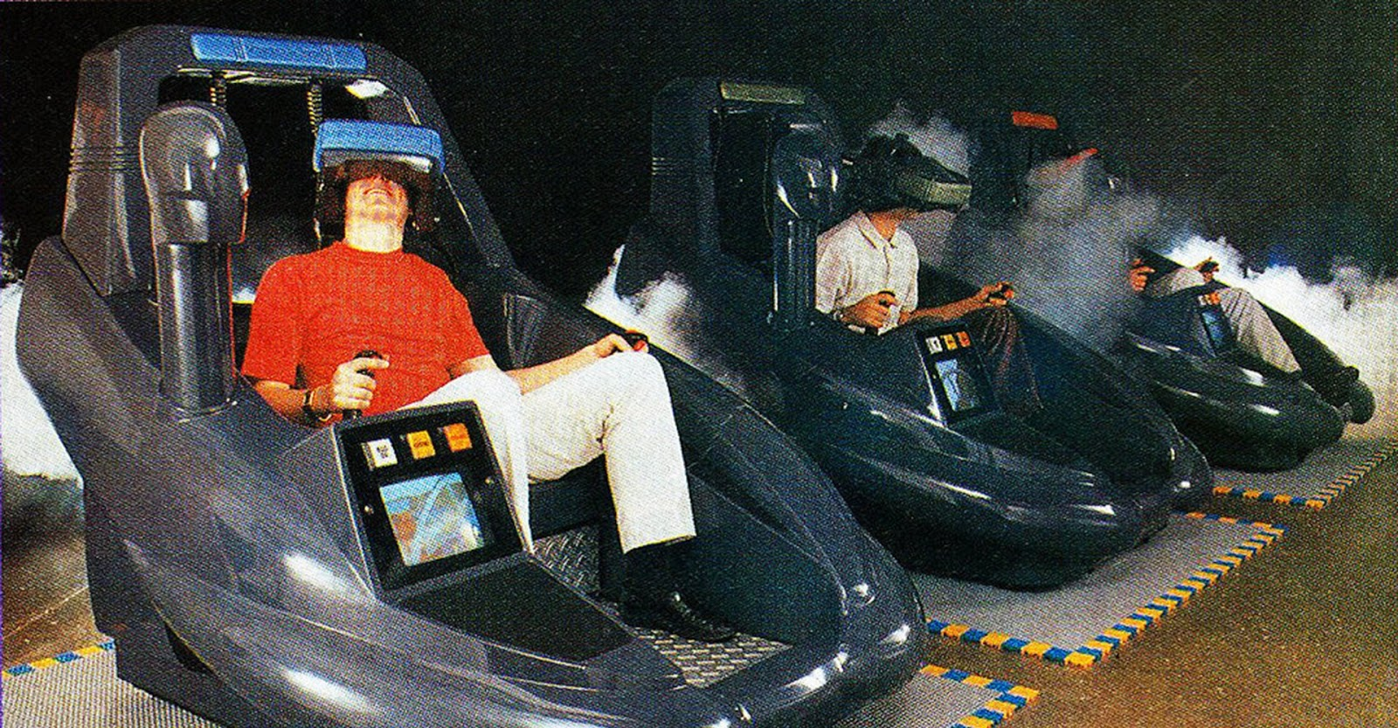
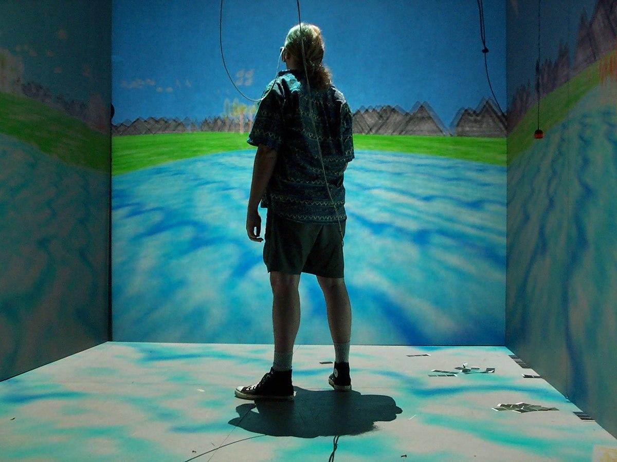
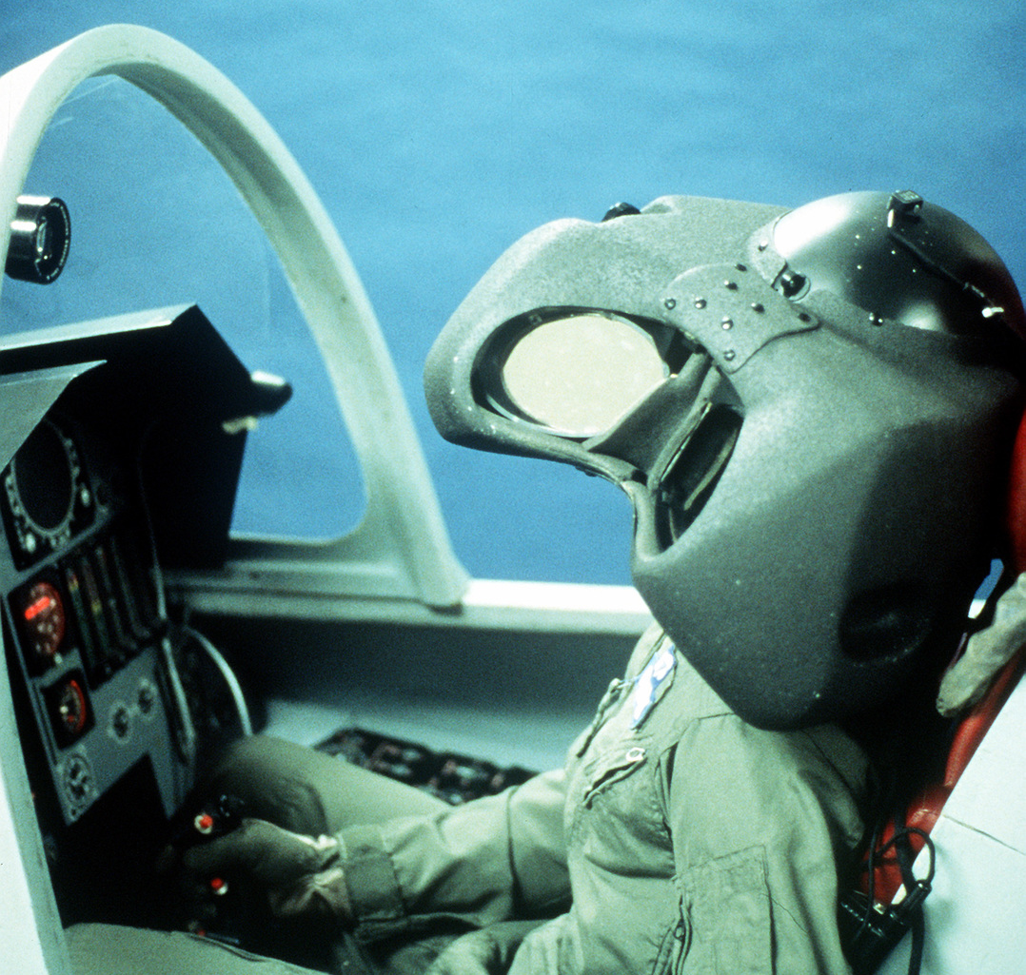
VPL Research
VR entertainment system
VR headsets and real-time immersive stereoscopic 3D images
CAVE, Virtual Boy, Home VR headsets
First company to sell VR Hardware
1985
1991
1995
1982
1987
1993
VCASS and Tron
Term VR is coined, Super Cockpit,
Holodeck
SEGA’s VR Glasses
Airforce develops virtual flight simulator,
First movie depicting VR released
announced to be available for public, but never released
Jaron Lanier first coins the term VR, Holodeck appears in Star Trek: The next Generation
Notes:
1982: Furness created a working model of a virtual flight simulator, for the military, called the Visually Coupled Airborne Systems Simulator (VCASS).
a fully immersive three dimensional circumambience of graphical information superimposed over the real world
1985: Jaron Lanier and Thomas Zimmerman founded VPL Research, Inc. This company is known as the first company to sell VR goggles and gloves. They developed a range of VR equipment, such as, the DataGlove, EyePhone HMD and the Audio Sphere.
1987: Jaron Lanier popularised the term "Virtual Reality" while at VPL Research.
Furness developed a flight simulator between 1986-1989 known as the Super Cockpit. The training cockpit featured: computer-generated 3D maps, advanced infrared and radar imagery and the pilot could see and hear in real-time. The helmet's tracking system and sensors allowed the pilot to control the aircraft using gestures, speech and eye movements. British Aerospace used the HMD similarly to Furness' Super Cockpit and developed the Virtual Cockpit which also featured speech recognition.
holodeck appears in Star Trek for the first time
1991: The Virtuality Group launched Virtuality. These were VR arcade machines where gamers could play in a 3D gaming world. This was the first mass-produced VR entertainment system.
A Virtuality pod featured VR headsets and real-time immersive stereoscopic 3D images. Some of the machines could be networked together for multi-player games. Eventually some of the very popular arcade games, like Pac-Man, had VR versions.
1993: SEGA announced that they were working on the SEGA VR headset which would be available for the general public to purchase. This headset was meant to be used for arcade games and the Mega Drive console. It had a visor-like look due to the influence of popular films, such as, RoboCop. LCD displays were placed in the visor, as well as stereo headphones and sensors for tracking head movement.
However, it was never released even though four games were made for it. One of the explanations for the termination was SEGA's concern of people injuring themselves as the VR effect was too realistic. However, this seems unlikely due to the limited processing power.
1995:
CAVE (automated virtual environment ): cubic room that sits in a larger darkened room. The side walls of
the CAVE are made up of rear-projection screens, whereas, the
ﬂoor is made of a down-, or rear-projection screen. Modern CAVE systems can project scenes to the ceiling as well, creat-
ing what is called a six-wall, or six-side, CAVE.
Nintendo launched the Virtual Boy console which played 3D monochrome video games. It was the first portable console to display 3D graphics. But it was a commercial failure due to:
The lack of colour graphics
The lack of software support
It wasn't comfortable to use
One year later it was discontinued.
Affordable home VR headsets were released:
Virtual IO released the I-Glasses.

Slide 17
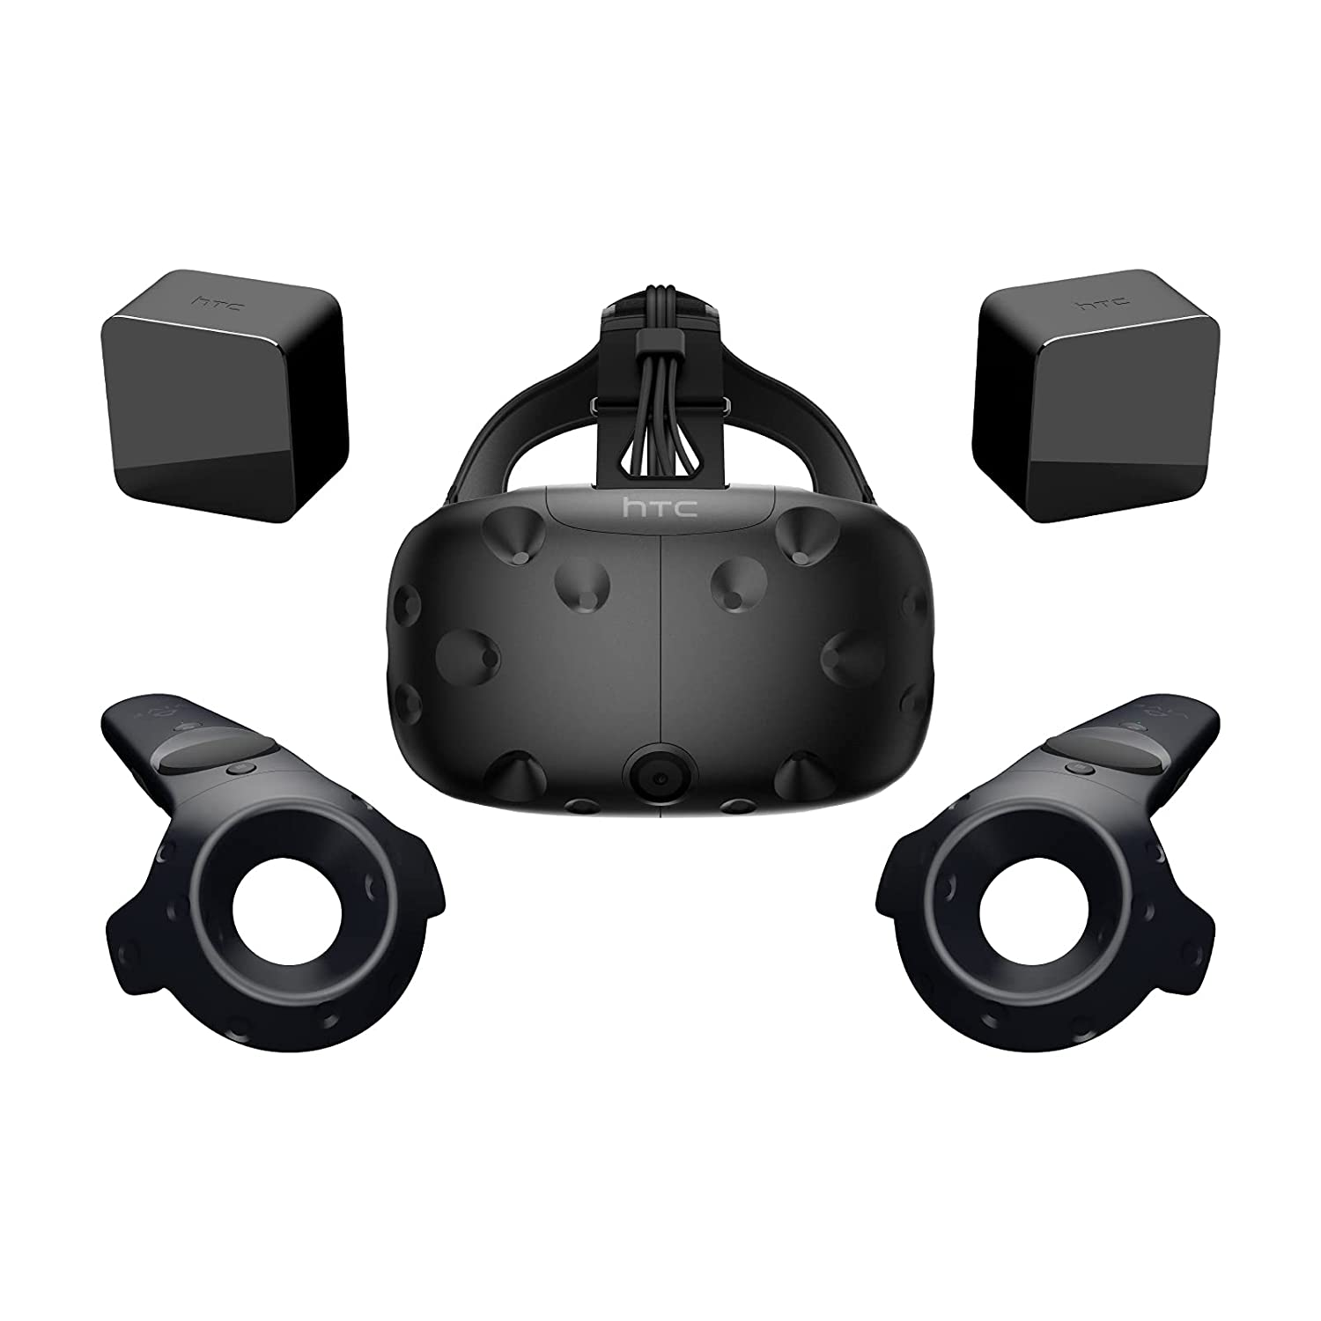
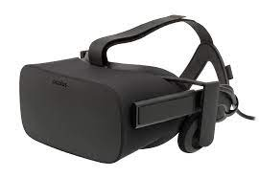
HTC Vive Stream VR Headset released
Facebook buys Oculus VR company
First commercial release of a headset with sensor-based tracking which allowed users to move freely in a space.
Defining moment in VR history, several VR hardware releases afterwards
Google Street View
2007
2014
2016
1997
2012
2015
Virtual Vietnam
Oculus Rift campaign
VR for public
Georgia Tech and Emory University researchers created VR war zone scenarios for veterans’ PTSD therapy
Luckey launched a Kickstarter campaign for the Oculus Rift which raised $2.4 million
VR possibilities started becoming widely available to the general public
Notes:
1997: Georgia Tech and Emory University researchers used VR to create war zone scenarios for veterans receiving exposure therapy for PTSD. This was known-as Virtual Vietnam
2007: Google intrdouces Google Strret View
2012: Luckey launched a Kickstarter campaign for the Oculus Rift which raised $2.4 million.
2014: Facebook bought the Oculus VR company for $2 billion. This was a defining moment in VR's history because VR gained momentum rapidly after this.
Sony announced that they were working on Project Morpheus, a VR headset for the PlayStation 4 (PS4).
Google released the Cardboard - a low-cost and do-it-yourself stereoscopic viewer for smartphones.
Samsung announced the Samsung Gear VR, a headset that uses a Samsung Galaxy smartphone as a viewer.
2015: VR possibilities started becoming widely available to the general public, for example:
The Wall Street Journal launched a VR roller coaster that followed the ups and downs of the Nasdaq Stock Market.
The BBC created a 360-degree video where users view a Syrian migrant camp.
The Washington Post released a VR experience of the Oval Office at the White House Correspondents’ Association Dinner.
Gloveone was successful in its Kickstarter campaign. These gloves let users feel and interact with virtual objects
2016: By 2016 hundreds of companies were developing VR products.
Most of the headsets had dynamic binaural audio.
Haptic interfaces were underdeveloped. Haptic interfaces are systems that allow humans to interact with a computer using their touch and movements - like the Gloveone gloves that were being developed. This meant that handsets were typically button-operated.
HTC released its HTC VIVE SteamVR headset. This was the first commercial release of a headset with sensor-based tracking which allowed users to move freely in a space.

Slide 18
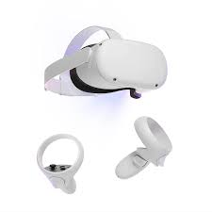
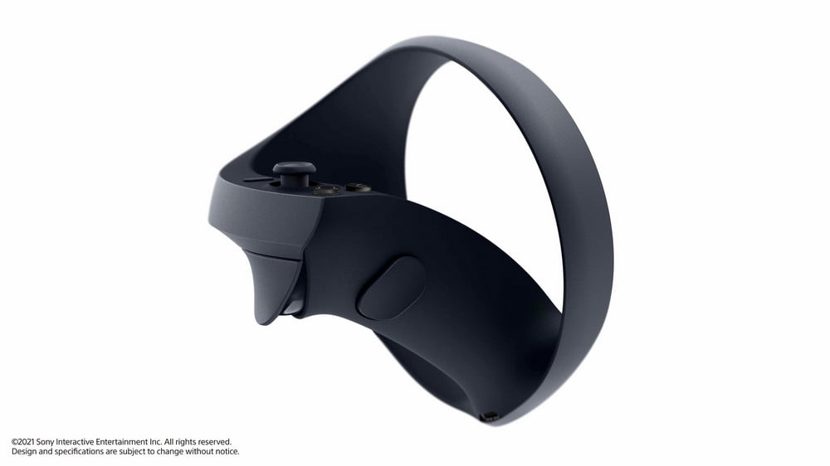
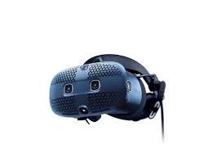
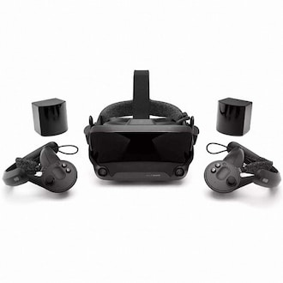
Birth of a VR superhit, Standalone headsets
VR during the Pandemic,
Oculus Quest 2
More than 150 apps for XR collaboration appear in an online database at the end of the year.
Beat Saber released, HTC Vive Focus as the first self-sufficient VR headset
2018
2020
2017
2019
2021
First VR arcade opens
HTC Vive Cosmos, Oculus Quest and Valve Index
Sony announces Playstation VR 2 for PS5
VR arcade “The Void” opens in Utah.
Notes:
2017: Meanwhile, the first official “The Void” arcade is opening in Utah. The VR arcade experience combines virtual and actual reality. To do so, designers recreate the virtual playing field in a physical space equipped with real objects such as walls and torches.
If a Void player reaches for a virtual torch, the analog counterpart is in the same place in reality – including heat emitters. This makes the VR world much more believable with haptic elements.
Displays currently have: 1440 x 1440 px ressolution two 2.89 inch lc displays qith 90-100 degrees field ov view.
2018: With Beat Saber (review), one of the most important VR games of the coming years appears in 2018 and immediately becomes a phenomenon. Less than a month after its release, the game has already sold more than 100,000 copies and generated sales of $2M.
The concept: armed with two laser swords, players slice up approaching cubes to the rhythm of electronic music. The developers hit the bull’s eye with this. Beat Saber integrates VR movement into the gaming experience more simply and elegantly than any other game before it. It only works in VR; there is no comparable experience on the monitor.
With the HTC Vive Focus, the Taiwanese are launching the first self-sufficient VR headset at the end of the year and want to score points primarily in the B2B sector and in education
2019: HTC Vive Cosmos: sharpest display to date and minimal fly screen effect. At the same time, the VR headset is to become simpler and more mobile. Integrated cameras take care of spatial orientation, and there is no need for an external tracking system. 1440 x1700 px, two LC displays with RGB subpixel matrix for a reduced fly screen effect and integrated adjustable interpupillary distance. BUT bad critique due to low battery time
oculus: The Quest’s two OLED screens bring 1,600 x 1,440 pixels to each eye. The headset supports two Oculus Touch controllers, more flexibility as well as a wireless VR experience in standalone mode
valve Index: High resolution, crisp colors, variable frame rates, innovative controllers, excellent tracking and high wearing comfort make the Valve Index (review) one of the best PC VR headset on the market.
2020:The year 2020 primarily tells the story of a pandemic that affects all areas of people’s lives. The deadly virus Sars-CoV-2 spreads worldwide and cripples the economy in many countries. People quarantine and working from home becomes the norm.
The VR industry aims to meet the growing demand for video calling and online meetings with telepresence apps. More than 150 apps for XR collaboration appear in an online database at the end of the year.
The Oculus Quest 2 becomes a full-fledged PC VR headset with the official Oculus Link cable. LC display with 1,832 by 1,920 pixels per eye, refresh rates of up to 120 hertz, better CPU, more memory, and a low price.

Slide 19
Contents (Today)
01.
02.
03.
04.
What is VR?
VR Keywords to remember
History of VR
(since 1956)
Classification
1.1 The Perfect VR
1.2 Definitions
2.1 The 3 I’s of VR
3.1 Classification
3.2 The Reality-Virtuality Continuum

Slide 20
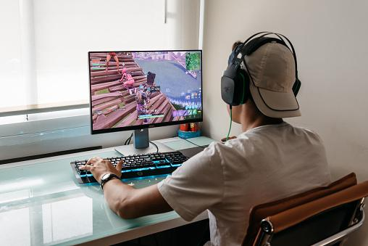
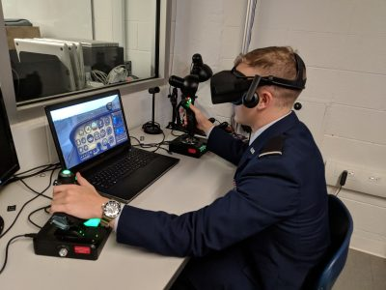
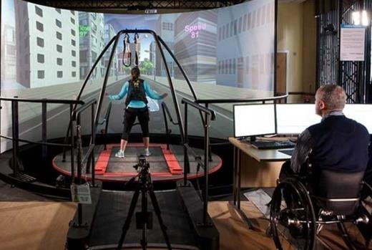
Classification
Non- immersive VR
Semi - Immersive VR
Fully - immersive VR
Some control over virtual environment
No direct interaction
Focus on visual 3D aspect of VR
no physical movement
HMD
Majority of senses addressed
6 DoF
Notes:
To have the effect of concrete existence without actually having concrete existence
Non-immersive. This type of VR typically refers to a 3D simulated environment that's accessed through a computer screen. The environment might also generate sound, depending on the program. The user has some control over the virtual environment using a keyboard, mouse or other device, but the environment does not directly interact with the user. A video game is a good example of non-immersive VR, as is a website that enables a user to design a room's decor.
Semi-immersive. This type of VR offers a partial virtual experience that's accessed through a computer screen or some type of glasses or headset. It focuses primarily on the visual 3D aspect of virtual reality and does not incorporate physical movement in the way that full immersion does. A common example of semi-immersive VR is the flight simulator, which is used by airlines and militaries to train their pilots.
Fully immersive. This type of VR delivers the greatest level of virtual reality, completely immersing the user in the simulated 3D world. It incorporates sight, sound and, in some cases, touch. There have even been some experiments with the addition of smell. Users wear special equipment such as helmets, goggles or gloves and are able to fully interact with the environment. The environment might also incorporate such equipment as treadmills or stationary bicycles to provide users with the experience of moving through the 3D space. Fully immersive VR technology is a field still in its infancy, but it has made important inroads into the gaming industry and to some extent the healthcare industry, and it's generating a great deal of interest in others.

Slide 21
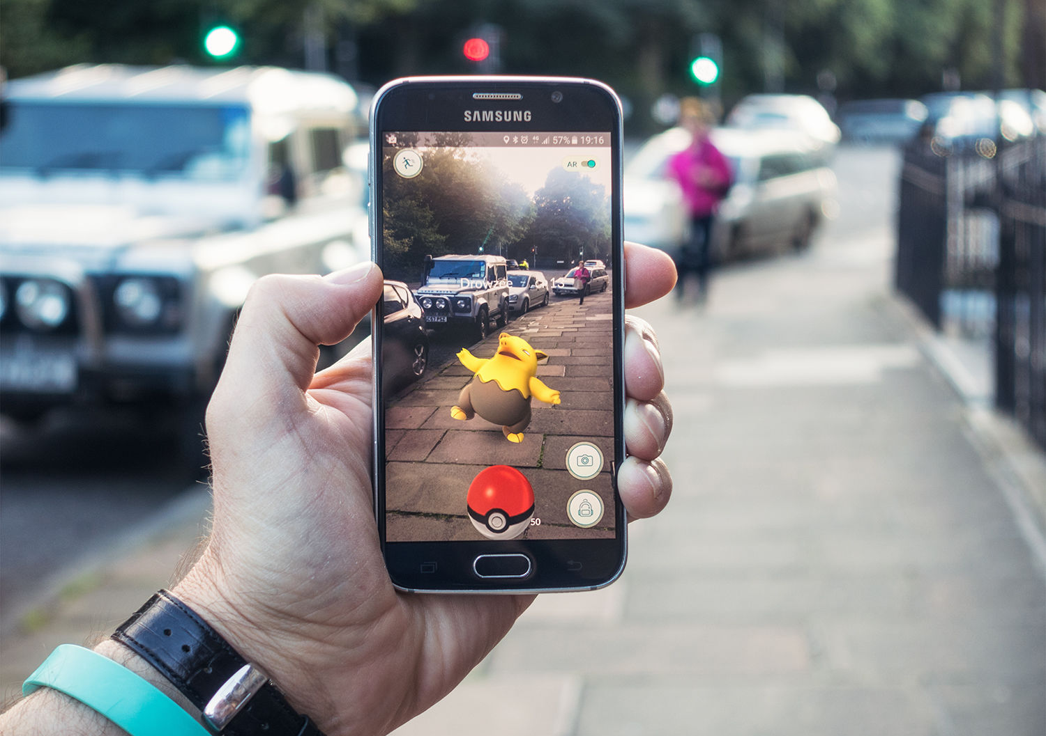
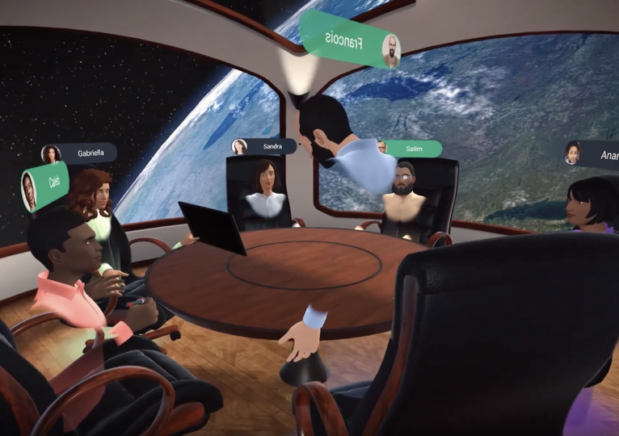
Augmented Reality
Collaborative VR
virtual overlays on real-world environments
People from different locations meet virtually

Slide 22
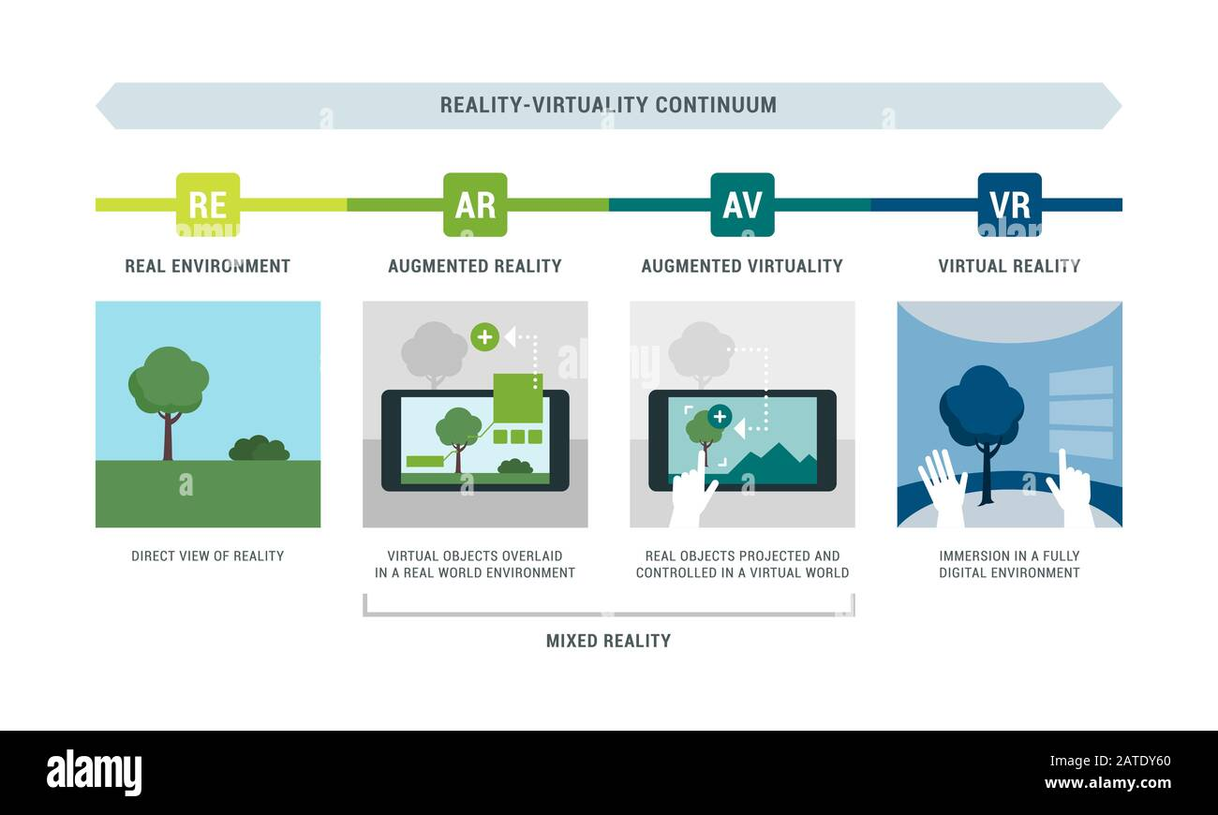
Reality-Virtuality Continuum
Mixed Reality
Any environment where the real and virtual objects are combined within a single display
Real Environment
Augmented Reality
Augmented Virtuality
Virtual Reality
Consists solely of real of physical objects
The real world is augmented with digital elements
The virtual world is augmented with real or physical elements
Consists solely of real or digital objects

Slide 23
Contents (Today)
01.
02.
03.
04.
What is VR?
VR Keywords to remember
History of VR
(since 1956)
Classification
1.1 The Perfect VR
1.2 Definitions
2.1 The 3 I’s of VR
3.1 Classification
3.2 The Reality-Virtuality Continuum

Slide 24
VR
Technologies
History, Survey and
Classification
Farhadiba Mohammed
20226471
Notes:
https://ieeexplore.ieee.org/abstract/document/8717158

Slide 25
Questions from Tuesday
Brain Computer Interface in Virtual Reality (2019)
Study:
Hardware: Headset that consists of three components: a wearable electroencephalography (EEG) device, a VR headset and a virtual interface.
Task: Object rotation or scaling in VR using either mental commands or facial expression (smile and eyebrow movement).
Results: Mental commands were often inconsistent and persistent while facial expressions were consistent and bursty.
Conclusion: Research looks into brain input within VR as well but ist still in its
infancy. Issues include tracking and hardware.
Notes:
To record the brain activity, we use Emotiv EPOC+ EEG headset. This EEG device has 14 electrodes with saline based wet sensors. These electrodes do not require any gel and therefore is a better match to our application compared to regular wet electrodes. 14 channels is sufficient in our application and has enough bandwidth to enable us to control VR/AR device. The user is able to wear this EEG headset together with the AR/VR headset. Therefore, this design is user-friendly. We did not chose Electro-cap EEG because it gradually squeezes the users head and becomes uncomfortable for the user after a short time.
We found that mental commands were often inconsistent, where different trials would result in drastically different results - perhaps due to movement of the EEG headset. Mental commands were also persistent - they tended to stay active far past when the user wanted the command to stop. In contrast, facial expressions tended to be both consistent and bursty. For comfort, facial expressions were a bit difficult for our subjects while wearing the VR headset, due to the positioning on the face. However, most users still found facial expressions quite usable. Users also reported facial expressions to be more repeatable than mental commands - thinking a command multiple times the same way was found to be rather difficult. In contrast, users quickly picked up facial expressions to accurately and consistently achieve tasks.
https://ieeexplore.ieee.org/abstract/document/8717158

Slide 26
Contents (Tuesday)
01.
02.
03.
04.
What is VR?
VR Keywords to remember
History of VR
(since 1956)
Classification
1.1 The Perfect VR
1.2 Definitions
2.1 The 3 I’s of VR
3.1 Classification
3.2 The Reality-Virtuality Continuum

Slide 27
Contents (Today)
05.
06.
07.
08.
VR Methods
VR Applications
Locomotion Techniques in VR
VR Challenges
Notes:
2.1 Entertainment: Tiltbrush

Slide 28
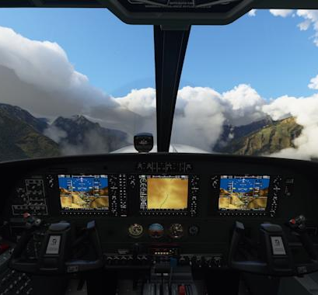
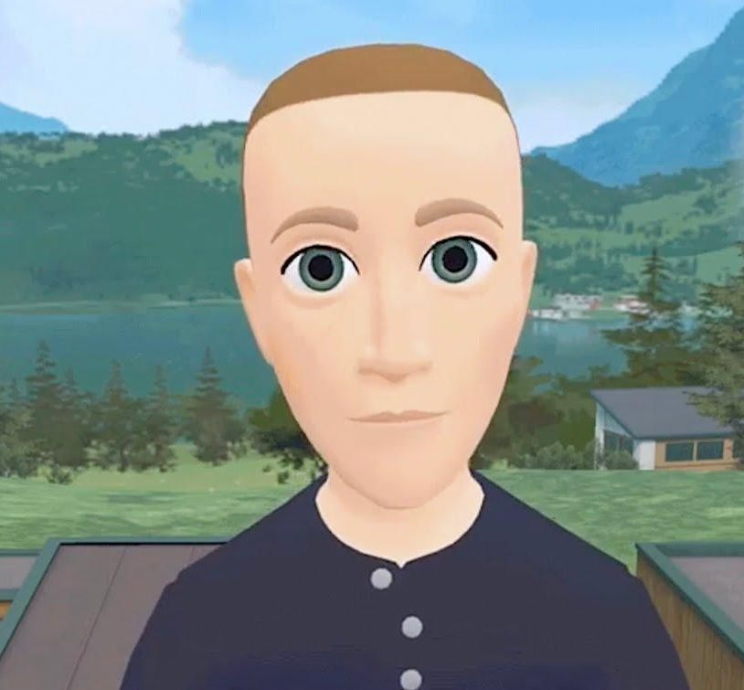
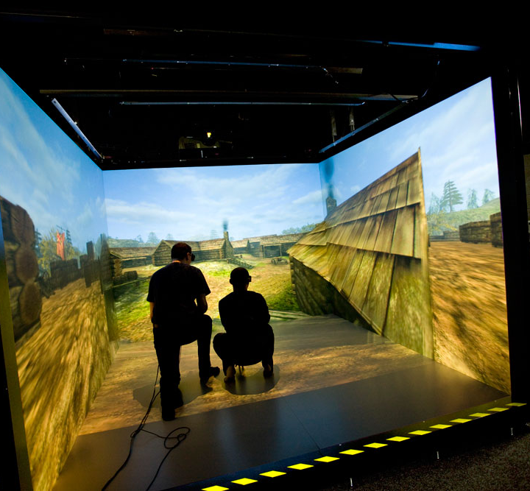
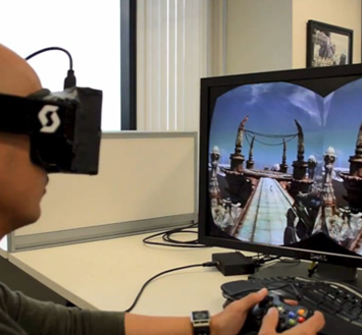
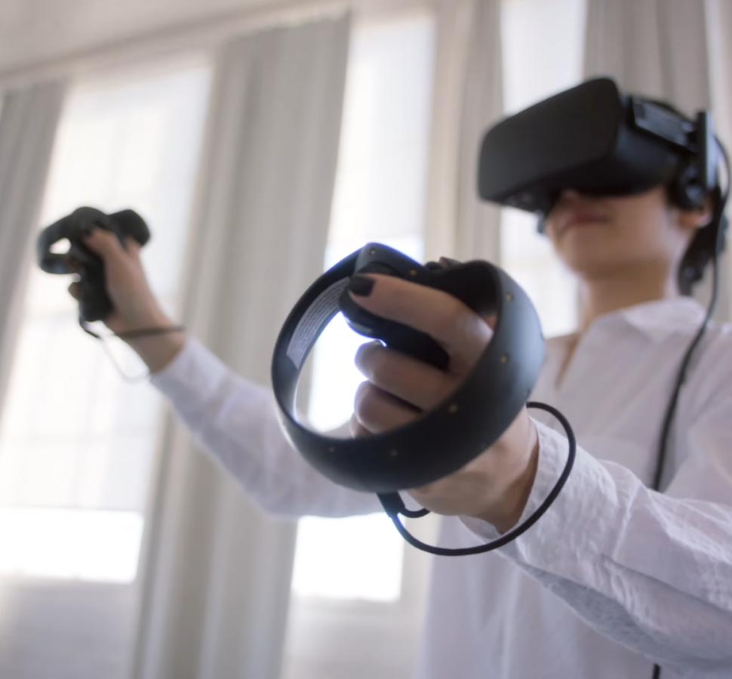
Methods
Simulation-based VR
Avatar Image-based VR
Projector-based VR
Desktop-based VR
Head-Mounted Display
Computer-generated simulation of real-world
Creation of avatars and interaction with other user avatars
Substantially immersive virtual experience that draws users into a simulated environment modeled after a real environment
Displaying a three-dimensional virtual world on a display device
Transport users a seemingly enclosed 3D virtual world. Can include positional tracking, audio inputs and output components, and haptic feedback
Notes:
Simulation-based: a simulation-based virtual reality system involves a computer-generated simulation or approximate imitation of real-world environment or situations and phenomenon.
Learning is one of the more popular applications of simulation-based VR. Driving simulator and flight simulator are notable examples in which drivers and pilots are drawn into a simulated environment that gives them an actual impression of driving or flying a plane.
Avatar image-based: An avatar image-based VR allows a user to generate its own graphical representation while interacting with the avatars of other users.
Visual feedback is the primary type of sensory feedback employed in this type of VR system. Applications center primarily on incorporation with other types and methods of virtual reality, such as in the case of placing avatars in a simulated virtual environment.
Projector-based: involves a substantially immersive virtual experience that draws users into a simulated environment modeled after a real environment. There can be some overlaps between simulation-based VR system and projector-based VR system depending on the application. However, the main purpose of a projector-based VR system is to draw users into a realistic-looking albeit virtual environment.
Desktop-based: a desktop-based virtual reality system simply involves displaying a three-dimensional virtual world on a display device such as a desktop or handheld display.The differentiating feature of this VR system is that it focuses on providing computer-generated visual perception and it does not use other sensory input-input components such as a specialized positional tracking equipment. First-person video games are considered as an example.
HMD: A specific method for realizing virtual reality involves the use of a head-mounted display or HMD to transport users a seemingly enclosed three-dimensional virtual world. An HMD can include positional tracking, audio inputs and output components, and haptic feedback. HMDs can also be used to implement specific types of virtual reality system. For example, a driving simulator or a projected simulated real-world environment can include the use of an HMD as its main input-output equipment.

Slide 29
Contents (Today)
05.
06.
07.
08.
VR Methods
VR Applications
Locomotion Techniques in VR
VR Challenges
Notes:
2.1 Entertainment: Tiltbrush

Slide 30
Applications
Automotive Industry
Sports
Healthcare
Arts and Design
Social
Education & Training
Fitness and Wellbeing
Real estate, Architecture and Interior Design
Recruitment
Entertainment
Retail
Tourism
Notes:
List of applications will dive deep

Slide 31
Automotive

Slide 32

Use Cases
Virtual Prototyping and Design
Training
Virtual Reality Showrooms
Safety of Self - Driving Cars

Slide 33
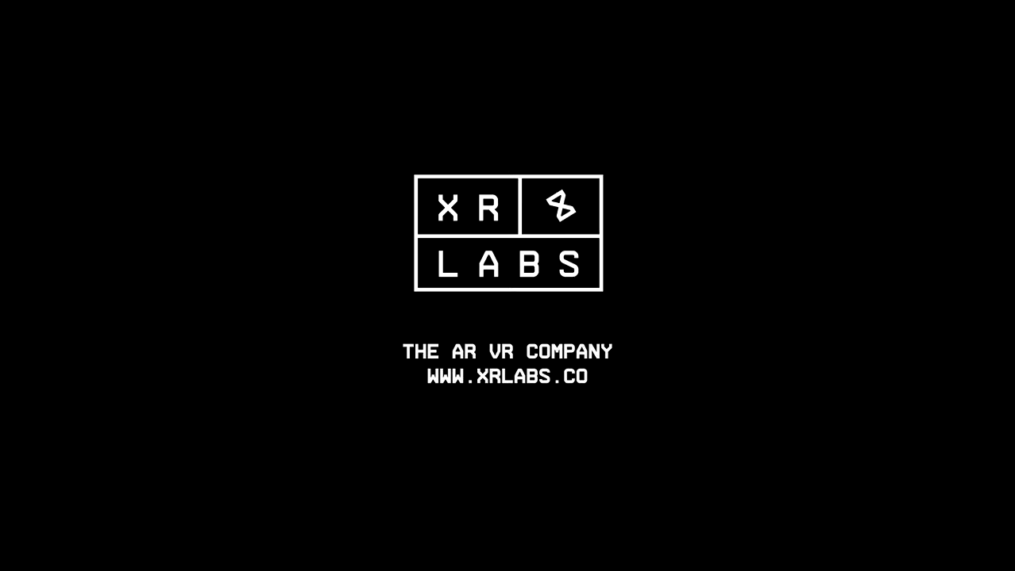

Slide 34
Healthcare

Slide 35

Use Cases
Pain relief
Training surgical Skills
Treatment for mental Health Issues:
VR exposure therapy in the treatment of PTSD and anxiety

Slide 36


Slide 37
Education & Training

Slide 38
Use Cases
Teaching and Learning:
Rendering Pipeline in VR
Immersive Vocabulary Learning
Exploring Space
Collaboration/ Marketing:
Virtual Campus
3. Training:
Training without material cost or risk of injury
Simulating dangerous situations
Notes:
Rendering Pipeline in VR
VR Classroom
Immersive Vocabulary Learning
Virtual campus: VictoryVR
Exploring Space: Tech Row
Training without material cost, risk of injury
Simulating dangerous situations

Slide 39
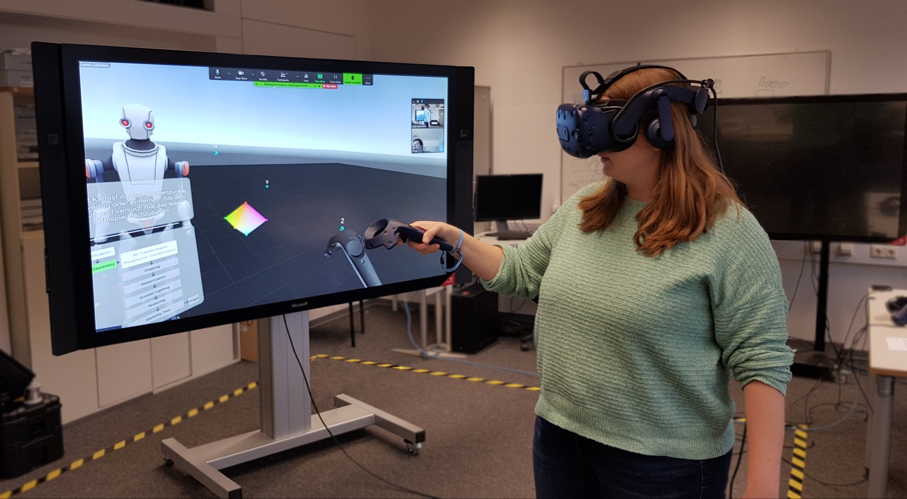
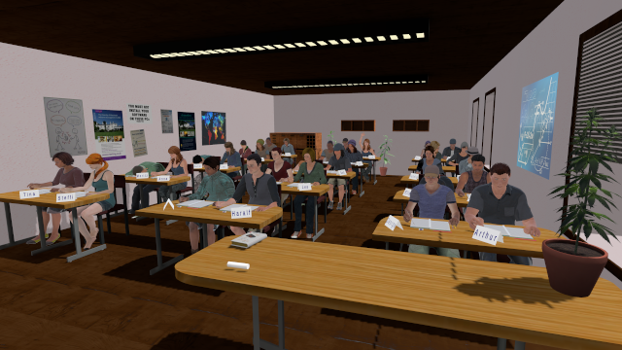
RWTH Aachen University - Department of Learning Technologies
Notes:
Framework of 3 I’s of VR Design. Will talk about each a little more in detail

Slide 40
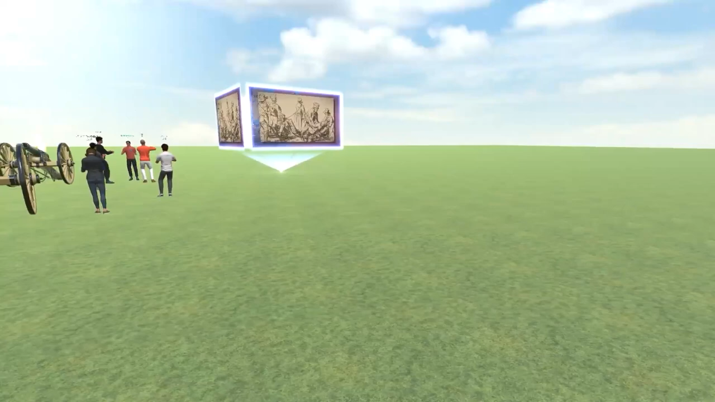

Slide 41
My favorite VR Application

Slide 42
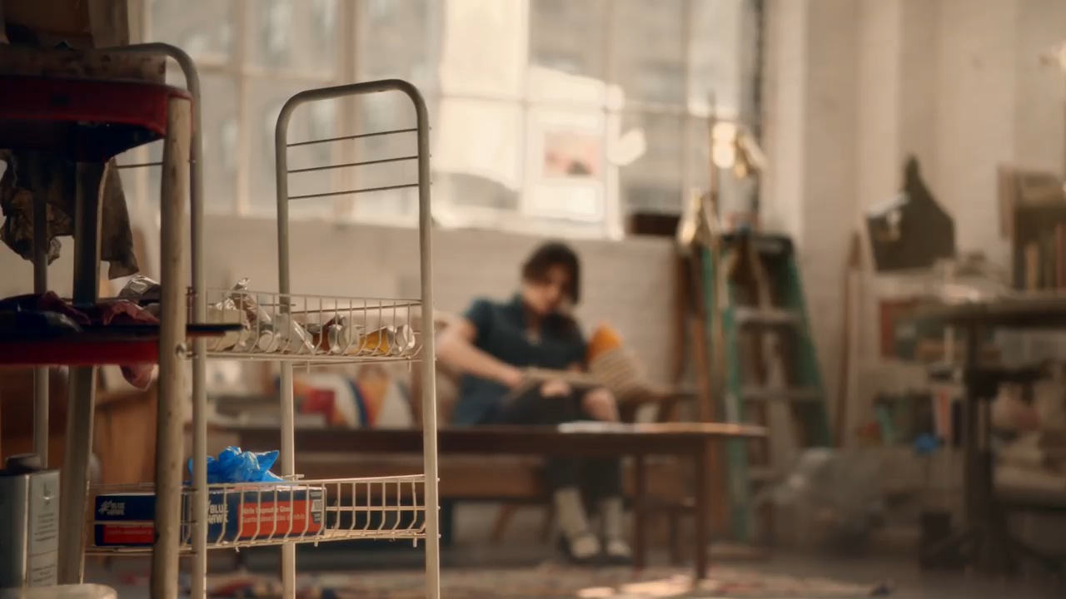

Slide 43
Contents (Today)
05.
06.
07.
08.
VR Methods
VR Applications
Locomotion Techniques in VR
VR Challenges
Notes:
2.1 Entertainment: Tiltbrush

Slide 44
How to move through VR?
Walking:
-> only possible in limited rooms (not larger than tracked area)
Notes:
First idea to solve this could be: can we not make them walk faster. Facebook had a look at that when they released oculus rift and found out that it is possible until 25%

Slide 45

Can’t we just make people walk faster?
+/- 5cm height difference tolerated
Speed increases by +/- 25% are unnoticed by users
Notes:
Facebook bought oculus rift, they had a look at that
Instead of 8 km you could walk around with 10
Issue here is: our tracking systems are not yet advanced enough so users might drift over time. To compensate the drifts these VR systems subconciously change the speed to compensate these drifts over time. Scaling not a goood solution.
Btw height differences of 5 cm are tolerated, so if you place the camera much heigher that your own height oobviously the perspective changes which makes it feels unreal and as we have learned is not good for oour embodiment illusion.

Slide 46
How to move through VR?
Walking:
-> only possible in limited rooms (not larger than tracked area)
Walking-In-Place (WIP)
-> in open interaction spaces

Slide 47
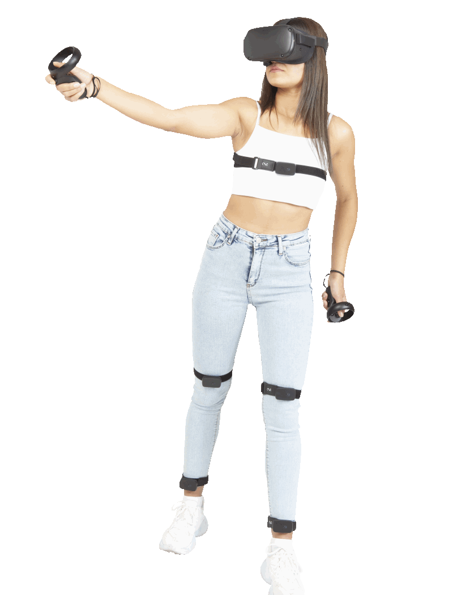
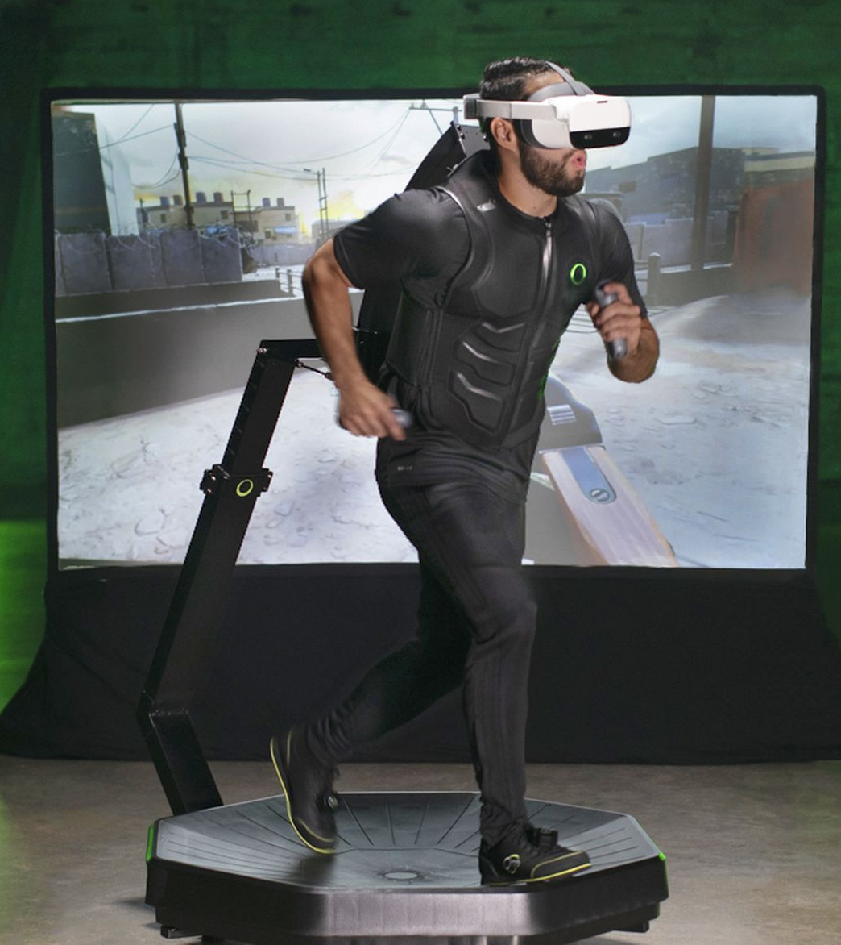
Two types of WIP
Tracking – based WIP
Mechanical WIP

Slide 49
How to move through VR?
Walking:
-> only possible in limited rooms (not larger than tracked area)
Walking-In-Place (WIP)
-> in open interaction spaces
But what can you do if it is not possible to use your legs?
Notes:
First idea to solve this could be: can we not make them walk faster. Facebook had a look at that when they released oculus rift and found out that it is possible until 25%

Slide 50

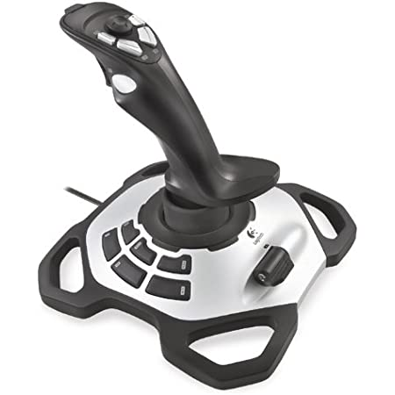

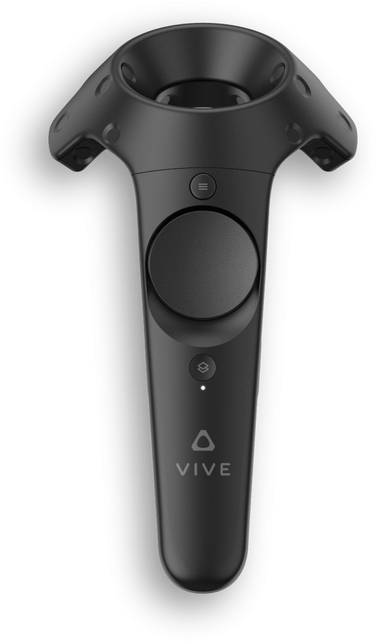

Locomotion Techniques
Arm Cycling
Point Tugging
Teleporting
Joystick
Notes:
Hand-opoerated bycycling
Grab and drag – moves whole scene around you
Raycast
Treasure chest located around this nice city

Slide 51
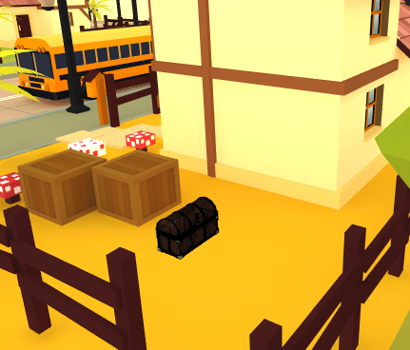
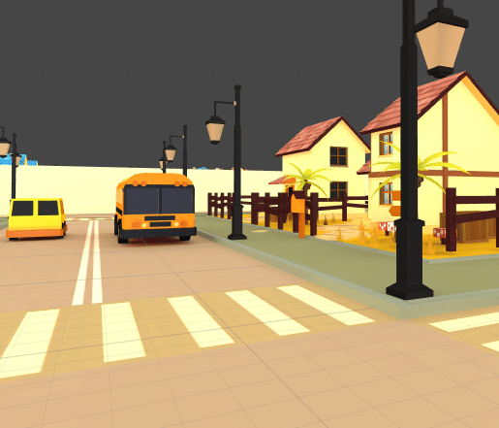
Evaluation
Coomer et al. SAP ‘18
Notes:
Coomer er al

Slide 52



Enjoyment
3.8
Enjoyment
Enjoyment
Enjoyment
3.2
Tiredness
3.2
3.9
2.9
2.5
1.5
1.5
Control
4.3
Control
Control
Control
3.6
3.2
4.1
Arm Cycling
Point Tugging
Teleporting
Joystick
Notes:
Hand-opoerated bycycling
Grab and drag – moves whole scene around you
Raycast
Treasure chest located around this nice city

Slide 53
Distance
896m
Distance
Distance
Distance
1180m
1572m
1280m
Arm Cycling
Point Tugging
Teleporting
Joystick
Notes:
Hand-opoerated bycycling
Grab and drag – moves whole scene around you
Raycast
Treasure chest located around this nice city

Slide 54
Sickness
Sickness
37
80
19
13
Arm Cycling
Point Tugging
Teleporting
Joystick
Notes:
Hand-opoerated bycycling
Grab and drag – moves whole scene around you
Raycast
Treasure chest located around this nice city

Slide 55
Locomotion Techniques: Verdict
Enjoyment
3.8
Enjoyment
3.9
13
1.5
1.5
Distance
896m
Control
19
4.3
Control
4.1
Arm Cycling
Point Tugging
Teleporting
Joystick
Notes:
Hand-opoerated bycycling
Grab and drag – moves whole scene around you
Raycast
Treasure chest located around this nice city

Slide 56
Contents (Today)
05.
06.
07.
08.
VR Methods
VR Applications
Locomotion Techniques in VR
VR Challenges
Notes:
2.1 Entertainment: Tiltbrush

Slide 57
VR Challenges
FIeld-of-View (FOV) is limited
High price
Uncanny valley
Limited use-cases for consumers, mostly bought by gamers
Aesthetics and comfort
Precision and control
Tracking
Vertigo/ sickness

Slide 58
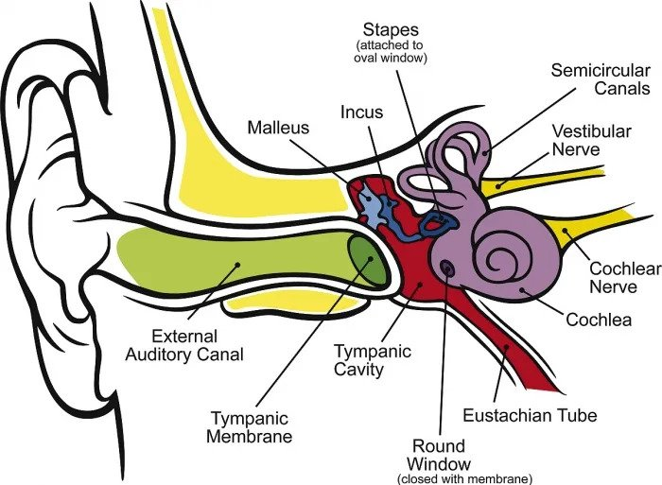
Vertigo
The Vestibular System
The semicircular canals in our internal ear determine how our head is rotated in the world
Contradicting information from oother senses lead to vertigo

Slide 59
Moving in a direction that you are not facing will cause sickness

Slide 60
Contents (Today)
05.
06.
07.
08.
VR Methods
VR Applications
Locomotion Techniques in VR
VR Challenges
Notes:
2.1 Entertainment: Tiltbrush

Slide 61
Summary

Slide 62
Summary (20.09)
Virtual reality is a simulated 3D environment that enables users to explore and interact with a virtual surrounding in a way that approximates reality, as it is perceived through the users' senses.
Immersion
Presence
Orientation
3 I’s
Interaction
Imagination
Place Illusion
Plausibility Illusion
Embodiment Illusion
3 DoF vs 6 DoF

Slide 63
Summary (20.09)
History:
1956: Sensorama - Morton Heilig
1968: Sword of damocles - Ivan Sutherland
1975: Videoplace by Myron Krueger
1987: Term VR coined by Jaron Lanier
1991: First VR entertainment system
1995: CAVE
1997: Virtual Vietnam
2014: Facebook buys Oculus VR Company
Classification:
Non-immersive
Semi-immersive
Fully-immersive
Notes:
Lets first have a look at the etymology of the word virtual reality.
which is exactly the effect achieved in a good virtual reality system. There is no requirement that the virtual environment match the real world.

Slide 64
Reality-Virtuality Continuum
Mixed Reality
Any environment where the real and virtual objects are combined within a single display
Real Environment
Augmented Reality
Augmented Virtuality
Virtual Reality
Consists solely of real of physical objects
The real world is augmented with digital elements
The virtual world is augmented with real or physical elements
Consists solely of real or digital objects

Slide 65
Summary
5 Methods:
Simulation-based
Avatar Image-based
Projector-based
Desktop-based
Head-Mounted Display
Multiple Application areas
Automotive Industy
Health Care
Education & Training
…

Slide 66
Summary
Locomotion Techniques:
Walking
Walking-in-Place (WIP)
Controller-based Walking
VR Challenges:
FIeld-of-View (FOV) is limited
High price
Uncanny valley
Limited use-cases for consumers,
mostly bought by gamers
Aesthetics and comfort
Vertigo/ sickness

Slide 67
References
https://prezi.com/uwrvopsguxvp/virtual-reality-timeline/
https://virtualspeech.com/blog/history-of-vr
https://swisscognitive.ch/2021/07/27/6-ar-vr-challenges-in-2021/
https://www.nas.nasa.gov/Software/VWT/vr.html
https://www.profolus.com/topics/types-and-methods-of-virtual-reality-systems/
https://www.geeksforgeeks.org/the-illusions-in-virtual-reality/
https://virtualspeech.com/blog/vr-applications
https://heizenrader.com/the-3-types-of-virtual-reality/
https://www.youtube.com/watch?v=aOYHg8qdxTE
https://www.youtube.com/watch?v=LcD1VgOljLg&t=14s
https://www.youtube.com/watch?v=bHPw6pGIJog
https://www.youtube.com/watch?time_continue=1&v=ycBYOl_mXZU&feature=emb_logo
Notes:
Template by PPTMon.com
Coomer, Noah & Bullard, Sadler & Clinton, William & Williams, Betsy. (2018). Evaluating the effects of four VR locomotion methods: joystick, arm-cycling, point-tugging, and teleporting. 1-8. 10.1145/3225153.3225175.

Slide 68
References
Template by PPTMon.com
Coomer, Noah & Bullard, Sadler & Clinton, William & Williams, Betsy. (2018). Evaluating the effects of four VR locomotion methods: joystick, arm-cycling, point-tugging, and teleporting. 1-8. 10.1145/3225153.3225175.
Notes:
Template by PPTMon.com
Coomer, Noah & Bullard, Sadler & Clinton, William & Williams, Betsy. (2018). Evaluating the effects of four VR locomotion methods: joystick, arm-cycling, point-tugging, and teleporting. 1-8. 10.1145/3225153.3225175.

